Slide 1
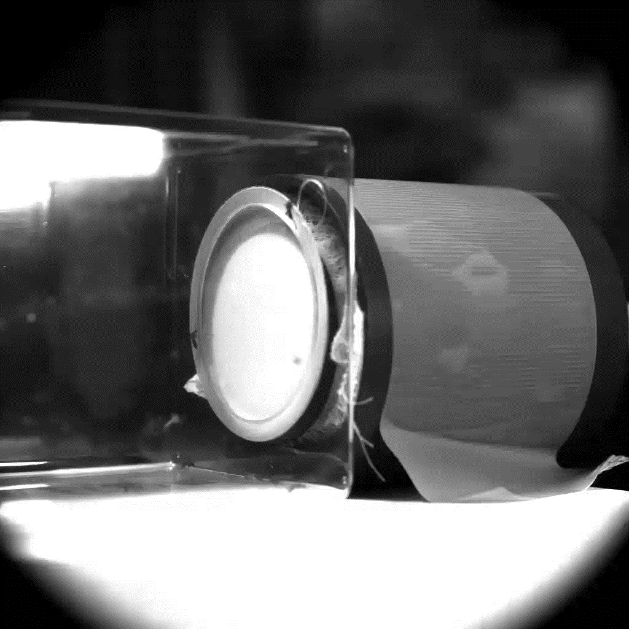
Aedes albopictus
Deet 10% (High Speed)

