Slide 1
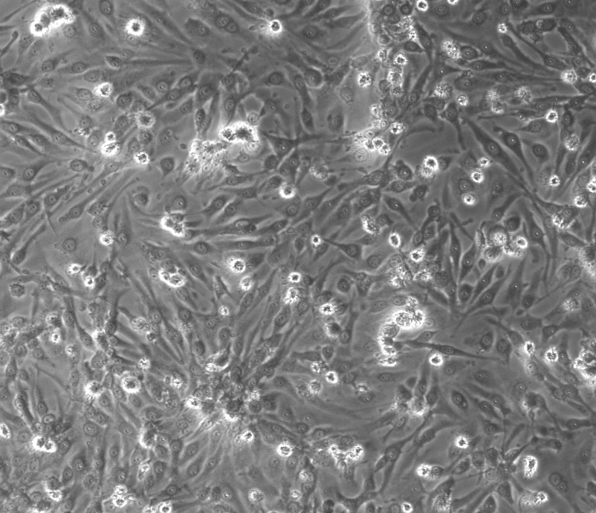
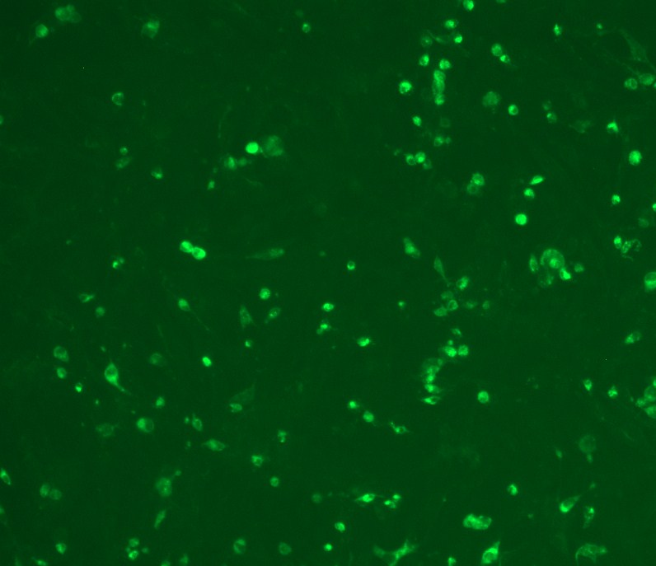
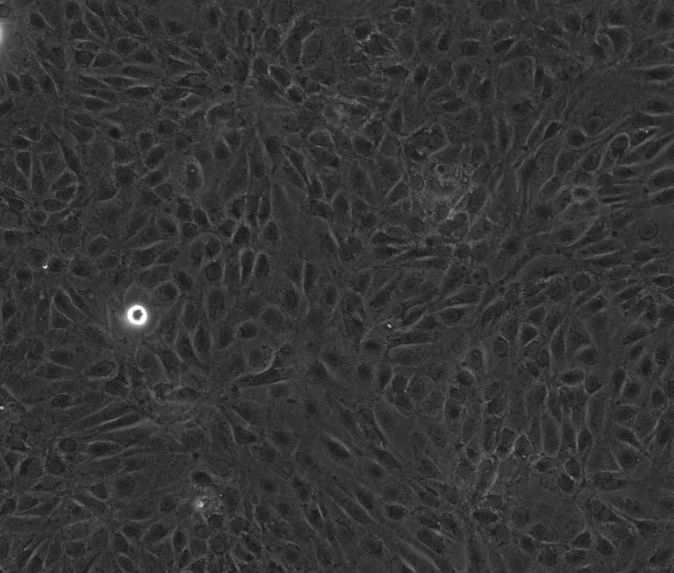
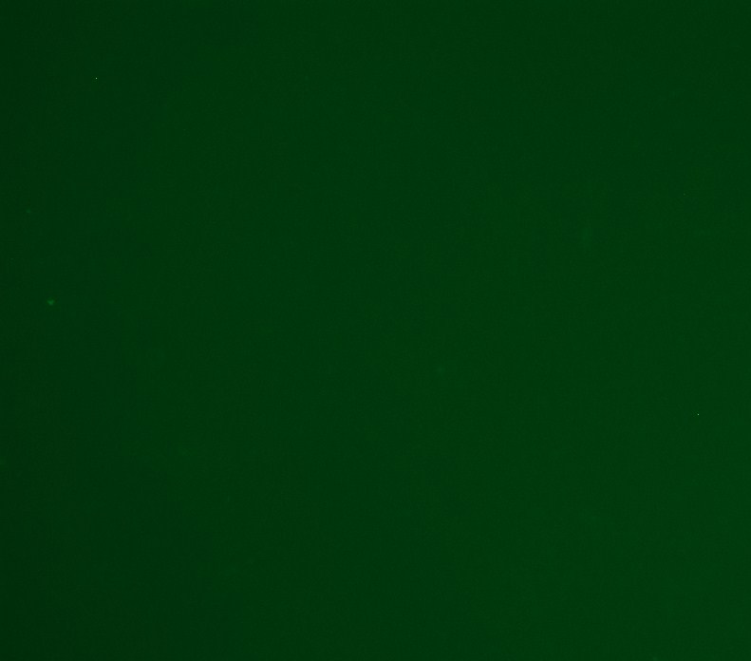
Bright field
IFA
A
B
SARS-CoV-2
infected
C
D
Mock-
infected
C
D
Additional file 1: Figure S1: Indirect Immunofluorescent assay (IFA) for detection of SARS-CoV-2 infected cells. SARS-CoV-2 was incubated for 3 days on Vero E6 cells. A & B: SARS-CoV-2-infected Vero E6 cells (positive control cells); and C & D: Mock-infected Vero E6 cells (negative control cells). (Magnification 10x)

