Slide 1
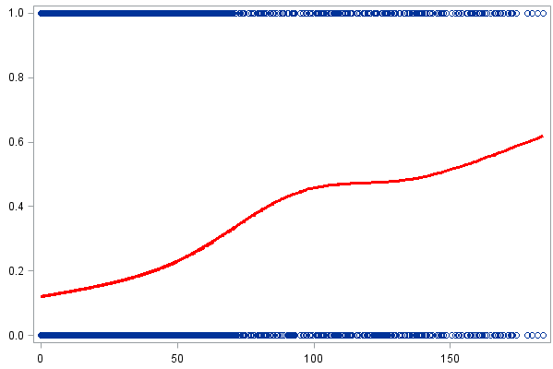
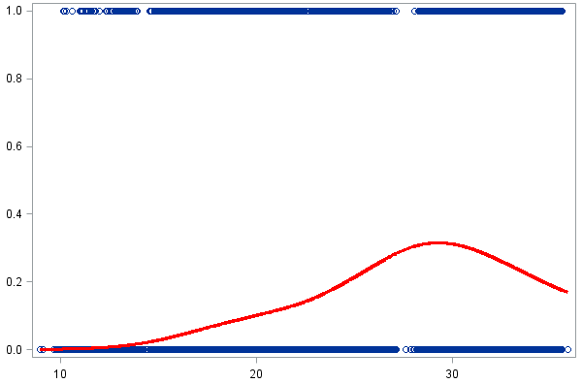
A
B
Probability of Ae. aegypti presence
Probability of Ae. aegypti presence
Rainfall (total mm previous month)
Temperature (avg. in °C for previous month)

