Slide 1
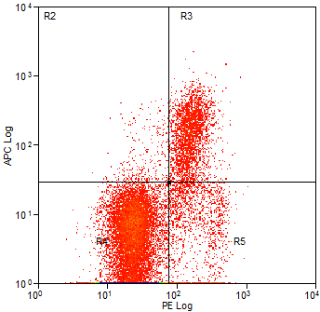
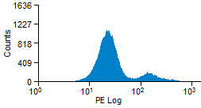
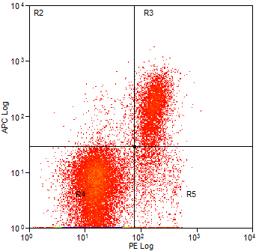
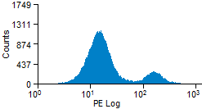

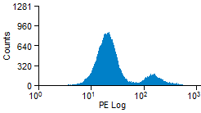
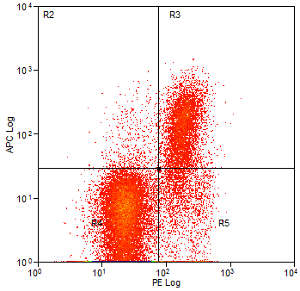
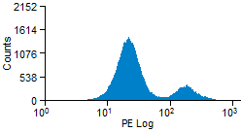
Additional Data File 7 - The effect of UNC1999 and VPA on LCL viability
AH LCL cells were treated with 1mM VPA, 3µM UNC1999 or the two in combination for 24 hours. Cell cycle profile was assessed by propidium iodide staining and apopotosis by the annexin V assay.
0.9%
9.3%
Control
Counts
Annexin V
85.1%
4.8%
Propidium Iodide
Propidium Iodide
1.1%
11.5%
1mM VPA
Counts
Annexin V
83.9%
3.6%
Propidium Iodide
Propidium Iodide
1.1%
10.9%
3µM UNC1999
Counts
Annexin V
83.13%
4.9%
Propidium Iodide
Propidium Iodide
1.1%
12.5%
1mM VPA + 3µM UNC1999
Counts
Annexin V
81.0%
5.4%
Propidium Iodide
Propidium Iodide

