Slide 1
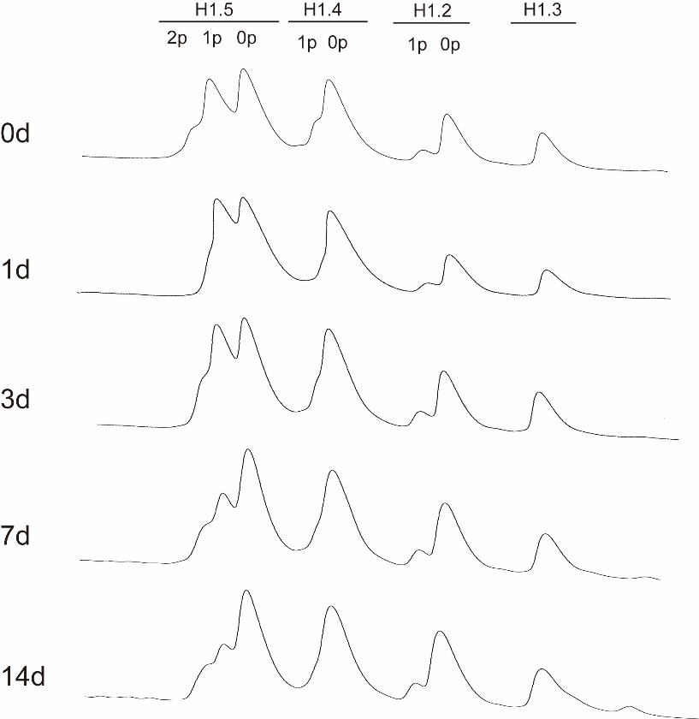
Additional file 3: Figure S2
NT2
+RA

