Slide 1
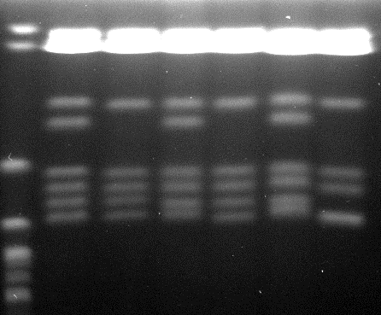
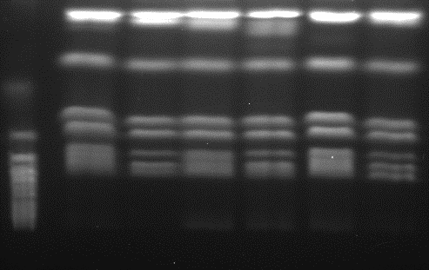
DAY286-1
Eaf3-1
Nbn1
Nbn1-1
DAY286
Eaf3
S.c. 867
Ch5a
Ch5b
Ch6a
Ch6b
Ch7a
Ch7b
Ch1a,b
ChR
Ch2a,b
Ch3a,b
Ch4a,b
Fig. S1

