Slide 1


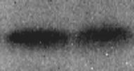

















Data set 1
DAY286-1
Nbn1-1
Eaf3-1
3153A
DAY286
Nbn1
Eaf3
Sor55
H4
acH4
H4acK5
H4acK12
H4acK16

Slide 2









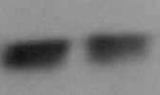










Data set 2
DAY286-1
Nbn1-1
Eaf3-1
3153A
DAY286
Nbn1
Eaf3
Sor55
H4
acH4
H4acK5
H4acK12
H4acK16

Slide 3




















Data set 3
DAY286-1
Nbn1-1
Eaf3-1
3153A
DAY286
Nbn1
Eaf3
Sor55
H4
acH4
H4acK5
H4acK12
H4acK16

