Slide 1
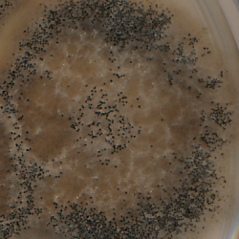
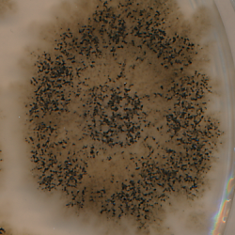
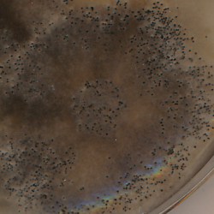
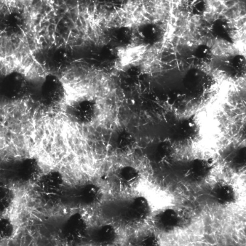
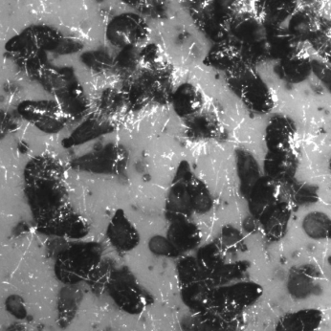
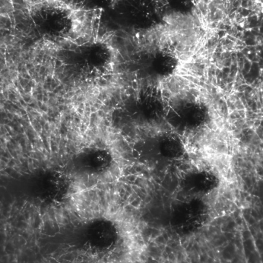
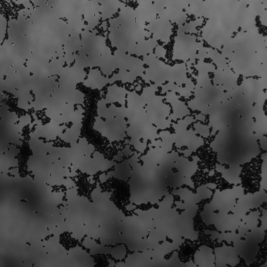
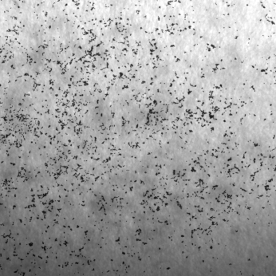
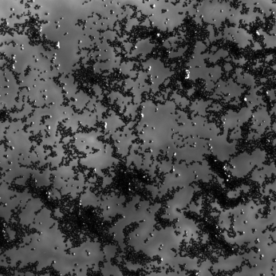
Fig. S13A
♀ WT x ♂ ΔPaKmt6
♀ ΔPaKmt6 x ♂ WT
Fig. S13B
ΔPakmt6 mat+ ΔPakmt6 mat- Δmat
WT mat+
WT mat-
ΔPaKmt6 mat+
ΔPaKmt6 mat-
Fruiting bodies
Ascospore projection

