Slide 1
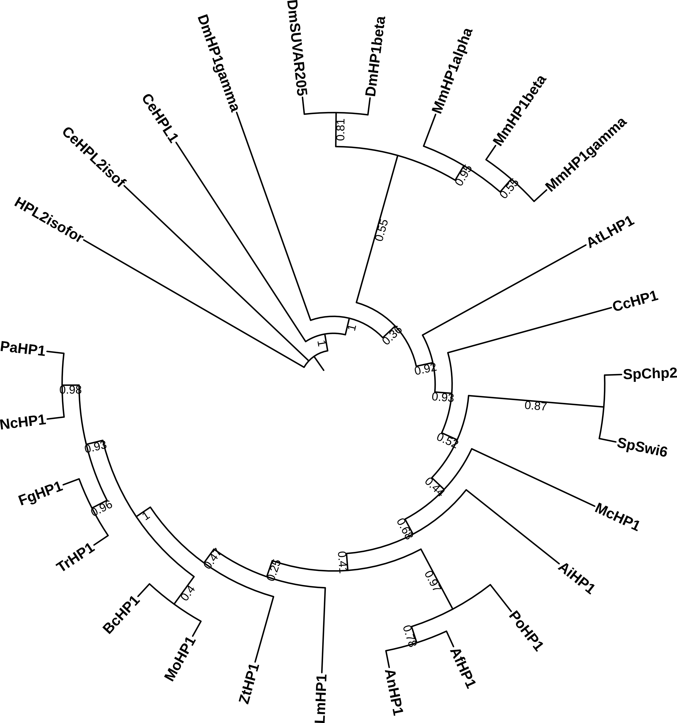
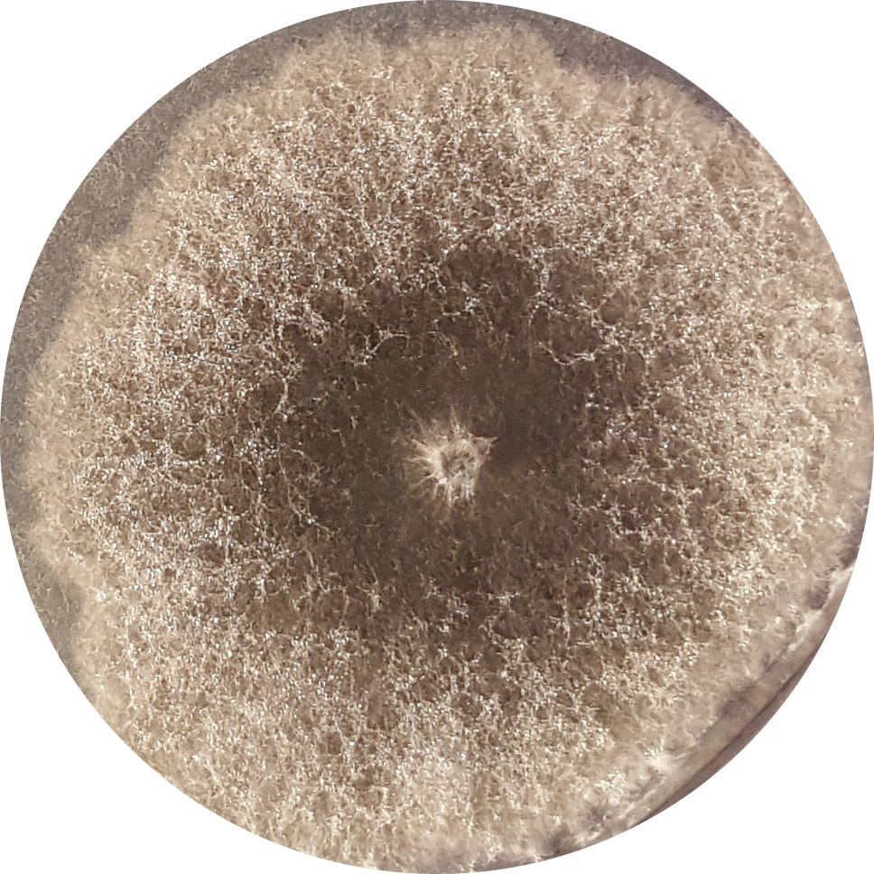
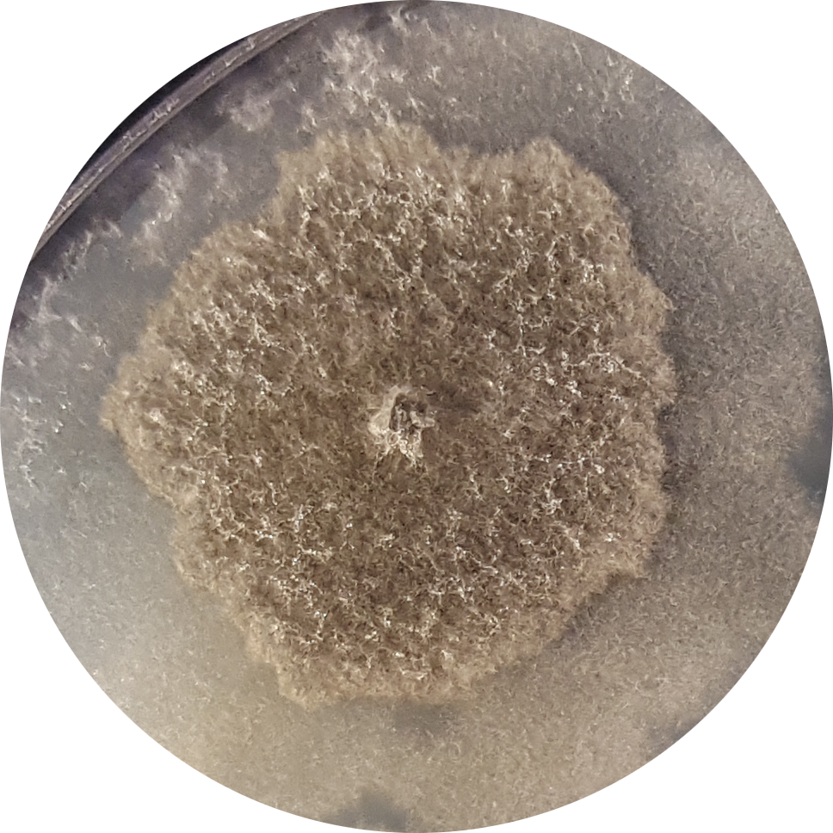
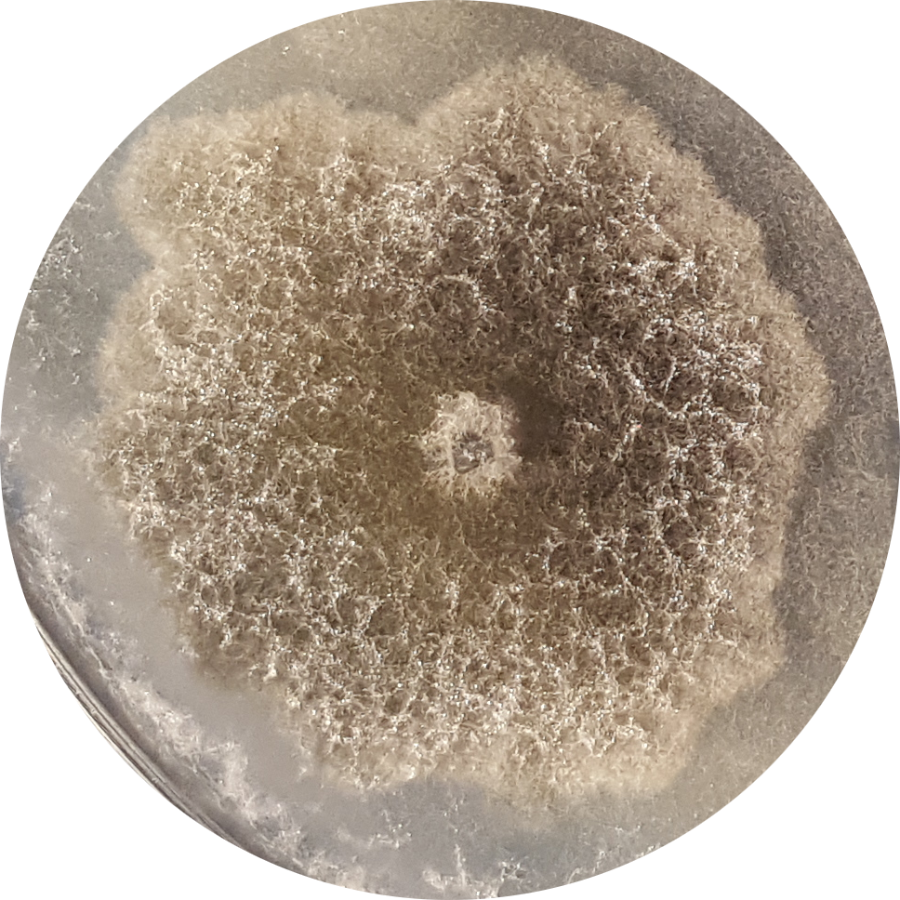
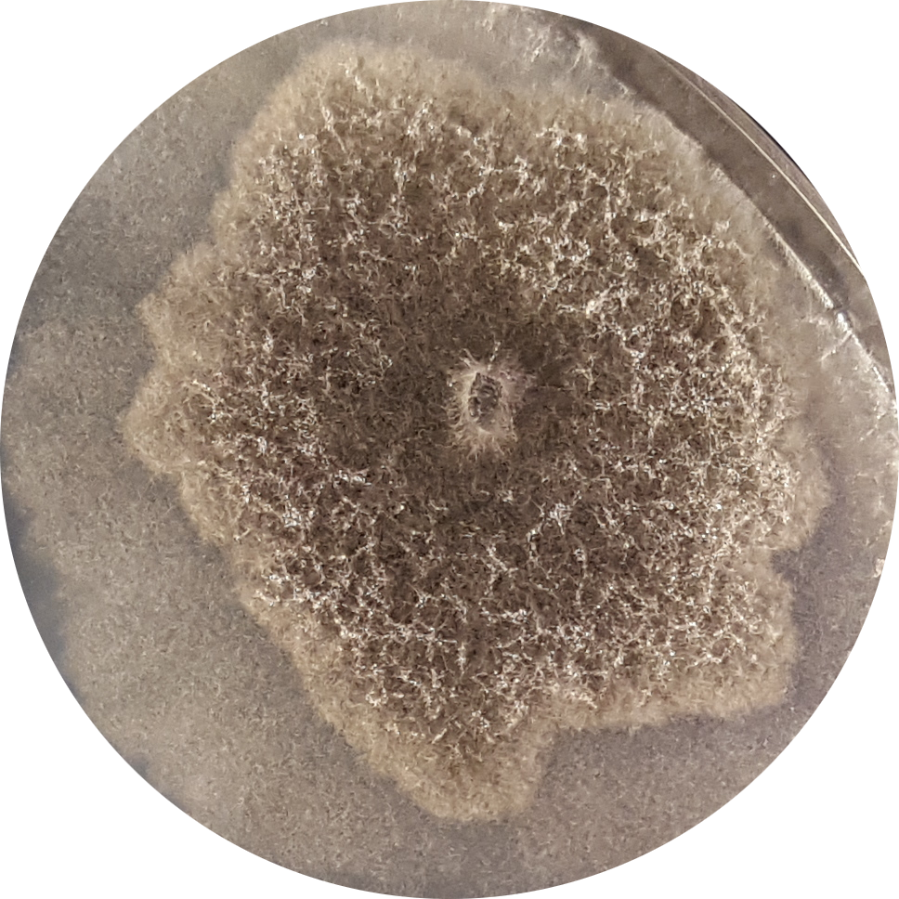
Fig. S15A
ΔPaHP1
Fig. S15B
WT
1433 bp
2501 bp
3448 bp
EcoRV
EcoRI
EcoRV
2501 bp
ΔPaHP1
1433 bp
PaHP1
EcoRV
EcoRV
3448 bp
EcoRI EcoRV
Fig. S15C
WT
ΔPaHP1
ΔPaKmt1
ΔPaKmt1ΔPaHP1

