Slide 1
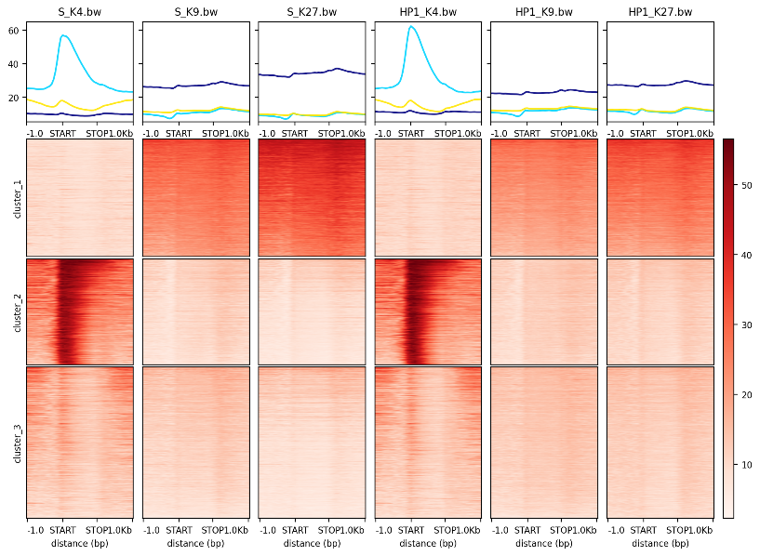
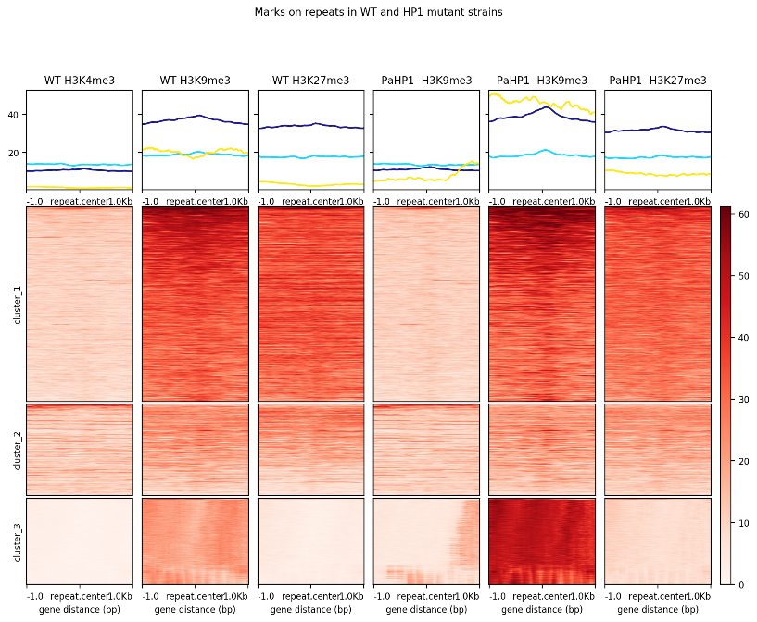
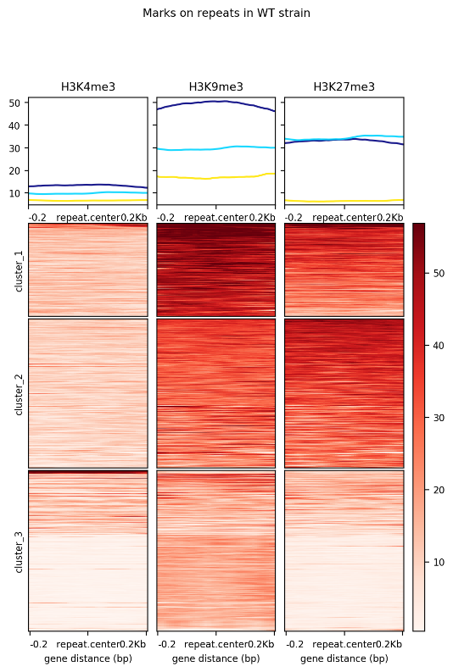
Fig. S16
CDS
Repeats
WT
ΔPaHP1
WT
ΔPaHP1
H3K4me3
H3K9me3
H3K27me3
H3K4me3
H3K9me3
H3K27me3
H3K4me3
H3K9me3
H3K27me3
H3K4me3
H3K9me3
H3K27me3
60
40
Modification
levels
40
20
20
50
Cluster 1
Cluster 1
40
Cluster 2
30
Cluster
2
20
Cluster 3
10
Cluster
3
-1
-1
-1
-1
-1
-1
0
0
0
0
0
0
+1
+1
+1
+1
+1
+1
-0.2
-0.2
-0.2
-0.2
-0.2
-0.2
STOP
STOP
STOP
STOP
STOP
STOP
+0.2
+0.2
+0.2
+0.2
+0.2
+0.2
START
START
START
START
START
START

