Slide 1
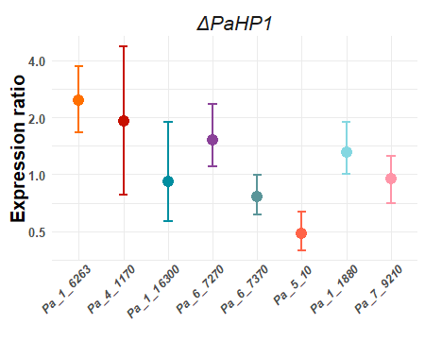
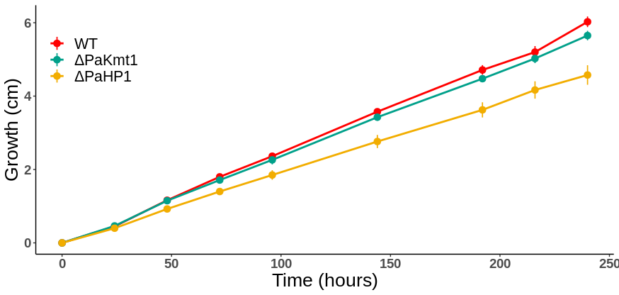
Fig. S17A
Pa_1_6263
Pa_1_16300
Pa_4_1170
Pa_6_7270
Pa_6_7370
Pa_1_1880
Pa_5_10
Pa_7_9210
H3K4me3
WT
H3K9me3
H3K27me3
4
2
Expression ratio
1
0.5
∆PaHP1
H3K4me3
H3K9me3
H3K27me3
Fig. S17B

Slide 2
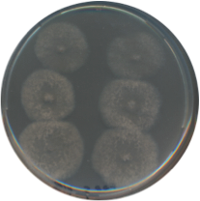
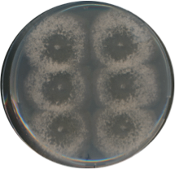
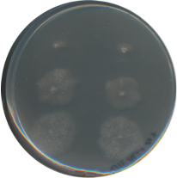
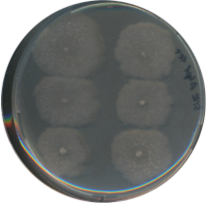
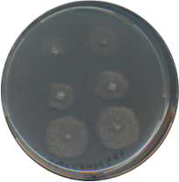
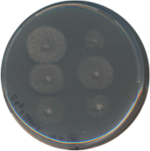
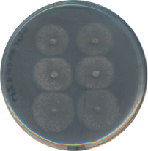
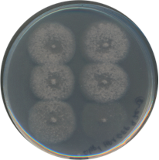
Fig. S17C
Step 1
0 day
Growth starting point
4 days
Stationary phase, plug#3
Edge, stationary phase, plug#2
Growing phase, plug#1
8 days
Step 2
Step 3
#3a
#3b
#3a
#3b
3 Days
#2a
#2b
#2a
#2b
3 Days
#1a
#1b
#1a
#1b
WT
ΔPaHP1
ΔPaKmt1
ΔPaHP1
ΔPaHP1
PaHP1⁺

Slide 3
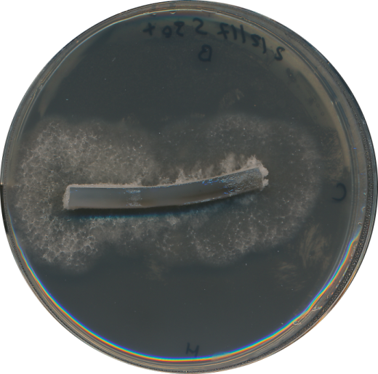
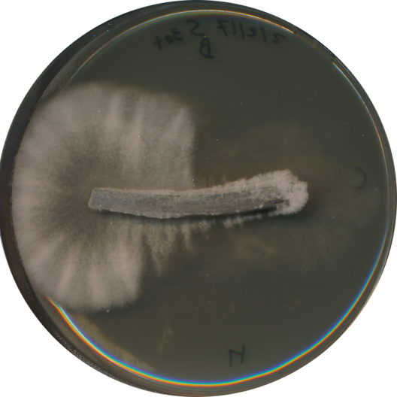
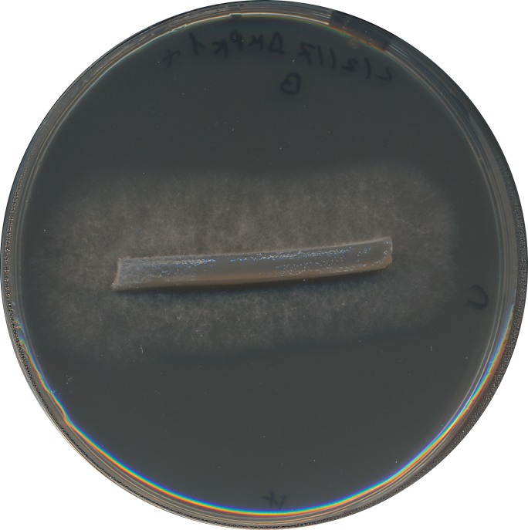
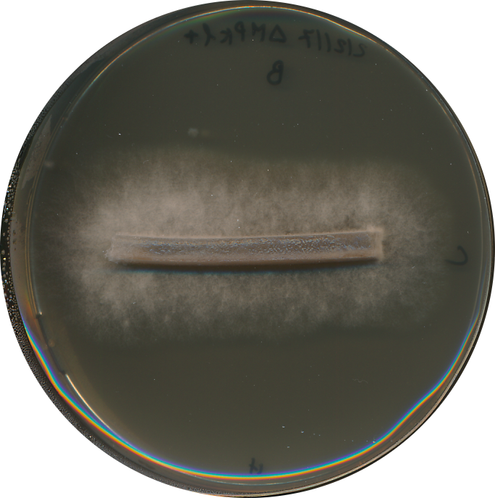
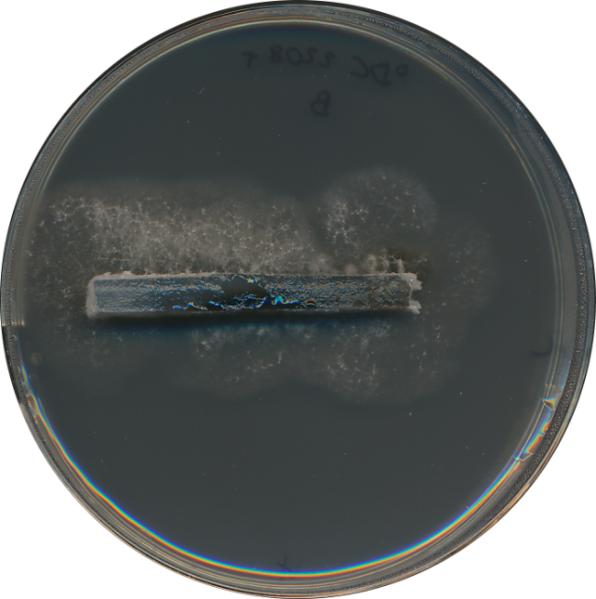
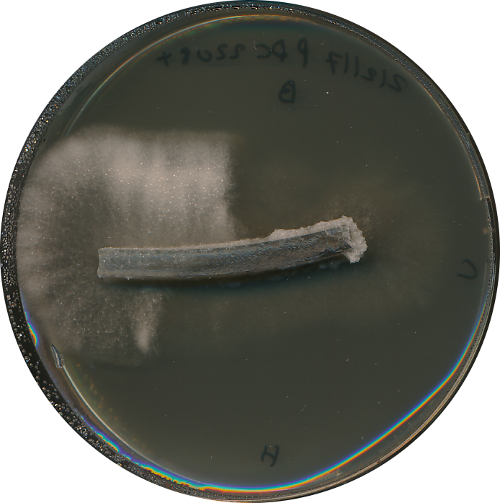
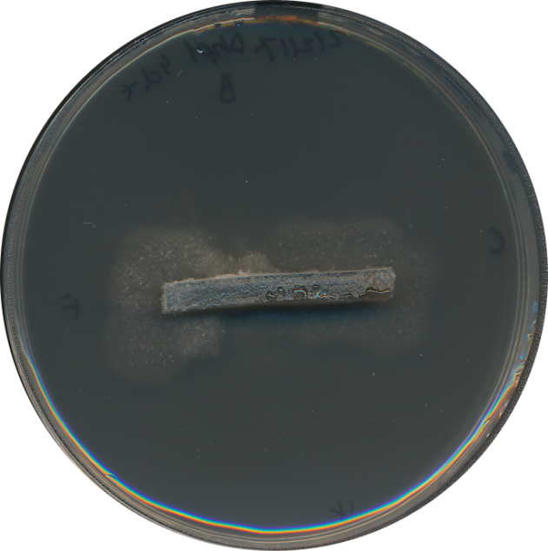
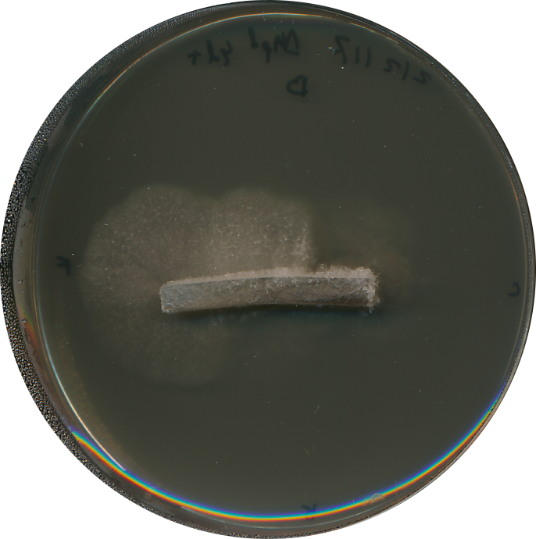
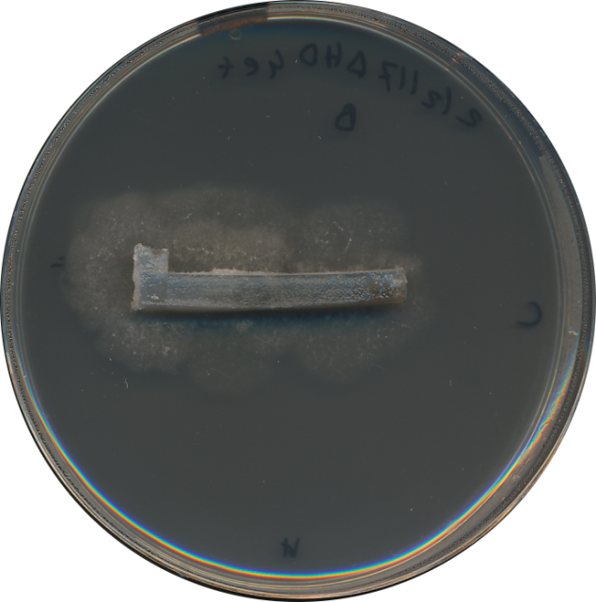
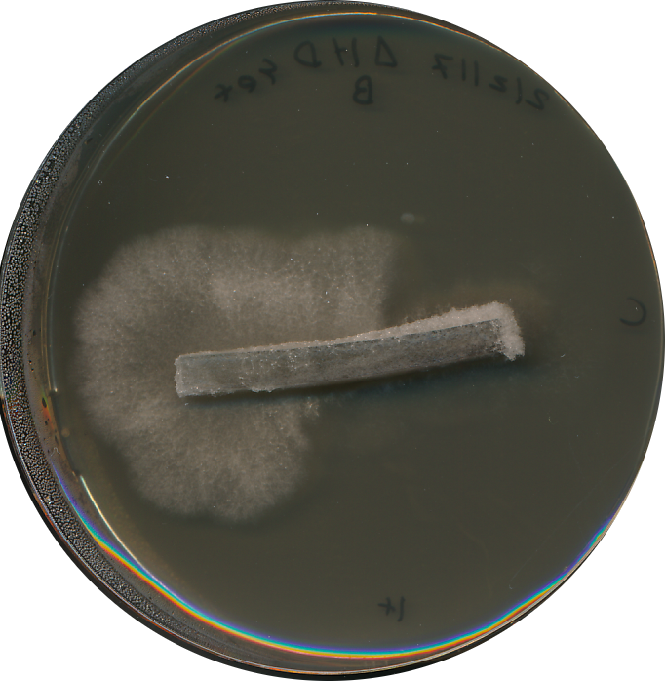
Fig. S17D
M2
M2+ YE
WT
ΔPaMpk1
PDC2208
ΔPaHP1
ΔPaHP1
ΔPaKmt1

