Slide 1
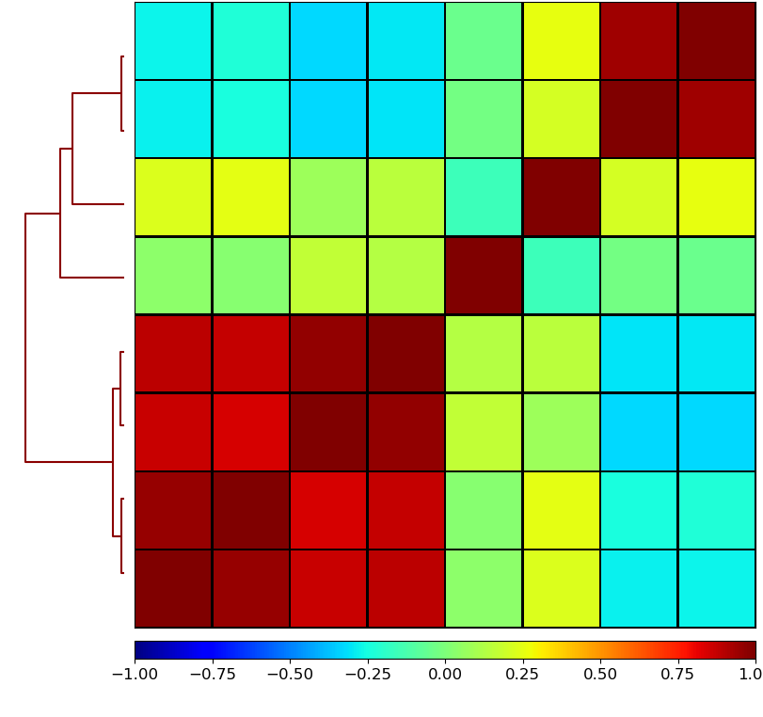
Fig. S3A
WT-3d_K27me3
WT-2e_K27me3
WT-3d_K9me3
WT-3d_K4me3
WT-2e_K9me3
WT-2e_K4me3
mock
input
WT-3d_K4me3
WT-2e_K4me3
input
mock
WT-3d_K9me3
WT-2e_K9me3
WT-3d_K27me3
WT-2e_K27me3

Slide 2
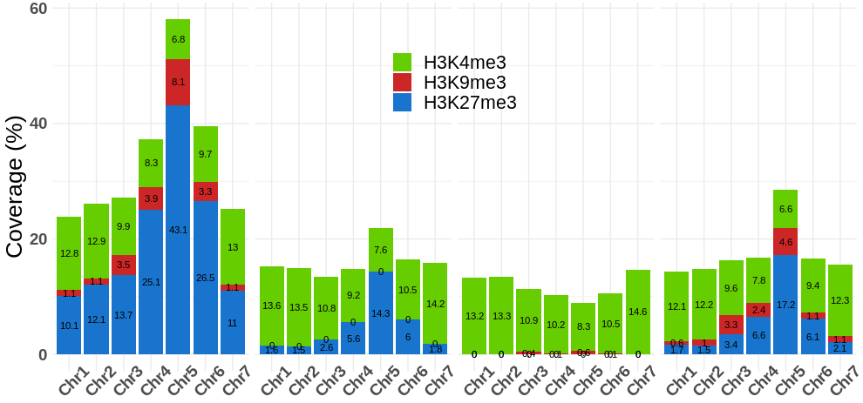
Fig. S3B
WT
∆PaKmt1
∆PaKmt6
∆PaHP1

Slide 3
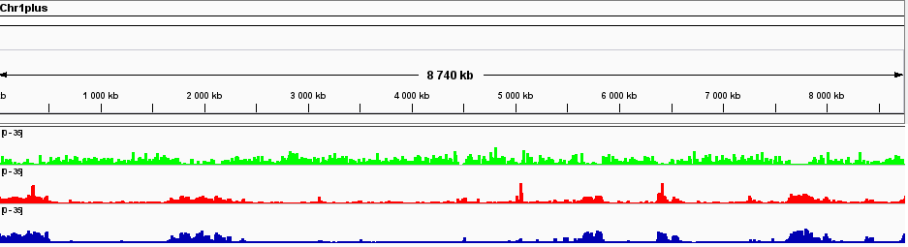
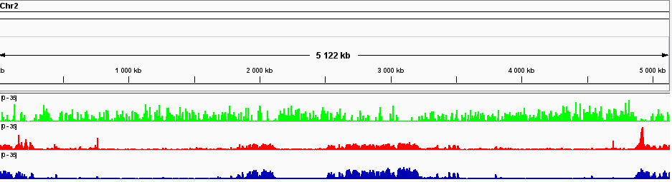
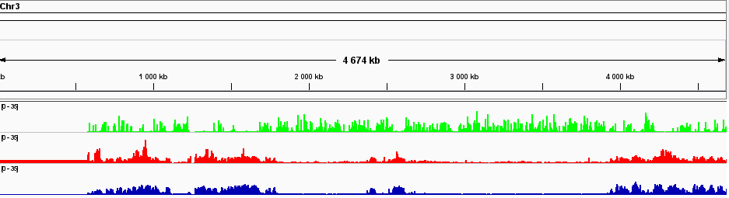
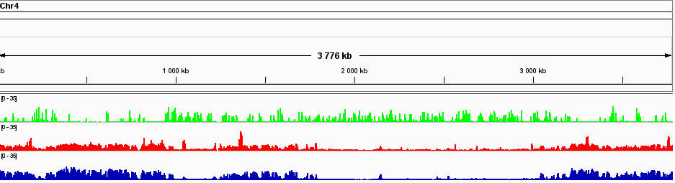
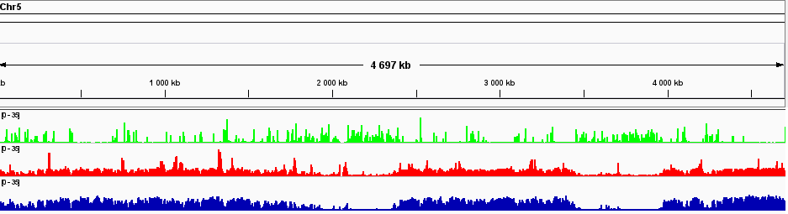
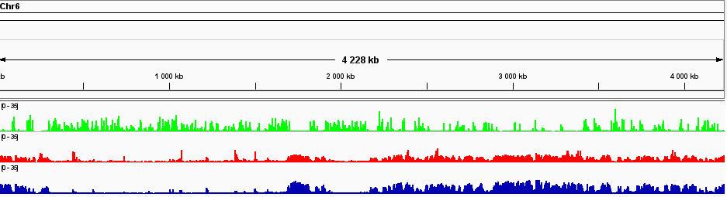
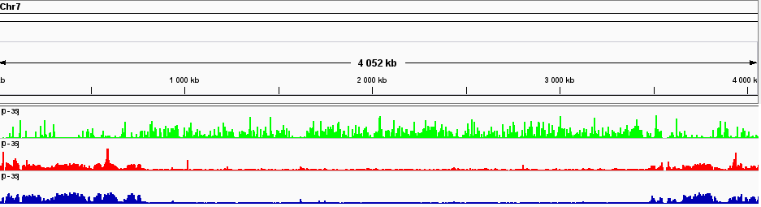
Fig. S3C
WT
H3K4me3
H3K9me3
H3K27me3

Slide 4
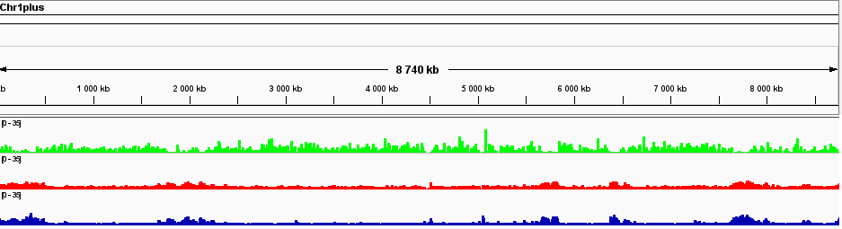
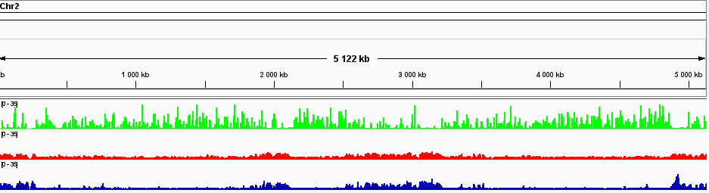
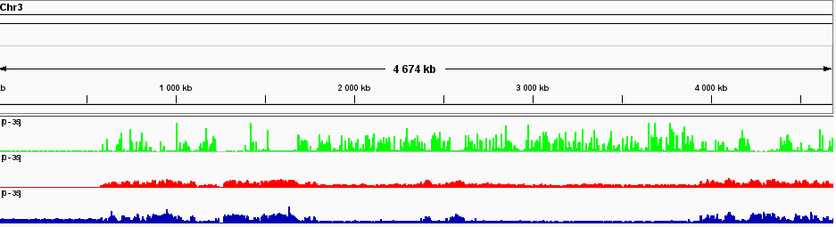
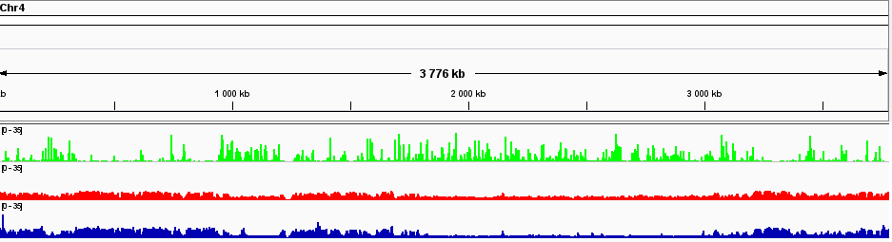
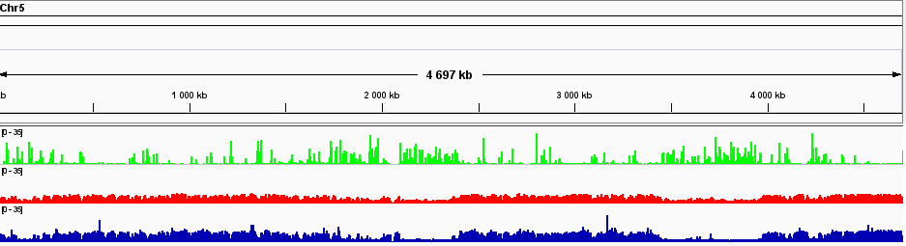
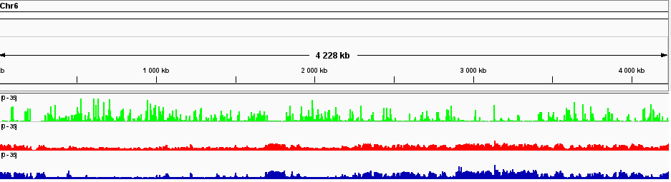
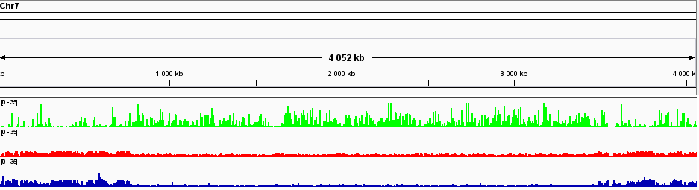
ΔPaKmt1
H3K4me3
H3K9me3
H3K27me3

Slide 5
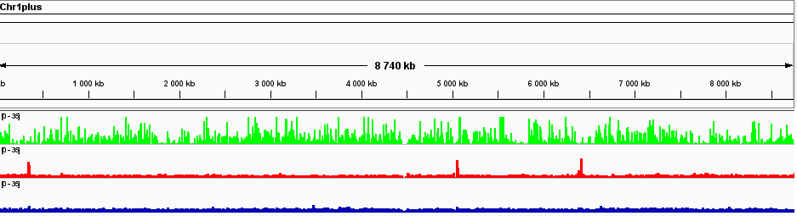
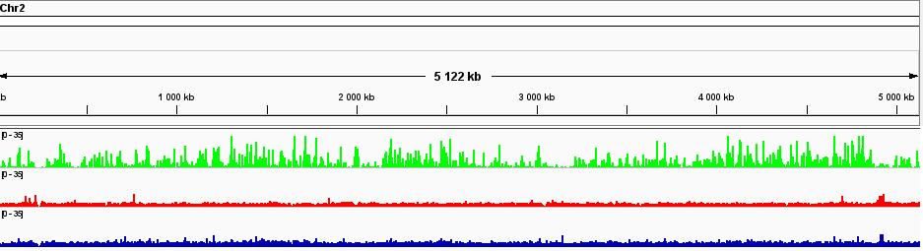
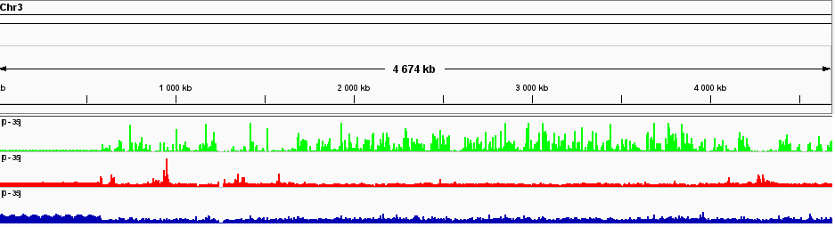
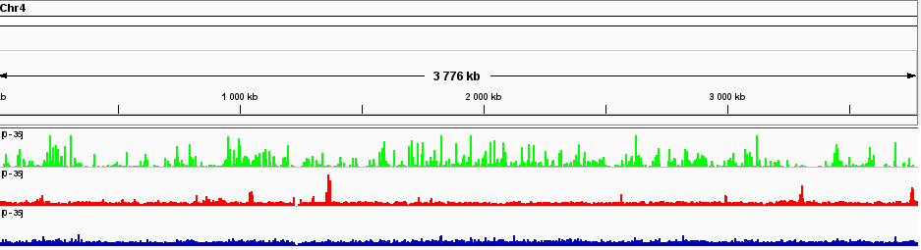
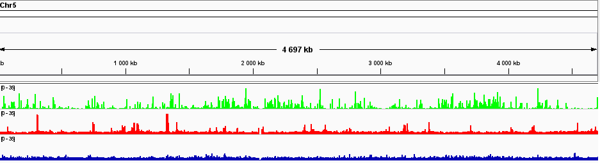
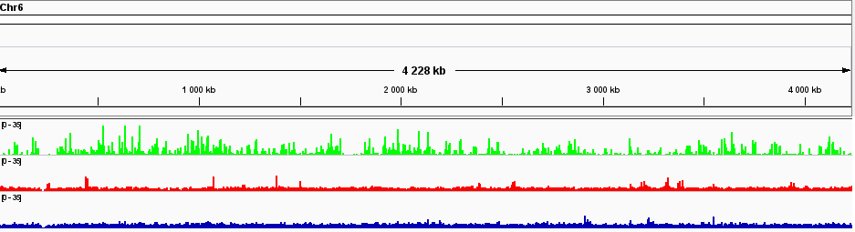
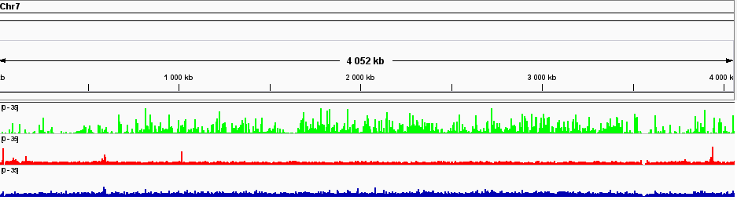
ΔPaKmt6
H3K4me3
H3K9me3
H3K27me3

Slide 6
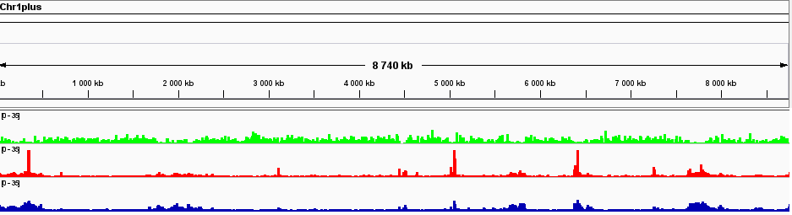
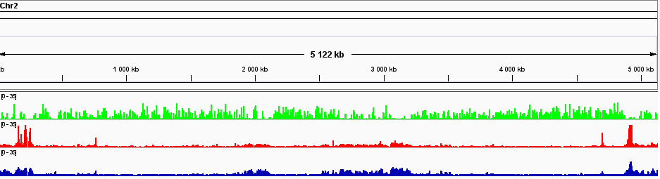
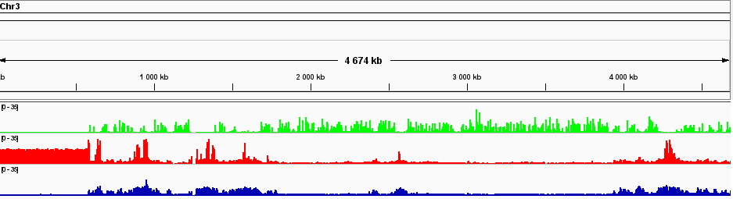
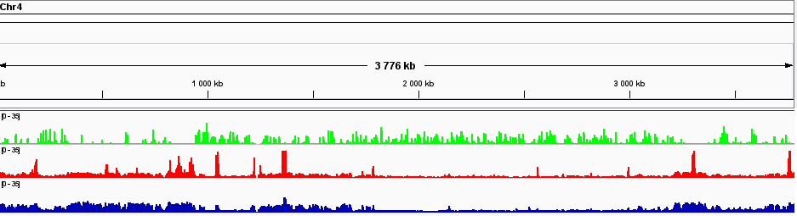
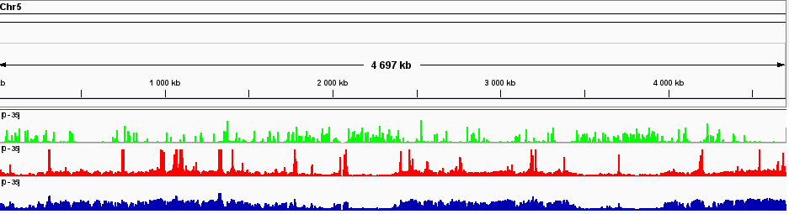
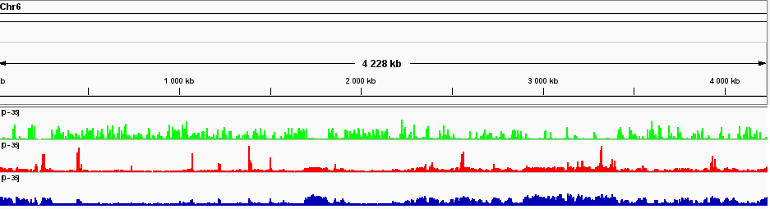
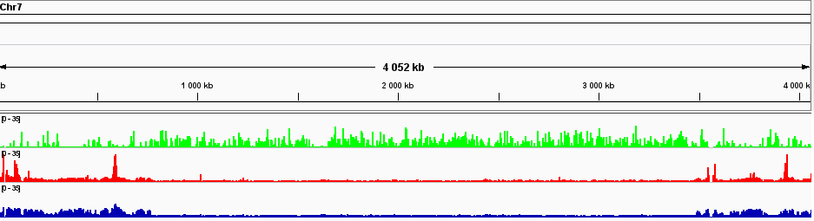
ΔPaHP1
H3K4me3
H3K9me3
H3K27me3
rDNA

Slide 7
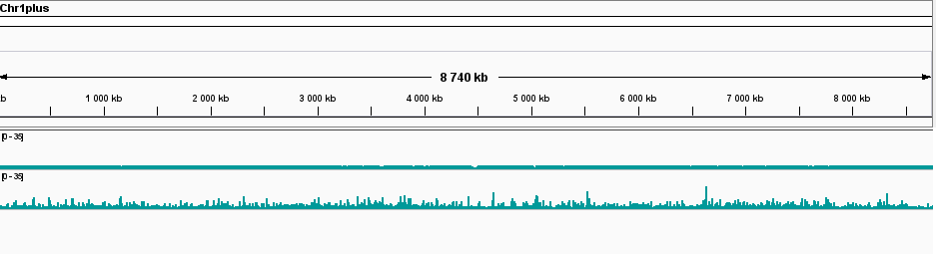
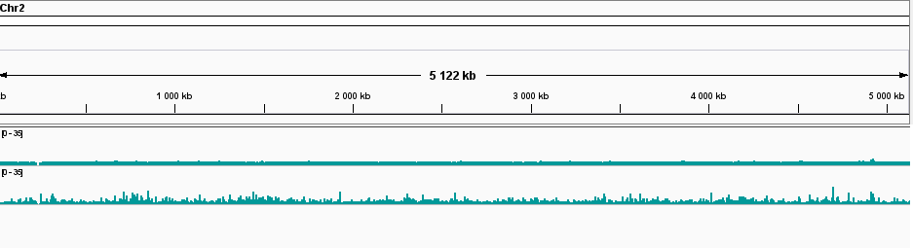
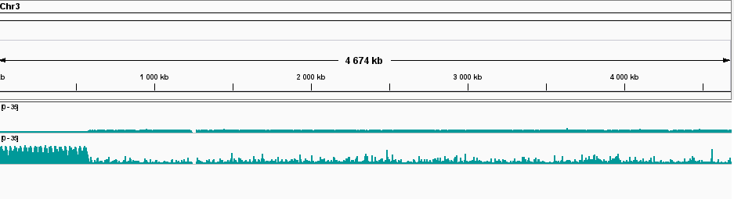
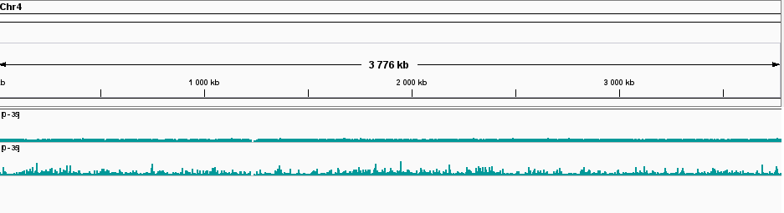
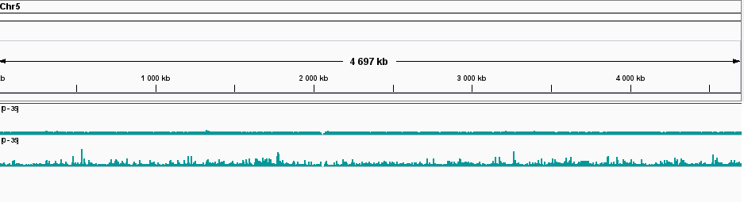
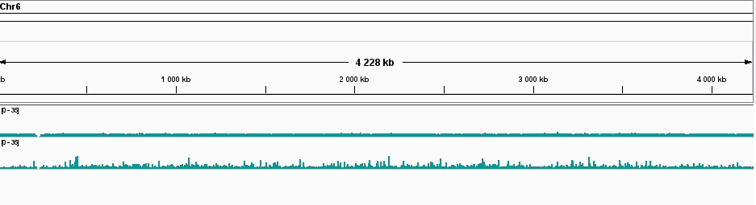
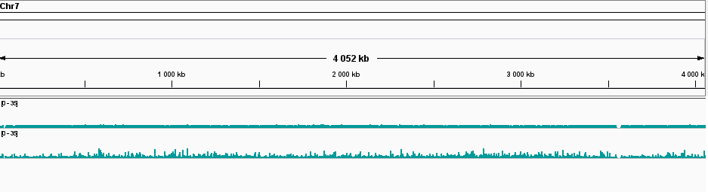
Up = input
Down = mock
rDNA

Slide 8
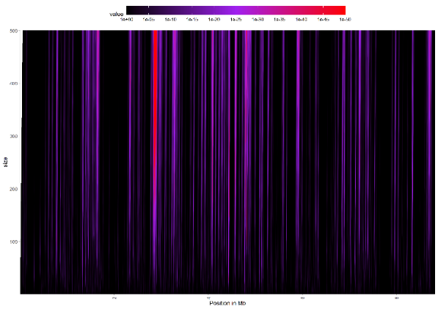
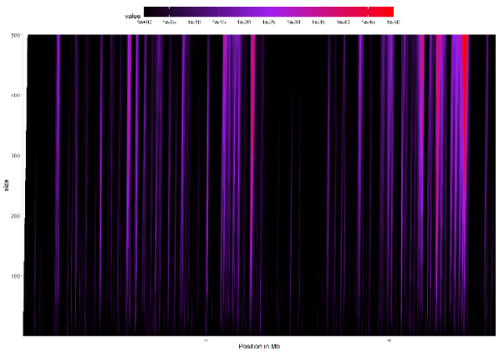
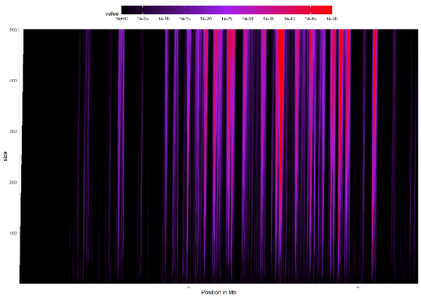
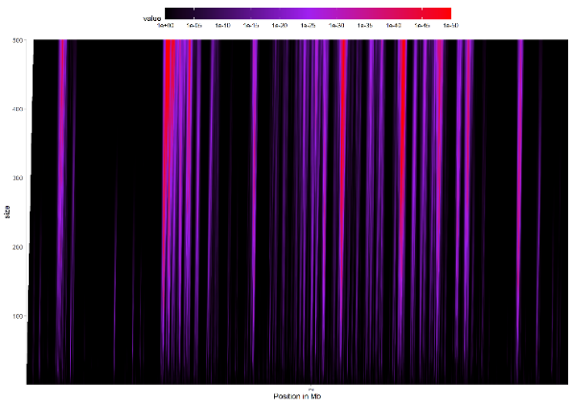
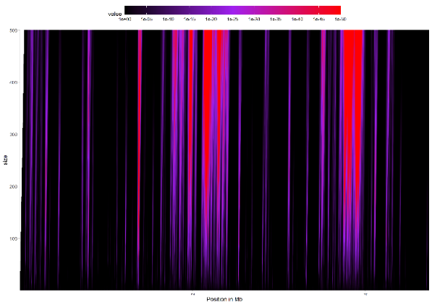
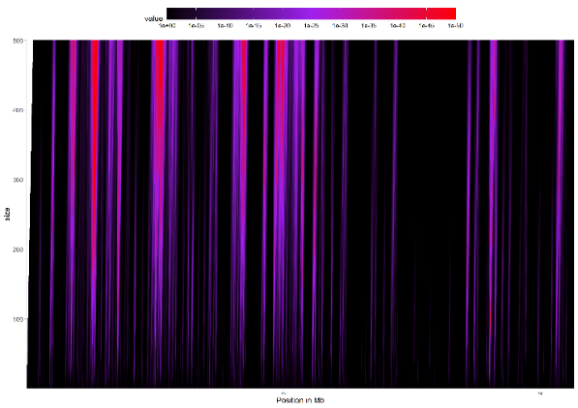
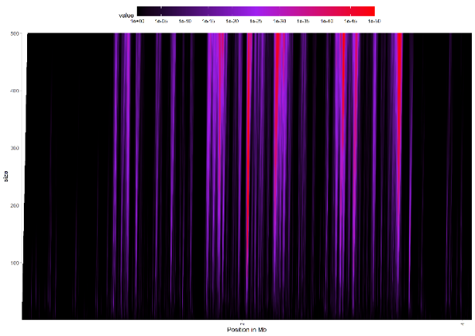
Fig. S3D
WT
H3K4me3
Chr1
Chr2
Chr3
Chr4
Chr5
Chr6
Chr7

Slide 9
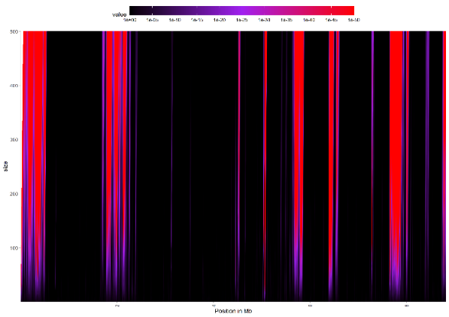
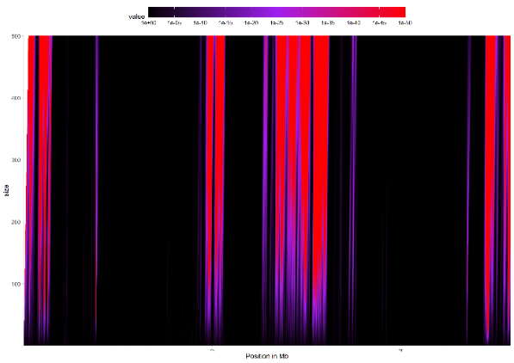
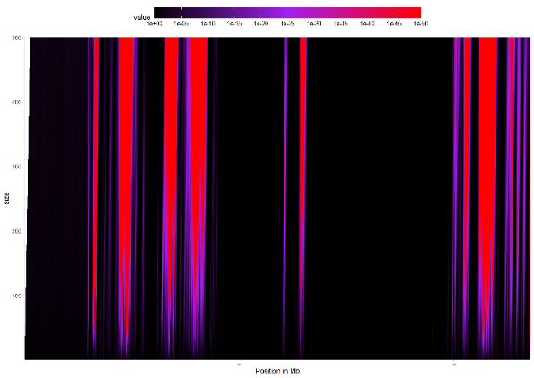
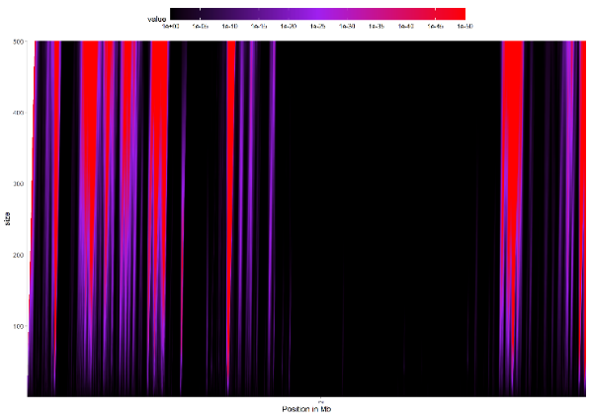
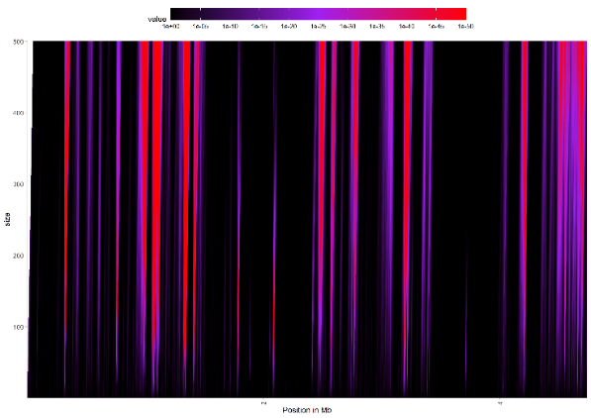
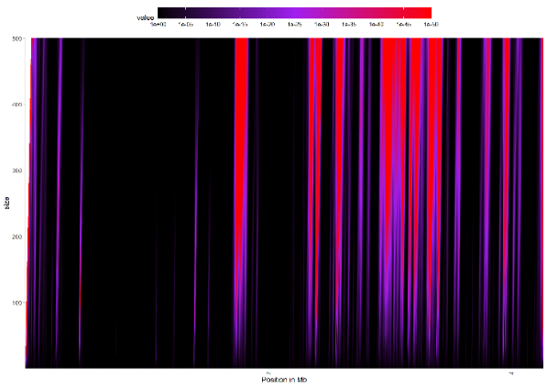

WT
H3K9me3
Chr1
Chr2
Chr3
Chr4
Chr5
Chr6
Chr7

Slide 10







WT
H3K27me3
Chr1
Chr2
Chr3
Chr4
Chr5
Chr6
Chr7

Slide 11







ΔPaKmt1
H3K4me3
Chr1
Chr2
Chr3
Chr4
Chr5
Chr6
Chr7

Slide 12







ΔPaKmt1
H3K9me3
Chr1
Chr2
Chr3
Chr4
Chr5
Chr6
Chr7

Slide 13







ΔPaKmt1
H3K27me3
Chr1
Chr2
Chr3
Chr4
Chr5
Chr6
Chr7

Slide 14







ΔPaKmt6
H3K4me3
Chr1
Chr2
Chr3
Chr4
Chr5
Chr6
Chr7

Slide 15







ΔPaKmt6
H3K9me3
Chr1
Chr2
Chr3
Chr4
Chr5
Chr6
Chr7

Slide 16







ΔPaKmt6
H3K27me3
rDNA
Chr1
Chr2
Chr3
Chr4
Chr5
Chr6
Chr7

Slide 17







ΔPaHP1
H3K4me3
Chr1
Chr2
Chr3
Chr4
Chr5
Chr6
Chr7

Slide 18







ΔPaHP1
H3K9me3
rDNA
Chr1
Chr2
Chr3
Chr4
Chr5
Chr6
Chr7

Slide 19







ΔPaHP1
H3K27me3
Chr1
Chr2
Chr3
Chr4
Chr5
Chr6
Chr7

Slide 20







Input
Chr1
Chr2
Chr3
Chr4
Chr5
Chr6
Chr7

Slide 21







Mock
rDNA
Chr1
Chr2
Chr3
Chr4
Chr5
Chr6
Chr7

