Slide 1
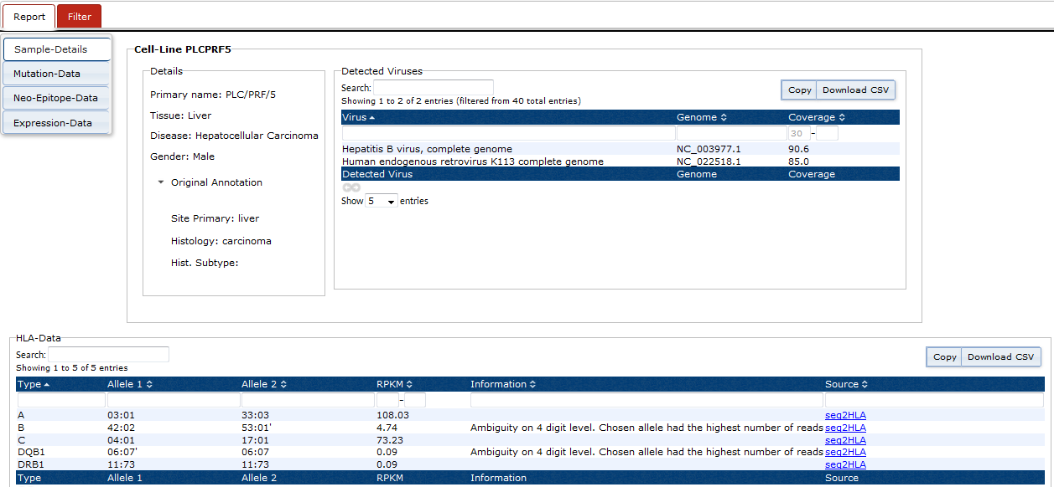
Figure S1. Virus identification. HBV is expressed in the liver carcinoma cell line PLC/PRF/5.

