Slide 1
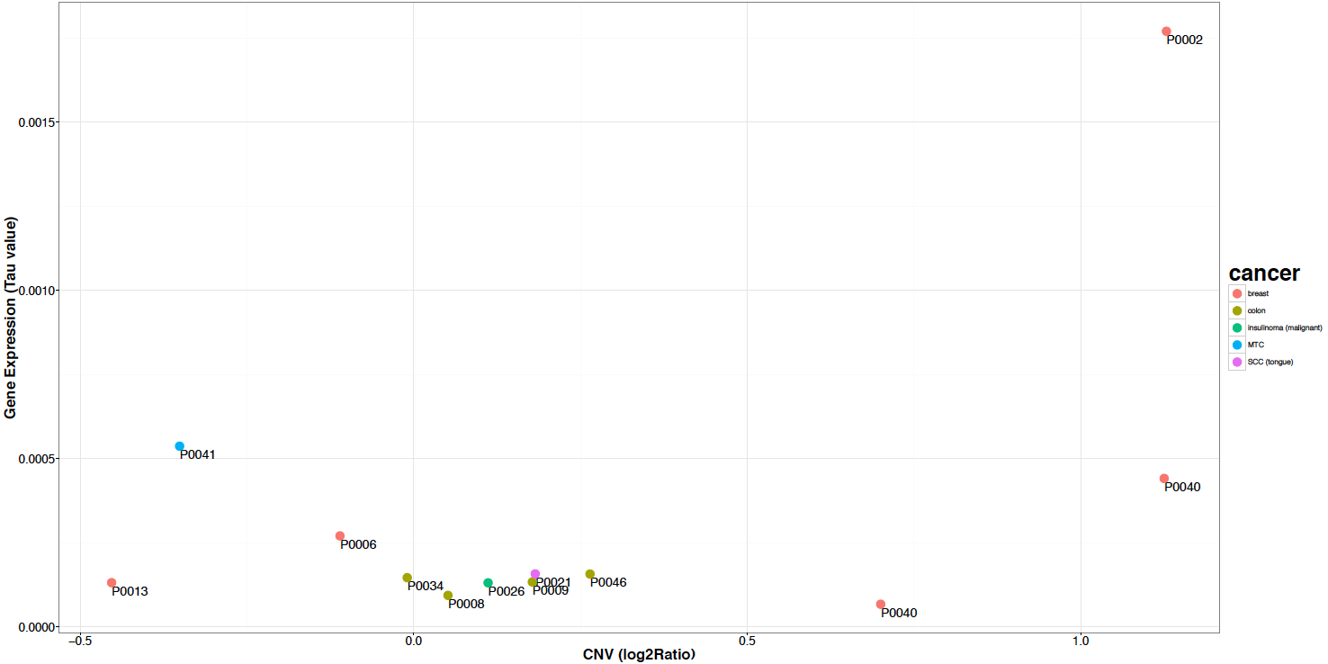
Figure S8
CNV (log2 ratio)
*
*

