Slide 1
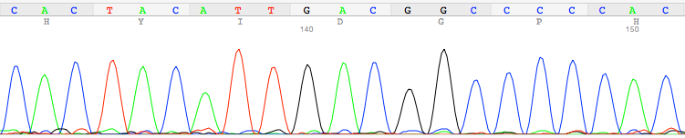
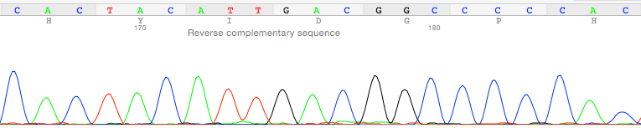
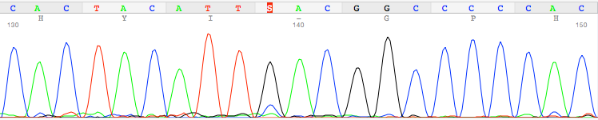
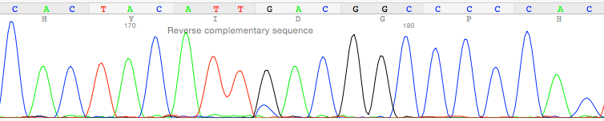
Figure S10
p.D587
Normal sample
Forward primer
Normal sample
Reverse primer
Tumor sample
Forward primer
Tumor sample
Reverse primer
p.D587H

