Slide 1
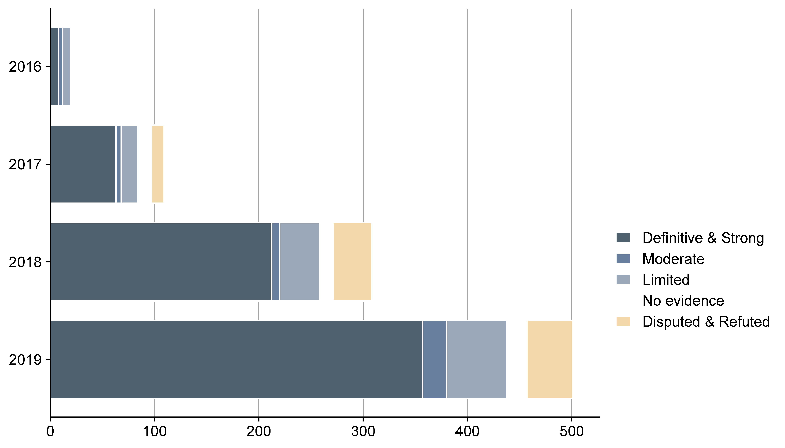
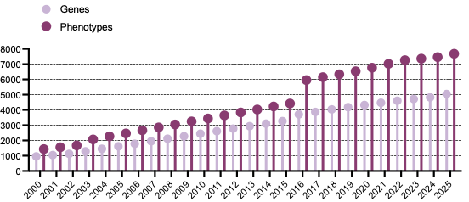
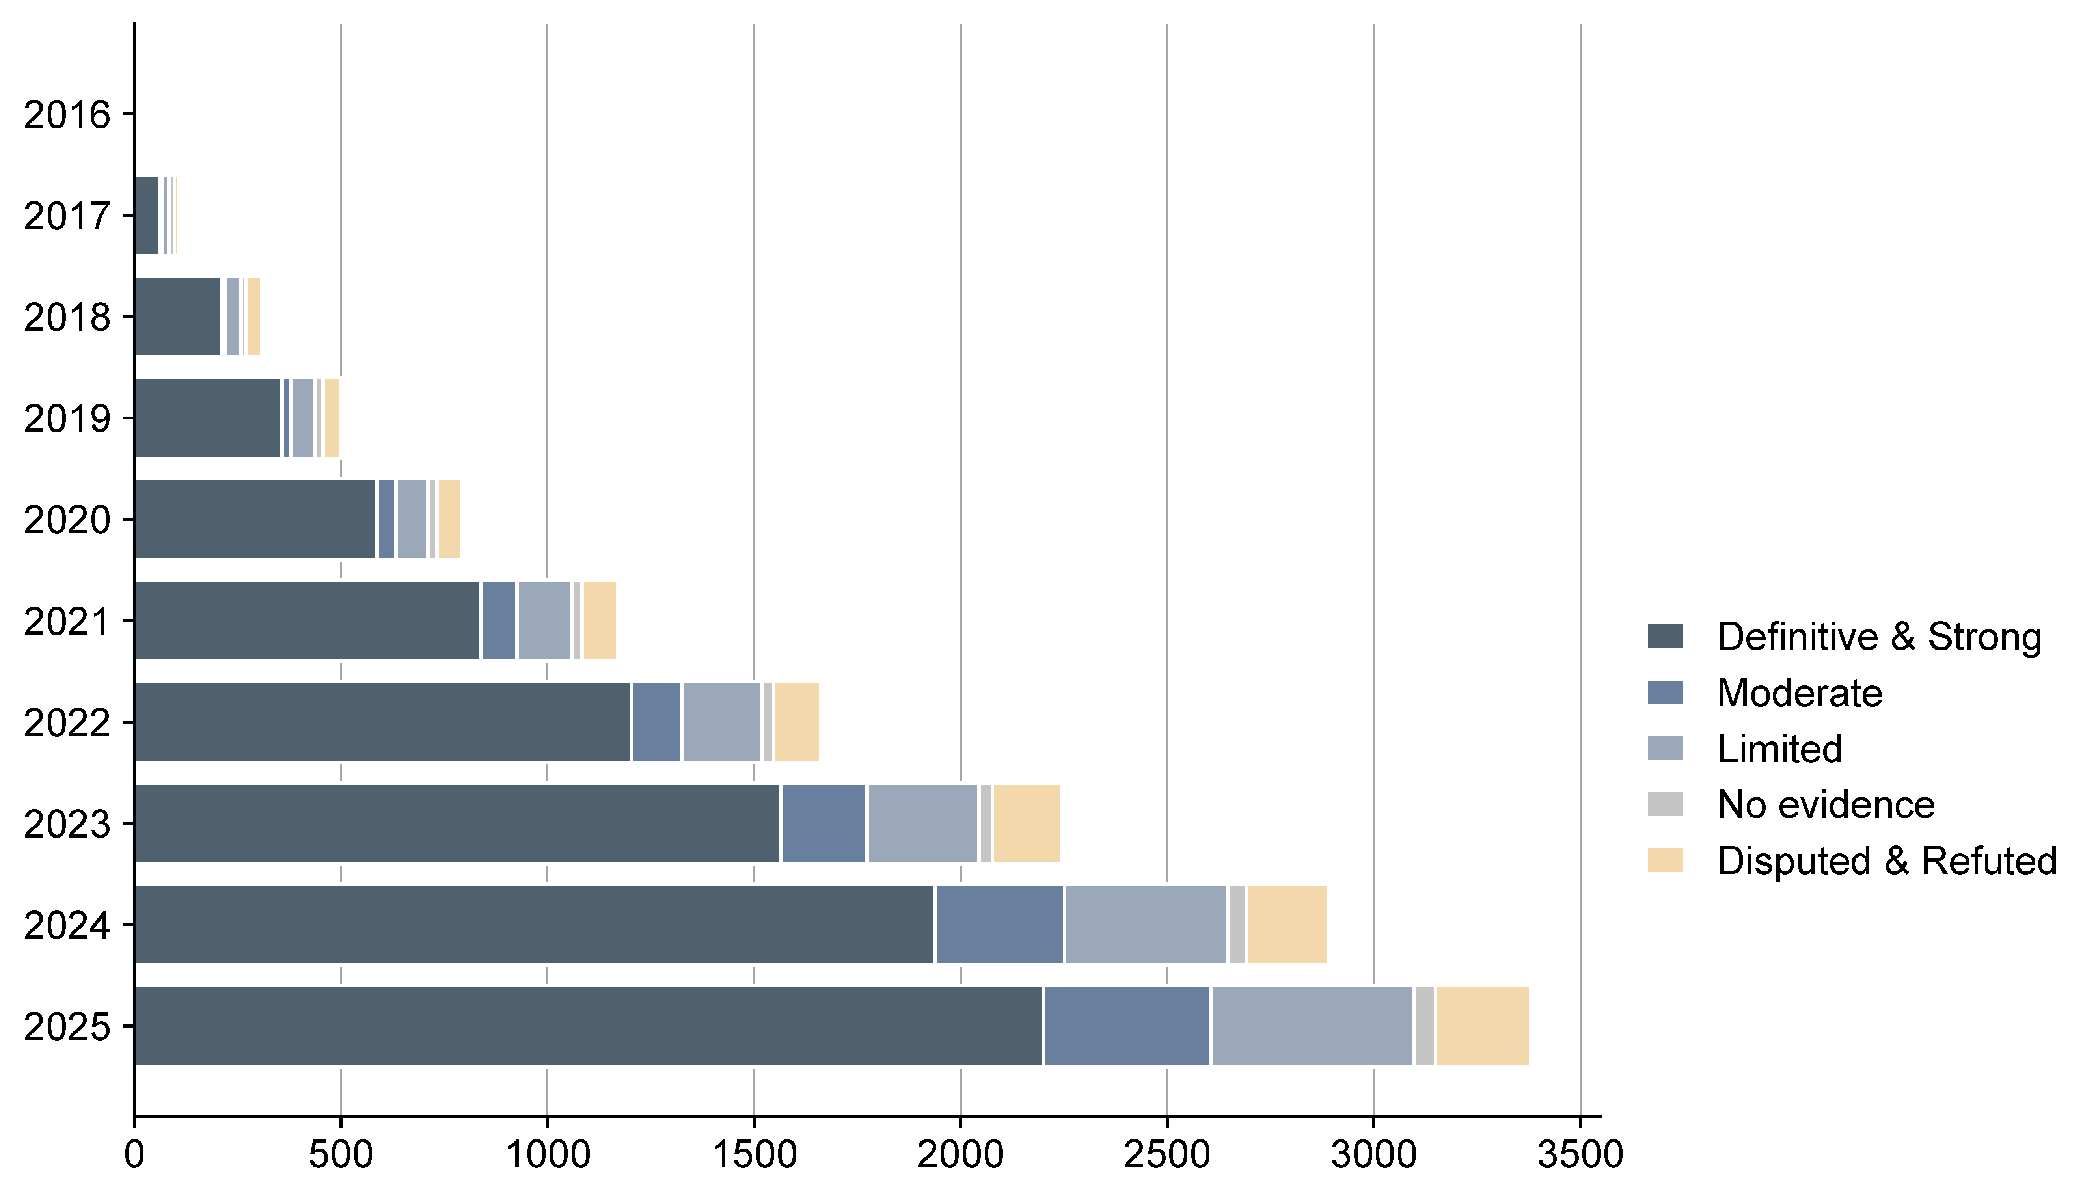
Mid-1990s: Emerging VUS concept
2000
2000: First guidance on sequence variant classification
2001
2002: Recognition of VUS in BRCA1/2 counseling
2002
2003
2004
2005
2007: ACMG recommendations
2006
2007
2008
26
8
2009
2010
109
63
2013: Launch of ClinVar, ClinGen
2011
212
308
2012
357
501
2014: Launch of ExAC
2013
2014
2015: ACMG/AMP guidelines
2015
2017: Launch of gnomAD
2016
2018: ACMG/AMP Variant Classification as a Bayesian Framework
2017
2018
Fig. 1
2019
2020
2020: A point-based model to align with the ACMG/AMP criteria
587
793
2021
839
1,171
2022
1204
1,662
2024: ACMG/AMP/
CAP/ClinGen SVC v4.0
(forthcoming)
2023
1565
2,245
2024
1937
2,892
2025
2201
3,380
7000 5000 3000 1000
0 1000 2000 3000
Number of phenotypes/genes
Number of ClinGen gene-disease curation
ACMG guidelines
OMIM phenotypes with known genetic basis
Definitive & Strong
Moderate
Database
Genes associated with OMIM phenotypes
No evidence
Disputed & Refuted
Limited

Slide 2
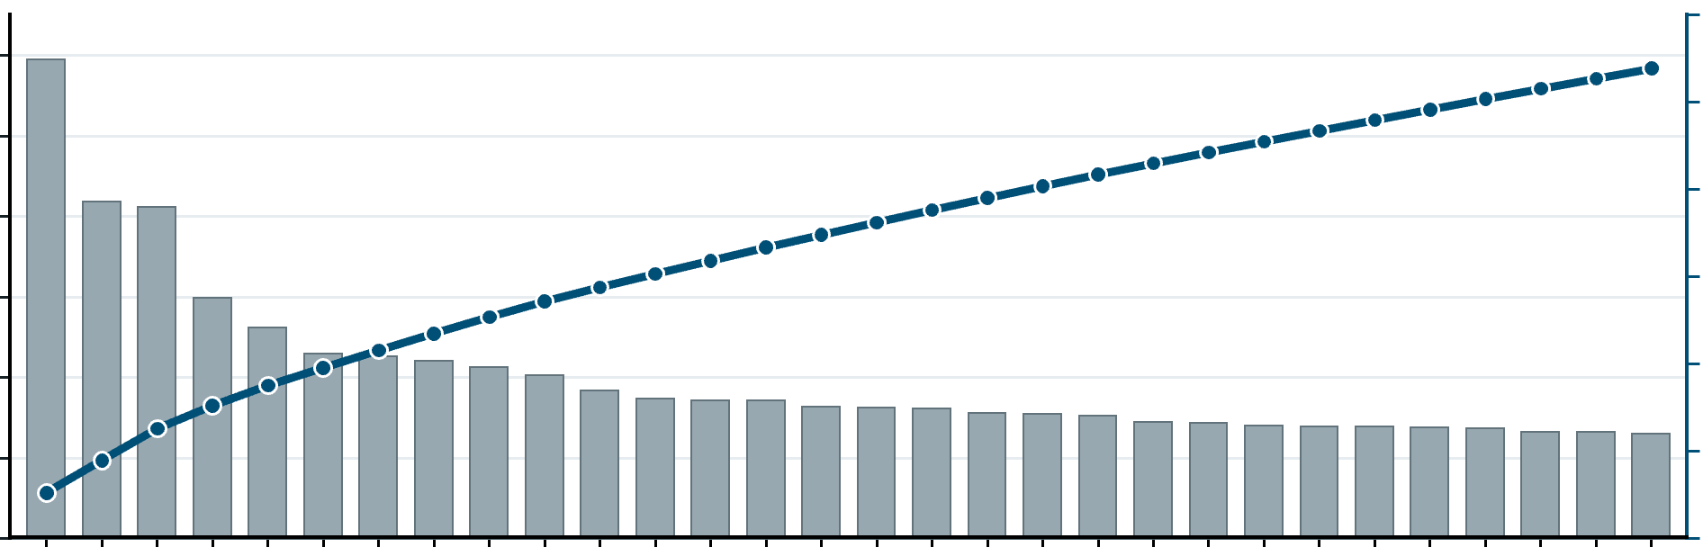
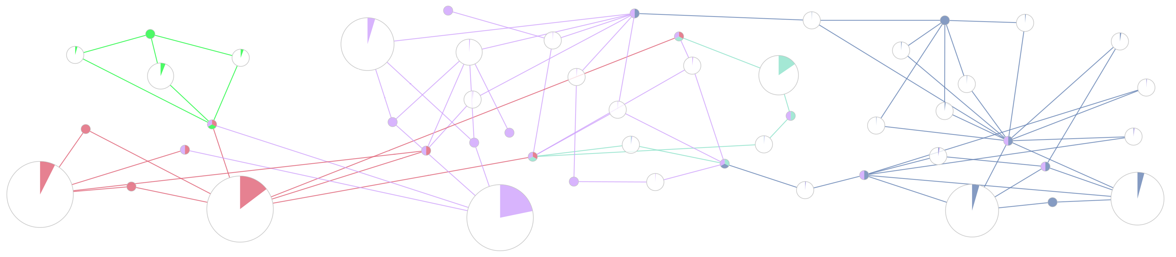



A
4
3
53.4%
B
27.6%
P/LP
VUS
Conflicting
B/LB
8.9%
VUS
53.4%
SNV composition (98.5%)
47.3%
~1.9M
46.4%
~ 4M
ClinVar
SNV
No. of variants in ClinVar (millions)
17.1%
0
500k
1000k
1500k
2000k
2
1
0
9.9%
35.9%
33.7%
P/LP
VUS
Conflicting
B/LB
Magnified non-SNV composition (1.5%)
8.2%
31.3%
Non-SNV
5746 14645 2641 5854 5711
26.2%
33.8%
0 5k 10k 15k 20k 25k 30k 35k
27.7%
30.5%
4.0%
Missense
Frameshift
Nonsense
Splice site
ncRNA
UTR
2013 2014 2015 2016 2017 2018 2019 2020 2021 2022 2023 2024 2025
C
Top 30 genes with most unique VUS
6%
5%
12k
10k
Top 30 genes with most unique VUS
8k
6k
4%
3%
Number of unique VUS
Cumulative VUS percentage
Cumulative VUS percentage
4k
2k
Number of unique VUS
2%
1%
0
ALK
NEB
0%
Fig. 2
ATM
RYR2
TSC2
DMD
PKD1
RAD50
POLE
RYR1
PLEC
APC
NF1
MSH6
MYH7
TTN
BRIP1
MSH3
SYNE1
PMS2
BRCA2
ALMS1
RECQL4
PALB2
DICER1
USH2A
POLD1
OBSCN
PRKDC
SMARCA4
D
Colorectal cancer
DICER1
MicroRNAs in cancer
APC
Neurodegeneration pathways
RYR1
Apelin signaling pathway
Nucleotide excision repair
POLE
DNA replication
Cancer pathways
RAD50
Oxytocin signaling pathway
ARVR
Hepatocellular carcinoma
Cellular senescence
Calcium signaling pathway
Adrenergic signaling in cardiomyocytes
Breast cancer
Non-homologous end-joining
Base excision repair
MSH3
Human papillomavirus infection
PRKDC
Circadian entrainment
PALB2
PMS2
POLD1
ALK
p53 signaling pathway
Cell cycle
Prion disease
Cardiac muscle contraction
BRCA2
MSH6
ATM
Thermogenesis
RYR2
DMD
SMARCA4
TSC2
MYH7
Viral myocarditis
BRIP1
Thyroid hormone signaling pathway
TTN
Cancer/Fanconi anemia pathway
Homologous recombination
Cardiomyopathy/skeletal muscle
Dilated cardiomyopathy
Cancer/mismatch repair

Slide 3

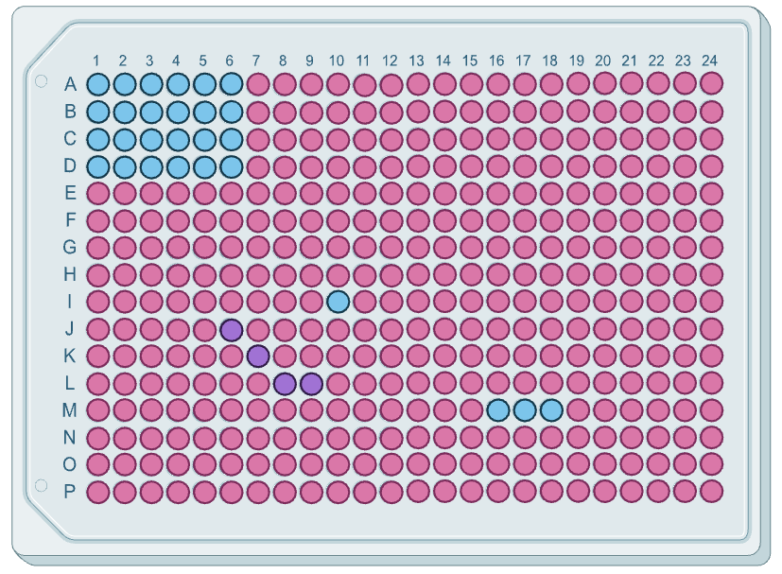








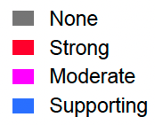
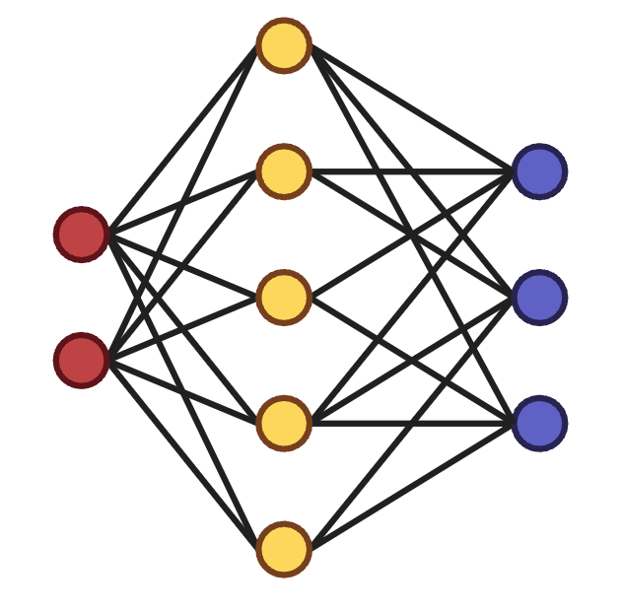
A
B
PVS1 PS1 PS2
Pathogenic criteria
Multi-omics: epigenome, transcriptome, proteome
AI prioritizes, interprets, and classifies VUS
PS3 PS4 PM1
434 (5.4%)
Population genetics
Data sharing
534 (6.7%)
2776 (34.8%)
High-throughput methods: MAVEs, SGE, cell painting
PM2 PM3 PM4
Functional
studies
Computational
predictions
VUS
reanalysis
Deep
phenotyping
PM5 PM6 PP1
Variant curation
guidelines
Genetic VUS
PP2 PP3 PP4
1281 (16.1%)
589 (7.4%)
BP1 BP2 BP3
Benign criteria
Fig. 3
BP4 BP5 BP7
848 (10.6%)
BS1 BS2
Default strength
BS3 BS4
Strong
Moderate
BA1
Supporting
0 500 1000 1500 2000 2500
ACMG/AMP criteria distribution in 3822 curated VUS
Notes:
Pathogenic: #eb9b9e
Benign: 88C3E8
#e8ebf0
https://imagecolorpicker.com/color-code/2596be
1. purpule: #b378b4
2. pink: #fbc9c3
3. red: #c74547
4. grey: #8b97ad
5. yellow: #f3d78a
6. green: #88d1d1

