Slide 1
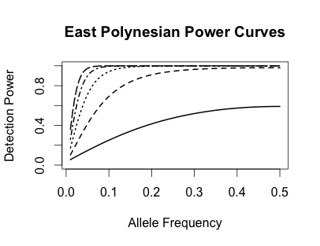
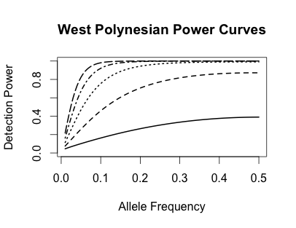
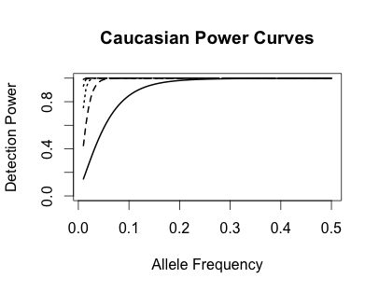
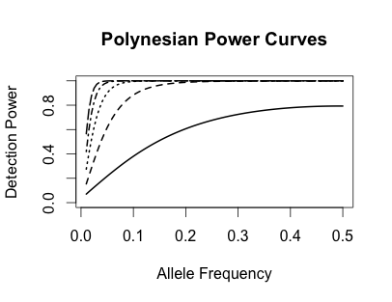
Association Power Curves (significance level=0.001)
OR
2.0
1.8
1.6
East Polynesian
West Polynesian
1.4
1.2
Caucasian
All Polynesian

Slide 2
Association Power Curves (significance level=0.05)
OR
2.0
1.8
1.6
East Polynesian
West Polynesian
1.4
1.2
Caucasian
All Polynesian

