Slide 1
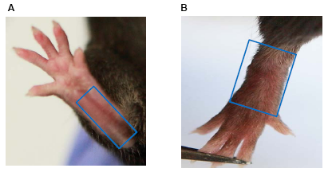
Supplemental figure 1. Location of ankle tissues that are used for whole-mount immunofluorescence staining. Images of paws were from a WT mouse. Based on our preliminary findings, we used the ventral portion (A) for staining capillary LVs and the dorsal portion (B) for staining mature LVs.

Slide 2
A
P3 P6 P9 P11
B
P3 P6 P9 P11
SMYH2
β-actin
Supplemental figure 2. Changes of morphology and expression of smooth muscle myosin heavy chain 2 in different passages of lymphatic muscle cells. Primary rat lymphatic muscle cells were cultured. Cells were harvested at different passages. (A) Images of bright fields show morphologic changes. (B) Expression of smooth muscle myosin heavy chain 2 (SMYH2) by Western blot analysis.
.

Slide 3
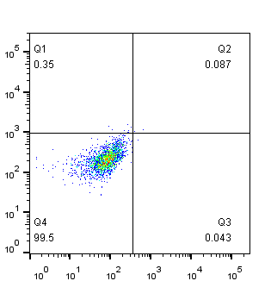
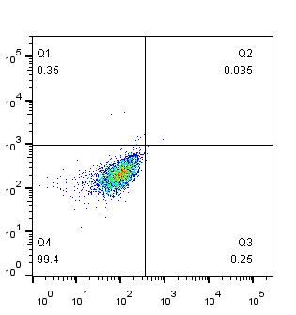


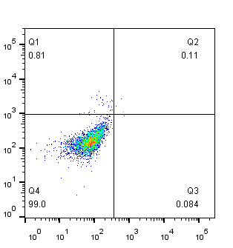

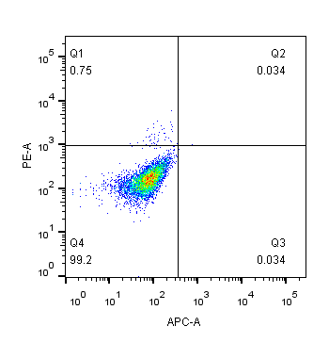

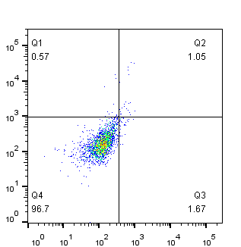
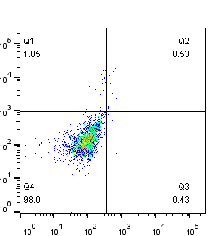
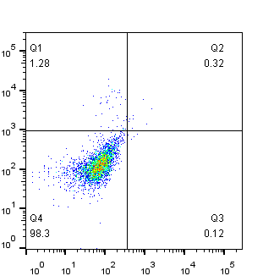
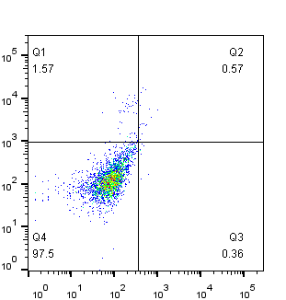
A
B
IL-6
0 ng/ml
2.2 ng/ml
6 ng/ml
20 ng/ml
Day 1
Day 5
Annexin V
Day 7
Propidium iodide
Supplemental figure 3. IL-6 had no effect on the growth and apoptosis of LMCs. Lymphatic smooth muscle cells were treated with 0, 2.2, 6, 20 ng/ml IL-6 for 1 to 7 days. (A) Cell growth was assessed by an MTT assay. Values are mean ± SD of 3 samples. (B) Cell apoptosis was determined by flow cytometry.

Slide 4
Weight (g)
NS
TNF-Tg+Saline
TNF-Tg+PNS
Supplemental figure 4. PNS did not significantly affect the weight of TNF-Tg mice. Weight of 3-month-old TNF-Tg mice were treated with PNS or saline by gavage daily for 3 months. n=7 mice/group, NS, p>0.05 by student t test.

