Slide 1
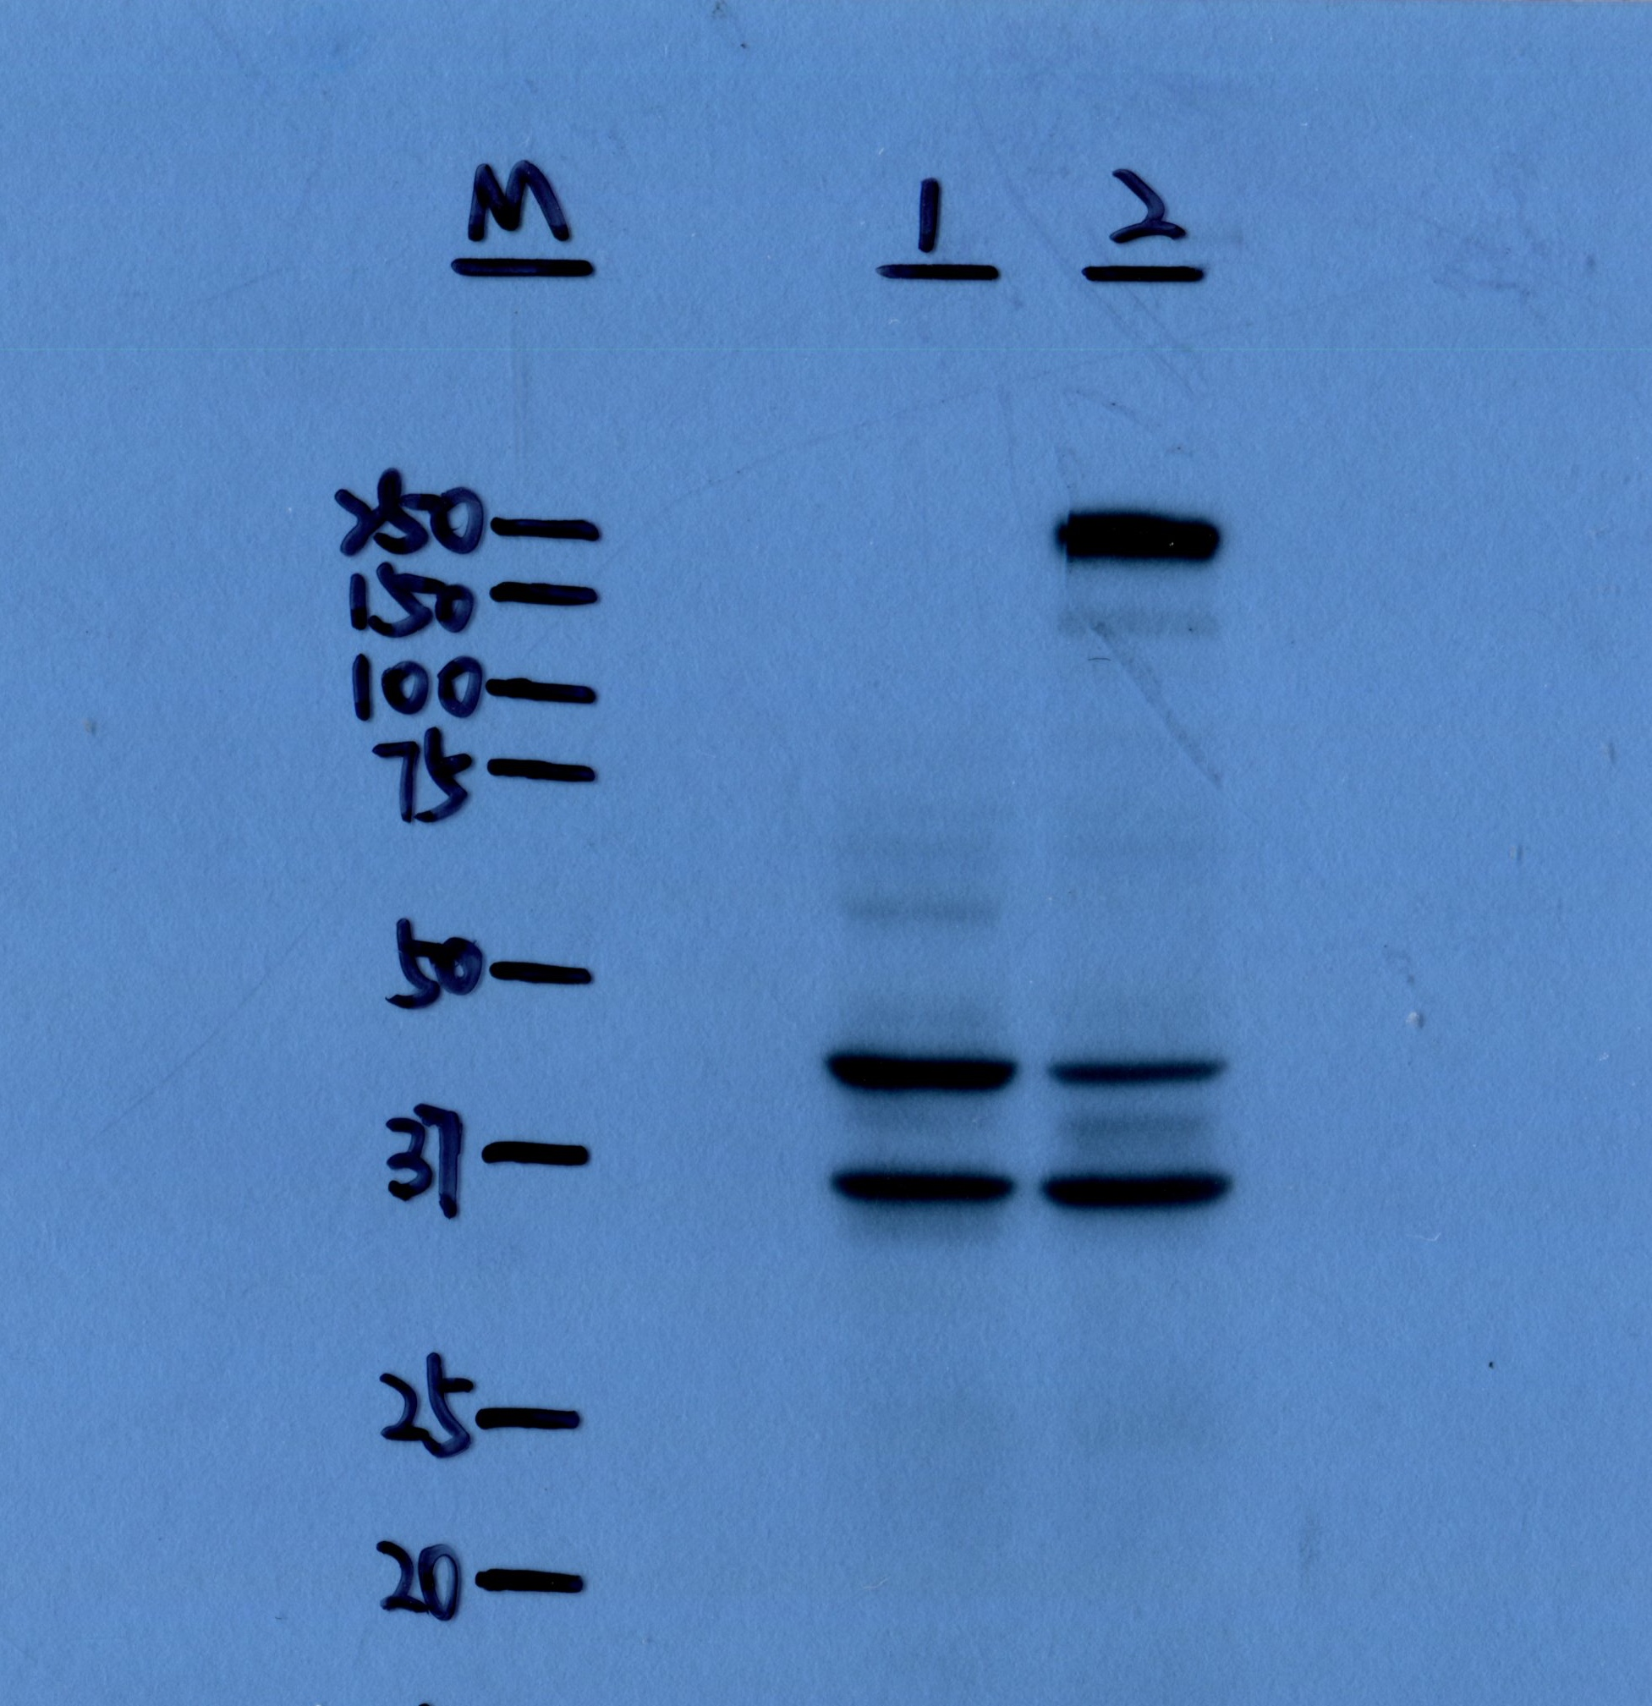
45kDa
Galectin9
LGALS9_OE
THP-1_NC

Slide 2
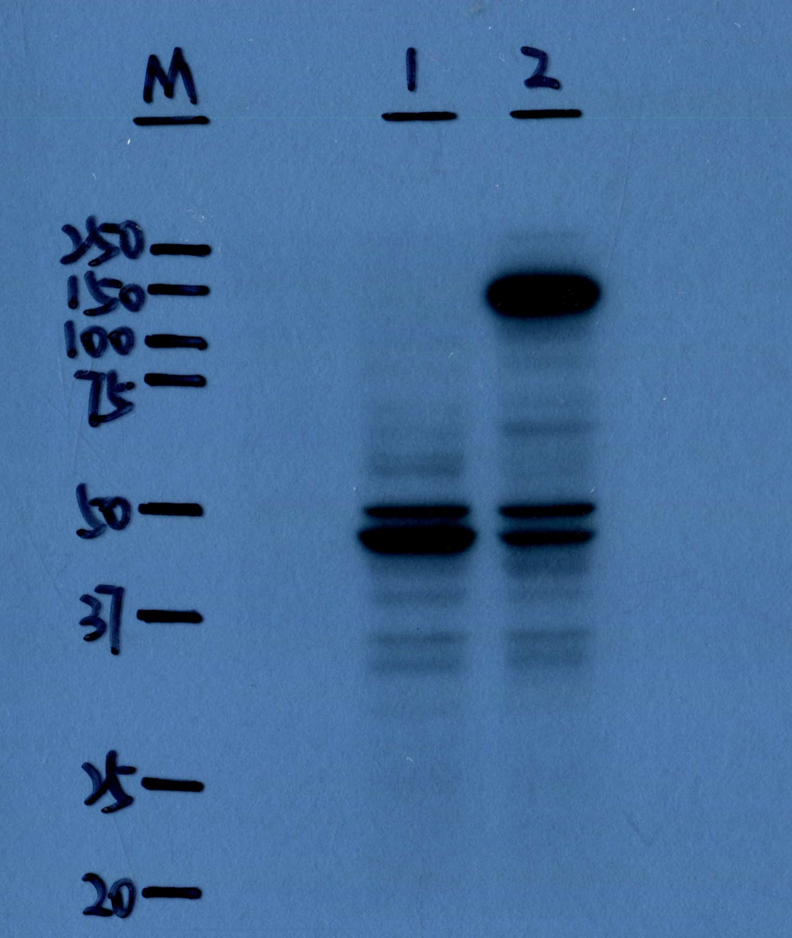
160kDa
CD163
THP-1_NC
LGALS9_OE

Slide 3
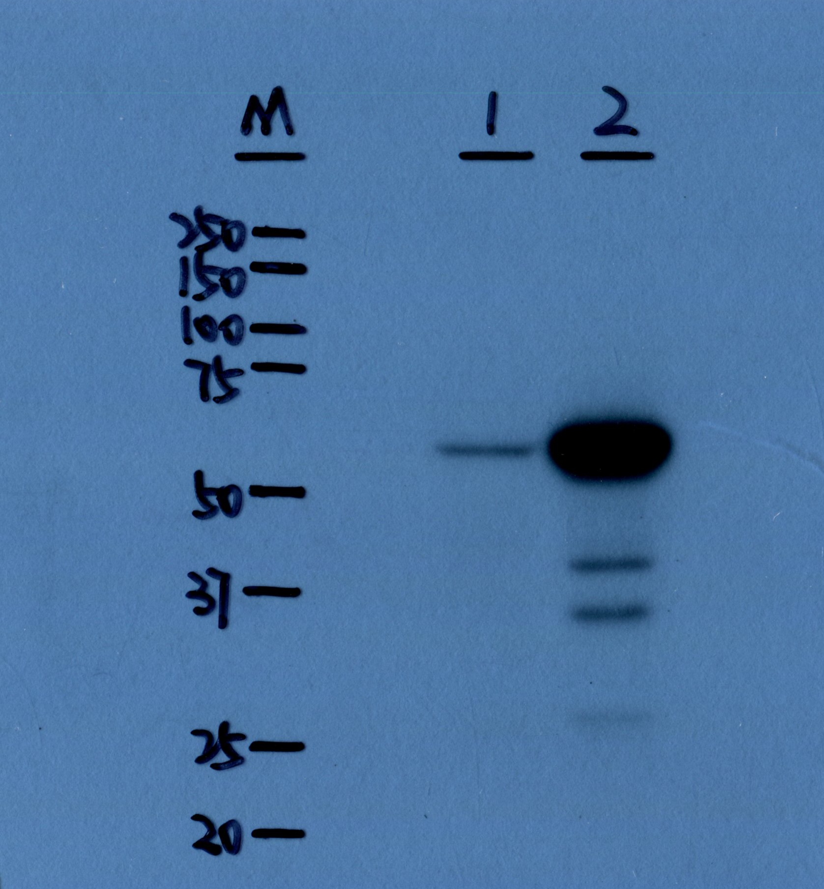
40kDa
CXCR3
THP-1_NC
LGALS9_OE

Slide 4
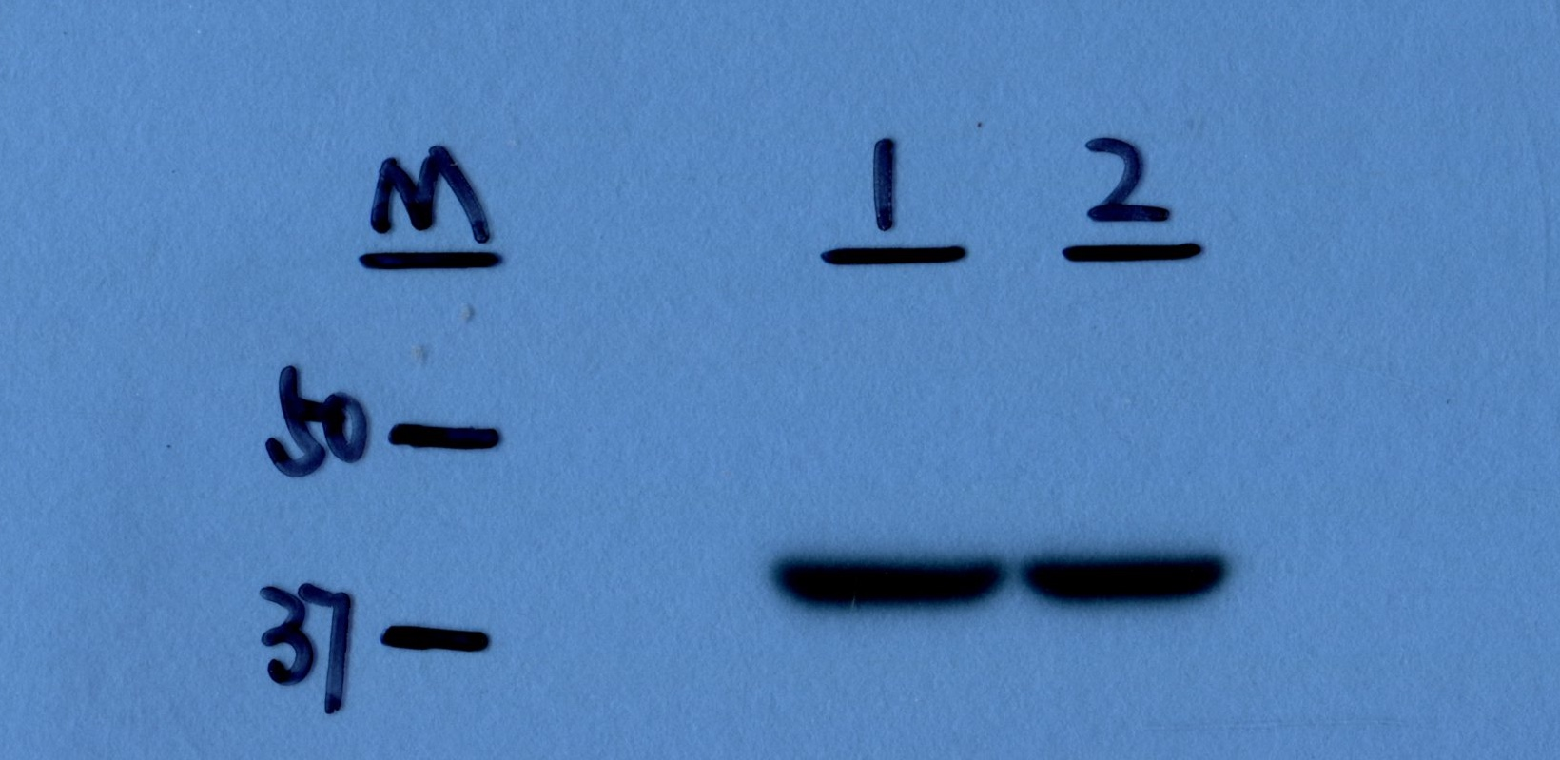
42kDa
𝝱-actin
THP-1_NC
LGALS9_OE

Slide 5
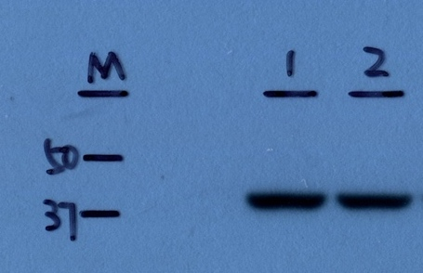
42kDa
𝝱-actin
THP-1_NC
LGALS9_OE

