Slide 1
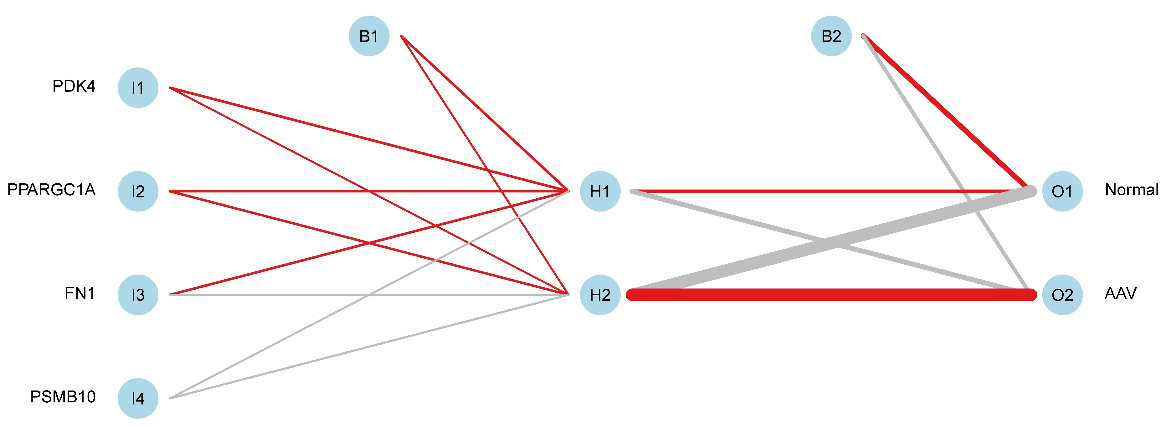
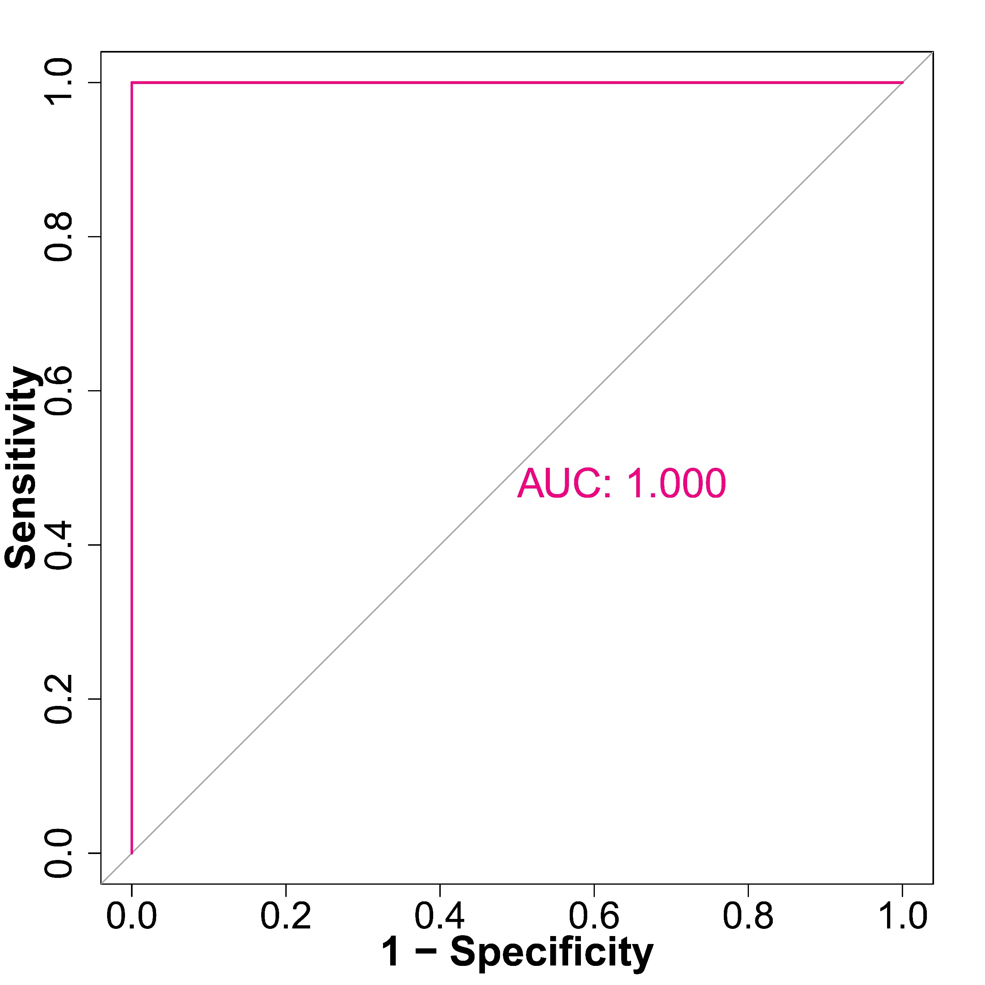
A
B
Supplementary Figure 4. Validation of the artificial neural network model and construction of the ROC curve in the validation set. (A) The artificial neural network model using the validation set. (B) Validation set artificial neural network evaluation of ROC curves.

