Slide 1
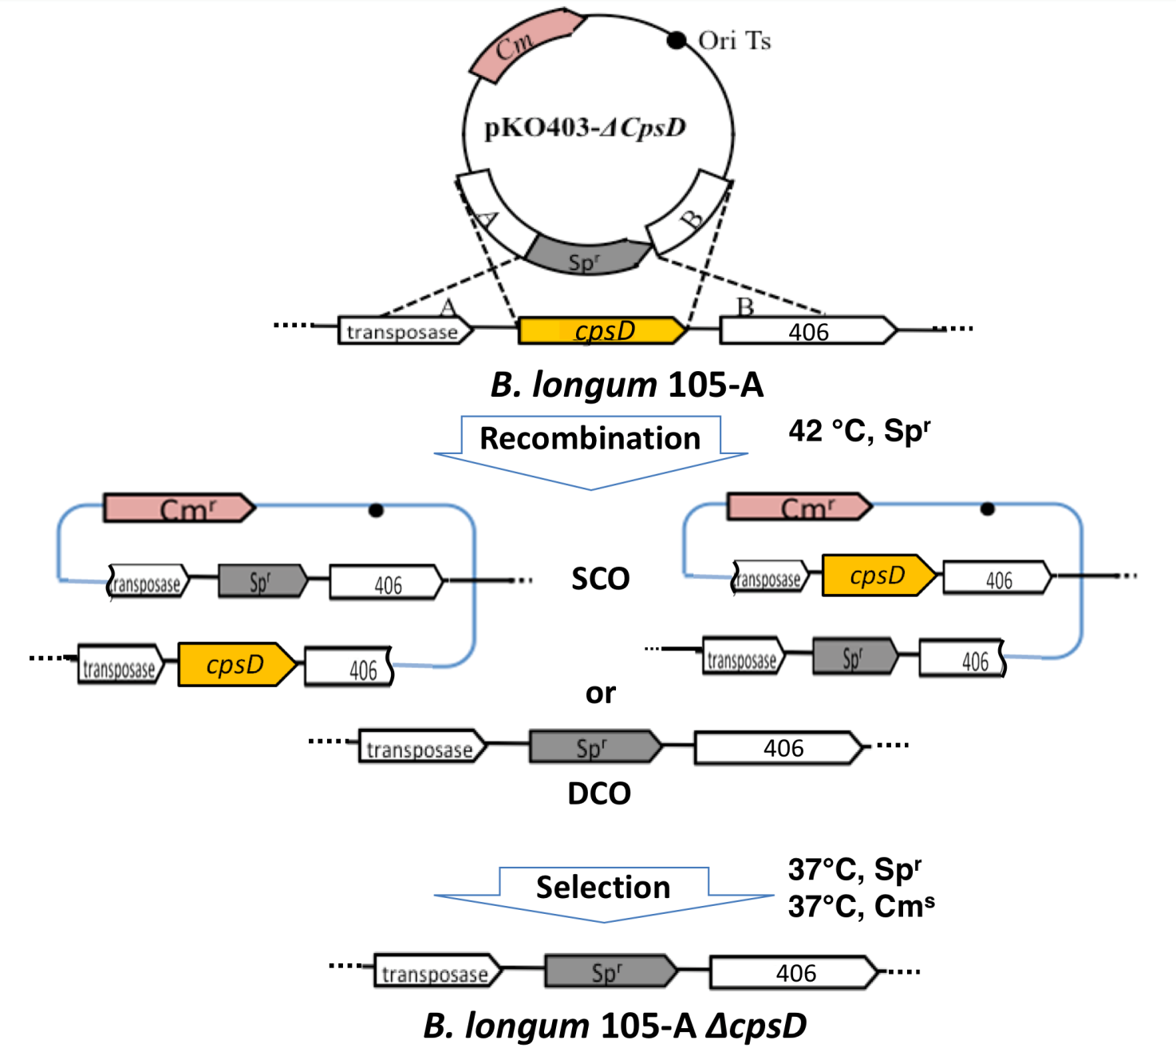
Supplementary Fig. 1.

