Slide 1
Additional File 1
Figure S1
Figure S1. The microbial composition of each individual is shown at phylum level. The individuals are sorted by the abundance of Bacteroidetes.

Slide 2
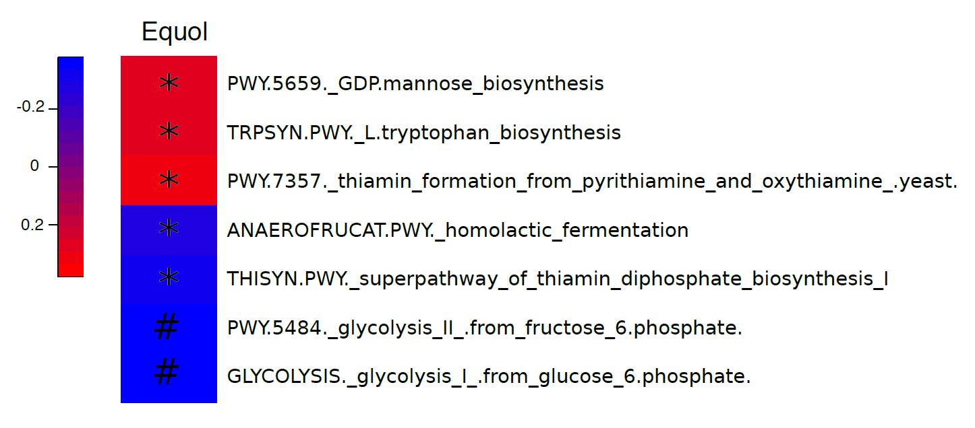
Additional File 1
Figure S2
Figure S2. Metabolic pathways associated with equol concentration in urine. “*” denotes P < 0.05 and “#” denotes P < 0.01.

