Slide 1
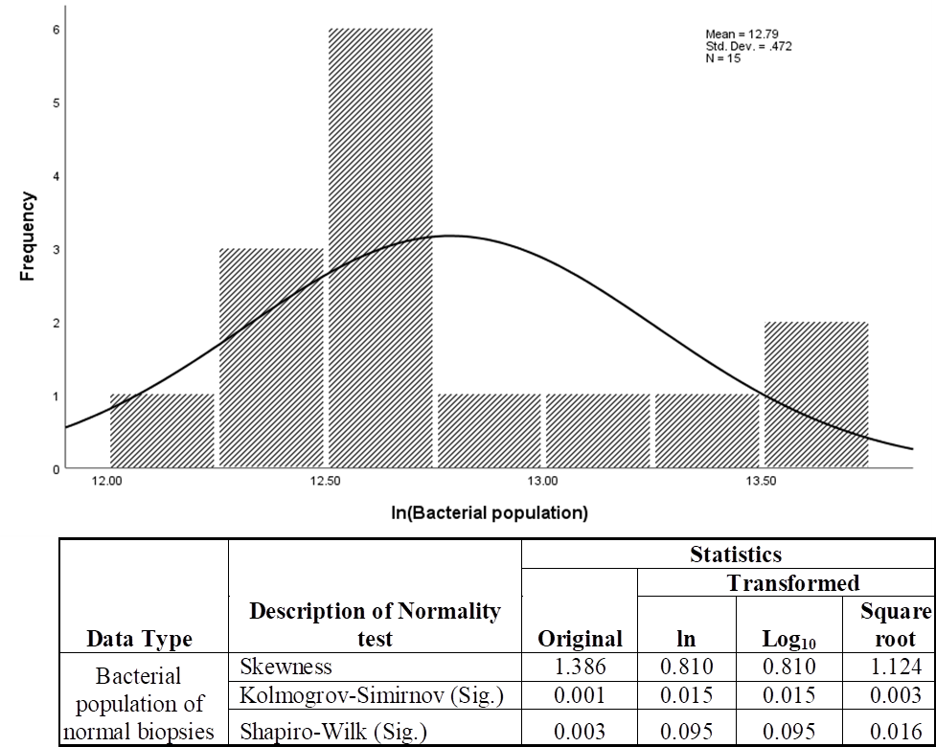
S1 Figure: Normal distribution of bacterial population isolated from adjacent normal biopsies of colorectal cancer patients. Original bacterial population data were transformed using a natural logarithm function (ln) and Pearson r correlation test was performed using transformed data.

Slide 2
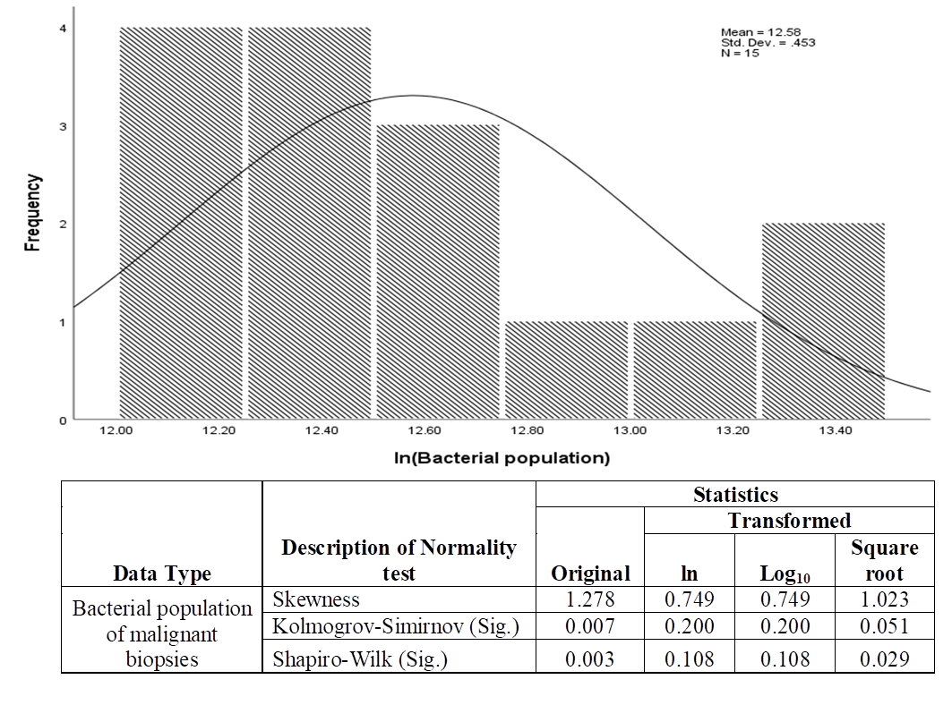
S2 Figure: Normal distribution of bacterial population isolated from malignant biopsies of colorectal cancer patients. Original bacterial population data were transformed using a natural logarithm function (ln) and Pearson r correlation test was performed using transformed data.

