Slide 1
Supplement Figure 1.

Slide 2
S2A.
S2B.
Coprococcus comes
Coprococcus CAG:131
Coprococcus catus
Ruminococcus AF21
Ruminococcus CAG
Ruminococcus CAG
0
Eh-
1
qPCR
2
Cyst
0
Eh-
1
qPCR
2
Cyst
0
Eh-
1
qPCR
2
Cyst
0
Eh-
1
qPCR
2
Cyst
0
Eh-
1
qPCR
2
Cyst
0
Eh-
1
qPCR
2
Cyst
S2C.
Catenibacterium mitsuokai
Catenibacterium sp.co_0103
Catenibacterium CAG
S2D.
Bacteroides sp.3_1
Bacteroides acidifaciens
Bacteroides bouchesdurhonensis
0
Eh-
1
qPCR
2
Cyst
0
Eh-
1
qPCR
2
Cyst
0
Eh-
1
qPCR
2
Cyst
0
Eh-
1
qPCR
2
Cyst
0
Eh-
1
qPCR
2
Cyst
0
Eh-
1
qPCR
2
Cyst
Supplement Figure 2.

Slide 3
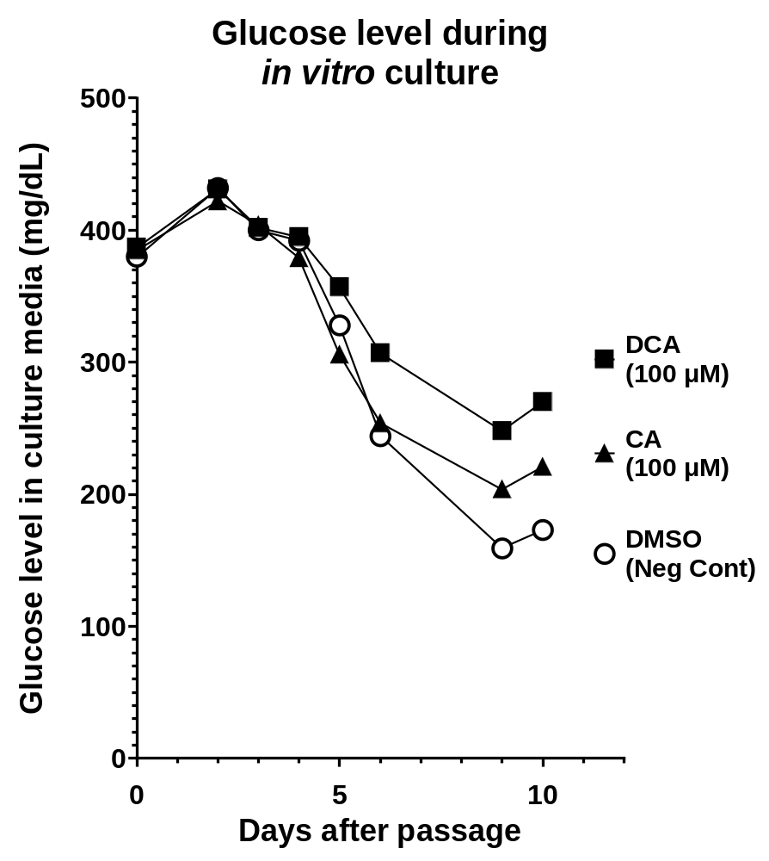
Supplement Figure 3.

Slide 4
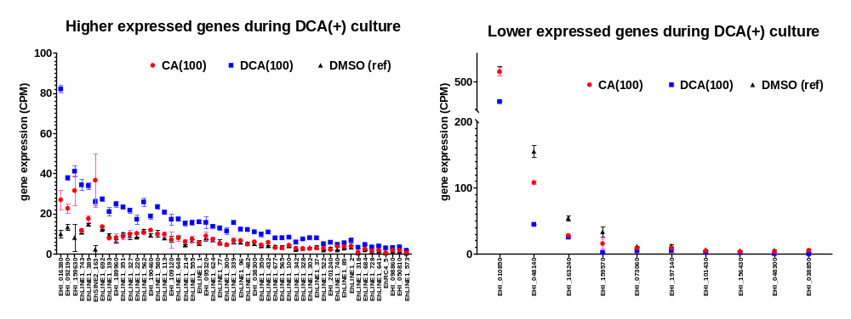
S4A.
S4B.
Supplement Figure 4.

