Slide 1
Wakisaka et al.
Figure S1
Relative abundance
P-Har
M’-OM5
Q-KY74
Q-KY101

Slide 2
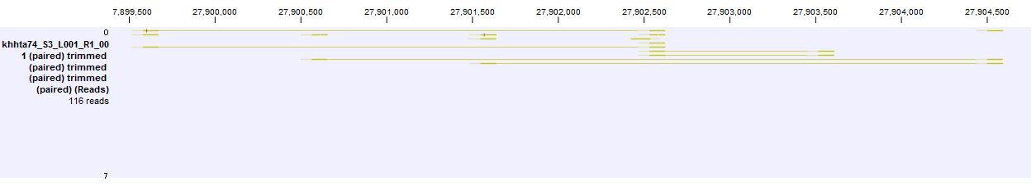
Wakisaka et al.
Figure S2
100F piRNA cluster in chr3R (Q-KY74)
Insertion site of P element

Slide 3
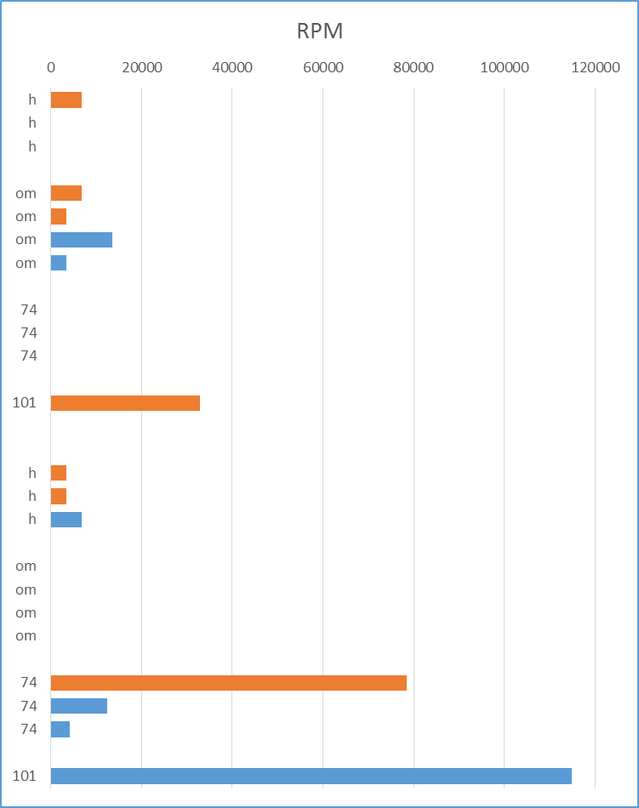
Wakisaka et al.
Figure S3
P elements in
dual-strand clusters unistrand clusters
active piRNA cluster
low activity piRNA cluster
( ) rank of piRNA cluster
(15)
(8)
P-Har
20A-B
100F
(11)
(135)
(15)
(6)
80E-F
M’-OM5
(26)
(20)
100F
(15)
Q-KY74
(56)
(56)
(5)
38C
Q-KY101
(15)
2000 0 0 2000 4000 6000 8000 10000
read numbers
read numbers

Slide 4
Wakisaka et al.
Figure S4
8000
6000
4000
2000
0
antisense
sense
(RPM)
P-element piRNAs
P-Har
M’-OM5
Q-KY74
Q-KY101
father testis

