Slide 1
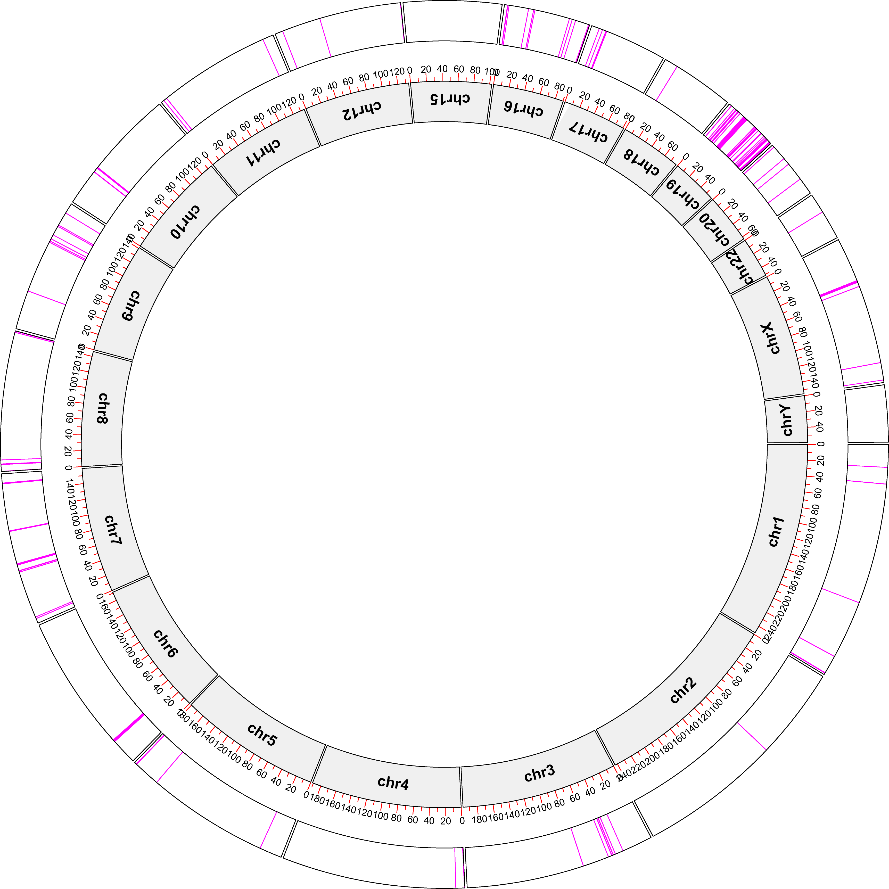
Supplementary Figure 1
KRAB-ZFP genes in human genome

