Slide 1
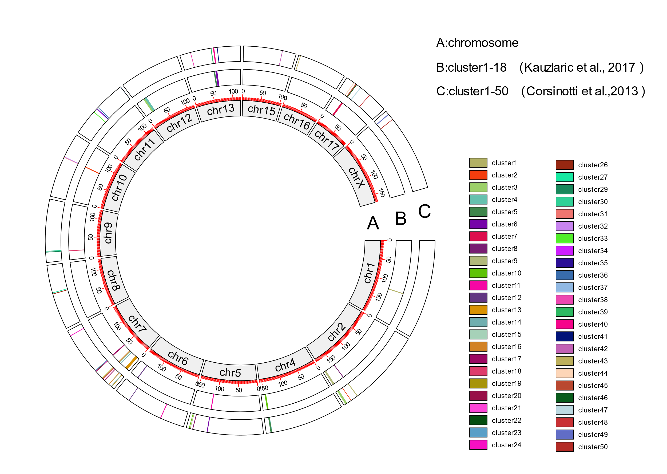

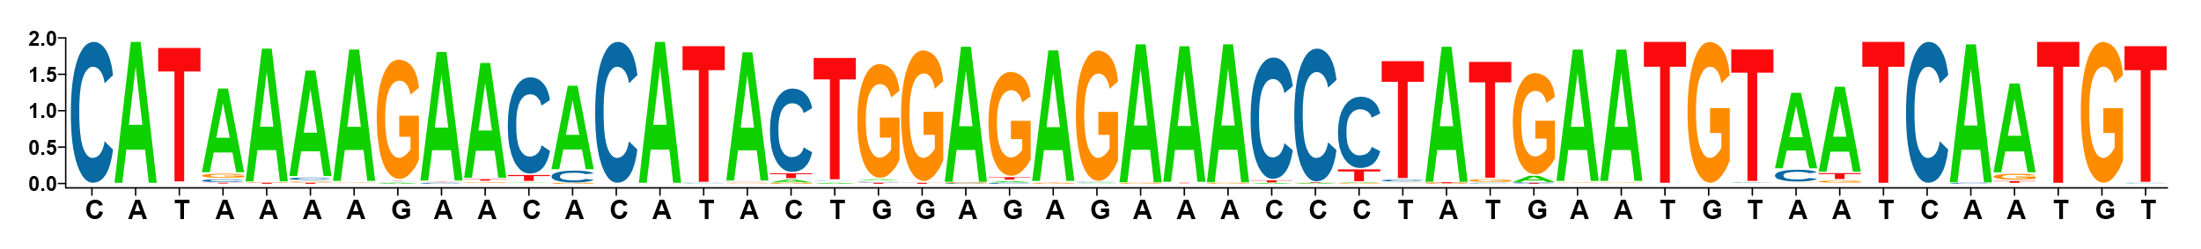
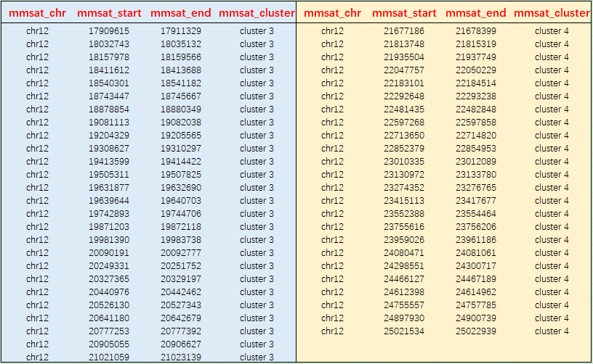
Supplementary Figure 8
A
a. Chromosomal layout
b. All clusters (18) in Ref. 32
(Kauzlaric et al., 2017)
c. All clusters (50) in this work
a
b
c
B
Chr.12; Cluster 3 in [Ref. 32] (No. of KRAB-Zfp/rGUs = 26)
Chr.12; Cluster 4 in [Ref. 32] (No. of KRAB-Zfp/rGUs = 24)
Cluster specific seq.
PAM1
PAM2
Cluster specific seq.

