Slide 1
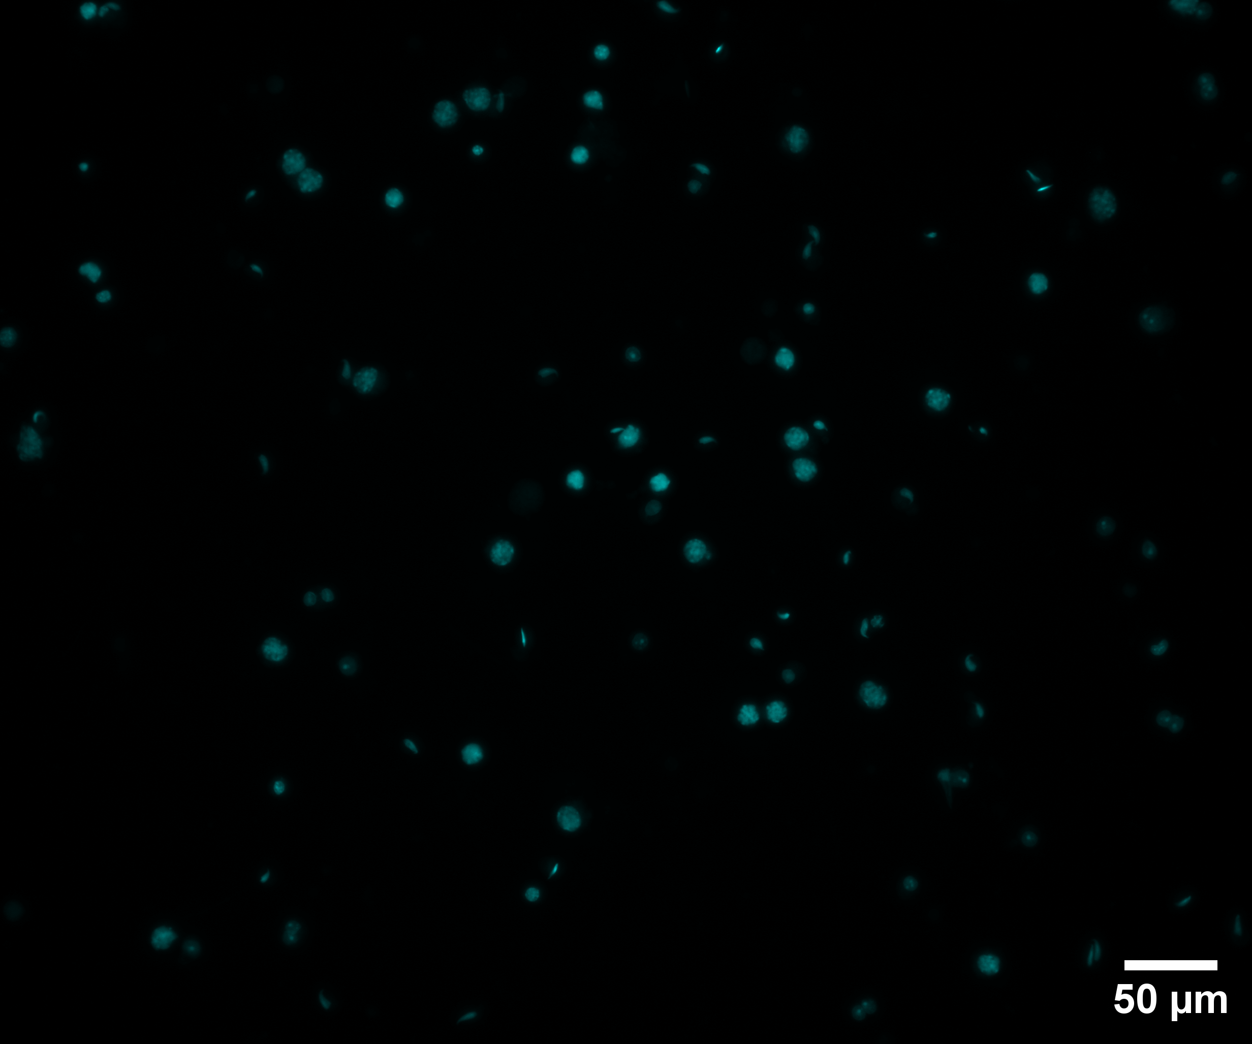
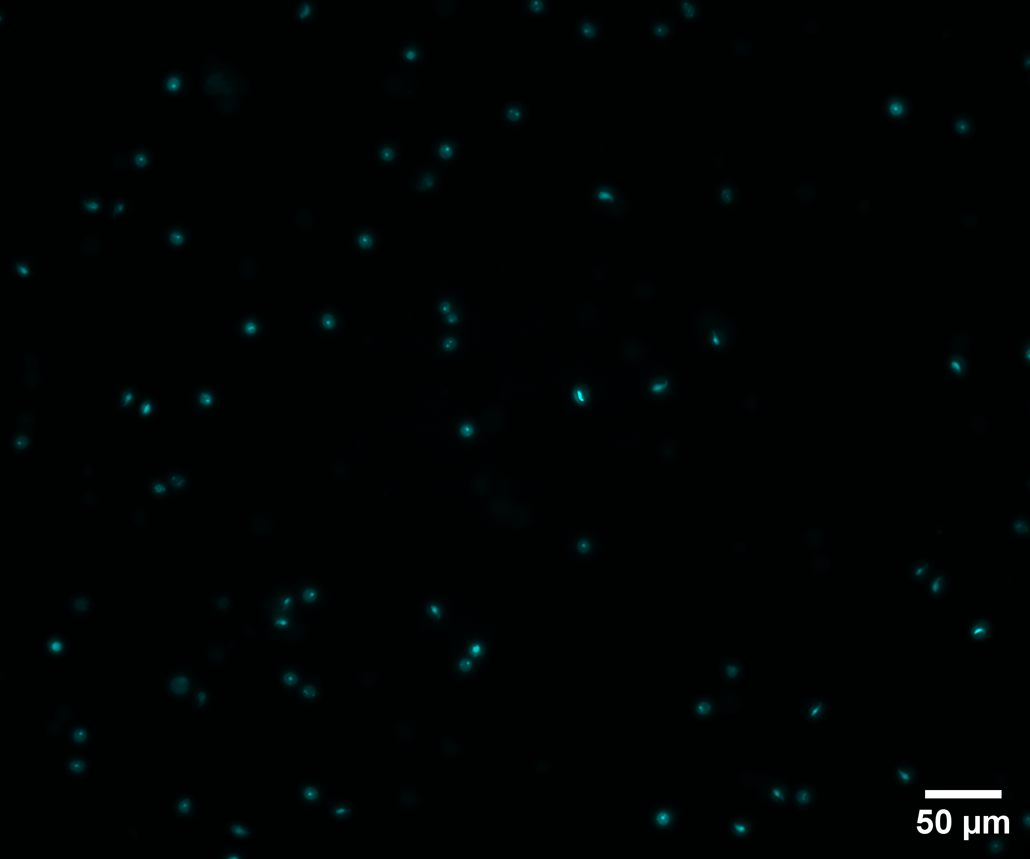
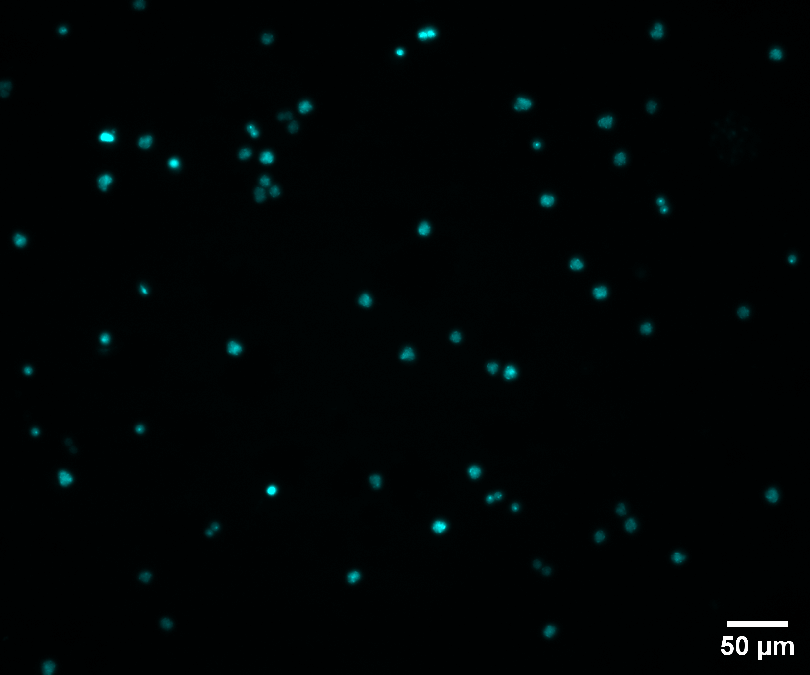
Supplementary Fig. 1. Representative images of A whole testis single cell suspension, B isolated round spermatid (arrow) and C isolated spermatocyte (star) populations following STA-PUT velocity sedimentation. Nuclei stained with Hoechst 33342 for determination of cell type based on nuclear morphology.
a
b
c
Hoechst 33342

Slide 2
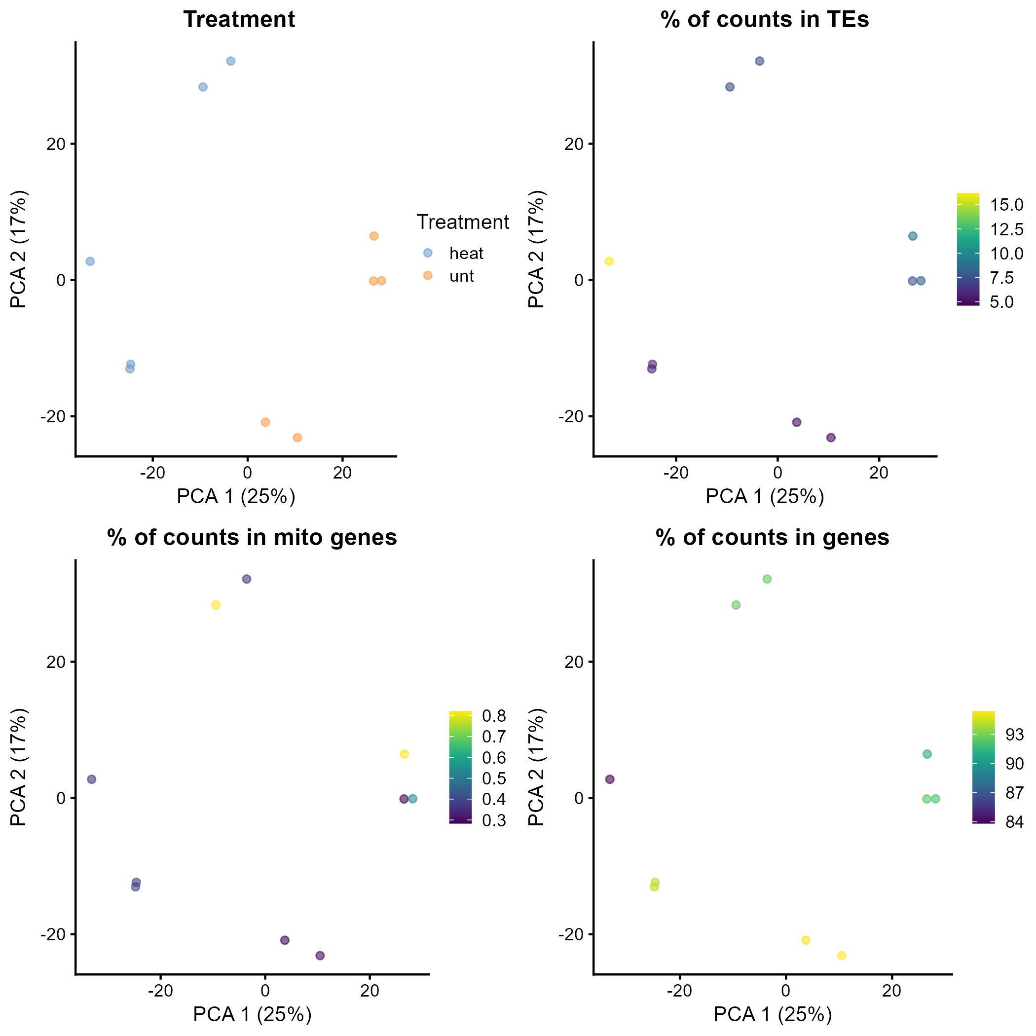
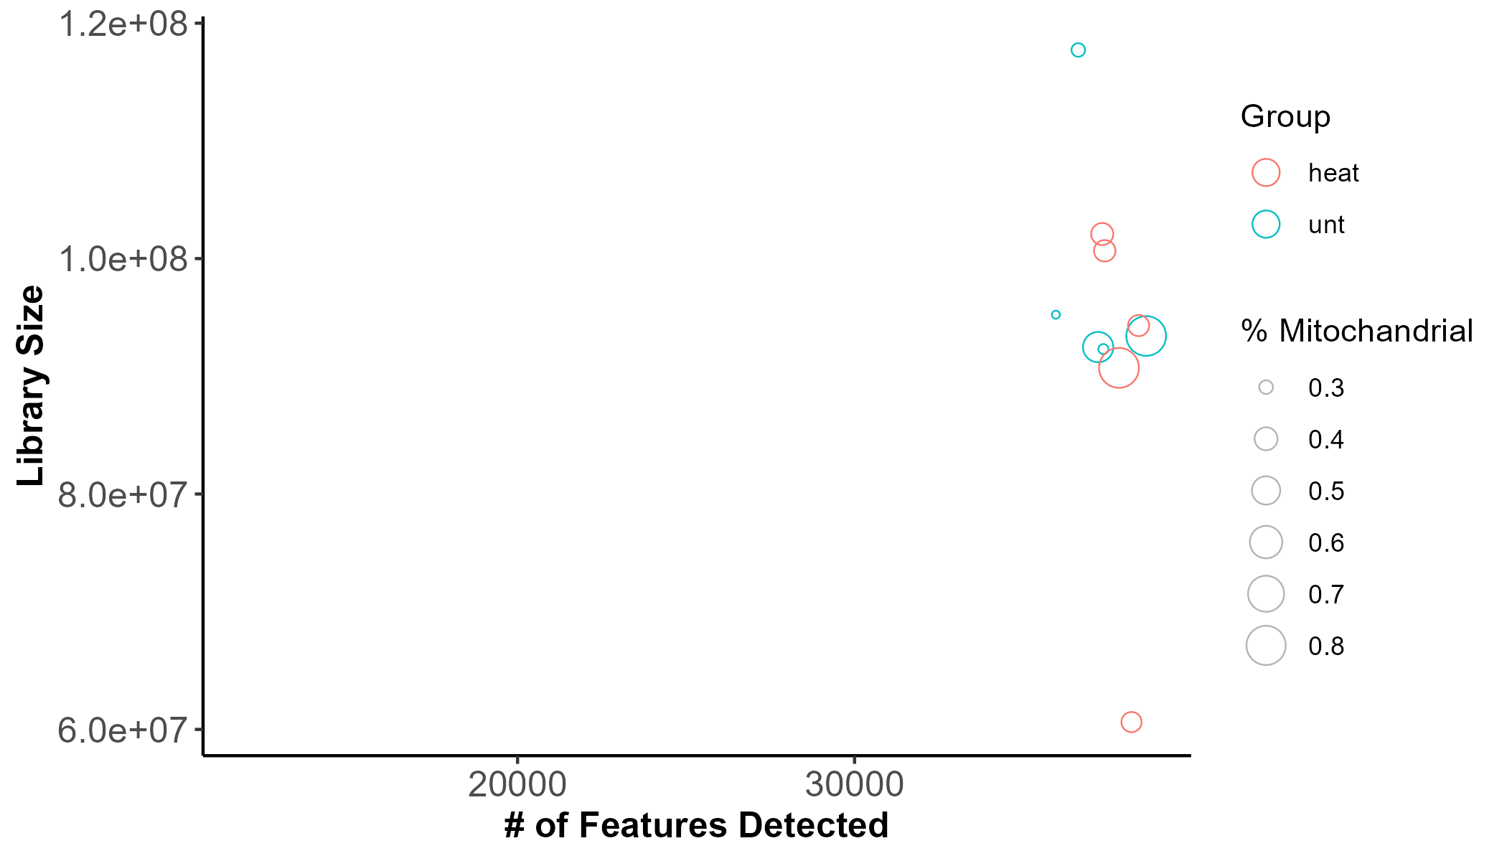
Supplementary Fig. 2. A Principal component analysis of top 500 variable genes shows separation of experimental groups. B-D Percentage counts mapped to TE , mitochondrial genes and genes. E Scatterplot of number of mapped reads, number of features detected, and percentage of features mapped to mitochondrial genes per sample.
a
b
c
d
e

Slide 3
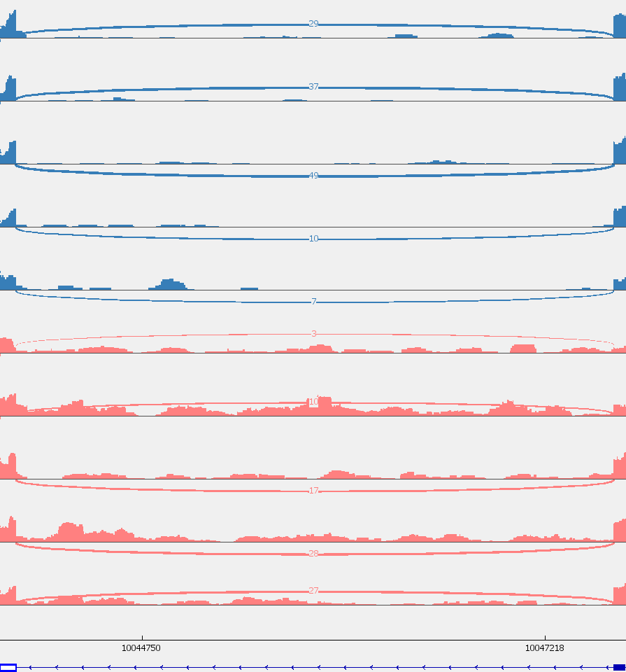
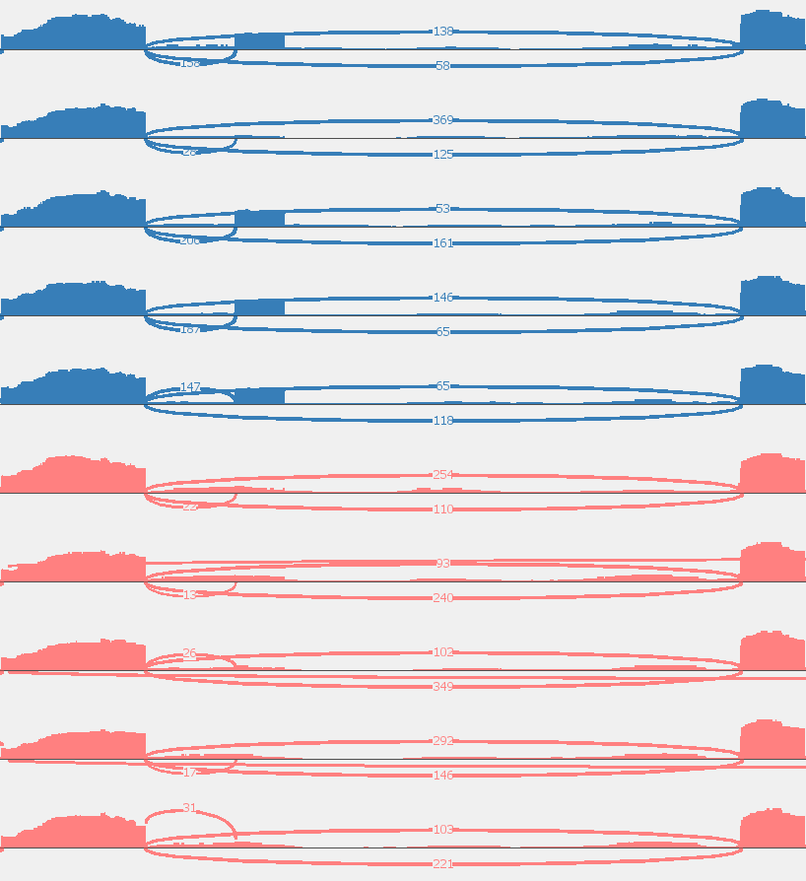
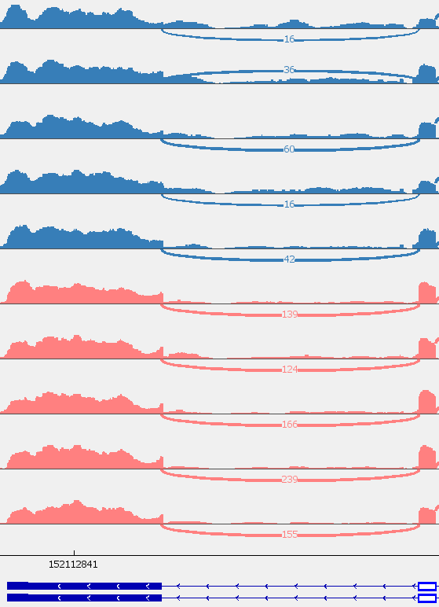
Supplementary Fig. 3. Sashimi plot of LSV events selected for orthogonal confirmation by qPCR. Selected events A gene-Fads2:s:10047636-10047712 ,B gene-4932415M13Rik:s:54035280-54035523 with visible control group intervariability, and C gene-Tas1r1:s:152115201-152115361. Plots generated by Interactive Genomics Viewer (IGV).
a
Fads2 E7-E8 chr19:10,043,879-10,047,712 (-)
0-39
33_1
0-47
33_2
0-66
33_3
0-20
33_4
0-19
33_5
0-32
42_1
0-36
42_2
0-32
42_3
0-51
42_4
0-56
42_5
b
4932415M13Rik E4-E6 chr17:54,035,280-54,036,633 (+)
0-692
33_1
0-900
33_2
0-680
33_3
0-698
33_4
0-553
33_5
0-721
42_1
0-663
42_2
0-897
42_3
0-828
42_4
0-740
42_5
c
Tas1r1 E5-E6 chr4:152,112,371-152,122,947 (-)
0-221
33_1
0-224
33_2
0-310
33_3
0-153
33_4
0-280
33_5
0-389
42_1
0-330
42_2
0-422
42_3
0-610
42_4
0-493
42_5

Slide 4
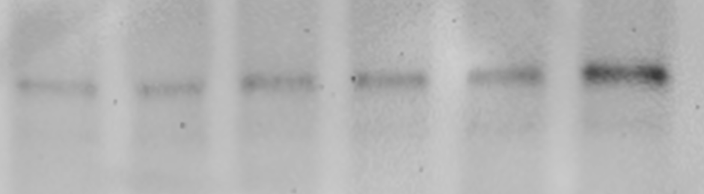
Supplementary Fig. 4. A Relative ORF1p protein abundance increases within heat stressed spermatocytes left and round spermatids right (N=3). B Additional biological replicate blot of ORF1 abundance within heat stressed round spermatids. relevant MW markers shown. Blots were re-probed with α-Tubulin for normalisation (cutout shown below corresponding blot).
a
Spermatocytes
Round Spermatids
33°C
42°C
33°C
42°C
70 kDa
55 kDa
ORF1p (41 kDa)
35 kDa
α-Tubulin (50 kDa)
b
33°C
42°C
70 kDa
55 kDa
ORF1p (41 kDa)
35 kDa
α-Tubulin (50 kDa)

Slide 5
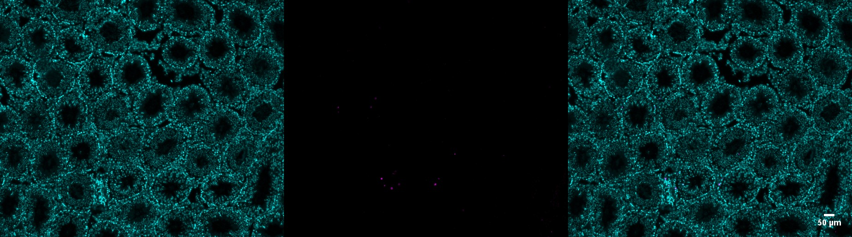
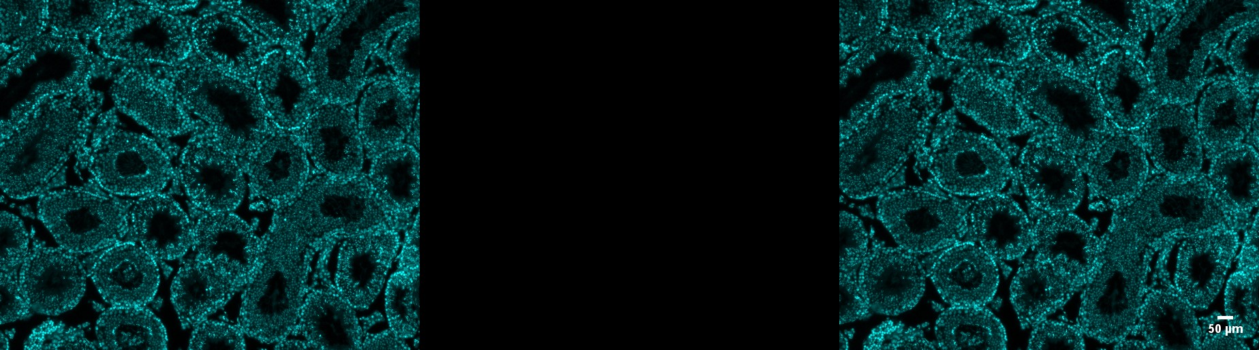
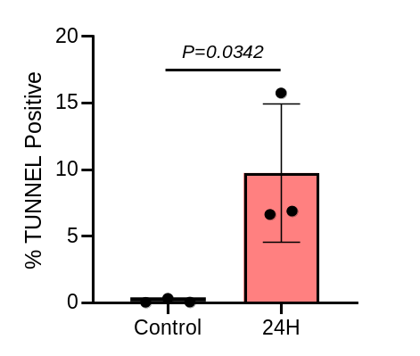
Supplementary Fig. 5. A TUNEL assay performed on testicular sections taken 24H post 30 min 33°C (control) and 42°C (heated) water bath (N=3). Nuclei counterstained with Hoechst 33342. B Percentage TUNEL positive cells increased 24 H post testicular heat stress. P value calculated by student’s t test.
a
Hoechst 33342 TUNEL – Alexa fluor 647 Merge
- TdT 42°C 33°C
b

Slide 6
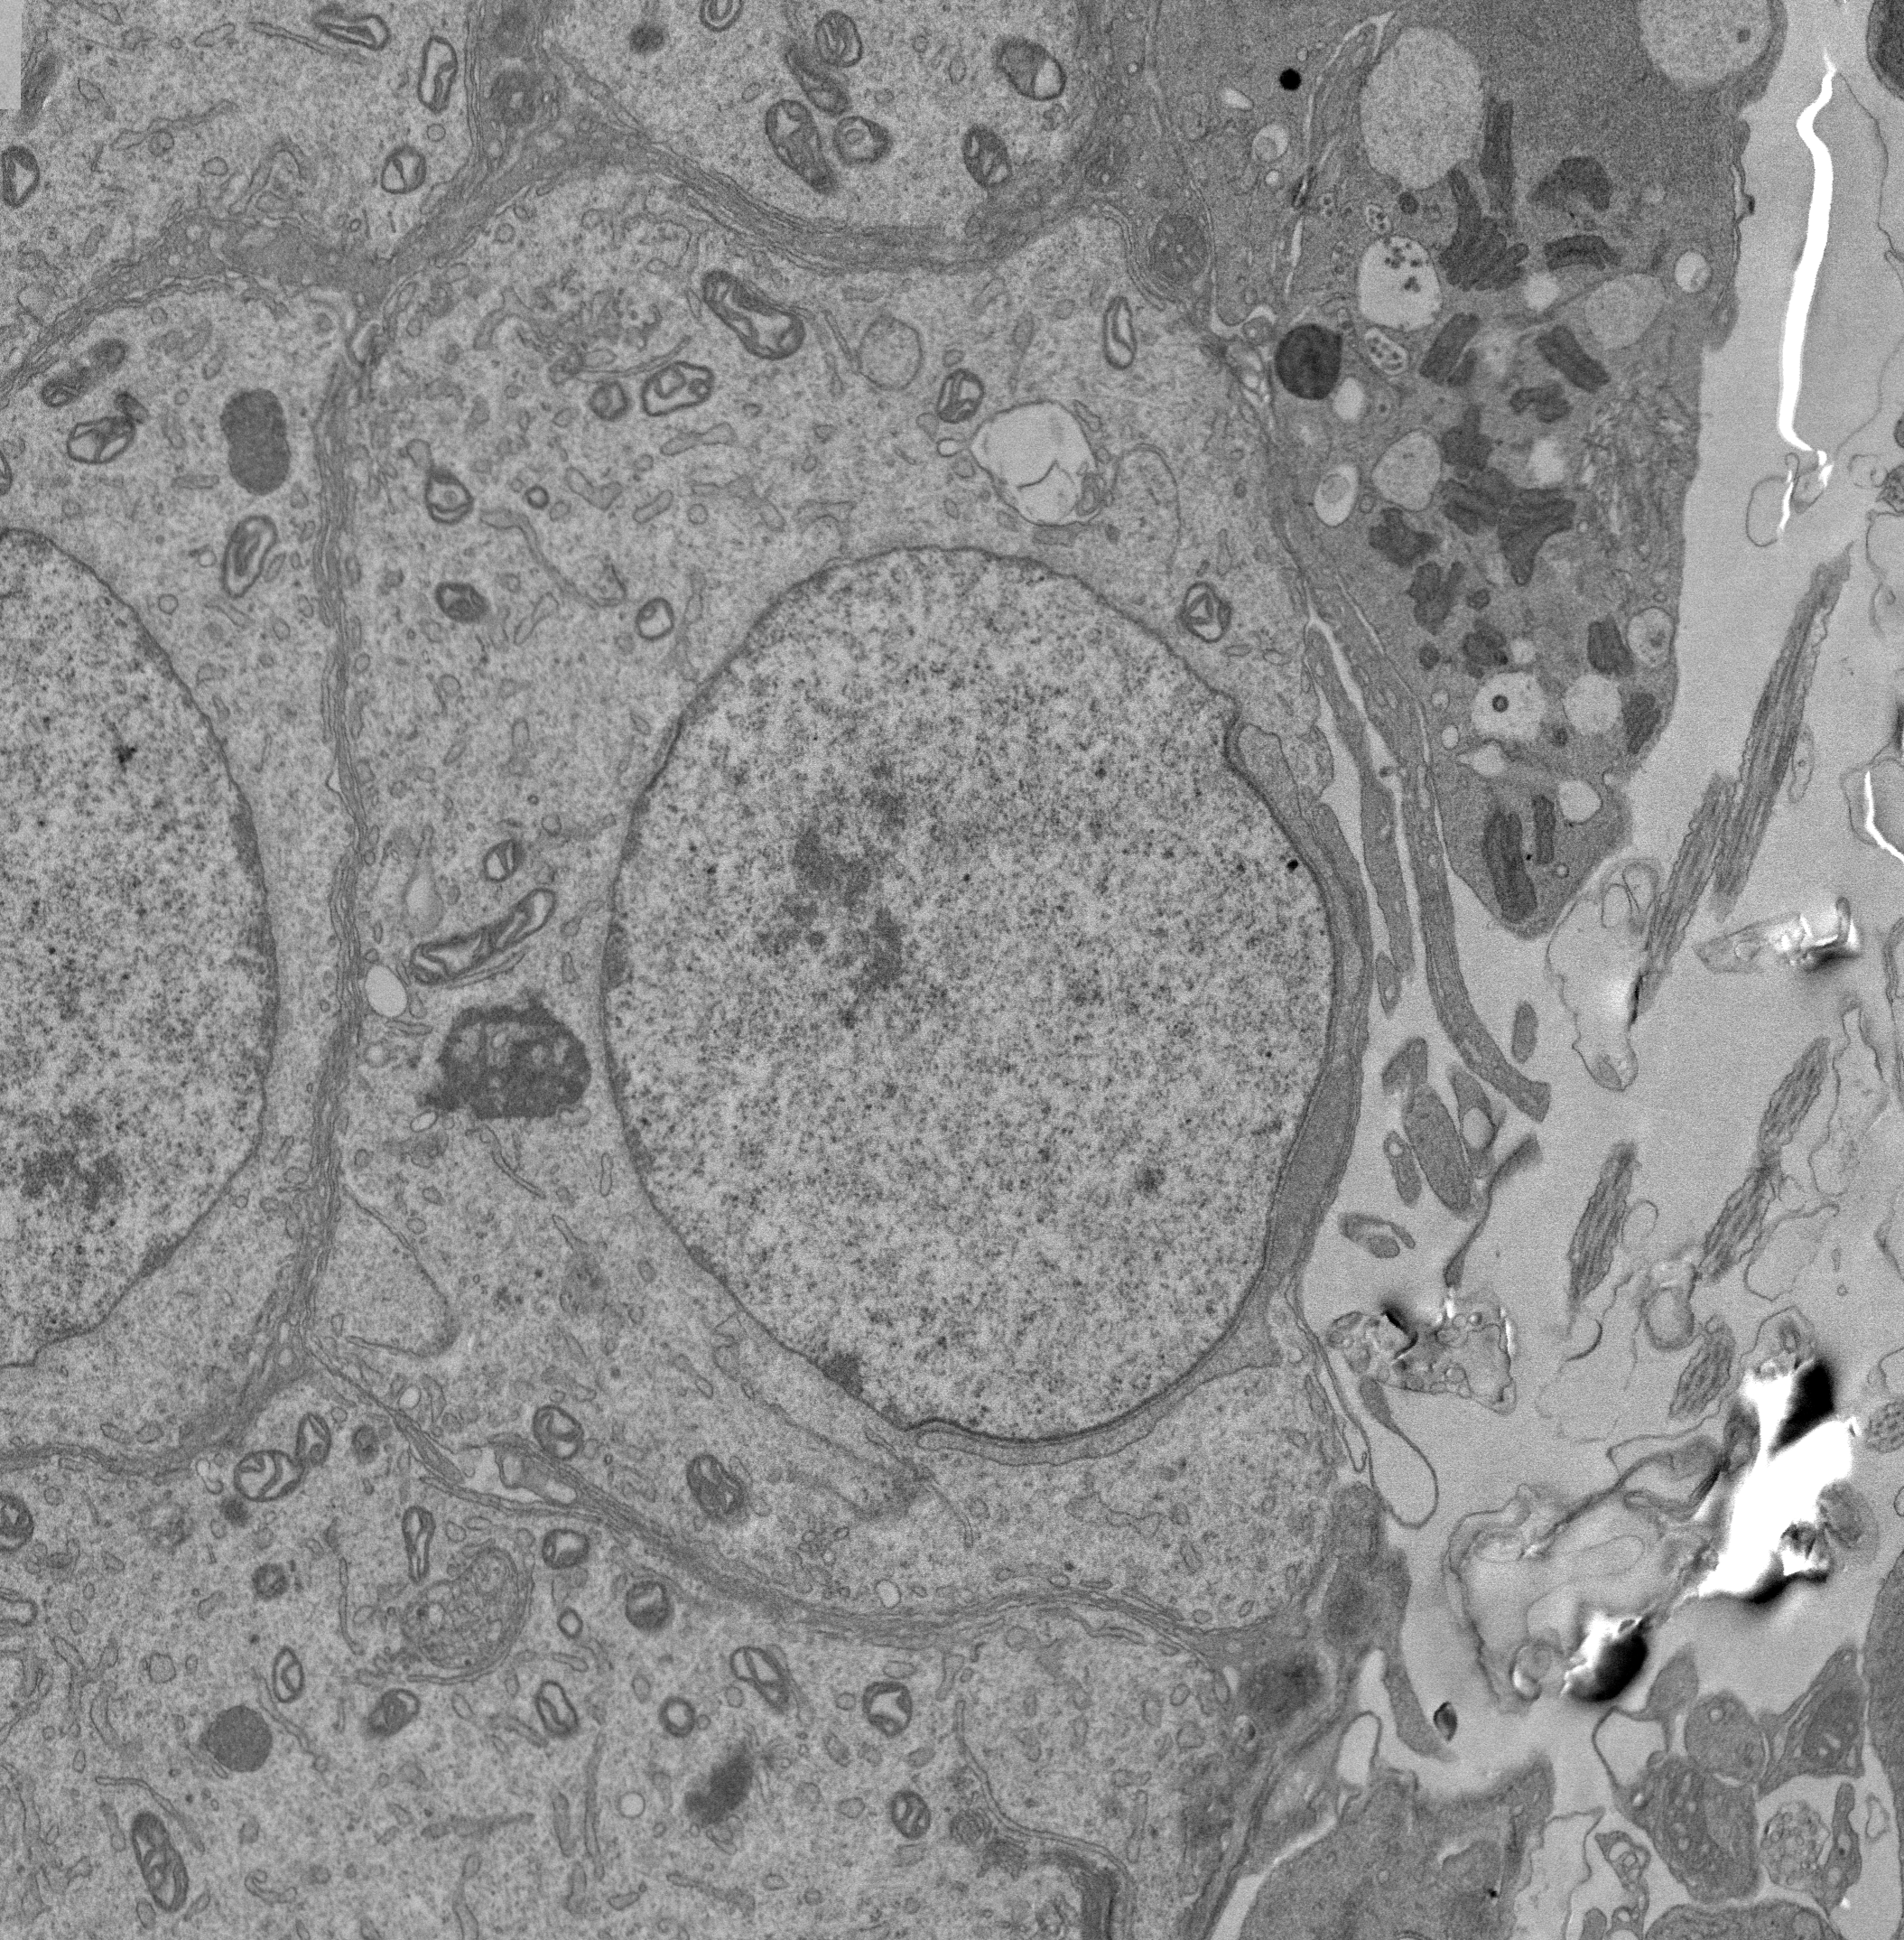
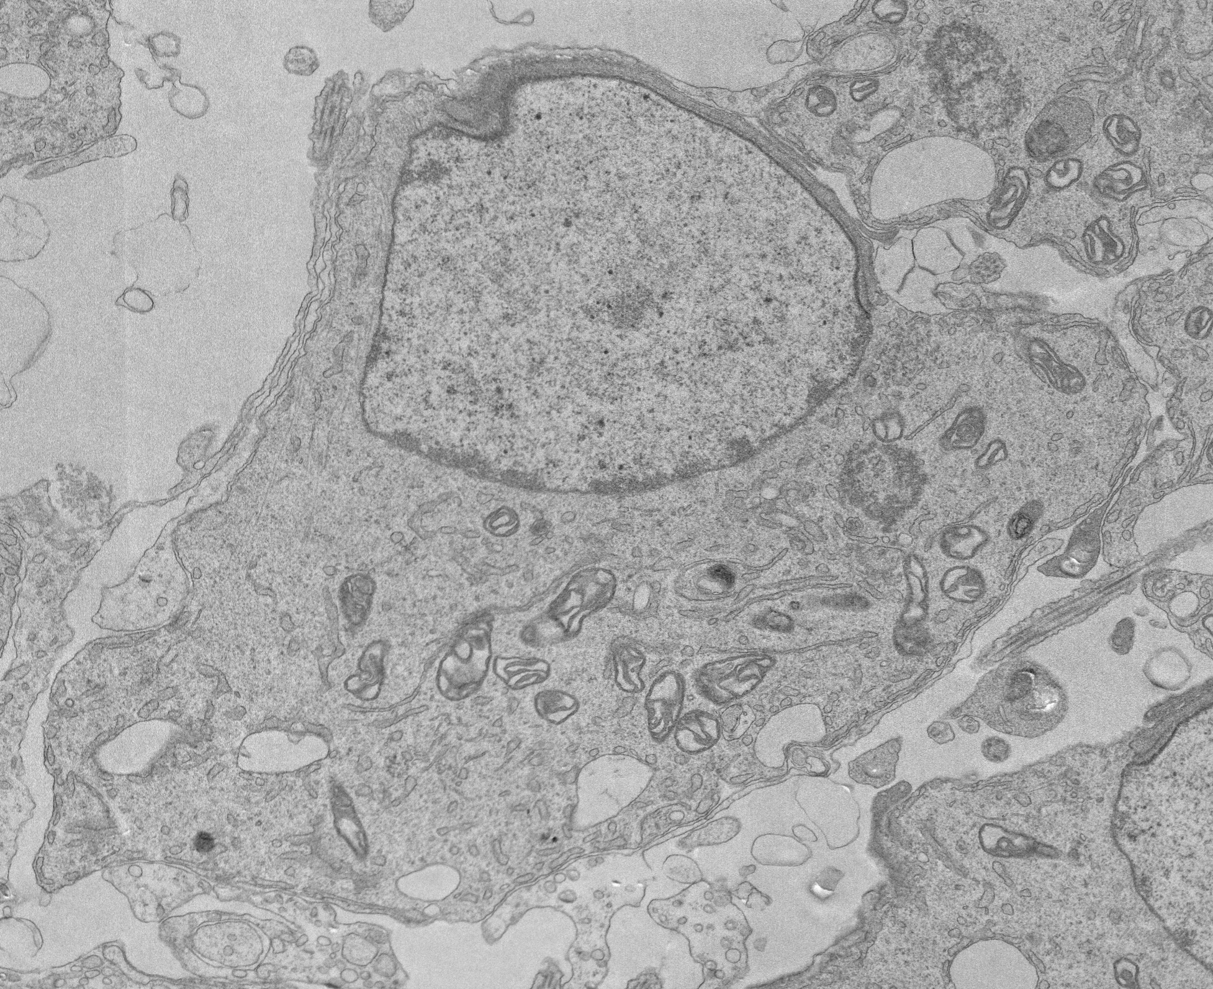
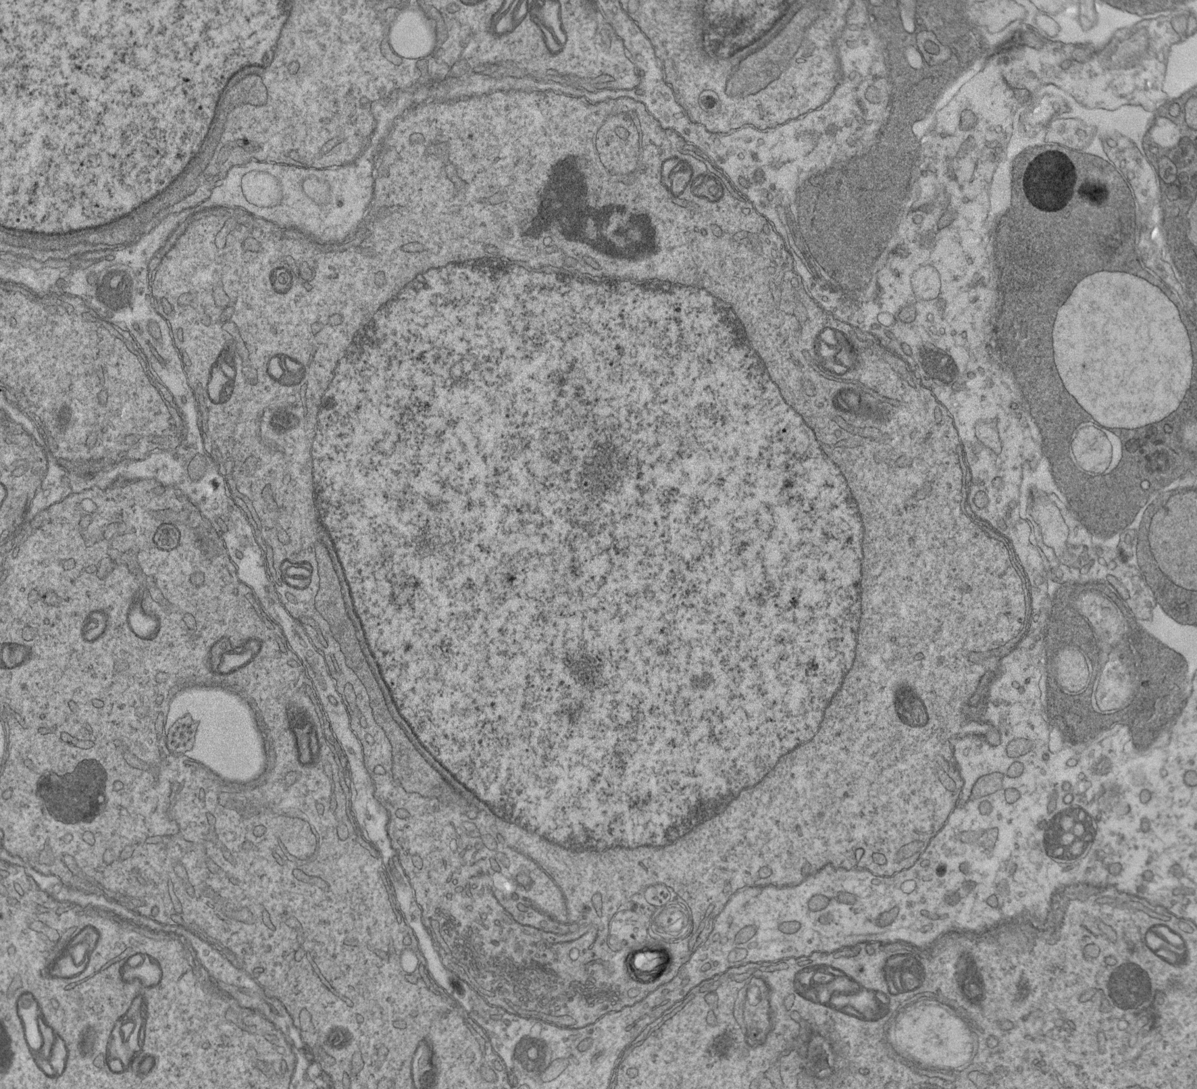
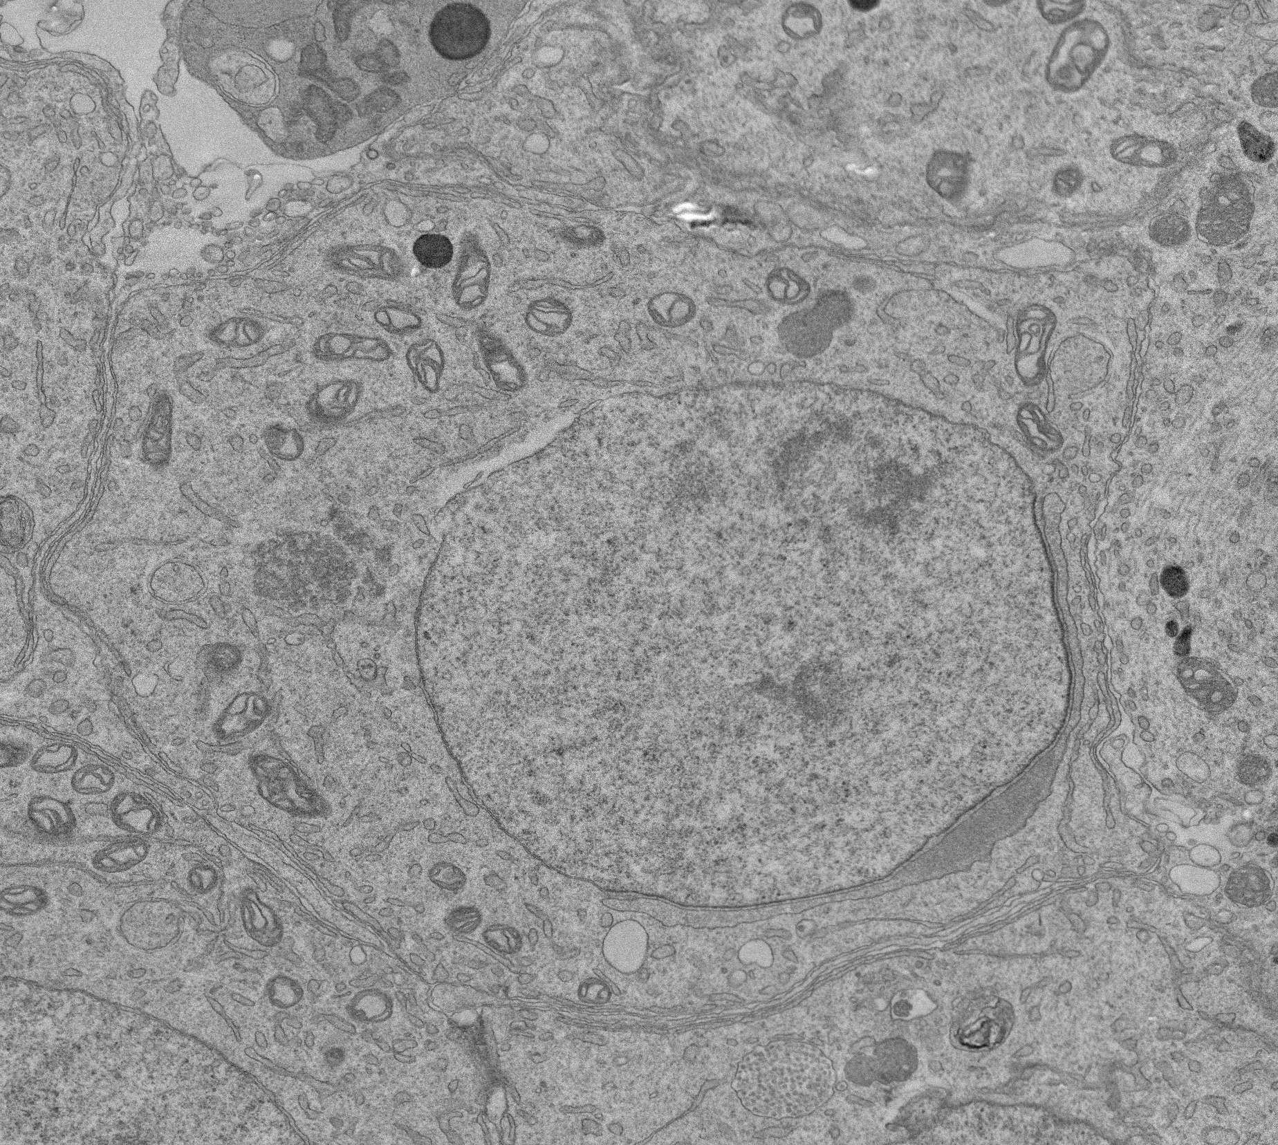
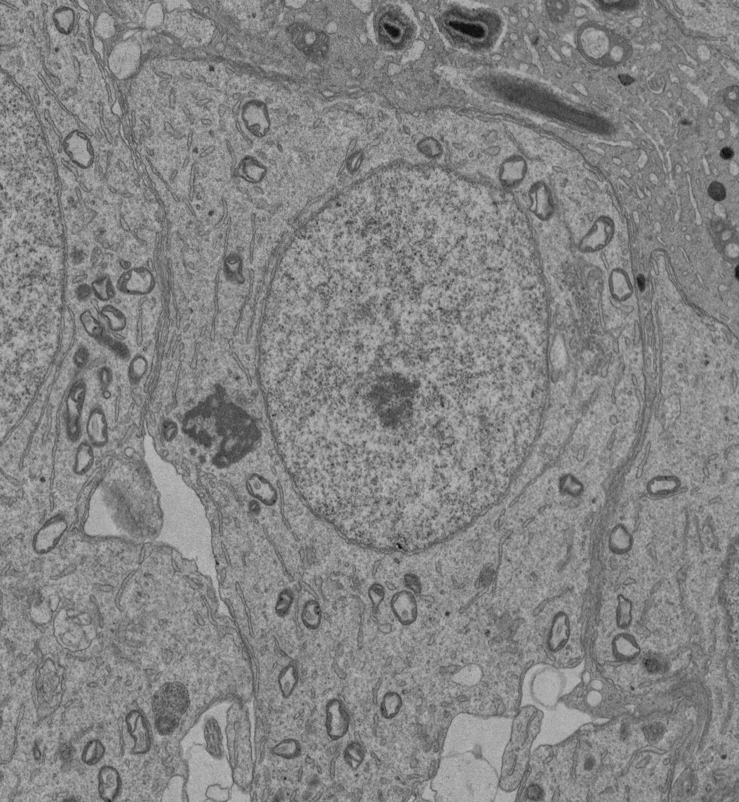
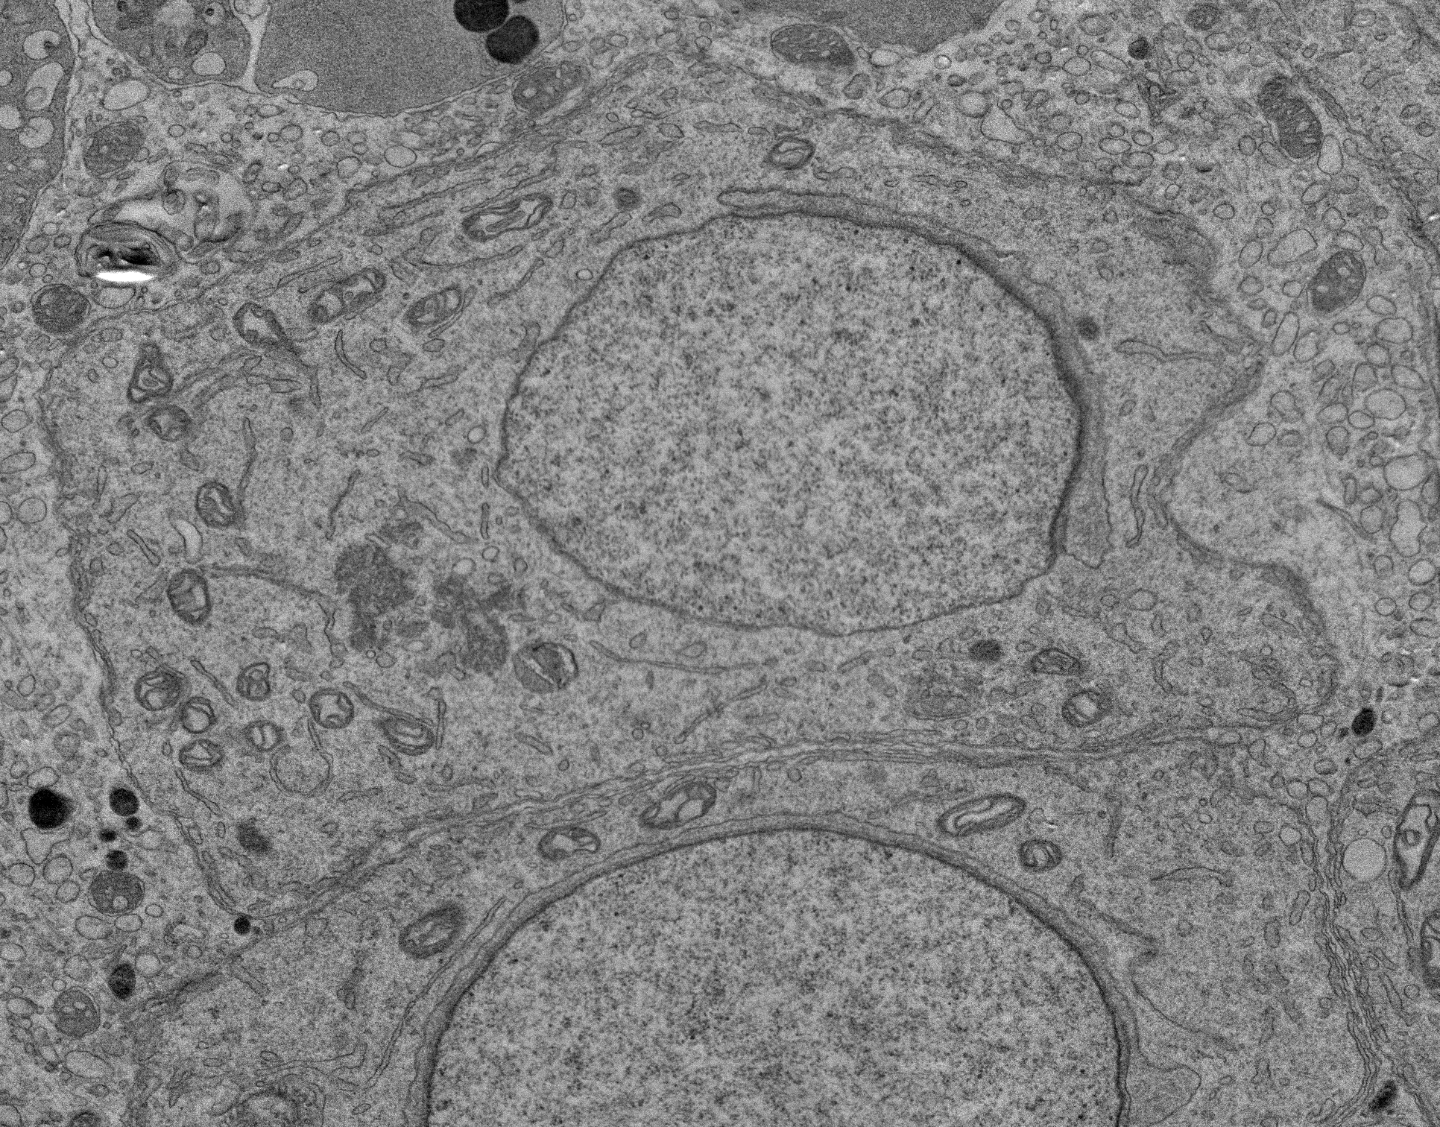
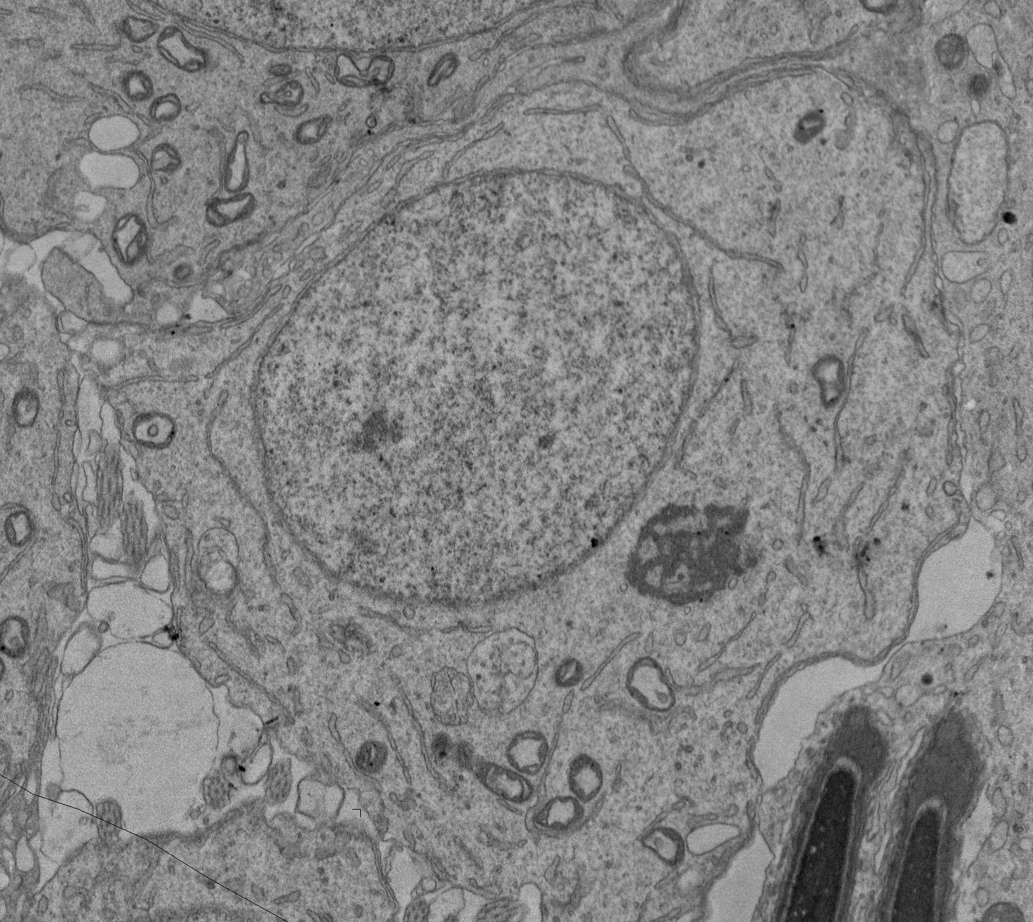
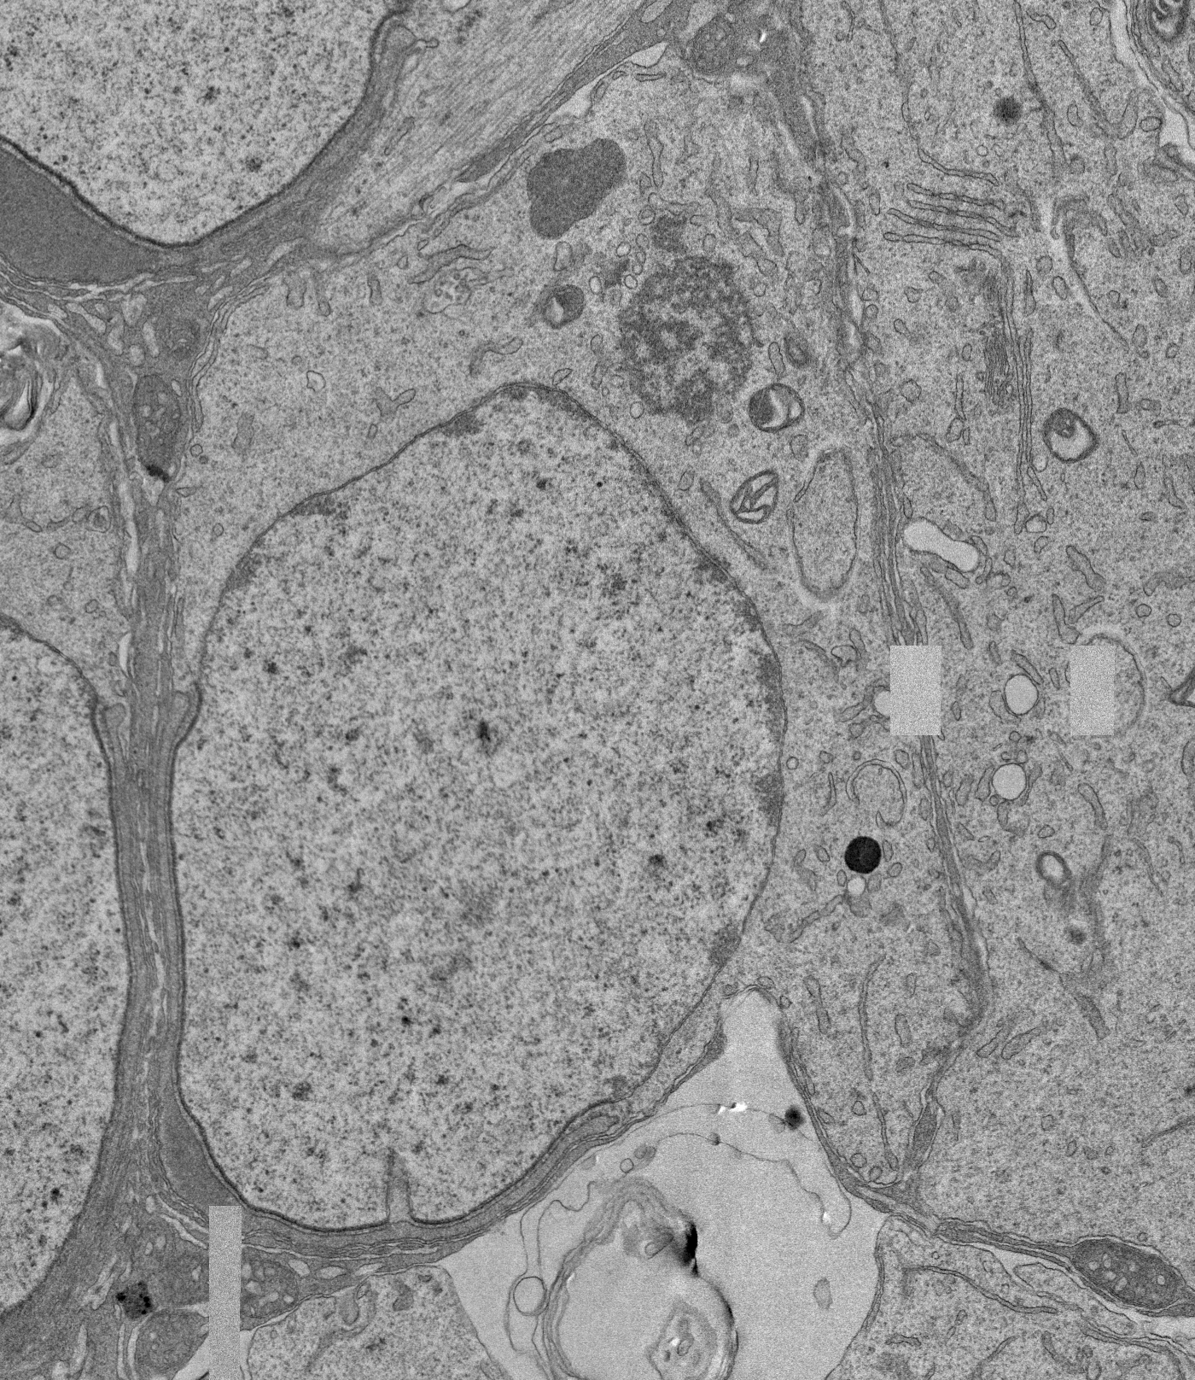
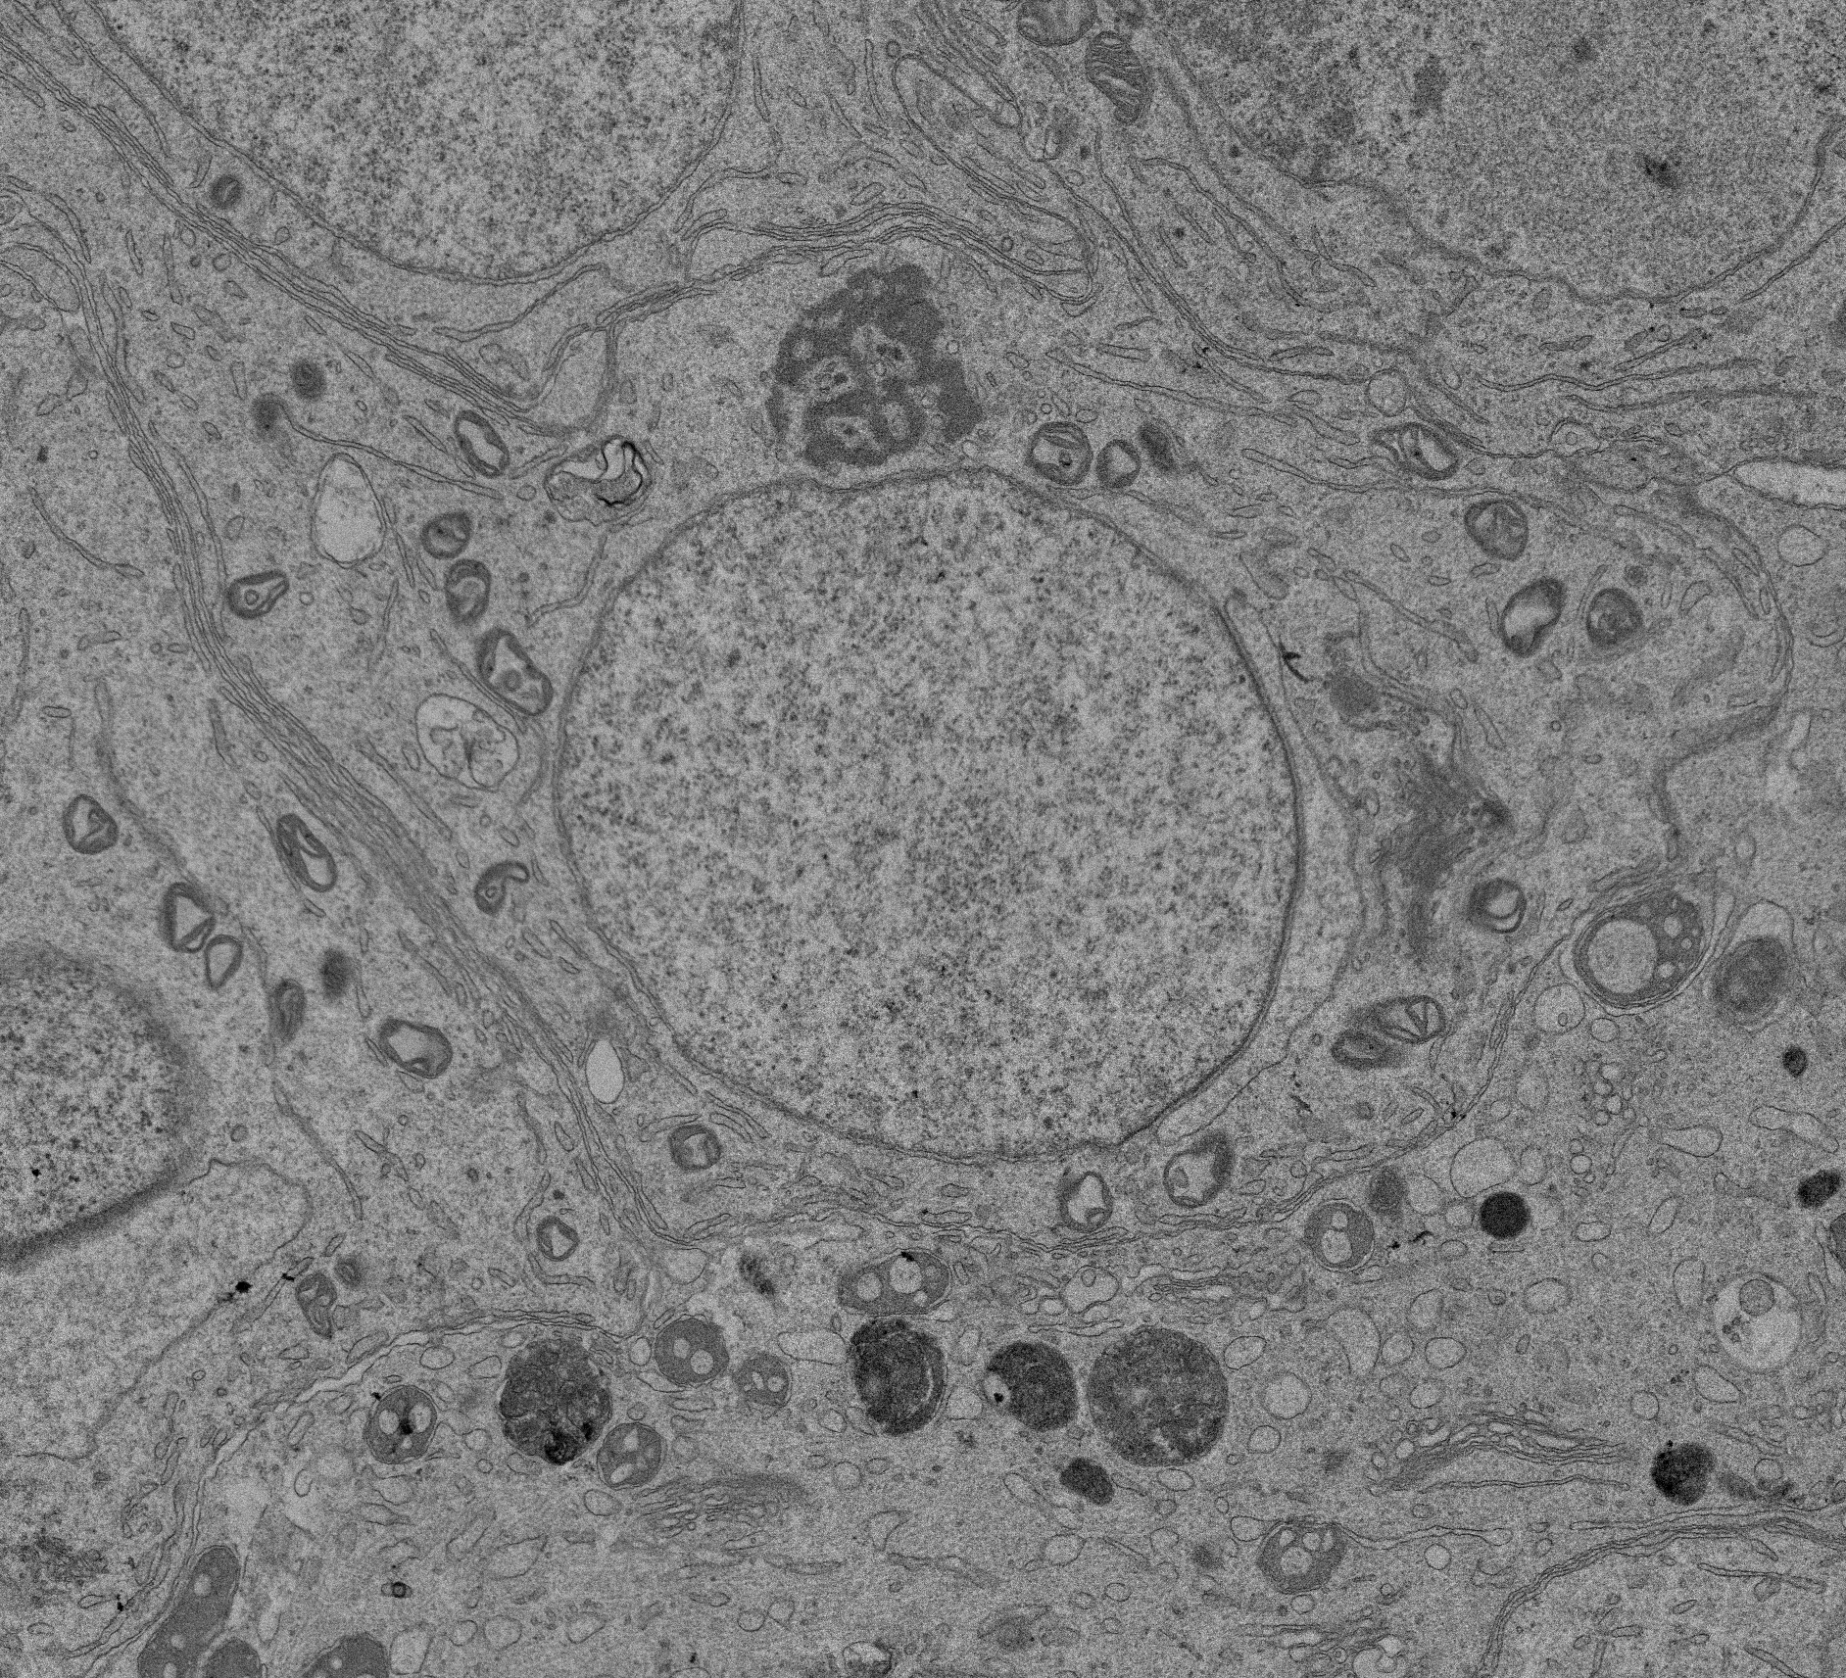
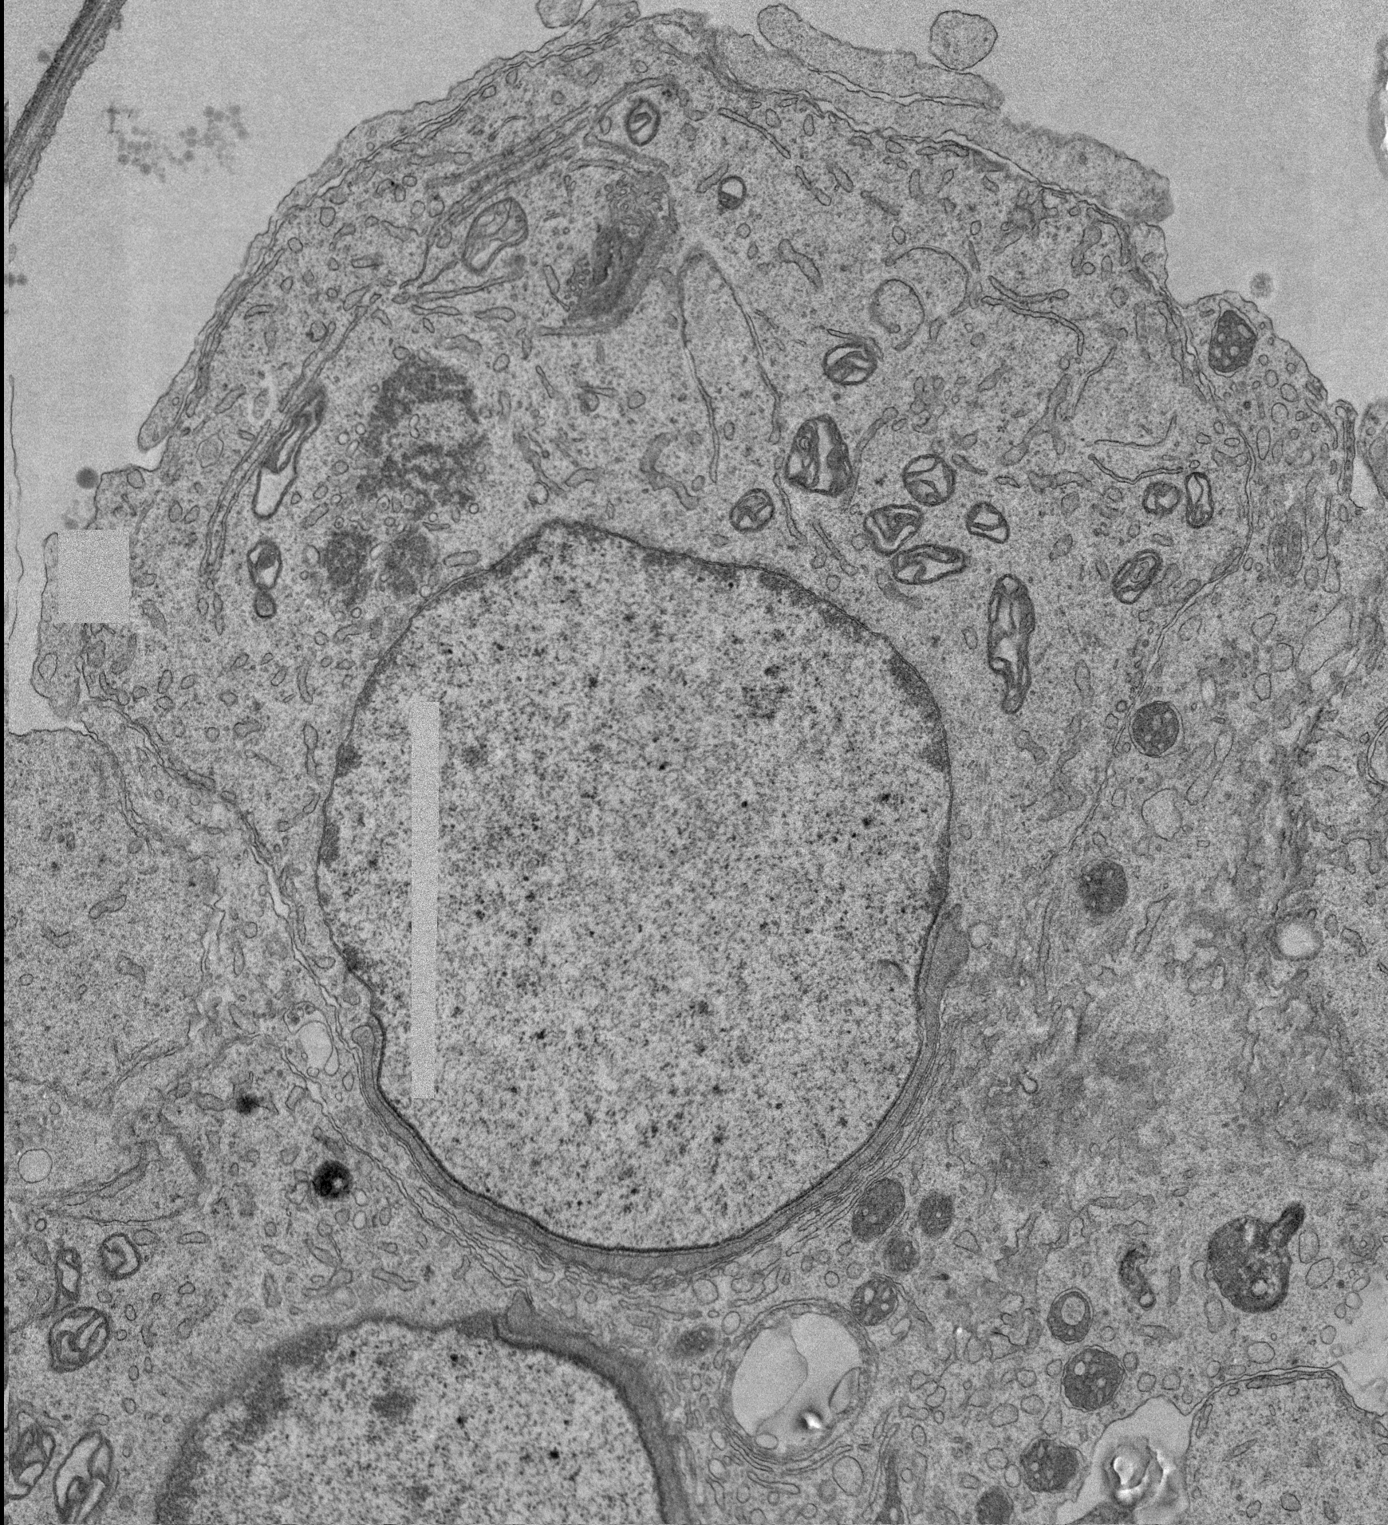
Supplementary Fig. 6. Additional representative electron microscopy images of round spermatids subject to control (33°C) or heat stress (42°C) in vivo, collected 3 hours post exposure. A Following 33°C treatment, the CB (white box) appears as a compact, electron dense structure adjacent to the nucleus (Nu), with the acrosome (Ac) and cytoplasm (Cy) labelled to indicate tubule stage. B Three hours after 42°C heat stress, the CB is dispersed, indicative of disrupted assembly. Enlarged inserts of the CB from control and heat stressed cells are shown, highlighting ultrastructural changes. Images are from one biological replicate per treatment and are representative of CB morphology observed across multiple cells and tubules.
a
33°C 3h
b
42°C 3h
Cy
Ac
Nu
Nu
Ac
Cy
Ac
Cy
Nu
Nu
Cy
Ac
Nu
Cy
Nu
Cy
Ac
Cy
Nu
Cy
Nu
Ac
Ac
Cy
Ac
Nu
Cy
Nu

Slide 7
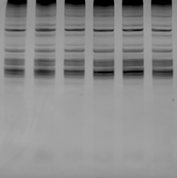


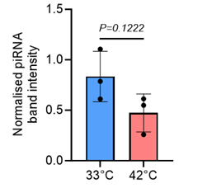
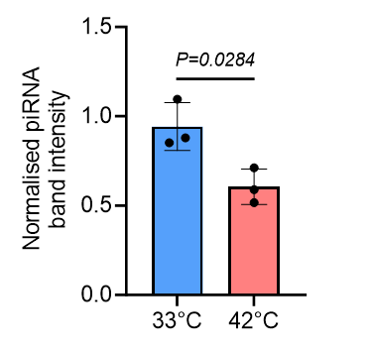
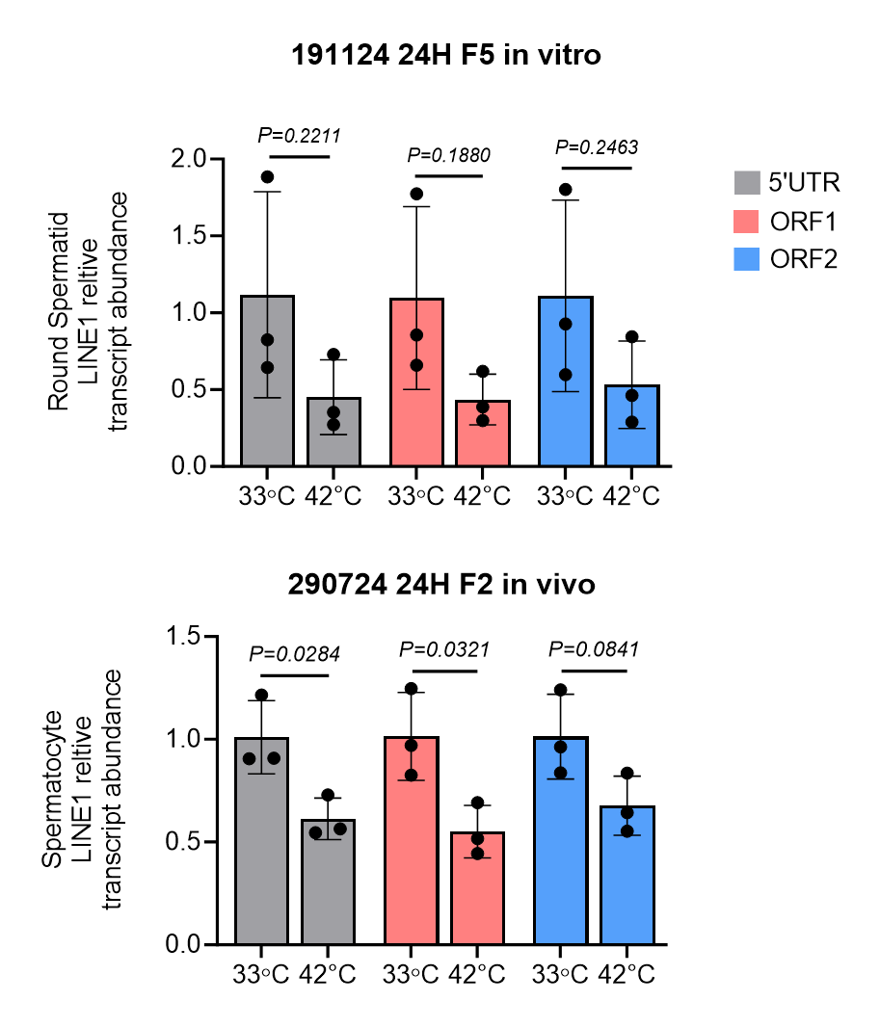
Supplementary Fig. 7. piRNA and LINE1 transcript abundance 24 hours post testicular heat stress. piRNA levels do not significantly differ from control in A round spermatids or B spermatocytes at 24 hours post testicular heat stress (N=3), enlarged image of piRNA band (dotted line) used for quantification is shown. qPCR quantification of LINE1 shows transcript abundance is not significantly changed in C round spermatids, whereas D 5’UTR and ORF1 primer pairs show reduction in LINE1 abundance in spermatocytes at 24 hours post heat stress (N=3). P value calculated by student’s t test.
a
33°C
42°C
b
33°C
42°C
piRNA
33°C
42°C
piRNA
33°C
42°C
piRNA
piRNA
c
d

