Slide 1
SUPPLEMENTARY FILE S1.
Visualization of the gene fragments after allelic discrimination and agarose gel electrophoresis.
Contents
Figure S1. ACTN3 Allelic discrimination plot
Figure S2. Visualization of the ACE gene fragments after agarose gel electrophoresis.
Figure S3. Visualization of the BDKRB2 gene fragments after agarose gel electrophoresis.
Figure S4. Visualization of the AGT gene fragments after agarose gel electrophoresis.

Slide 2
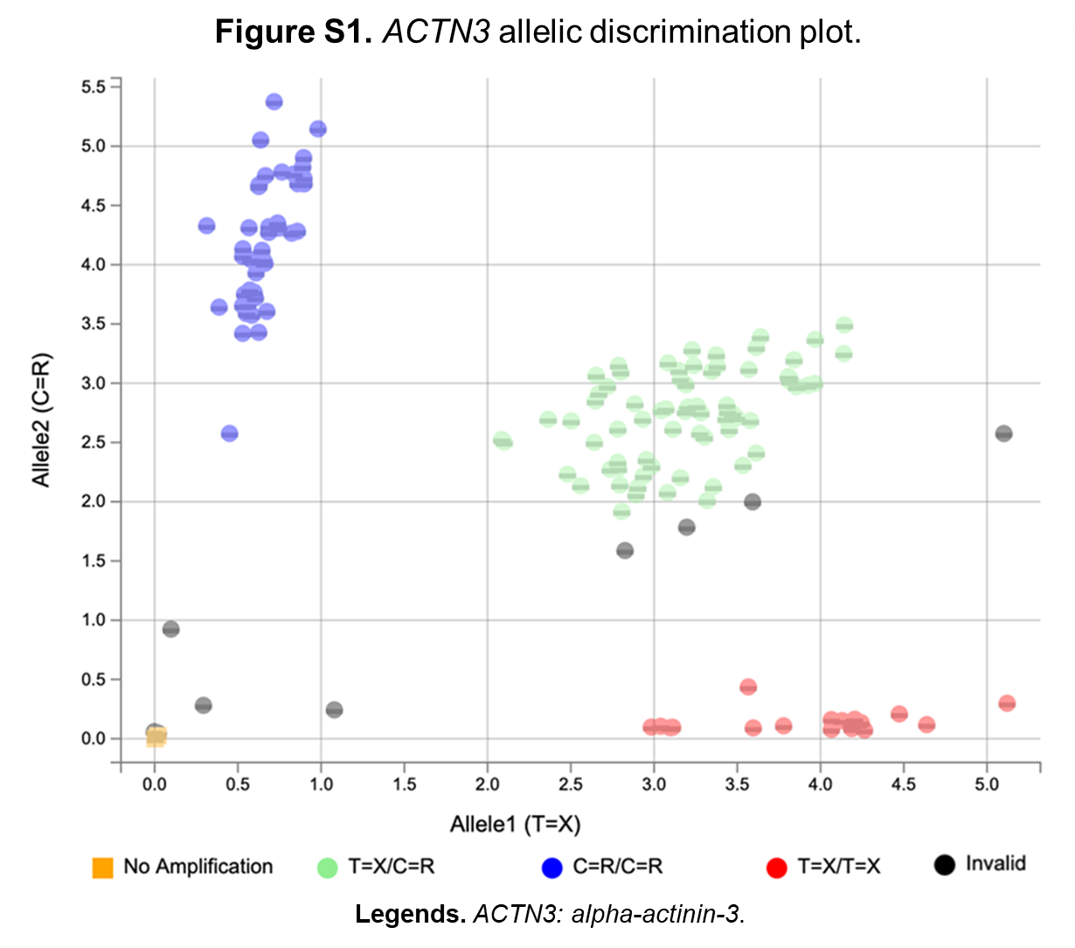

Slide 3
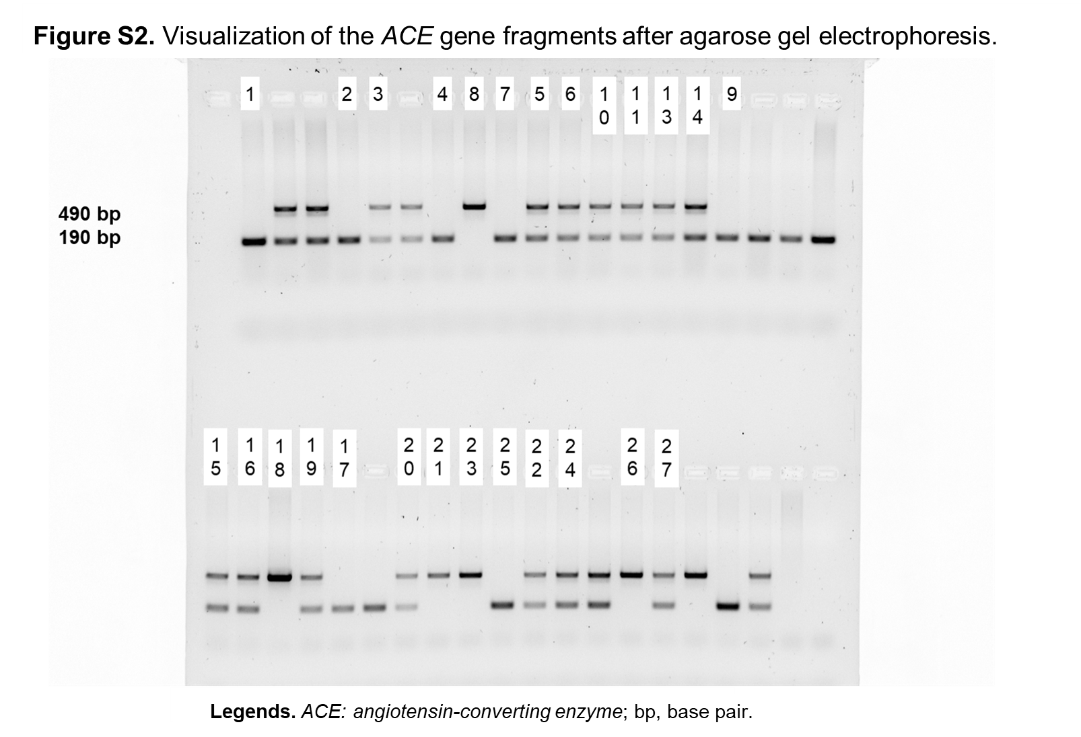

Slide 4
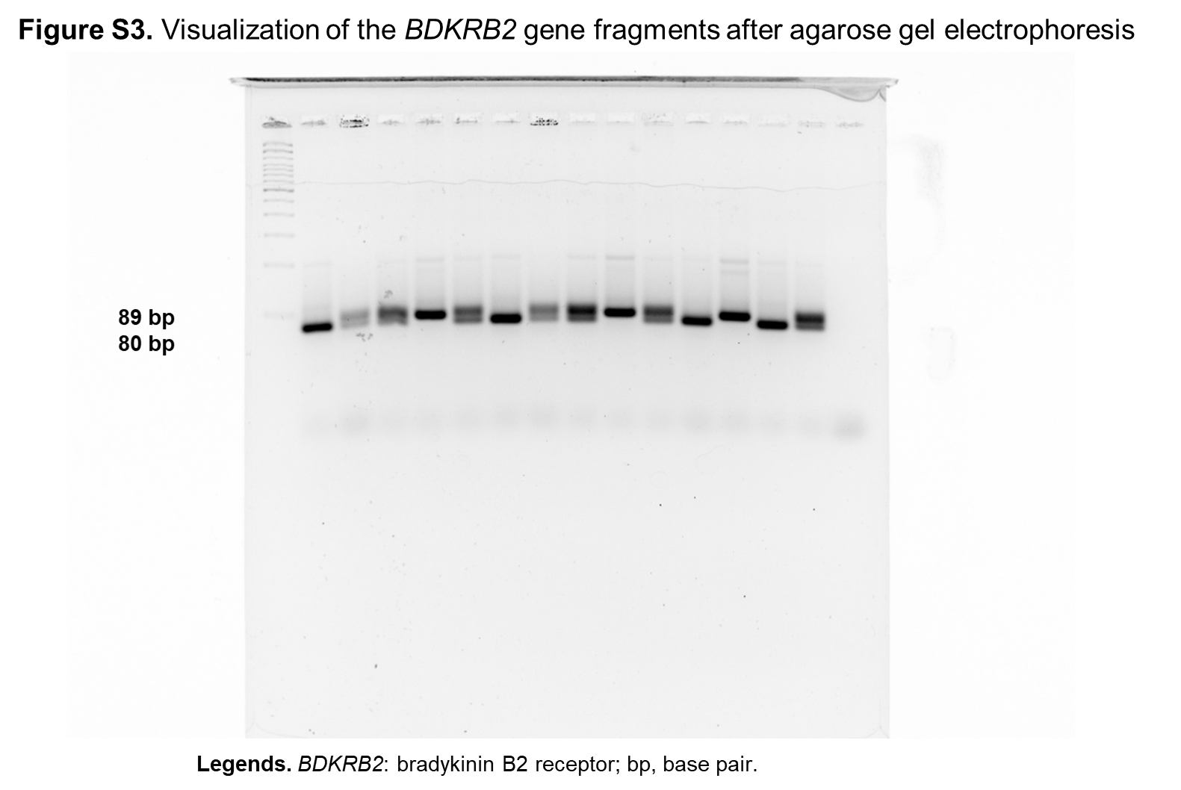

Slide 5
