Slide 1
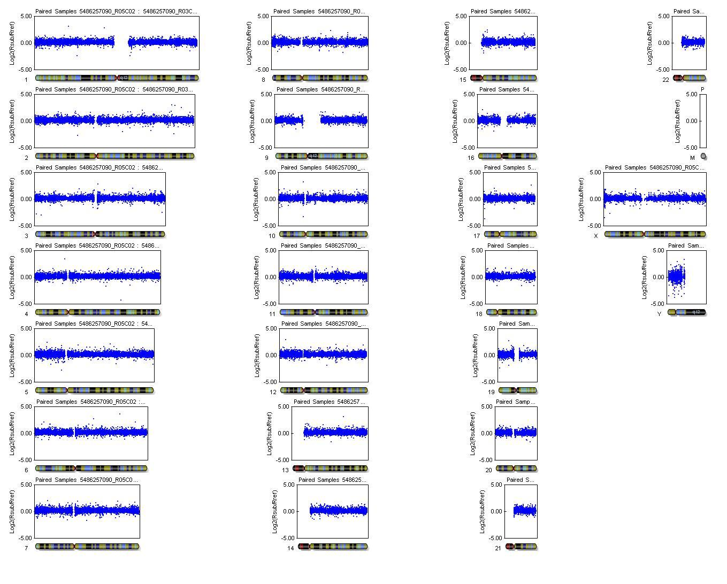
1
8
15
22
2
9
16
3
10
17
X
4
11
18
5
12
19
6
13
20
7
14
21
KB10460 IPS colony 1
Notes:
Additional file 2A. ppy60ips1vsfib log2R

Slide 2
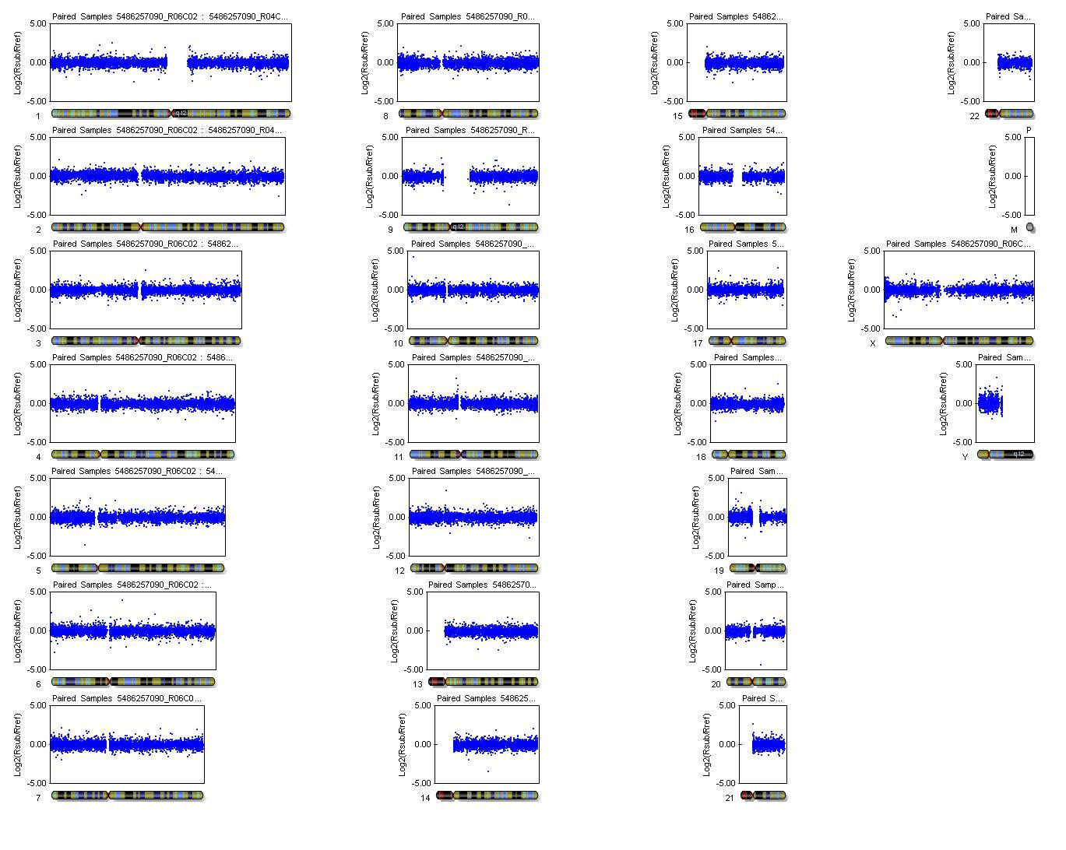
1
8
15
22
2
9
16
3
10
17
X
4
11
18
Y
5
12
19
6
13
20
7
14
21
KB10973 iPS colony 1
Notes:
Additional file 2B. ppy73ips1vsfib log2R

