Slide 1
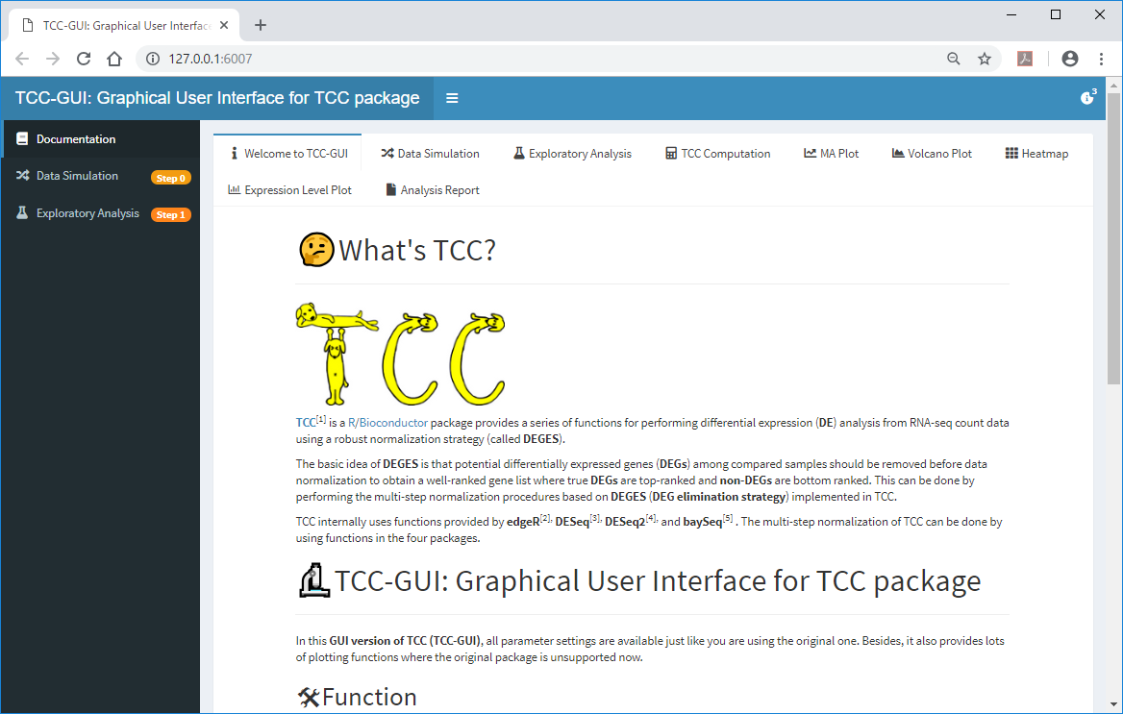
Step 1: Upload
  ①The Bottomly’s count data (bottomly count_table.txt) can be obtained here and imported in ②Step 1.
②
①
http://bowtie-bio.sourceforge.net/recount/countTables/bottomly_count_table.txt

Slide 2
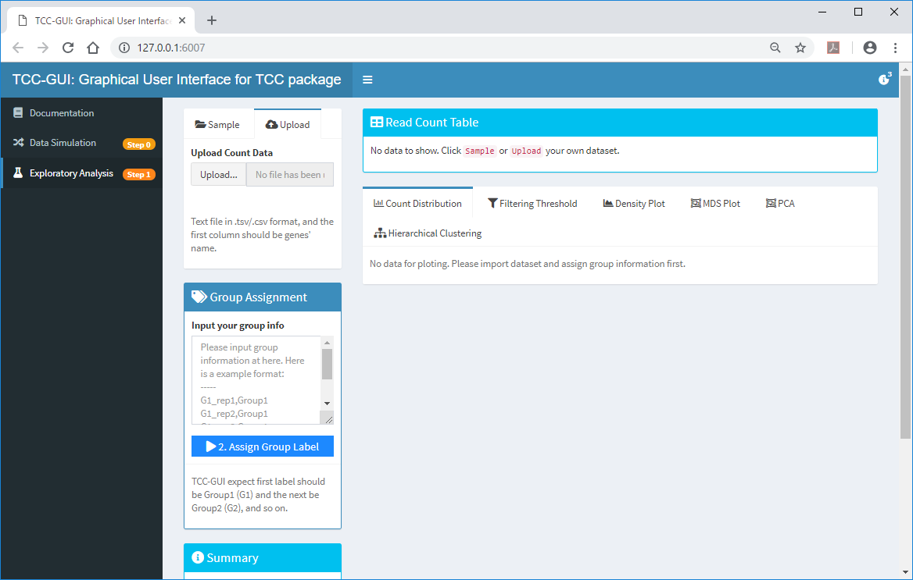
Step 1: Upload
  ①Upload, then ②Upload the file (bottomly count_table.txt).
①
②

Slide 3
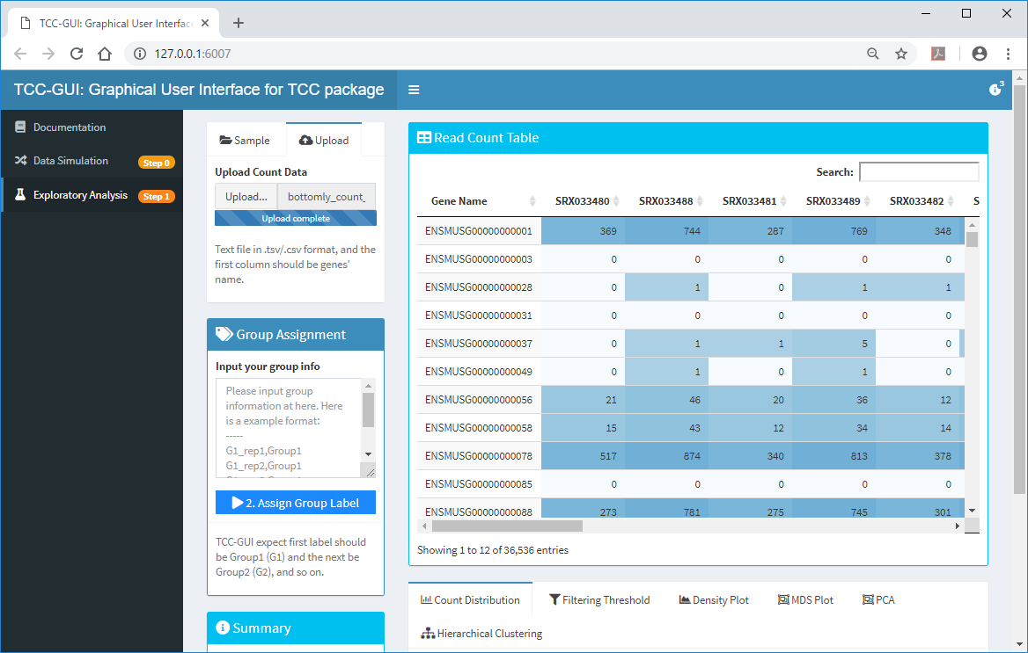

Step 1: Assign Group Label
  Input the ①group information for individual samples ②here. The first 10 lines correspond to C57BL/6J strains and the remaining 11 lines to DBA/2J strains.
①
②

Slide 4
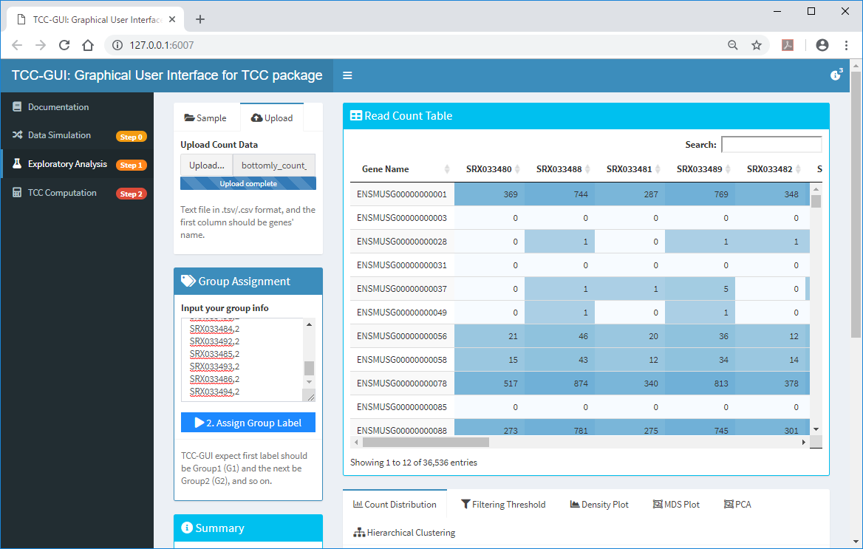
Step 1: Assign Group Label
  After copy and paste ①this information to ②here, ③click. After that, ④Move to the bottom of this page.
①
④
②
③

Slide 5
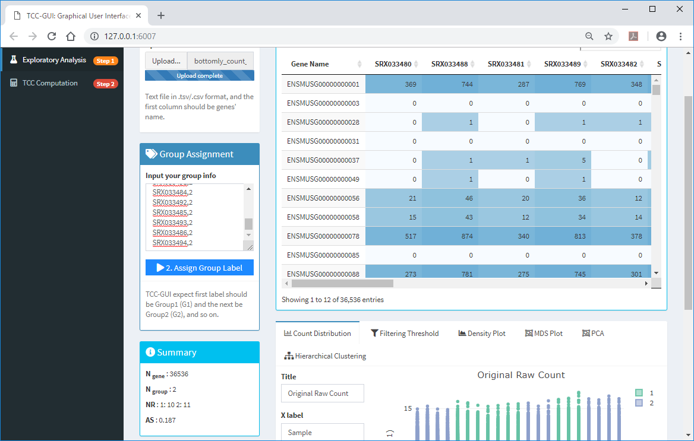
Step 1: AS score
  ①the average silhouettes (AS) score provides an objective measure of estimating the degree of group separation (Zhao et al.. 2018). It ranges from -1.0 to 1.0, a higher AS value indicating a higher degree of group separation (i.e., a higher percentage of DEGs). ②click.
②
①

Slide 6
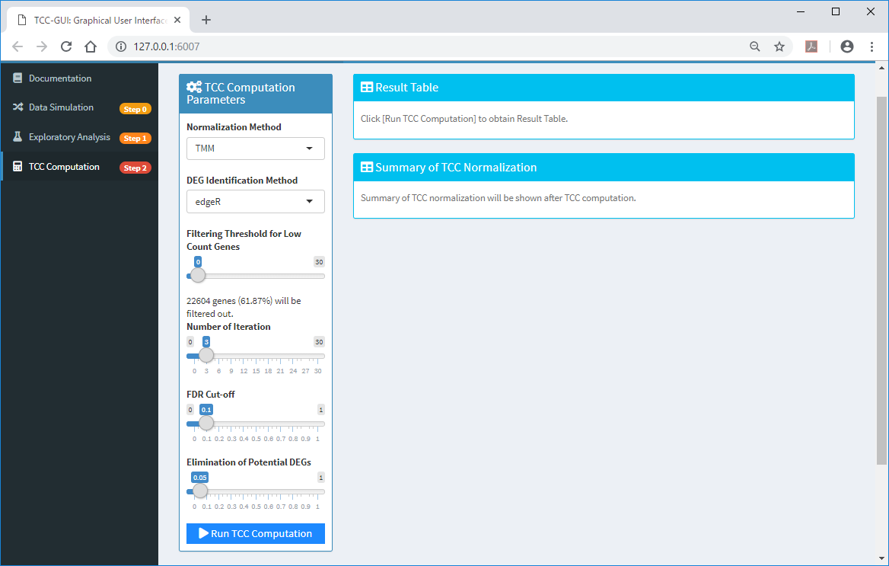
Step 2: TCC Computation
  By changing the threshold to filter low count genes as ①0, ②22604 genes will be filtered out. ③click.
①
②
③

Slide 7
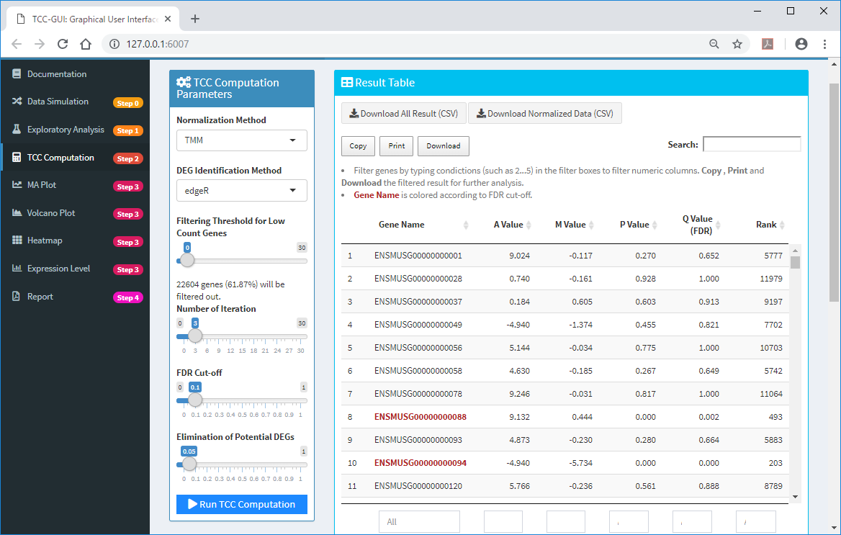
Step 2: Done
  TCC Computation (Step 2) was done. ①click “MA Plot (Step 3)”.
①

Slide 8
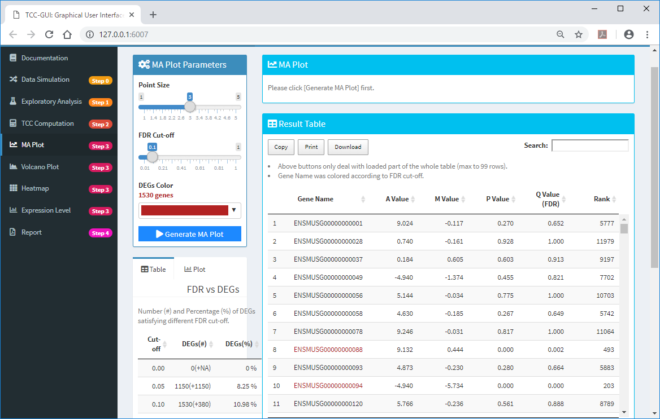
Step 3: MA Plot
  By the default threshold (①10% FDR), ②1530 genes were detected as DEGs. For generating the M-A plot, ③click here.
①
②
③

Slide 9
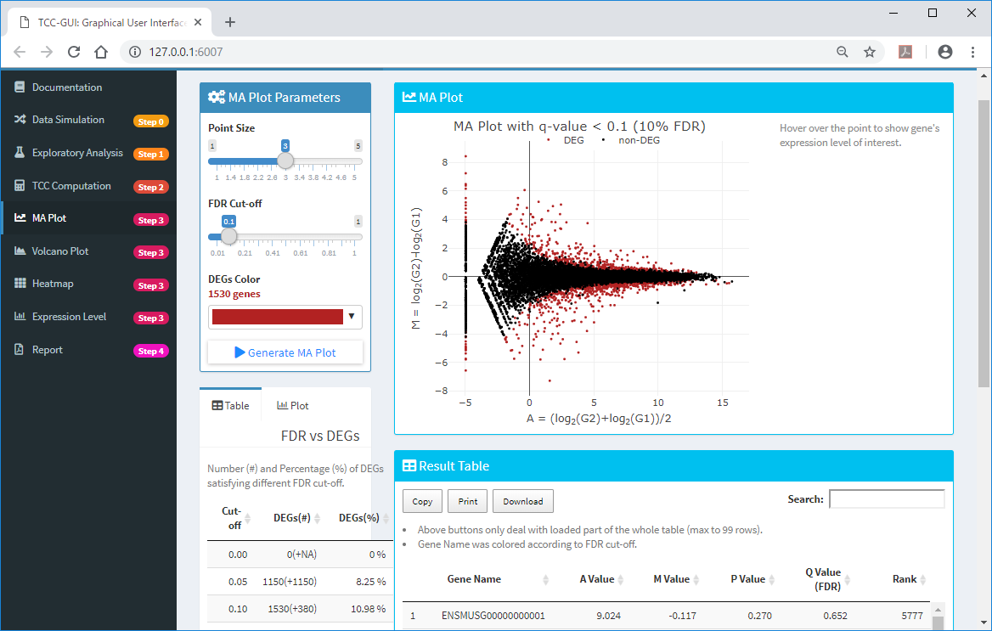
Step 3: MA Plot
  The M-A plot was generated.

