Slide 1

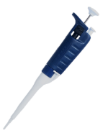
Fig. S1
O+ RBC
Centrifuge
4,000 rpm 21℃ 8 min
Pour 850 mL of
whole blood
Add 50 mL of 0.9% saline
Discard the supernatant
Repeat the procedure three times
(Centrifuge for 15 min at the last time)
Confirm the hematocrit is > 95%
Mix
RBC 40% (1 mL)
Plasma 60% (1.36 mL)
to reconstitute whole blood
Spot 50 µL of whole blood for each on a filter paper

