Slide 1
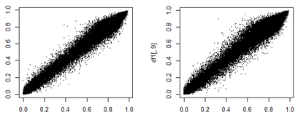
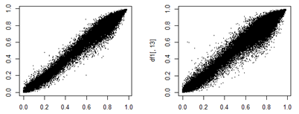
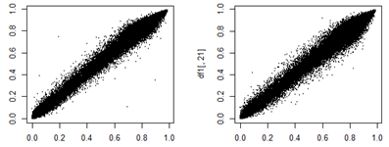
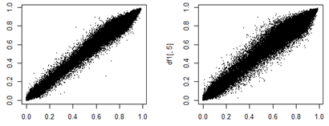
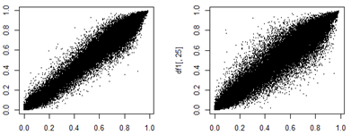
BS
Pt1
oxBS
BS
Pt2
oxBS
r=0.99
r=0.99
r=0.99
r=0.99
Beta value (R1)
Beta value (R1)
Beta value (R1)
Beta value (R1)
Beta value (R2)
Beta value (R2)
Beta value (R2)
Beta value (R2)
BS
Pt3
oxBS
r=0.99
r=0.99
Beta value (R1)
Beta value (R1)
Beta value (R2)
Beta value (R2)
BS
Cont. blood
oxBS
BS
Cont. brain
oxBS
r=0.99
r=0.99
r=0.99
r=0.97
Beta value (R1)
Beta value (R1)
Beta value (R1)
Beta value (R1)
Beta value (R2)
Beta value (R2)
Beta value (R2)
Beta value (R2)
Figure S2. Scatter plots showing correlation between technical replicates of beta values by BS/oxBS-array
Spearman’s correlation coefficient (r) revealed high reproducibility between beta values of technical replicates derived by BS-array (left panels) and oxBS-array (right panels) in the blood of three KOS14 patients (Pt1–Pt3), the control blood, and control brain samples. Vertical lines denote beta values of replicate 1 (R1), while horizontal lines denote those of replicate 2 (R2).

