Slide 1
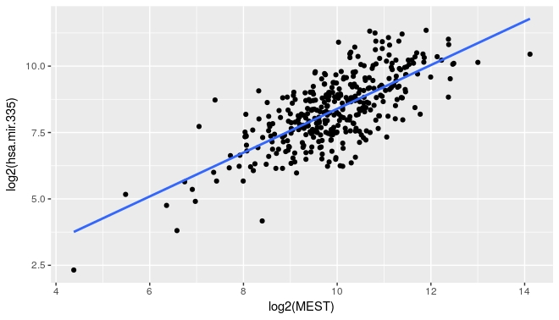
Figure S3
A
B

