Slide 1
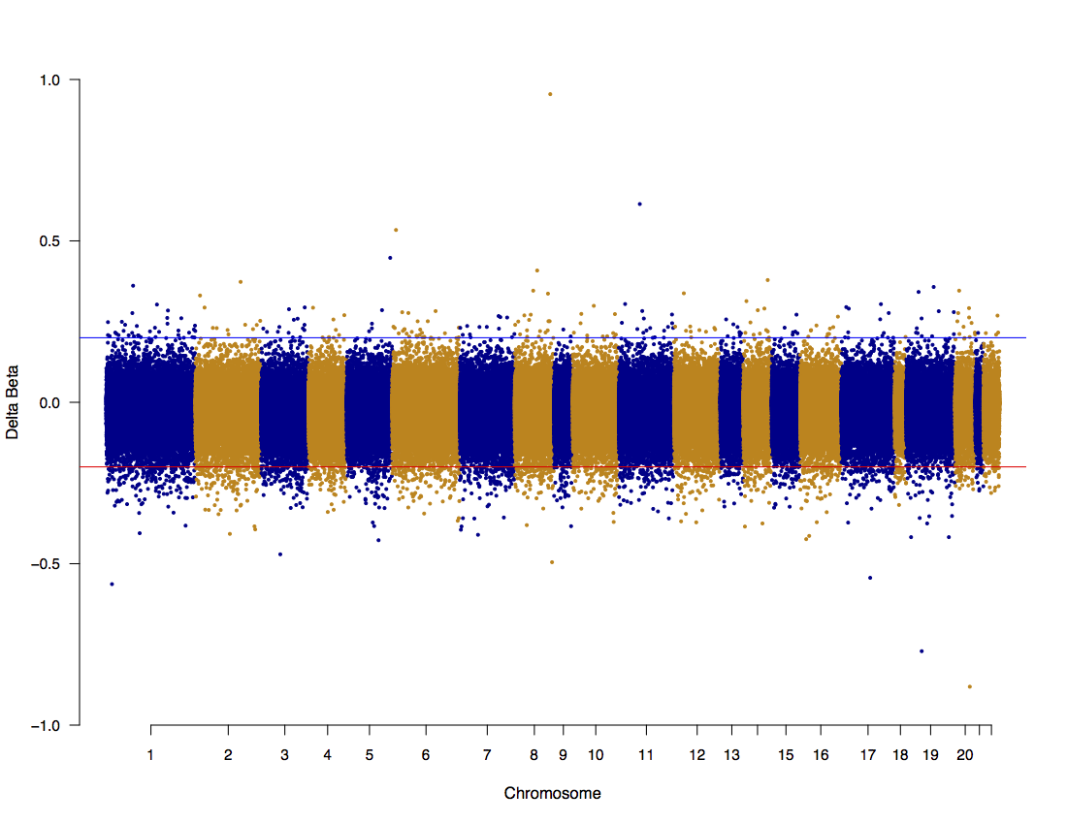
Additional file 8
Twin pair 1

Slide 2
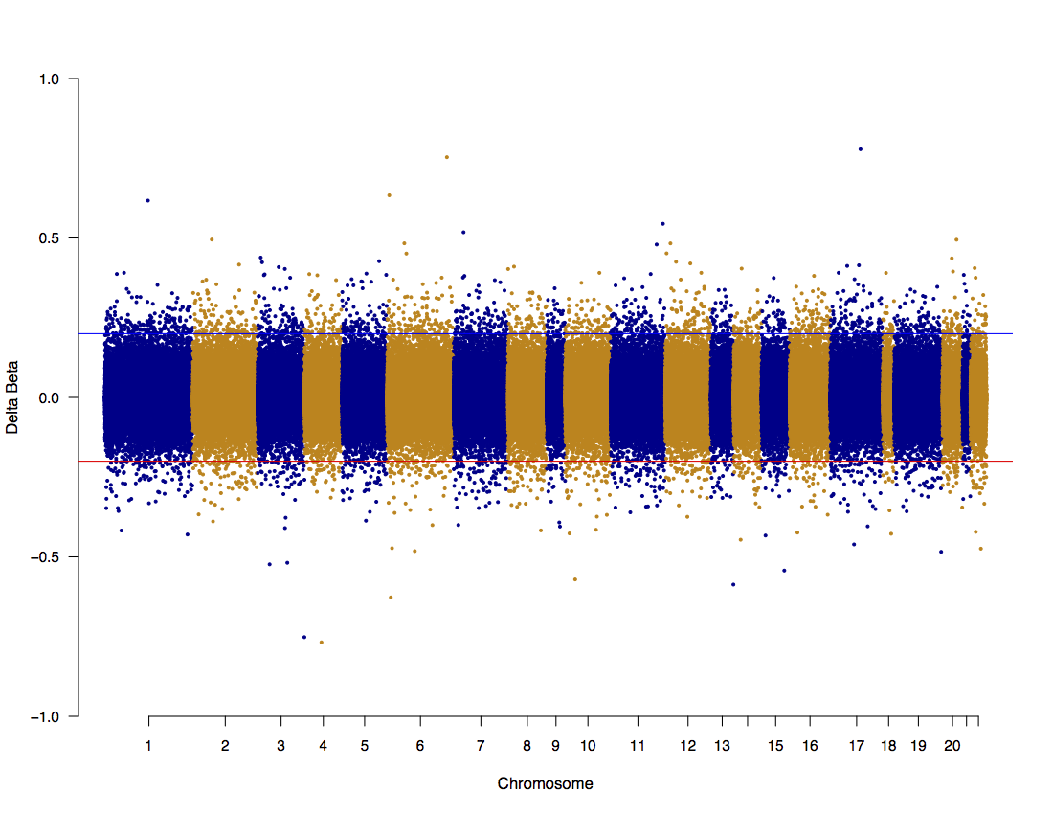
Twin pair 2

Slide 3
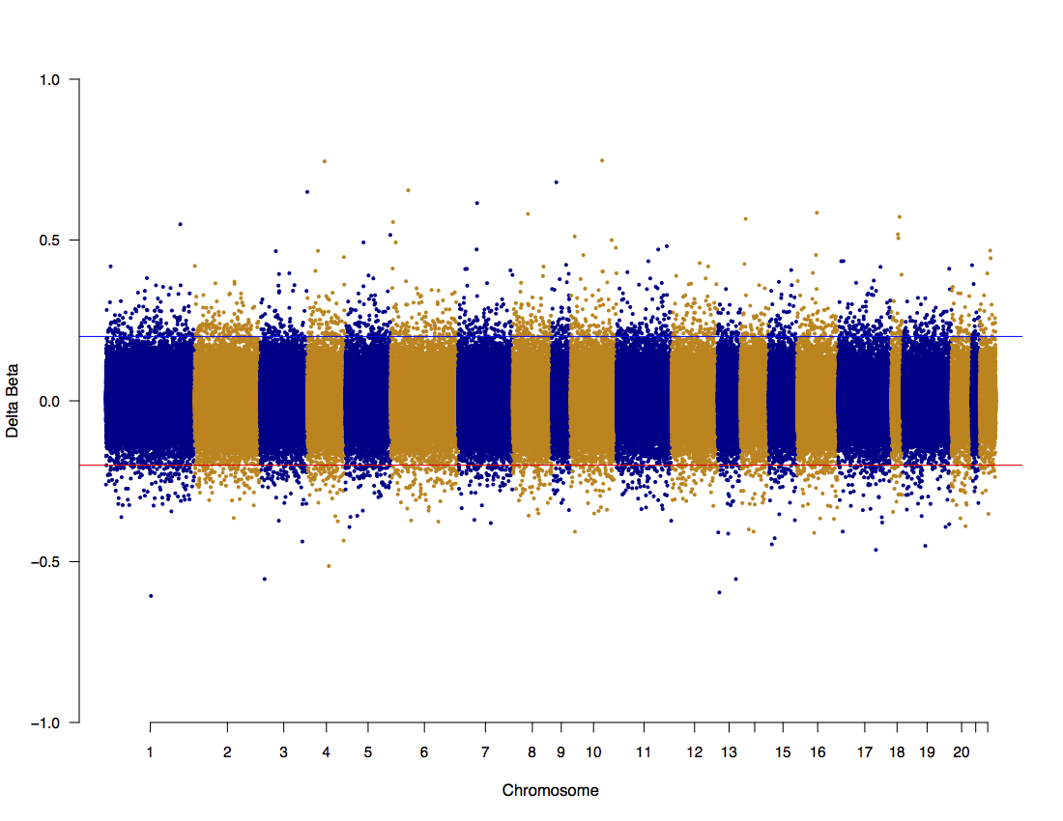
Twin pair 4

Slide 4
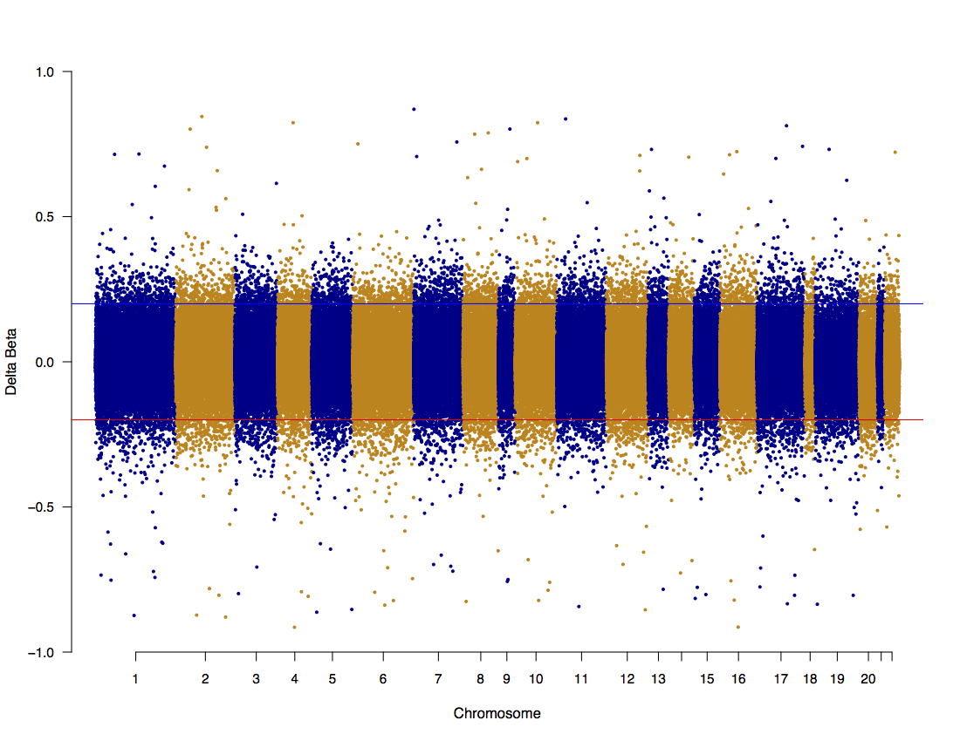
Twin pair 5

Slide 5

Twin pair 6

Slide 6
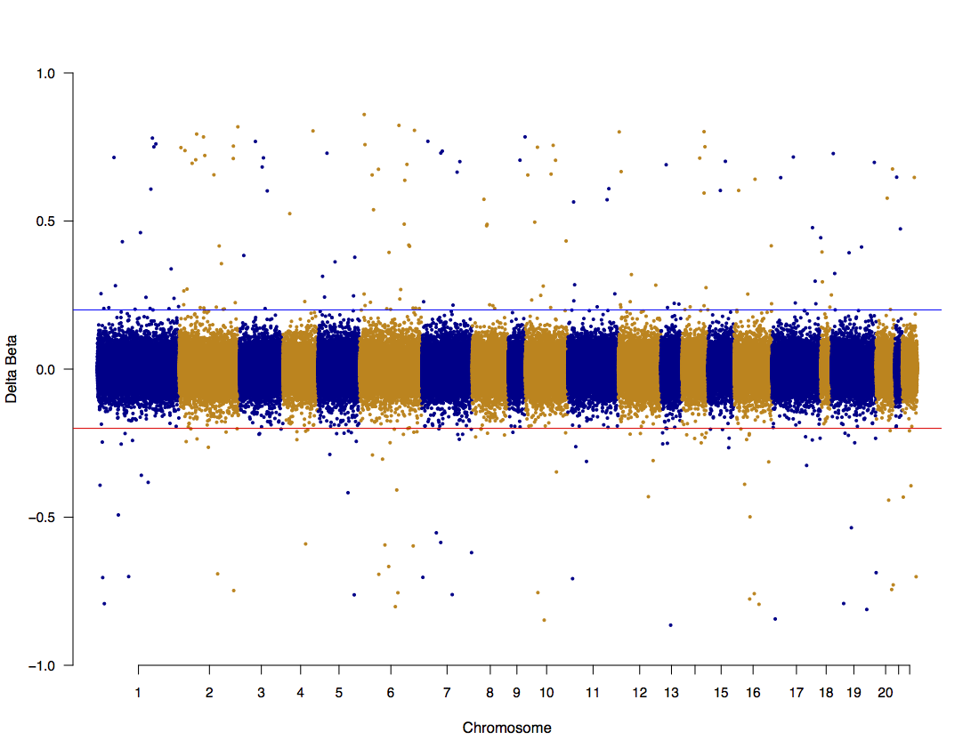
Twin pair 7

Slide 7
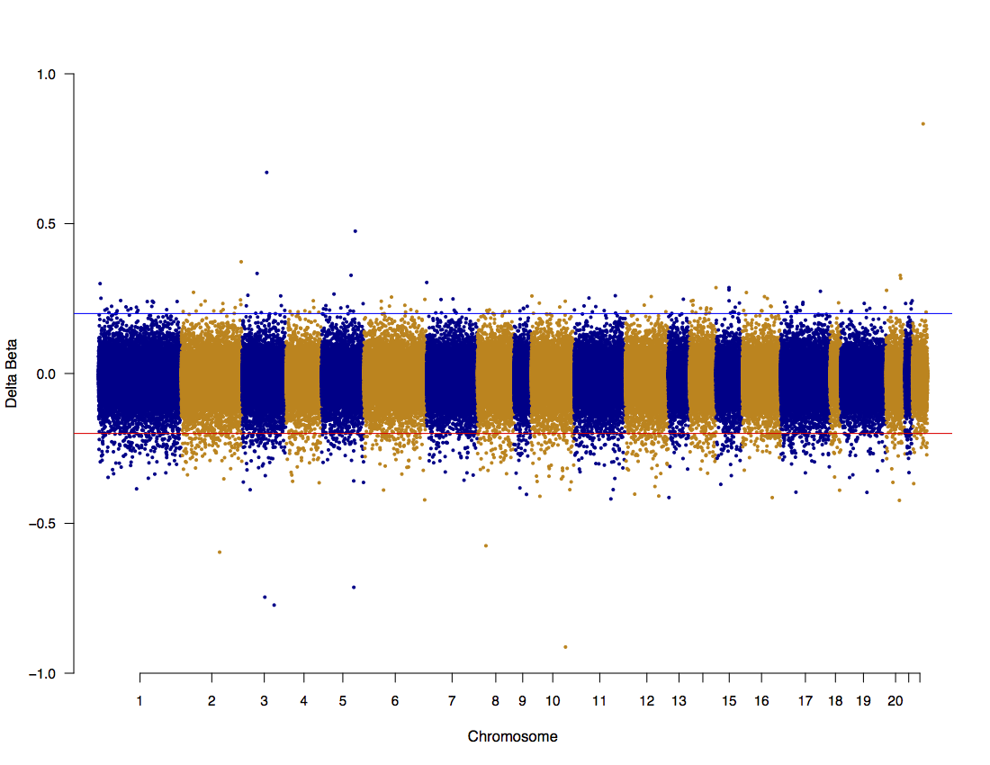
Twin pair 8

Slide 8
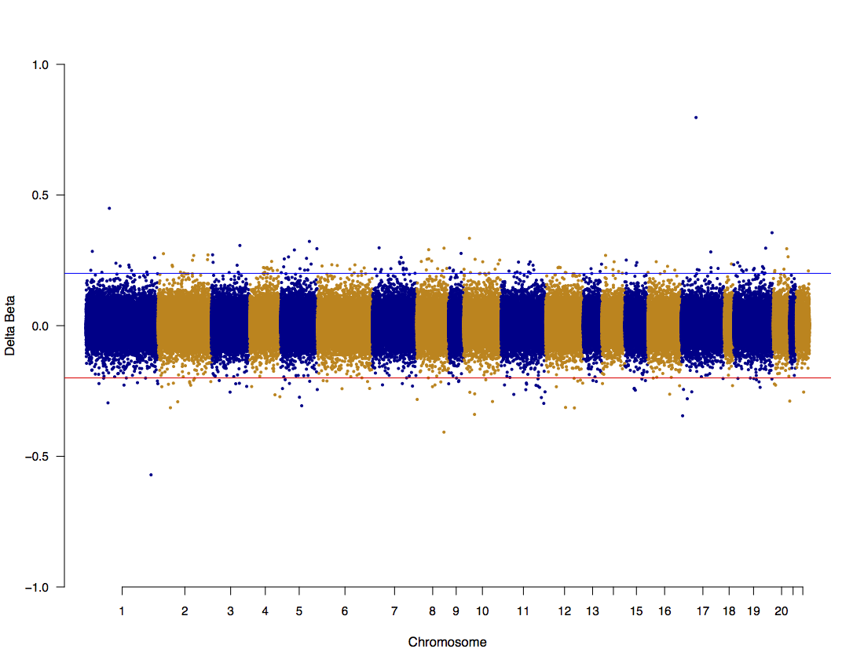
Twin pair 9

Slide 9
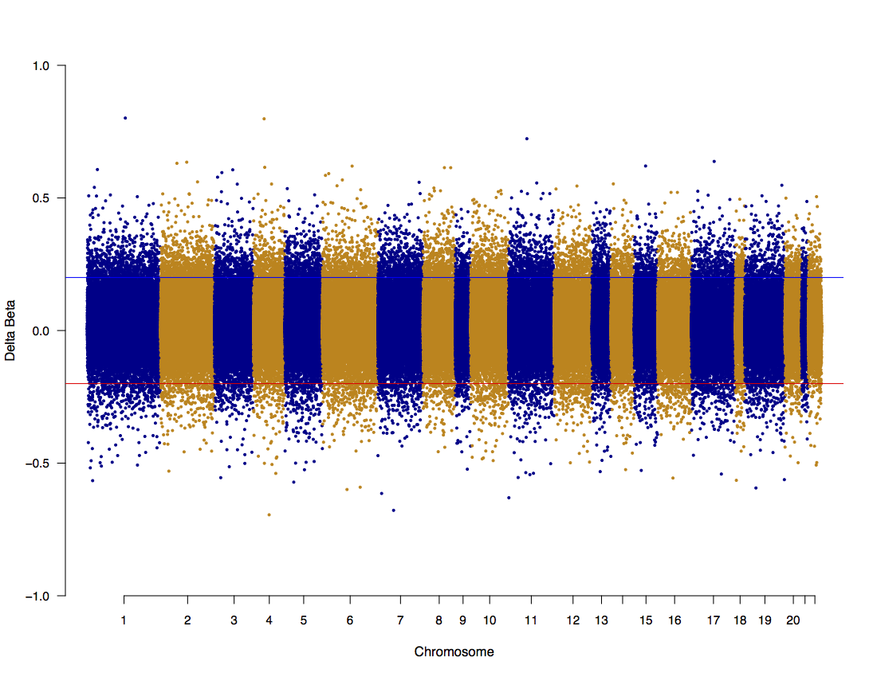
Twin pair 10

Slide 10
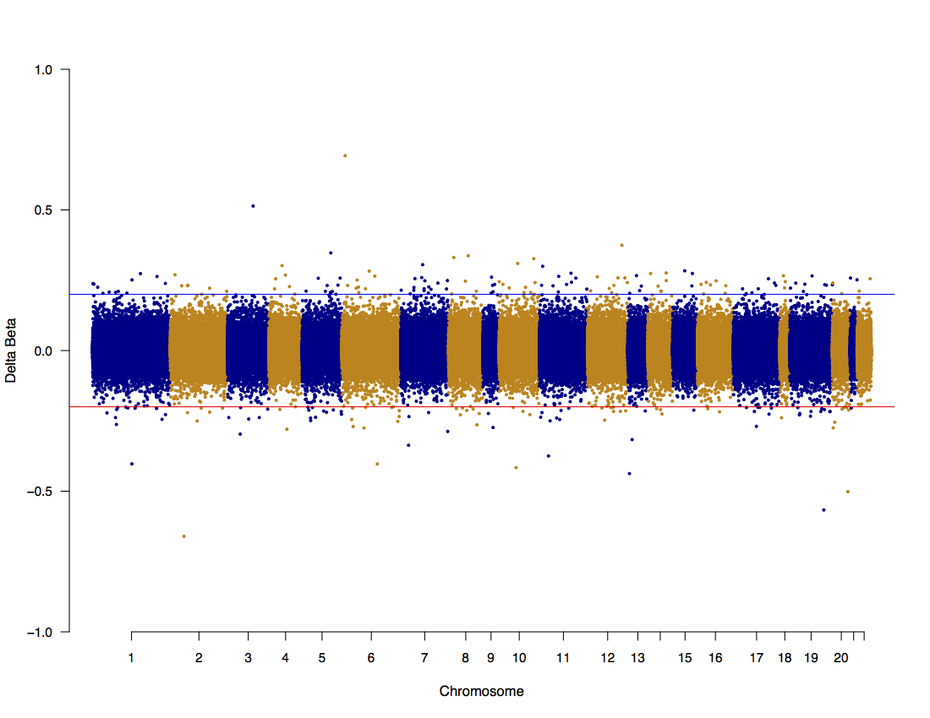
Twin pair 11

Slide 11
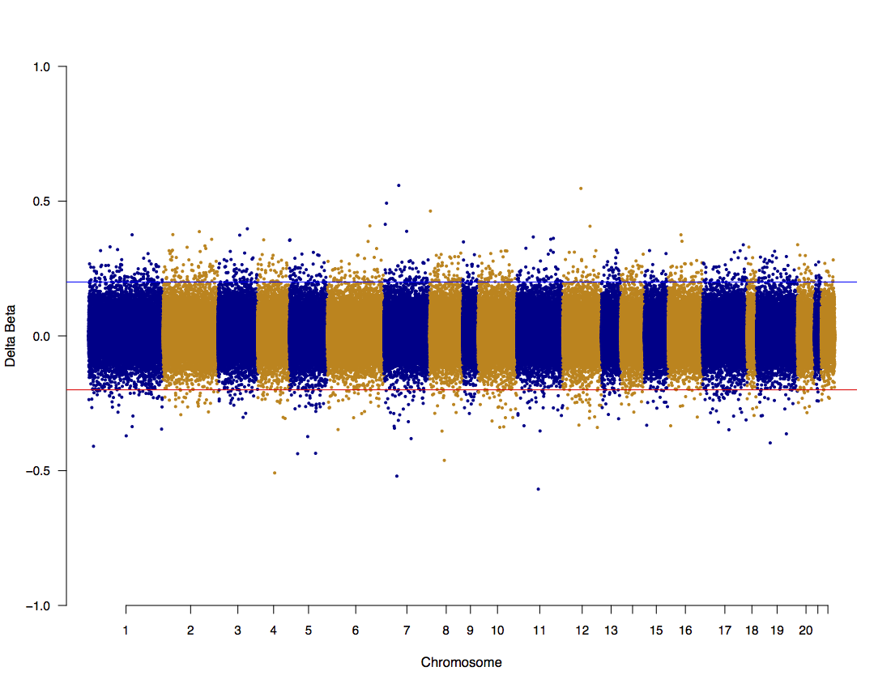
Twin pair 12

Slide 12
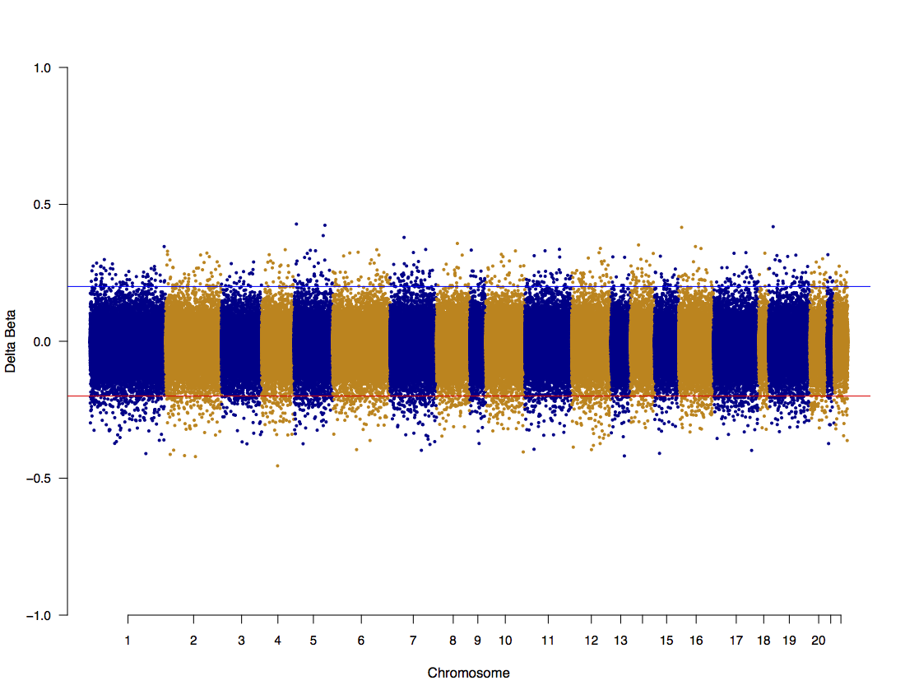
Twin pair 13

Slide 13
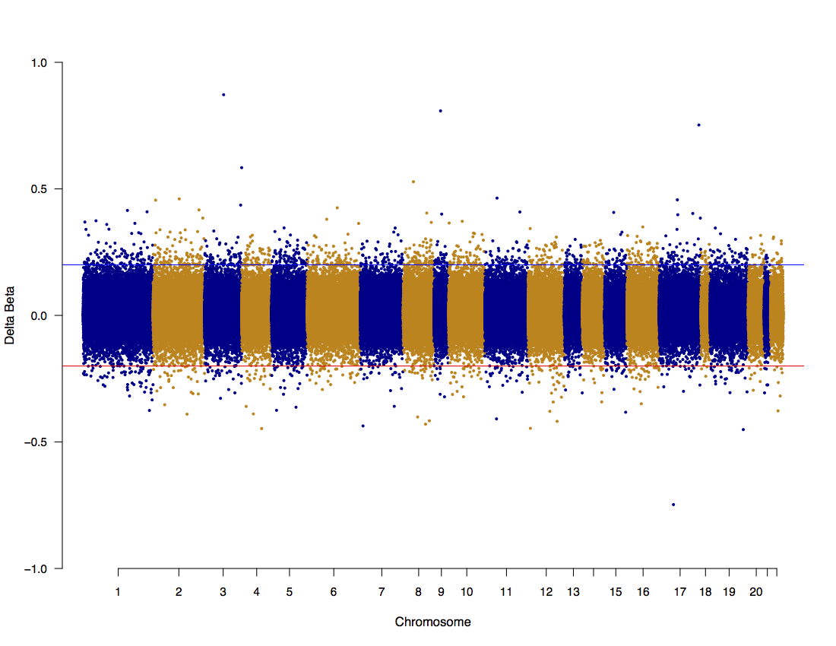
Twin pair 14

Slide 14
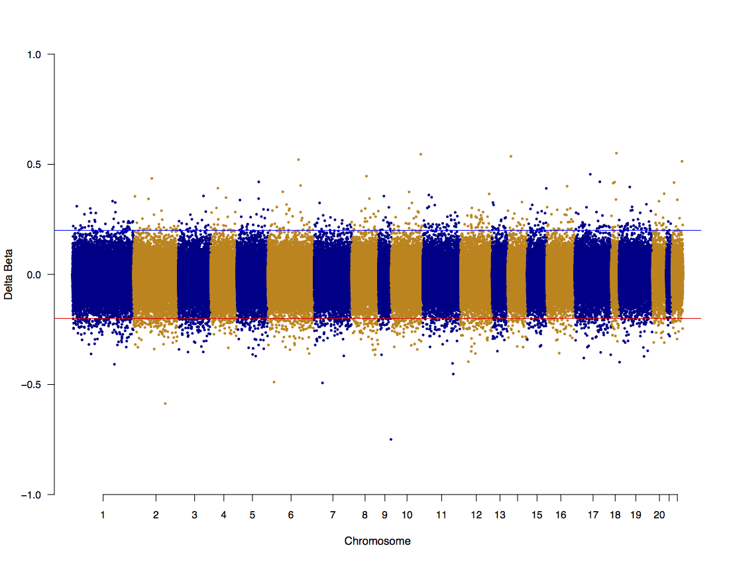
Twin pair 15

Slide 15
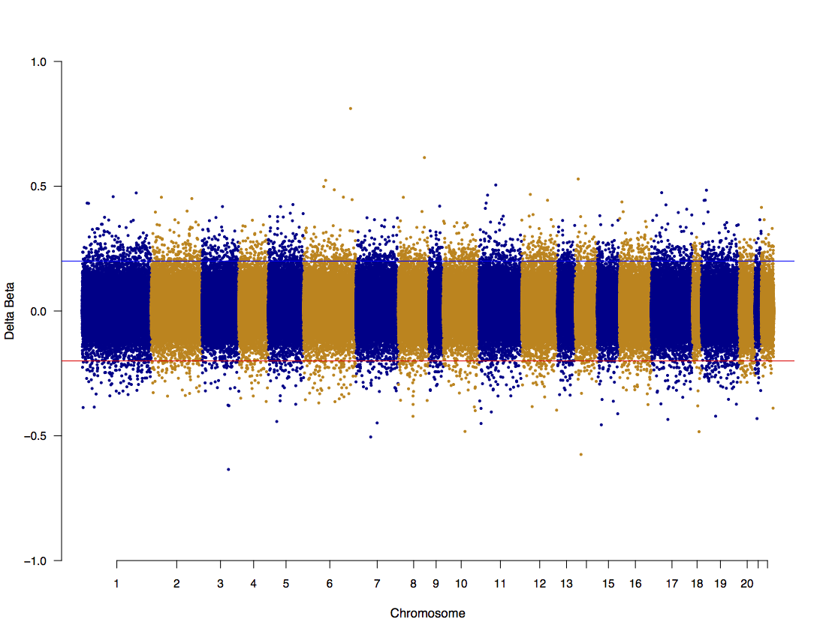
Twin pair 16

