Slide 1
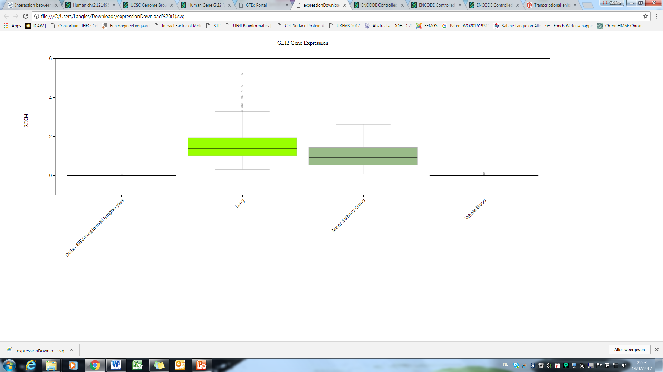
GLI2 Gene Expression from GTEx (release V6)
RPKM
Lung Salivary Gland Whole blood
Figure S2 – Langie et al.

