Slide 1
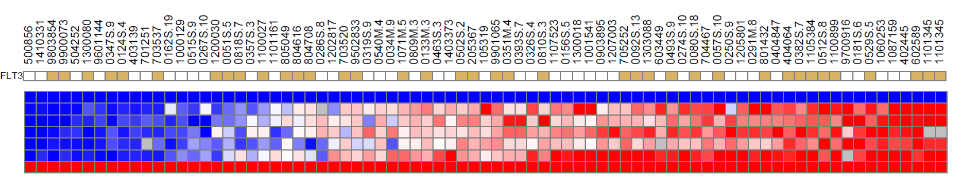
Figure S1
NPM1mut CN-AML patients
H3K27me3
0
15
100
GAPDH
HIST1H2BG-2AE
HIST1H1D
HIST1H4F
HIST1H4G
HIST1H3F-2BH
HOXD4
H3K27me3 HIST1^{low}
H3K27me3 HIST1^{high}
Mutations
FLT3ITD
DNMT3A
IDH2R140
IDH1
CEBPA
Figure S1 related to Figure 2. Heatmap of the H3K27me3 level in a new cohort of 78 NPM1mut CN-AML patients showing normalized H3K27me3 enrichment values obtained by ChIP-qPCR on the indicated HIST1 genes. Each column represents a patient sample sorted by upward-median values for HIST1 enrichment. H3K27me3 HIST1^{low} and H3K27me3 HIST1^{high} patients were defined as in Figure 1B with a H3K27me3 HIST1 mean value cut off at 15. Yellow square: mutation for the indicated gene; grey square: missing data.

Slide 2
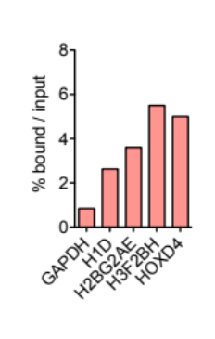
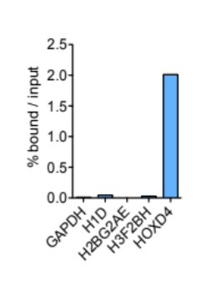
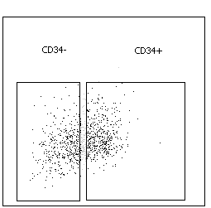
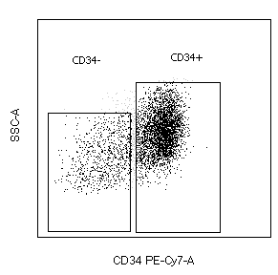
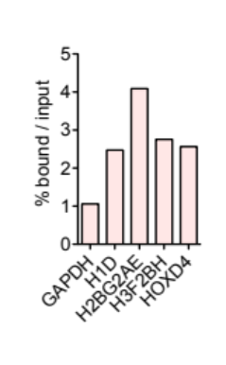
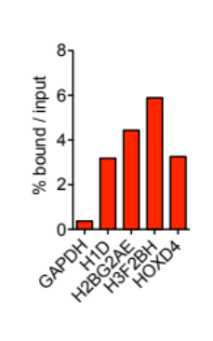
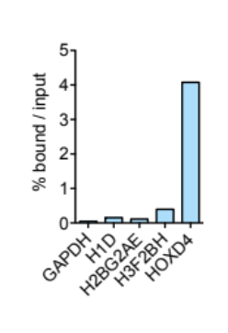
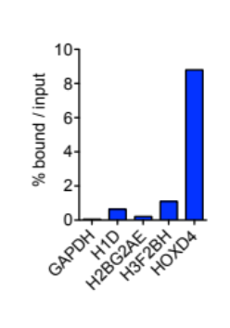
Figure S2
A
bulk
B
blasts
bulk
blasts
80%
52%
SSC-A
SSC-A
CD34
CD34
ChIP H3K27me3
ChIP H3K27me3
CD34low
CD34high
CD34low
CD34high
Figure S2 related to figure 2: Analysis of H3K27me3 HIST1 status in CD34low and CD34high sorted blasts. Additional H3K27me3 HIST1^{high} patient (a) and H3K27me3 HIST1^{low} patient (b) were analyzed. For a and b are shown; the gating strategy for separating blast cells according to CD34 expression level (upper left), the H3K27me3 HIST1 status on the bulk population (upper right), on CD34low blast population (lower left) and on CD34high blast population (lower right).

Slide 3




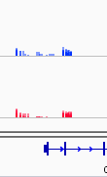

Figure S3
H3K27me3
H3K27me3 HIST1^{low}
[0-10]
[0-10]
[0-10]
[0-10]
[0-10]
[0-10]
[0-10]
[0-10]
[0-10]
[0-10]
[0-10]
[0-10]
H3K27me3 HIST1^{high}
HIST1H1D
HOXD4
CYBB
FCN1
CLEC4A
ITGAM
Figure S3 related to Figure 4. Representative Integrative Genomics Viewer (IGV) tracks of H3K27me3 signal obtained from ChIP-chip data published in Tiberi et al., 2015 (10) at HIST1H1D, HOXD4, CYBB, FCN1, CLEC4A and ITGAM promoters in merge H3K27me3 signals from HIST1^{low} (n=8) and H3K27me3 HIST1^{high} (n=19) CN-AML patient samples.

Slide 4
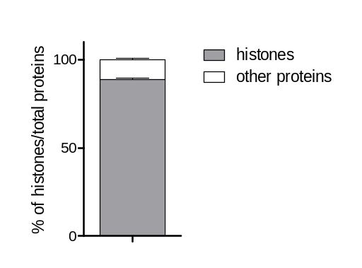
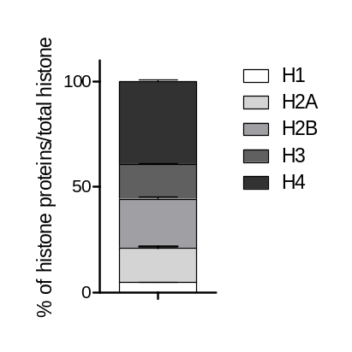
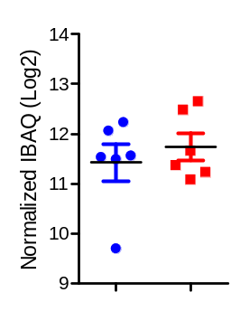
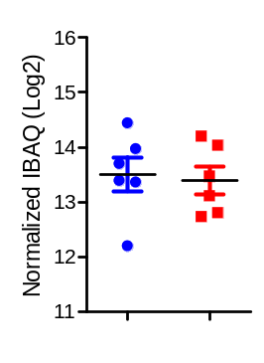
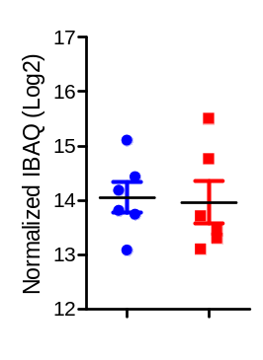
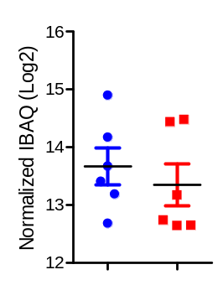
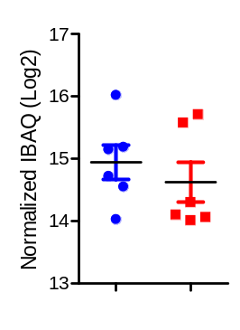
Figure S4
A
B
Figure S4 related to Figure 5: Histone protein extraction in NPM1mut patients. a Proportion of histone proteins relative to total chromatin bound fraction in 12 AML patients (6 H3K27me3 HIST1^{high;} 6 H3K27me3 HIST1^{low}). b Proportion of the different histone types relative to total histones in 12 AML patients (6 H3K27me3 HIST1^{high;} ; 6 H3K27me3 HIST1^{low}).
Figure S5
H3K27me3 HIST1^{low}
H3K27me3 HIST1^{high}
H1
H2A
H2B
H3
H4
NS
NS
NS
NS
NS
Figure S5 related to Figure 5: Total protein abundance of each histone types determined by IBAQ label-free quantification method. Results are expressed in IBAQ (Log2) adjusted on the median of the total protein extracted and normalized to total histone amount by patient. Statistical significance was estimated using unpaired t-test. NS, not significant.

Slide 5
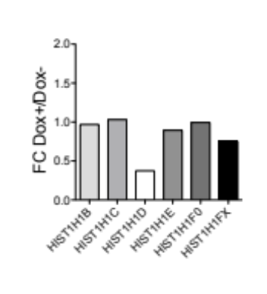
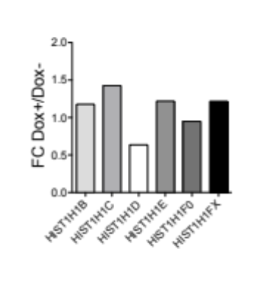
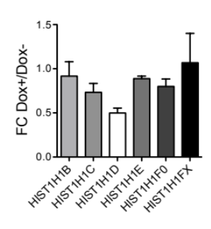


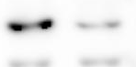





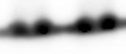
Figure S6
A
shRNA-1
B
shRNA-2
KD#2
KD#3
C
D
KD#2
KD#3
shRNA-2
kDa
Dox
-
+
-
+
kDa
Dox
-
+
H1-3
35
H1-3
35
25
25
Total H1
35
Total H1
35
25
H3
15
H3
15
Figure S6 related to Figure 6. Effect of H1-3 KD on histone H1 subtype mRNA and protein expression. a-b gene expression of the indicated histone H1 genes in (a) two additional H1-3 KD clones obtained with shRNA-1; KD#2 and KD#3 and in (b) a clone obtained with an additional shRNA; shRNA-2. Results are normalized on HPRT and expressed in fold change (FC) between doxycycline treated (Dox+) and non treated conditions (Dox-). c-d Immunoblot of H1-3, H1 and H3 in (c) KD#2 and KD#3 and (d) shRNA2 conditions in total cell lysates. Total H1 and H3 were used as loading controls. The arrow points the specific band for H1-3.

Slide 6
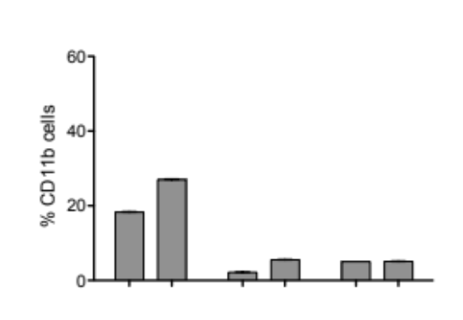
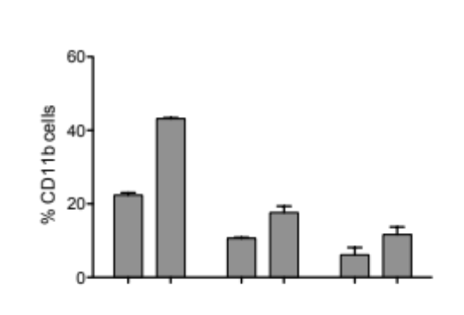
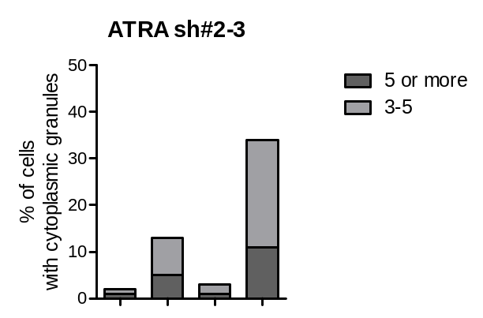
Figure S7
A
B
wo ATRA
ATRA 0.5 μM
KD#2
KD#3
shRNA2
KD#2
KD#3
shRNA2
Dox
-
+
-
+
-
+
Dox
-
+
-
+
-
+
Figure S7 related to Figure 6. Effect of H1d KD on CD11b expression in shRNA1 (clones KD#2 and KD#3) and in shRNA2 conditions. Percentage of CD11b positive cells in KD#2,KD#3 and shRNA2 upon or not (Dox-) 6-days-induction with 2 μg/mL doxycycline (Dox+), a without ATRA (wo ATRA), b with 72 hours of ATRA (0.5 μM). Data represent two independent experiments.
Figure S8
ATRA 0.5 μM
KD#2
KD#3
>5
2-5
-
+
-
+
Dox
Figure S8 related to Figure 6. Effect of H1d KD on ATRA-treated KD#2 and KD#3 morphology. Quantification of cells with cytoplasmic granules. Results are presented as a percentage of positive cells (more than 2 granules). At least 100 cells per condition were analyzed and data represent an average of two independent and blind experimenter counts obtained from 1 experiment.

