Slide 1
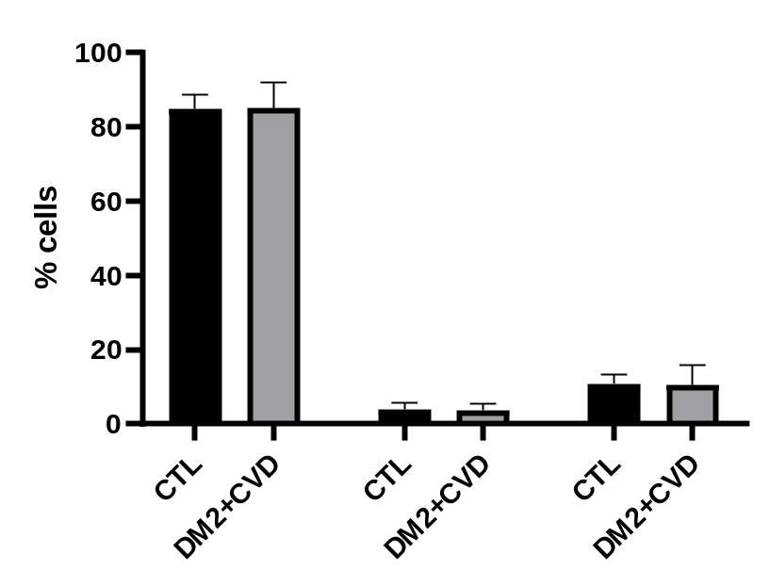
classical intermediate non-classical
Additional File 1. Monocytes were classified as classical (CD14⁺⁺CD16⁻), intermediate (CD14⁺⁺CD16⁺) or non-classical (CD14⁺CD16⁺). Fluorescence was measured using a FACS CANTO II (BD) and analysed with FlowJo software. There was no difference in cell number between control (CTL) and DM2+CVD monocyte populations.

Slide 2
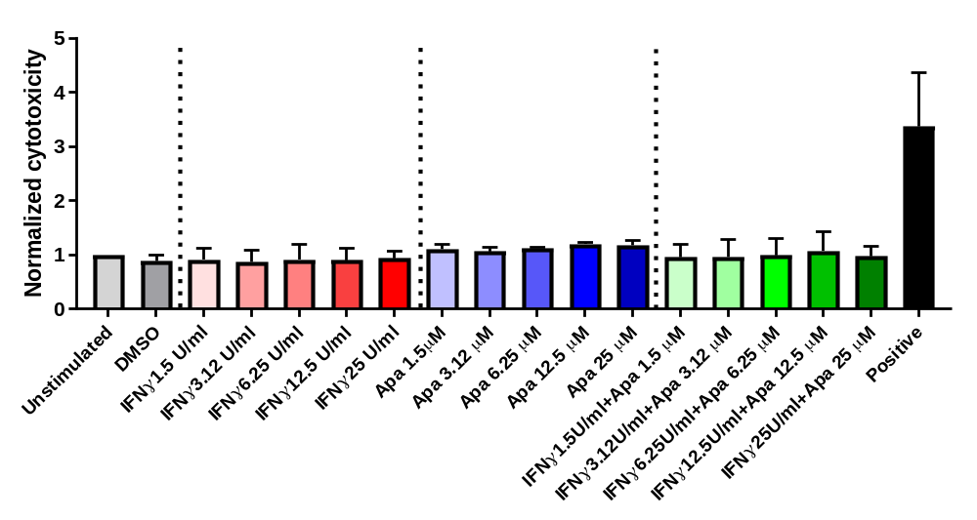
IFNγ
Apabetalone
Apabetalone + IFNγ
Additional File 2. Monocytes were stimulated ex vivo with IFNγ (1.5; 3.12; 6.25; 12.5; 25 U/ml), apabetalone (1.5; 3.12; 6.25; 12.5; 25 μM) or a combination of both stimuli for 24h. Subsequently, cytotoxicity was determined by measuring the enzyme lactate dehydrogenase (LDH) in the supernatant using the CytoTox 96 Non-Radioactive Cytotoxicity Assay. There was no difference between ‘unstimulated’ and stimulated conditions, except for the positive control where p<0.0001. Statistics: One-Way ANOVA with Dunnett’s multiple comparisons test.

Slide 3
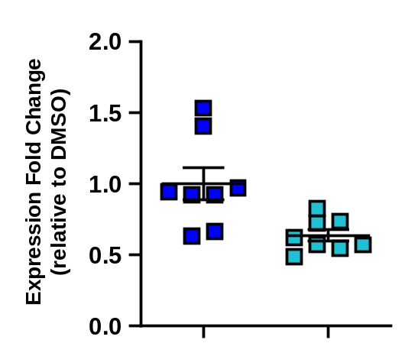
BRD4 mRNA
****
DMSO
Apabetalone
Additional File 3. BRD4 mRNA expression is reduced by ex vivo treatment with apabetalone in DM2+CVD monocytes (4h ex vivo treatment, 25 μM). BRD4 expression was measured by real time PCR and normalized to cyclophilin A (endogenous control). Statistics: Unpaired Student’s t-test, **** p<0.0001.

