Slide 1
Supplemental Figure 2
A
B

Slide 2
Supplemental Figure 3
Day 0
Day 3
Day 12
CTL
CTL
CTL
PCOS
PCOS
PCOS
CTL
CTL
CTL
PCOS
PCOS
PCOS
CTL
CTL
CTL
PCOS
PCOS
PCOS
Genes
Distance

Slide 3
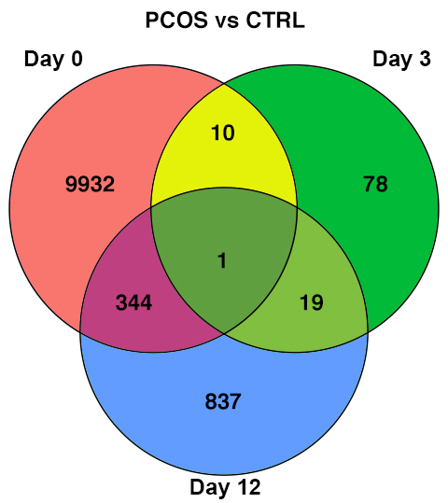
Supplemental Figure 4

Slide 4
Supplemental Figure 5

Slide 5
Supplemental Figure 6
TGFβ1
upregulated
downregulated
stimulate
inhibit
GRHL1
CEBPα
CRIP2
PPARγ
ESR2
NR4A1
GLI2
HMGA2
FOS
CDKN2C
CSRP2
JUNB
EGR1
FOXC2

Slide 6
Supplemental Figure 7
ATAC-Seq
RNA-Seq
A
B
C
Reads per Genome Coverage (RGPC)
D
Counts per Million Reads (CPM)
E
F
Day
PCOS
CTL

Slide 7
Supplemental Figure 8
ATAC-Seq
RNA-Seq
ATAC-Seq
RNA-Seq
A
I
B
J
C
K
D
L
Counts per Million Reads (CPM)
Counts per Million Reads (CPM)
Reads per Genome Coverage (RGPC)
Reads per Genome Coverage (RGPC)
E
M
F
N
G
O
H
Day
PCOS
CTL

Slide 8
Supplemental Figure 9
Total Content
De Novo Synthesis
A
P<0.009
P<0.006
B
P<0.010
P<0.007
Fold Change at Day 12 (PCOS vs. CTL)
C
P<0.014
P<0.022
D
P<0.028
P<0.017
Pair-match 1
Pair-match 2
Pair-match 3

