Slide 1
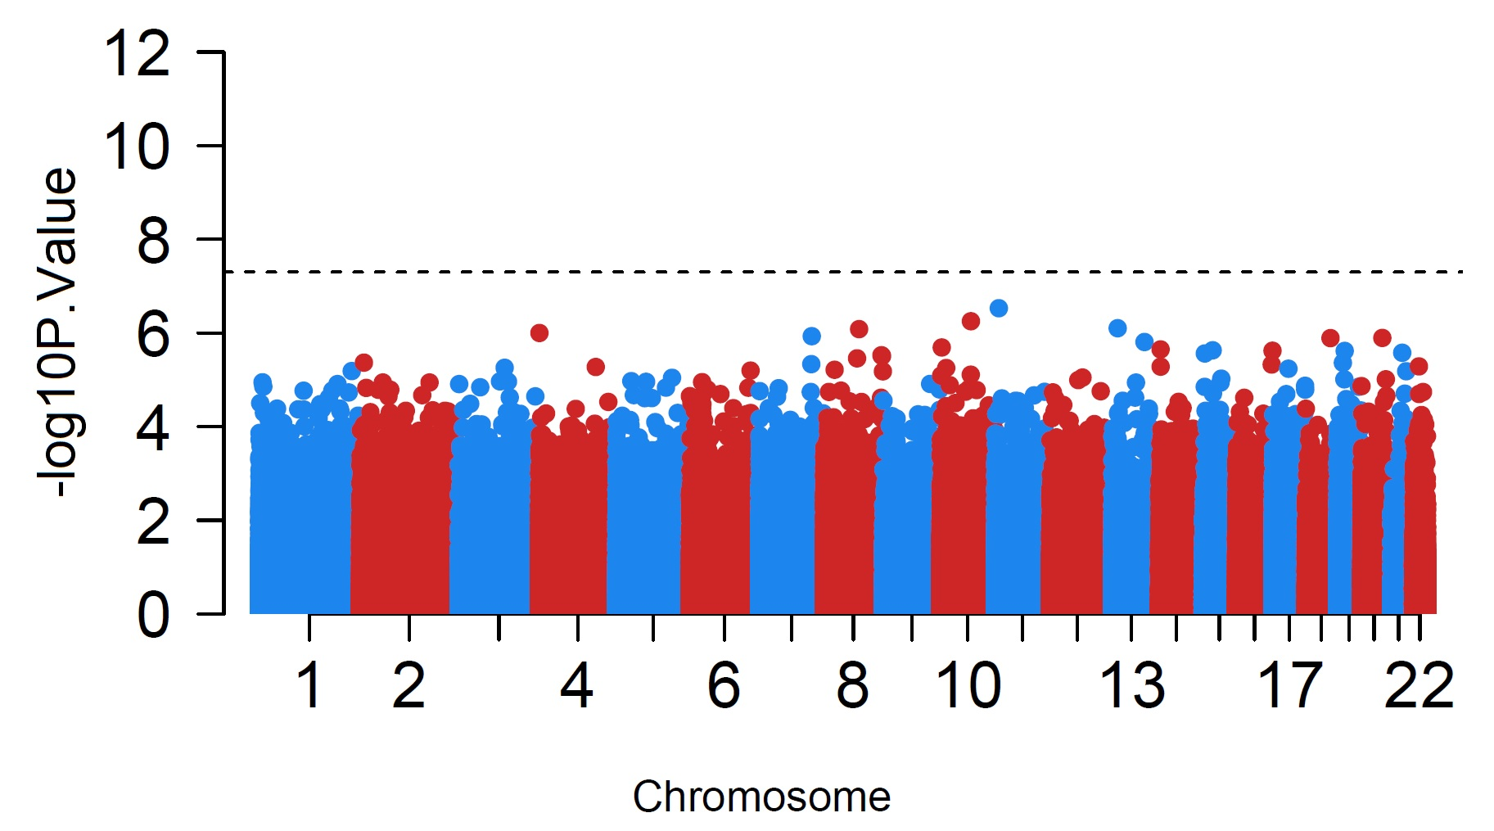
Supplementary Figure S1
Supplementary Figure S1: Manhattan plot for EWAS p-values of BMI x Time interactions showing no genome-wide significant effect on DNA methylation

Slide 2
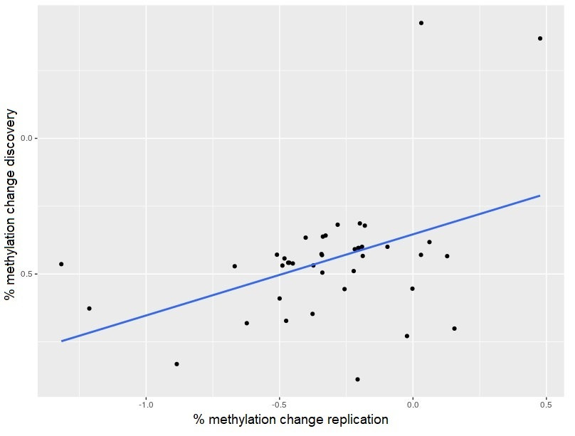
Supplementary Figure S2
r=0.48, p=0.0006
Supplementary Figure S2: Correlation of effect sizes of the 41 significant CpGs in discovery and replication sets.

Slide 3
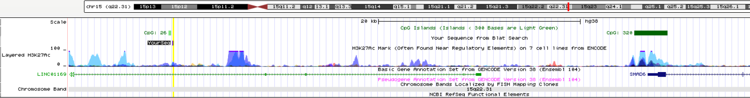
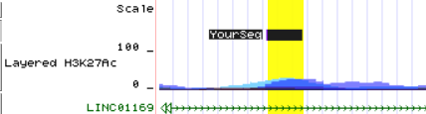
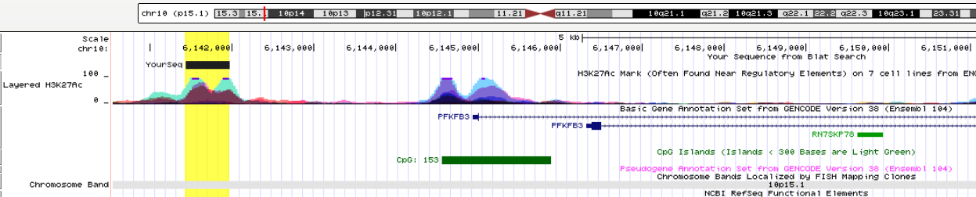
Supplementary Figure S3
A
Hypermethylated DMR region
Located within the body of LINC01169 (non-protein coding gene) and upstream of nearest geneSMAD6
B
Hypomethylated DMR region
Located in an H3K27ac binding site (active chromatin mark) at the promoter of PFKFB3 gene
Supplementary Figure S3: Genomic localization of the top DMR associated with SMAD6 (A) and PKFB3 genes (B).

