Slide 1
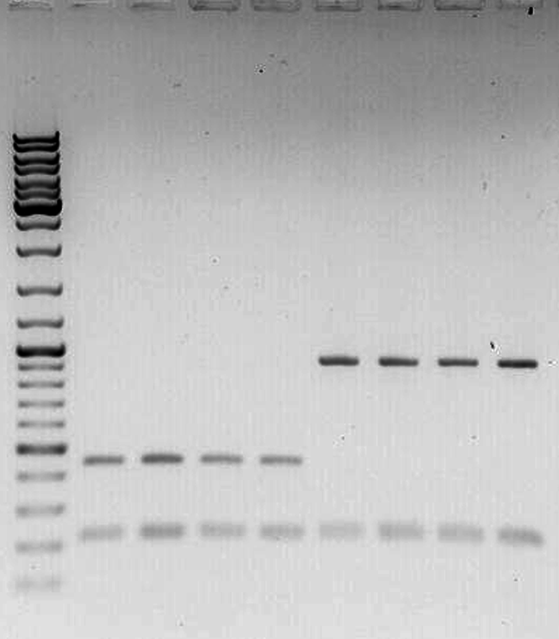
DMR1
DMR2
maternal
paternal
maternal
paternal
chr16
chr16
chr16
chr16
180.3 60.4
180.3 60.4
1.0 kb
0.5 kb
0.2 kb
U C C U
U C C U

