Slide 1
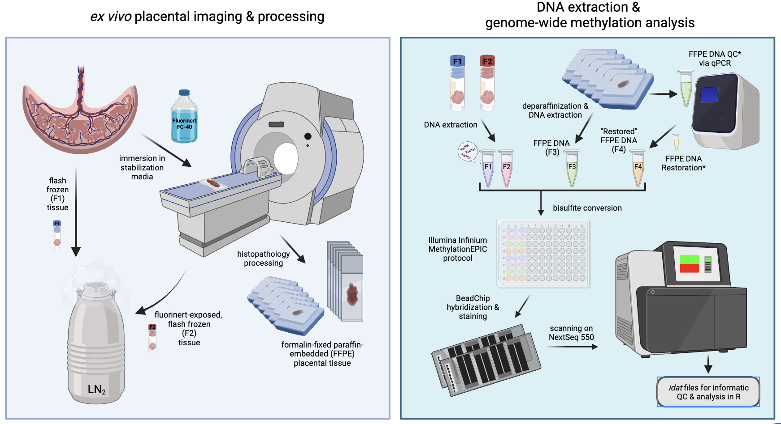
Supplemental Figure 1
A
B

Slide 2
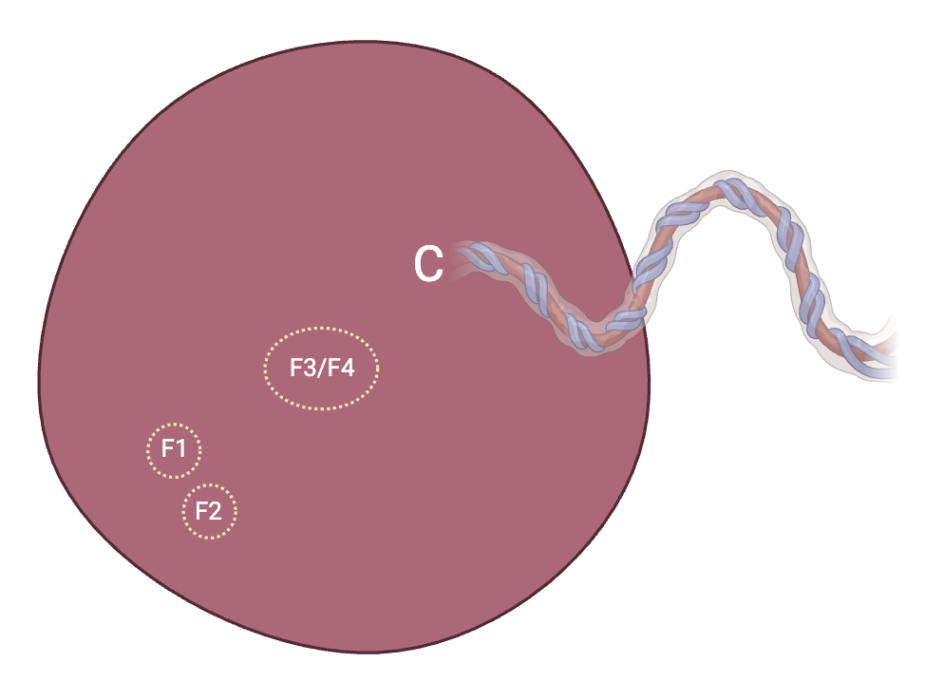
Supplemental Figure 2
A

Slide 3
Supplemental Figure 3

Slide 4
Supplemental Figure 4
A
B
F1
F2
C
D
F3
F4

