Slide 1
P=3.8*10⁻⁵
FC=1.8
rs1799962 genotype
nc886 methylation status
Fold change
 | T/T | T/T | T/T | T/C | T/C | T/C | C/C | C/C | C/C
 | Ref. | 1.7 | 1.9 | 1.6 | 2.1 | 2.9 | 2.3 |  | 3.2
Supplementary Figure 1. Association of nc886-5p blood RNA levels and epigenetic and genetic regulators. Having nc886 locus non-methylated in both alleles or being a carrier of the minor allele (C) of rs1799962 are associated with elevated nc886-5p levels, as compared to imprinted major allele homozygotes

Slide 2
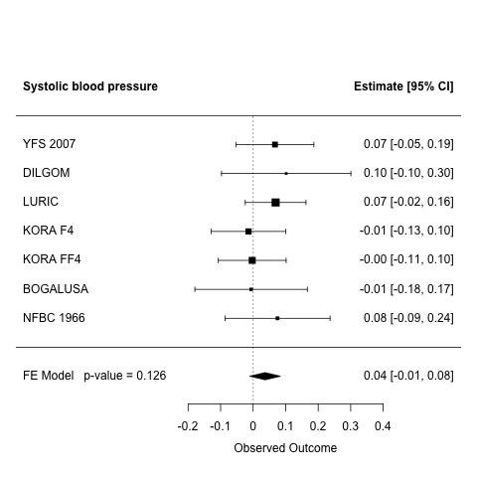
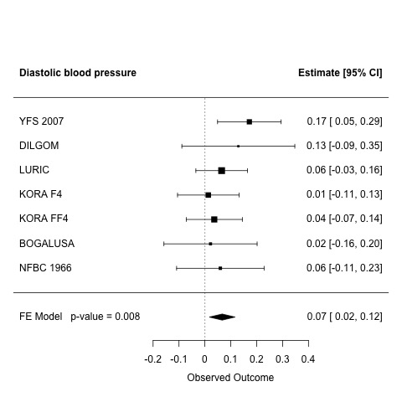
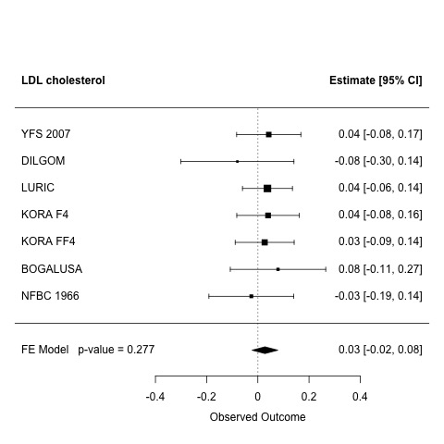
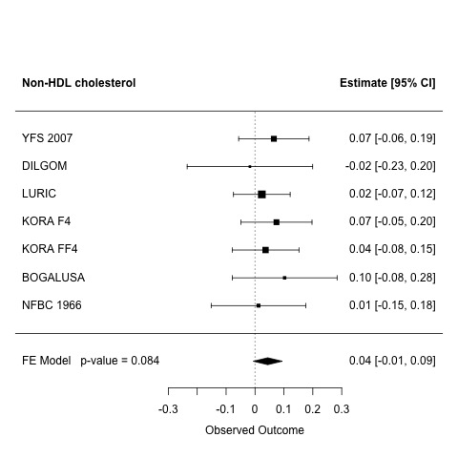
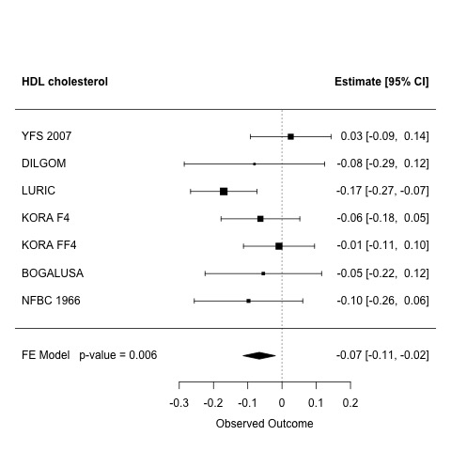
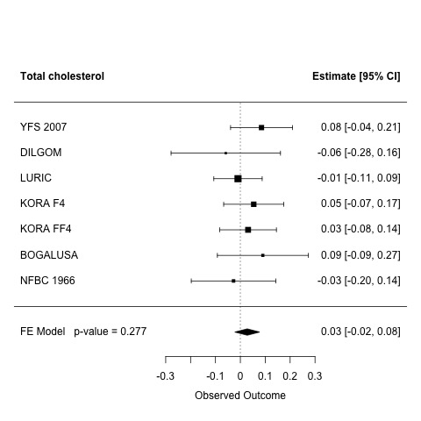
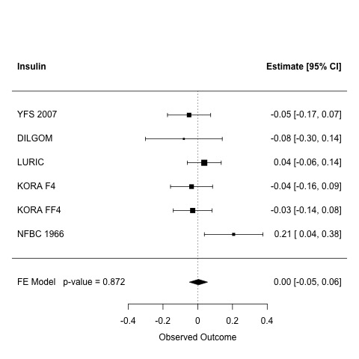
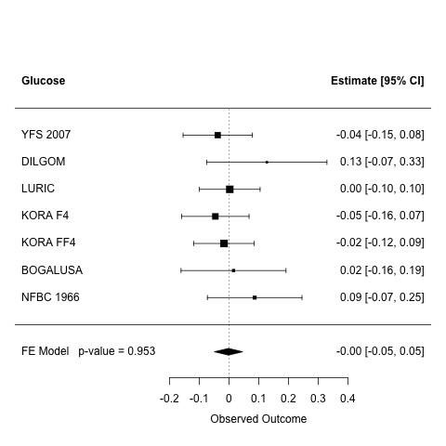
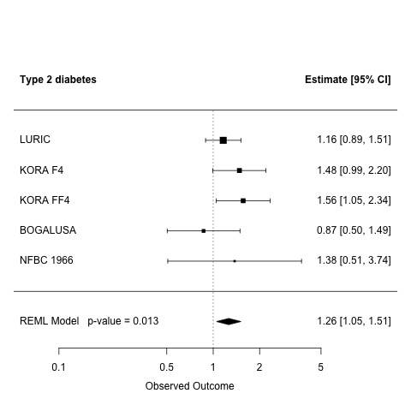
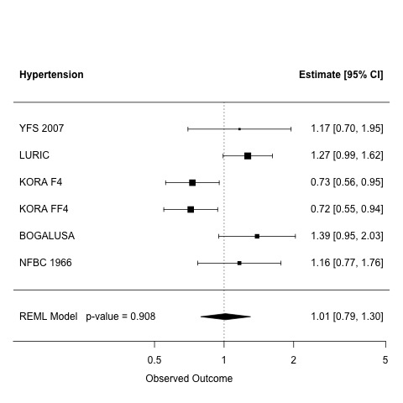
A
B
C
D
E
F
G
H
I
J
OR
OR
Supplementary Figure 2. Meta-analysis plots the association of predicted nc886 RNA levels and A) systolic blood pressure, B) diastolic bloop pressure in women, C) LDL cholesterol, D) Non-HDL cholesterol, E) HDL cholesterol, F) Total cholesterol, G) Insulin, H) Glucose, I) Type 2 diabetes, and J) Hypertension. Individuals with elevated predicted nc886 RNA levels are compared to imprinted major allele homozygotes.

Slide 3
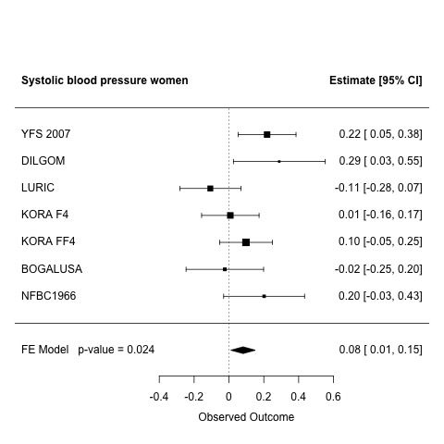
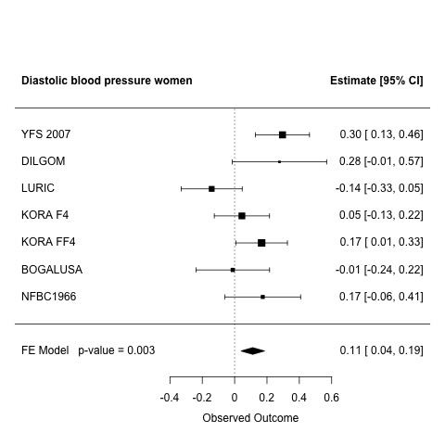
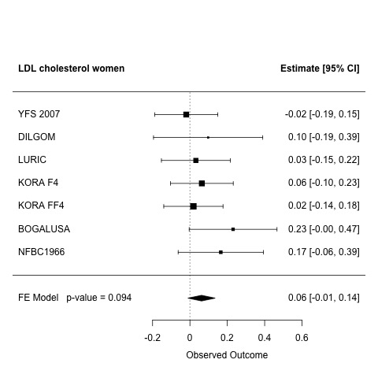
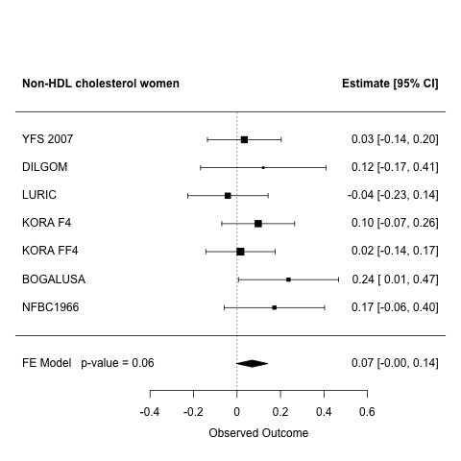
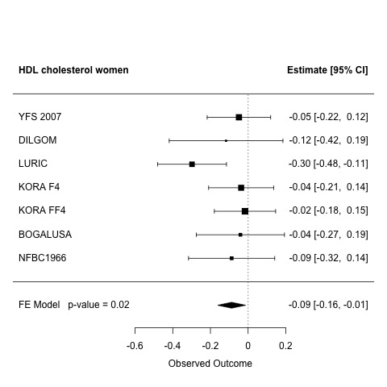
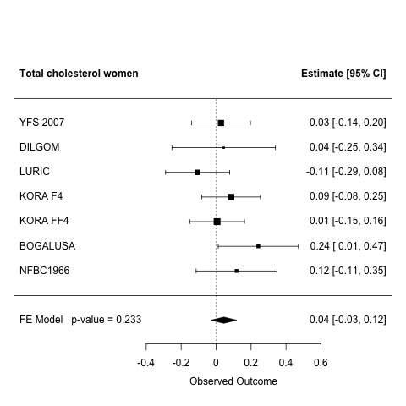
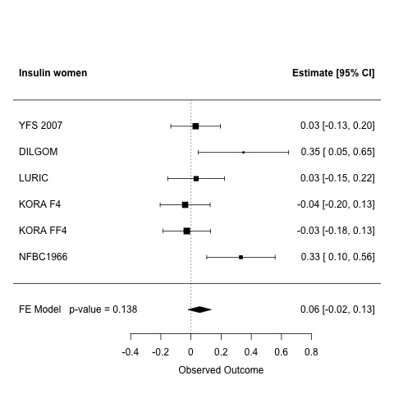
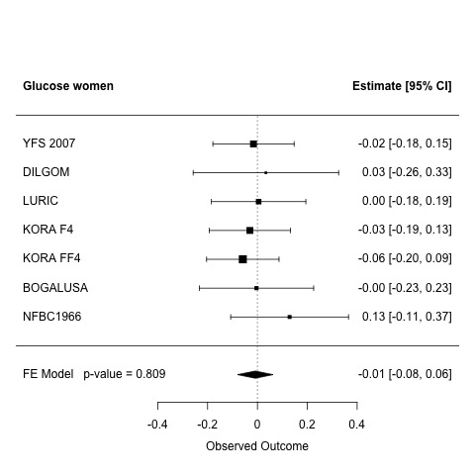
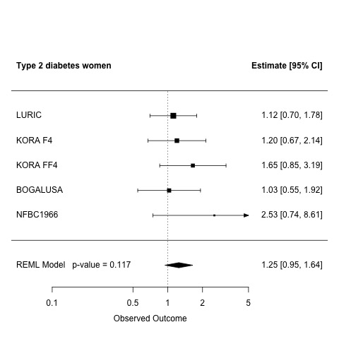
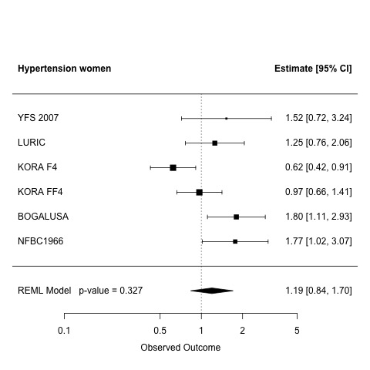
A
B
C
D
E
F
G
H
I
J
OR
OR
Supplementary Figure 3. Meta-analysis plots the association of predicted nc886 RNA levels and A) systolic blood pressure, B) diastolic bloop pressure in women, C) LDL cholesterol, D) Non-HDL cholesterol, E) HDL cholesterol, F) Total cholesterol, G) Insulin, H) Glucose, I) Type 2 diabetes, and J) Hypertension for women. Women with elevated predicted nc886 RNA levels are compared to women major allele homozygotes.

Slide 4
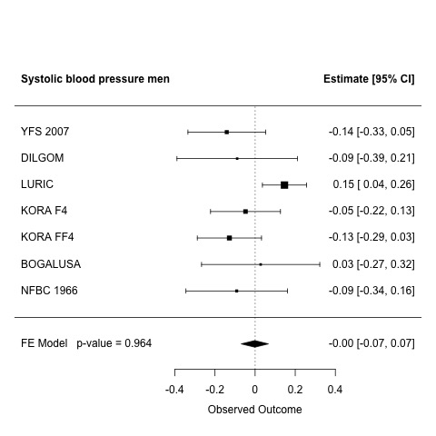
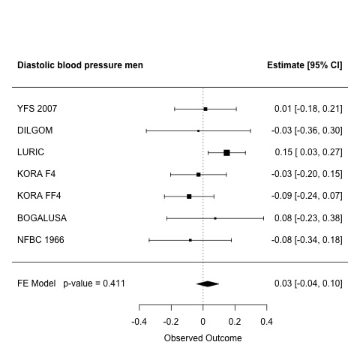
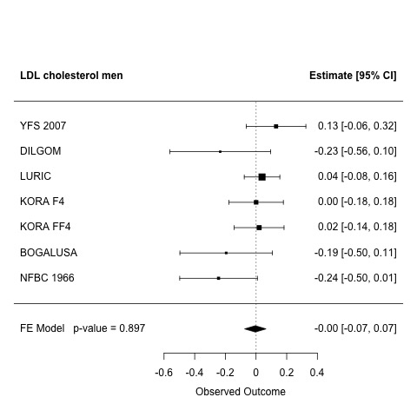
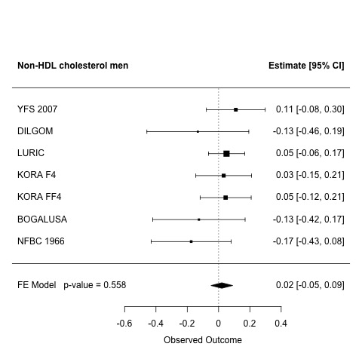
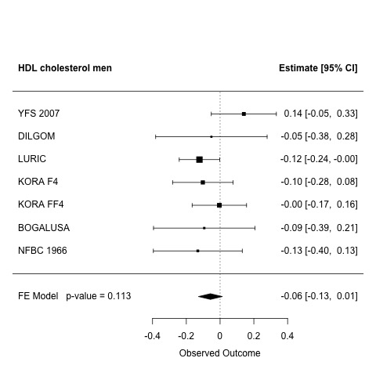
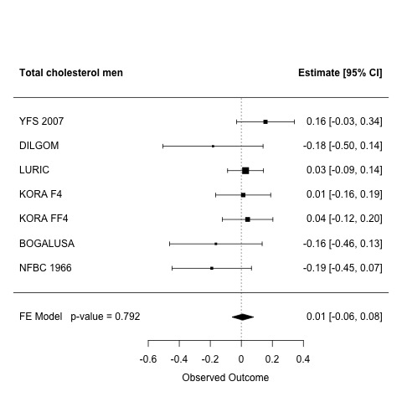
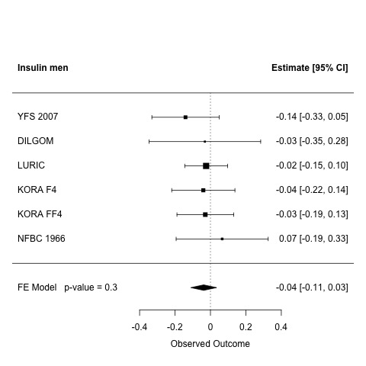
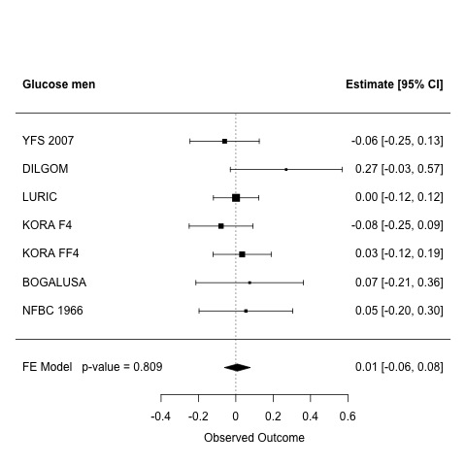
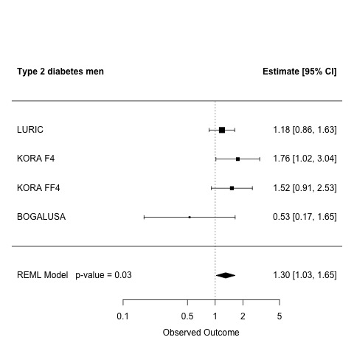
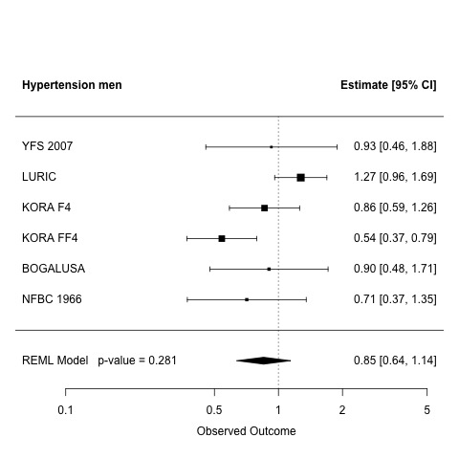
A
B
C
D
E
F
G
H
I
J
OR
OR
Supplementary Figure 4. Meta-analysis plots the association of predicted nc886 RNA levels and A) systolic blood pressure, B) diastolic bloop pressure in women, C) LDL cholesterol, D) Non-HDL cholesterol, E) HDL cholesterol, F) Total cholesterol, G) Insulin, H) Glucose, I) Type 2 diabetes, and J) Hypertension for men. Men with elevated predicted nc886 RNA levels are compared to men major allele homozygotes.

