Slide 1
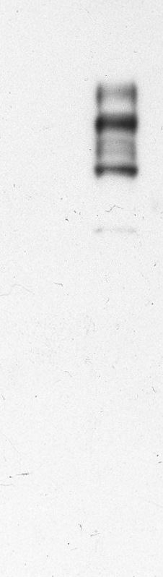
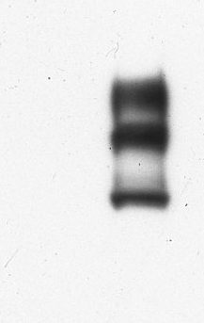
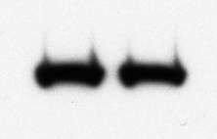
(a) PLD3
97.4
66
45
31
21.5
(b) Flag
66
(c) Hsp60
66
1
2
Supplementary Figure 1

