Slide 1
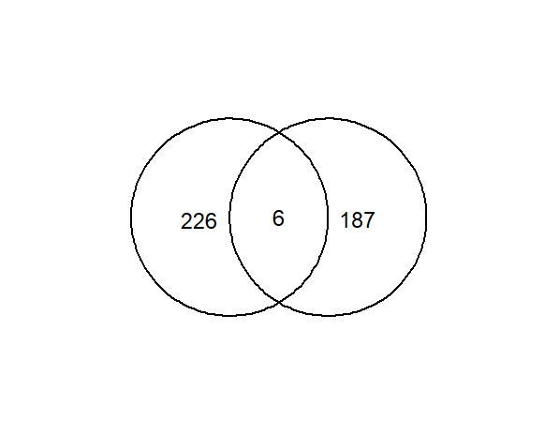
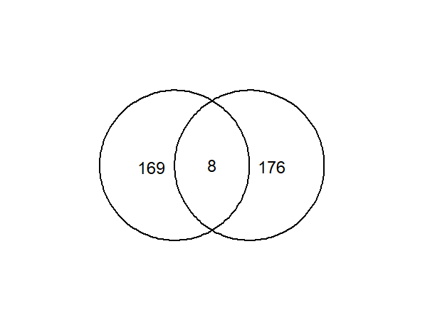
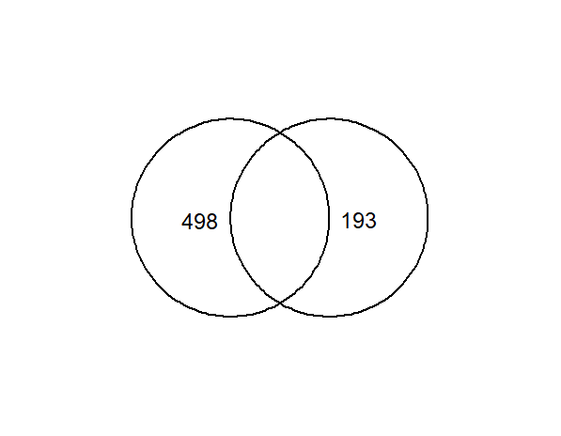
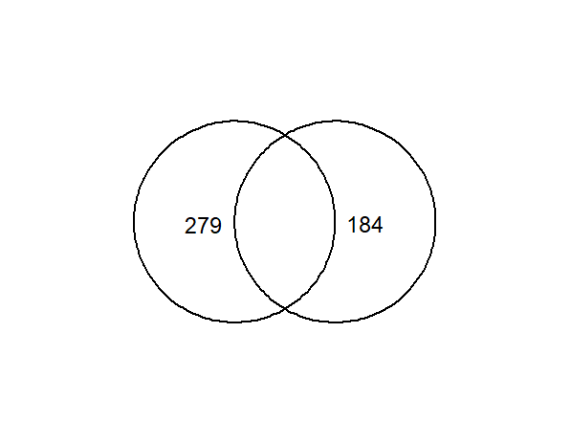
Figure S1, Xianwei Wang
Functional-validated human AD MG DEGs
Opposing direction of expression change with mouse Aβ⁺ MG DEG
Functional-validated mouse AD MG DEGs
Opposing direction of expression change with mouse Aβ⁺ MG DEG
Up-regulated
Up-regulated
Down-regulated
Up-regulated
Down-regulated
Down-regulated
Up-regulated
Down-regulated
Human AD MG
(232)
Mouse
Aβ⁺ MG (193)
Human
AD MG (177)
Mouse
Aβ⁺ MG (184)
Mouse
AD MG (498)
Mouse
Aβ⁺ MG (193)
Mouse
AD MG (279)
Mouse
Aβ⁺ MG (184)
6
8
Overlap analysis:
(A)
(B)
(C)
(D)
Genes | Log₂FC |  |  | Gene function | PMID
 | Human AD MG | Mouse Aβ⁺ MG | Mouse AD MG
Overlap (A): 6 genes
Slc2a5 | 0.68 | -0.85 | -0.89 | Fructose uptake for MG activation | 34884473
Stab1 | 1.09 | -2.01 | -1.08 | MC adhesion on extracellular fibronectin | 34968453
Selplg | 1.13 | -1.34 | -1.07 | Mediate leukocyte adhesion to vascular EC | 9128259
SMAD7 | 1.28 | -0.72 | na | IL-1β-induced apoptosis | 35795857
GOLGA4 | 1.79 | -0.71 | na | Secretion of TNF in activated MΦ | 18308930
SCFD2 | 1.91 | -0.60 | na | Cell proliferation | 32213542
Overlap (B): 8 genes
Ccl3 | -3.56 | 2.07 | 3.03 | Increased phagocytic activity | 11553580
Ch25h | -2.19 | 1.64 | 3.44 | Suppression of IL-1 driven inflammation | 25104388
Fth1 | -0.92 | 0.66 | 1.08 | Activation of infiltrating microglia | 33597025
STMN1 | -2.06 | 0.61 | na | Regulation cell locomotion | 19643027
RPS20 | -0.80 | 0.79 | na | Ribosome protein for protein synthesis | BioRxiv*
RPS27A | -0.79 | 0.66 | na | Ribosome protein for protein synthesis | BioRxiv*
RPS24 | -0.65 | 0.62 | na | Ribosome protein for protein synthesis | BioRxiv*
RPL32 | -0.64 | 0.82 | na | Ribosome protein for protein synthesis | BioRxiv*
* https://doi.org/10.1101/2021.01.13.426577
Figure S1. Functional-validated human/mouse Aβ phagocytic AD MG DEGs with opposing changes in gene expression in human/mouse AD MG and mouse Aβ⁺ MG (14 genes). A total of 14 functional-validated human Aβ phagocytic AD MG DEGs were identified by overlapping functional-validated human AD MG DEG with mouse Aβ⁺ MG screening dataset, displaying opposite changes in gene expression. Abbreviation: Aβ, amyloid beta; AD, Alzheimer’s disease; DEG, differentially expressed gene; FC, fold change; MG, microglia.

Slide 2
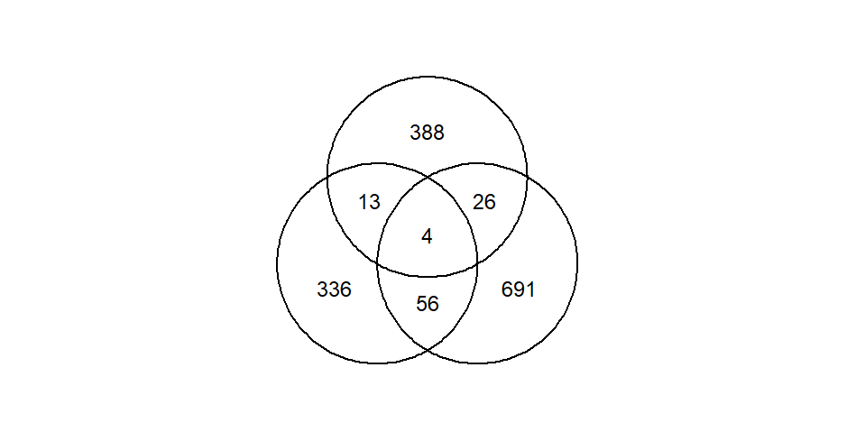

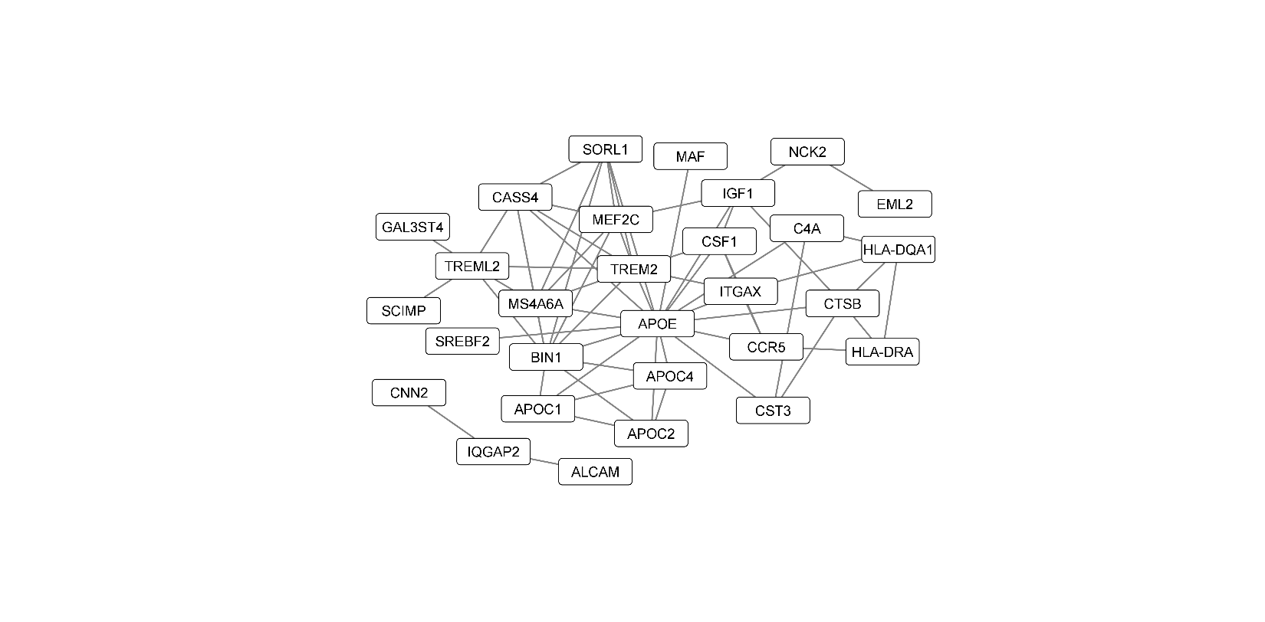
Figure S2, Xianwei Wang
A. Identification of GWAS-mapped AD genes (431)
PubMed Search
Filtration
Extraction of genes
Key words: (Alzheimer's Disease) AND (GWAS) AND 2010/01/01-2022/05/31
Total 2016 articles,
15 articles relevant
Human GWAS-mapped AD genes
(431)
B. GWAS-mapped AD MG DEGs (43 genes)
C. Expression profile of GWAS-mapped AD MG DEGs
in human AD (17 genes)
Human GWAS-mapped AD genes (431)
GWAS-mapped AD MG DEG only in human
Human
AD MG DEG
(409)
Mouse
AD MG DEG
(777)
GWAS-mapped AD MG DEG in both species
13
4
26
Log₂FC (AD vs CT)
GWAS-mapped AD MG DEG
common in both species
TMEM163, APOE
SNX6, TREM2
11 genes (up)
GWAS-mapped AD MG DEG
Human: 17 (4.2% of 409)
Mouse: 30 (3.9% of 777)
Total: 43 (3.8% of 1126)
D. Expression profile of GWAS-mapped AD MG DEGs in mouse AD models (30 genes)
GWAS-mapped AD MG DEG only in mouse
GWAS-mapped AD MG DEG in both species
Log₂FC (AD vs CT)
21 genes (up)
E. Molecular network and AD biological process of 43 GWAS-mapped AD MG DEGs (GO)
Molecular network
Top 15 neuro-immunological AD biological processes (GO)
Biological process (GO) | Enrichment effect | FDR
Negative regulation in APP catabolism* | 2.61 | 3.80E-03
Regulation of neurofibrillary tangle assembly | 2.43 | 5.40E-03
VLDL particle clearance | 2.31 | 3.90E-04
Aβ clearance | 2.24 | 4.90E-04
Negative regulation of cholesterol transport | 2.07 | 8.07E-05
Negative regulation of Aβ formation | 2.07 | 8.07E-05
MG migration | 2.07 | 1.30E-02
MG proliferation | 2.07 | 1.30E-02
MC differentiation | 2.05 | 9.70E-04
Glial cell migration | 2.05 | 9.70E-04
Apoptotic cell clearance | 2.01 | 1.48E-02
Antigen processing/presentation | 1.96 | 1.73E-02
Behavioral fear response | 1.96 | 1.73E-02
MΦ apoptotic process | 1.91 | 1.89E-02
IGF-R signaling | 1.80 | 2.57E-02
IGF-R: Insulin-like growth factor receptor; * Aspartic-type endopeptidase activity

Slide 3
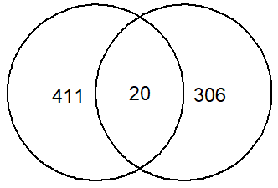
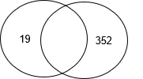
Figure S2, Xianwei Wang, continued
F. Identification of GWAS-mapped phagocytic AD MG DEGs altered by HHcy
Human GWAS-mapped AD genes (431)
Phagocytic AD MG DEG (326)
Cbs^{-/-} MG DEG (353)
20
1
Igf1
GWAS-mapped phagocytic AD MG DEGs (20)
Gene (20) | rsID | Odds ratio (95% CI) | Gene function | PMID
APOC1 | rs12691088 | 3.39 (3.15-3.65) | M2-like MΦ activation | 31986256, 35914680
APOC2 | rs1132899 | 1.08 (1.06-1.11) | LpL activation | 35851147, 12590574
APOE | rs2075650 | 2.53 (2.41-2.66) | MG migration & uptake of Aβ via Trem2 | 20460622, 34099706
ARRDC4/IGF1R | rs570487962 | 0.20 (0.10-0.37) | Proinflammatory cytokine transcription | 33074286, 28594402
BIN1 | rs6733839 | 1.17 (1.16-1.19) | MG activation and proinflammatory cytokine | 35379992, 35526014
CCR5 | 32bp deletion | 1.06 (0.57-1.96) | MG activation and MG chemotaxis | 15488313, 31447666
CNN2 | rs111278892 | 1.02 (1.01-1.03) | Cell motility and cell growth | 31986256, 26970176
CSF1 | rs756325 | 1.39 (0.75-2.58) | MG viability | 17192722, 24742461
CST3 | Haplotype B* | 3.80 (1.56-9.25) | Trem2⁺ MΦ or MG recruitment | 11074789, medRxiv**
CTSB | rs1065712 | 1.09 (1.06-1.12) | Production and secretion of interleukin-1β | 35379992, 31535638
ELMO1 | rs10247412 | 0.66 (0.56-0.77)*** | Cell migration and MΦ phagocytosis | 23571587, 14638695, 22503503
F2R | rs190204665 | Not available | Inhibition of NF-κB signaling | 32592681, 32226307
IGF1 | rs972936 | 1.3 (1.1-1.5) | M2-like MΦ activation and phagocytosis | 21176999, 28402847
ITGAX | rs59735493 | Not available | MC recruitment | 30617256, 19433759
MAF | rs450674 | 0.96 (0.95-0.98) | Production of chemokine CCL8 | 35379992, 29907708
SNX6 | rs28421851 | Not available | Endosome-to-TGN retrieval of receptors | 34075027, 17148574
SORL1 | rs74685827 | 1.19 (1.13-1.25) | MG uptake of Aβ | 35379992, 32941599
SYTL3 | rs56171440 | Not available | Vesicular trafficking | 33329707, 22308290
TMEM163 | rs35564151 | Not available | Lysosomal uptake of zinc | 33589840, 28199205
TREM2 | rs75932628 | 2.39 (2.09-2.73) | MG Aβ phagocytosis | 35379992, 28894284
*C, C, A at position -157, -72, +73 (homozygous); ** https://doi.org/10.1101/2021.08.17.21261668; ***Become to be not significant after adjusting APOE
Figure S2. Identification of GWAS-mapped phagocytic AD MG DEGs altered by HHcy. (A) Identification of 431 GWAS-mapped AD genes. A summary diagram was created to establish a set of AD genes mapped by GWAS using a PubMed search. (B) GWAS-mapped AD MG DEGs (43). We identified 43 GWAS-mapped AD MG DEGs by overlapping 431 GWAS-mapped AD genes with 409 human and 777 mouse AD MG genes. Among the 43 genes, 4 were common to both species. We plotted the expression changes of these genes in AD MG using a histogram, where the dark red bars indicate genes that were identified in both human (C) and mouse (D) AD MG. (E) Network and neuro-immunological AD biological process. We used the 43 identified GWAS-mapped AD MG genes to perform Gene Ontology (GO) analysis and identify the top 15 neuro-immunological biological processes and molecular networks. (F) GWAS-mapped phagocytic AD MG DEGs altered by HHcy. GWAS-mapped phagocytic AD MG genes altered by HHcy were identified by overlapping 431 human GWAS-mapped AD genes with 326 phagocytic AD MG genes and 353 Cbs^{-/-} MG genes. The functions and cellular locations of these genes are described in a table. Abbreviation: Aβ, amyloid beta; AD, Alzheimer’s disease; CI, confidence interval; DEG, differentially expressed gene; ER, endoplasmic reticulum; FC, fold change; FDR, false discovery rate; GO, gene ontology analysis; GWAS, Genome-wide association studies; HHcy, hyperhomocysteinemia; MG, microglia; PM, plasma membrane; TGN, trans-golgi-network.

