Slide 1
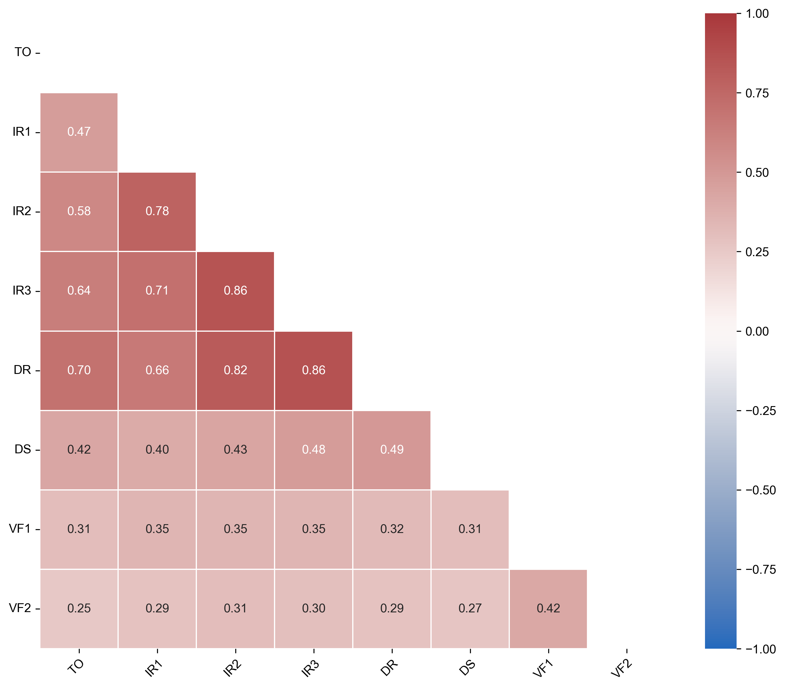
Supplementary Figure 1: Inter-task correlation heatmap.
Heatmap showing Spearman’s rank correlation coefficients (ρ) between scores of automated cognitive tasks to evaluate the internal consistency and overlapping constructs. Color intensity reflects correlation strength. Abbreviations: TO, temporal orientation; IR, immediate recall; DR, delayed recall; DS, digit span; VF, verbal fluency.

