Slide 1
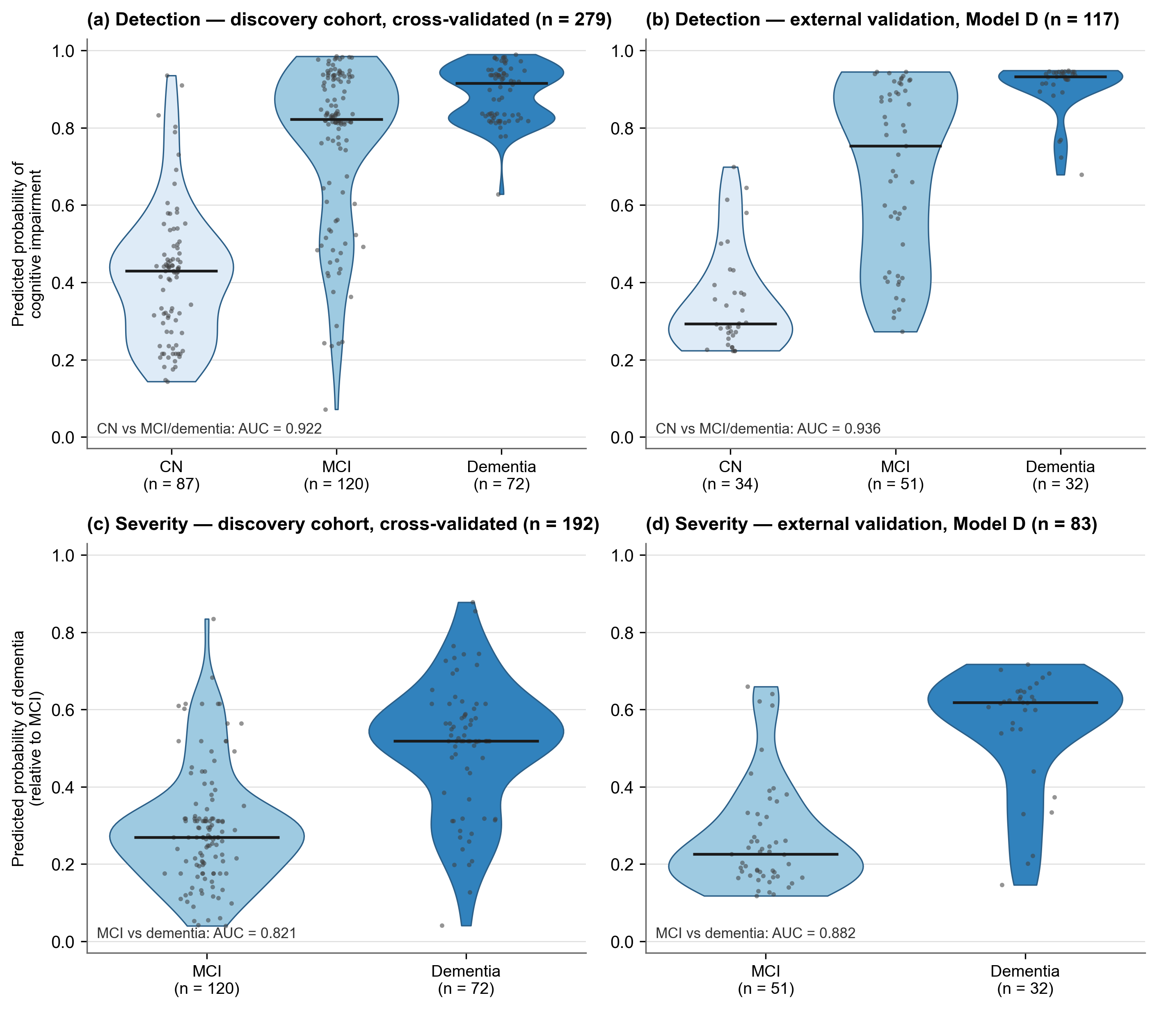
Supplementary Figure 4: Distributions of predicted probabilities by diagnostic group. Distributions of predicted probabilities produced by the classification models, shown separately by diagnostic group. (a, b) Predicted probability of cognitive impairment (1 − P[cognitively normal]) for all three groups. (c, d) Predicted probability of dementia relative to MCI (P[dementia] / (P[MCI] + P[dementia])) for participants with MCI or dementia; these probabilities are the decision variables used for the corresponding binary comparisons in the main analyses. Panels (a) and (c) show out-of-fold predictions from the full model in the high-confidence subset of the discovery cohort; panels (b) and (d) show predictions from Model D, which was trained on the discovery cohort and applied without modification to the high-confidence subset of the independent external validation cohort. Each violin shows the kernel density of the individual predictions, which are overlaid as points; the horizontal line indicates the median. The annotation in each panel provides the AUC for that comparison. Although individual acoustic features and task scores overlap substantially among the groups (Figures 1–4), the model output distributions are largely separated for the detection of impairment, whereas the comparison in which they overlap most (MCI versus dementia) has the lowest AUC. Abbreviations: CN, cognitively normal; MCI, mild cognitive impairment; AUC, area under the receiver operating characteristic curve.

