Slide 1
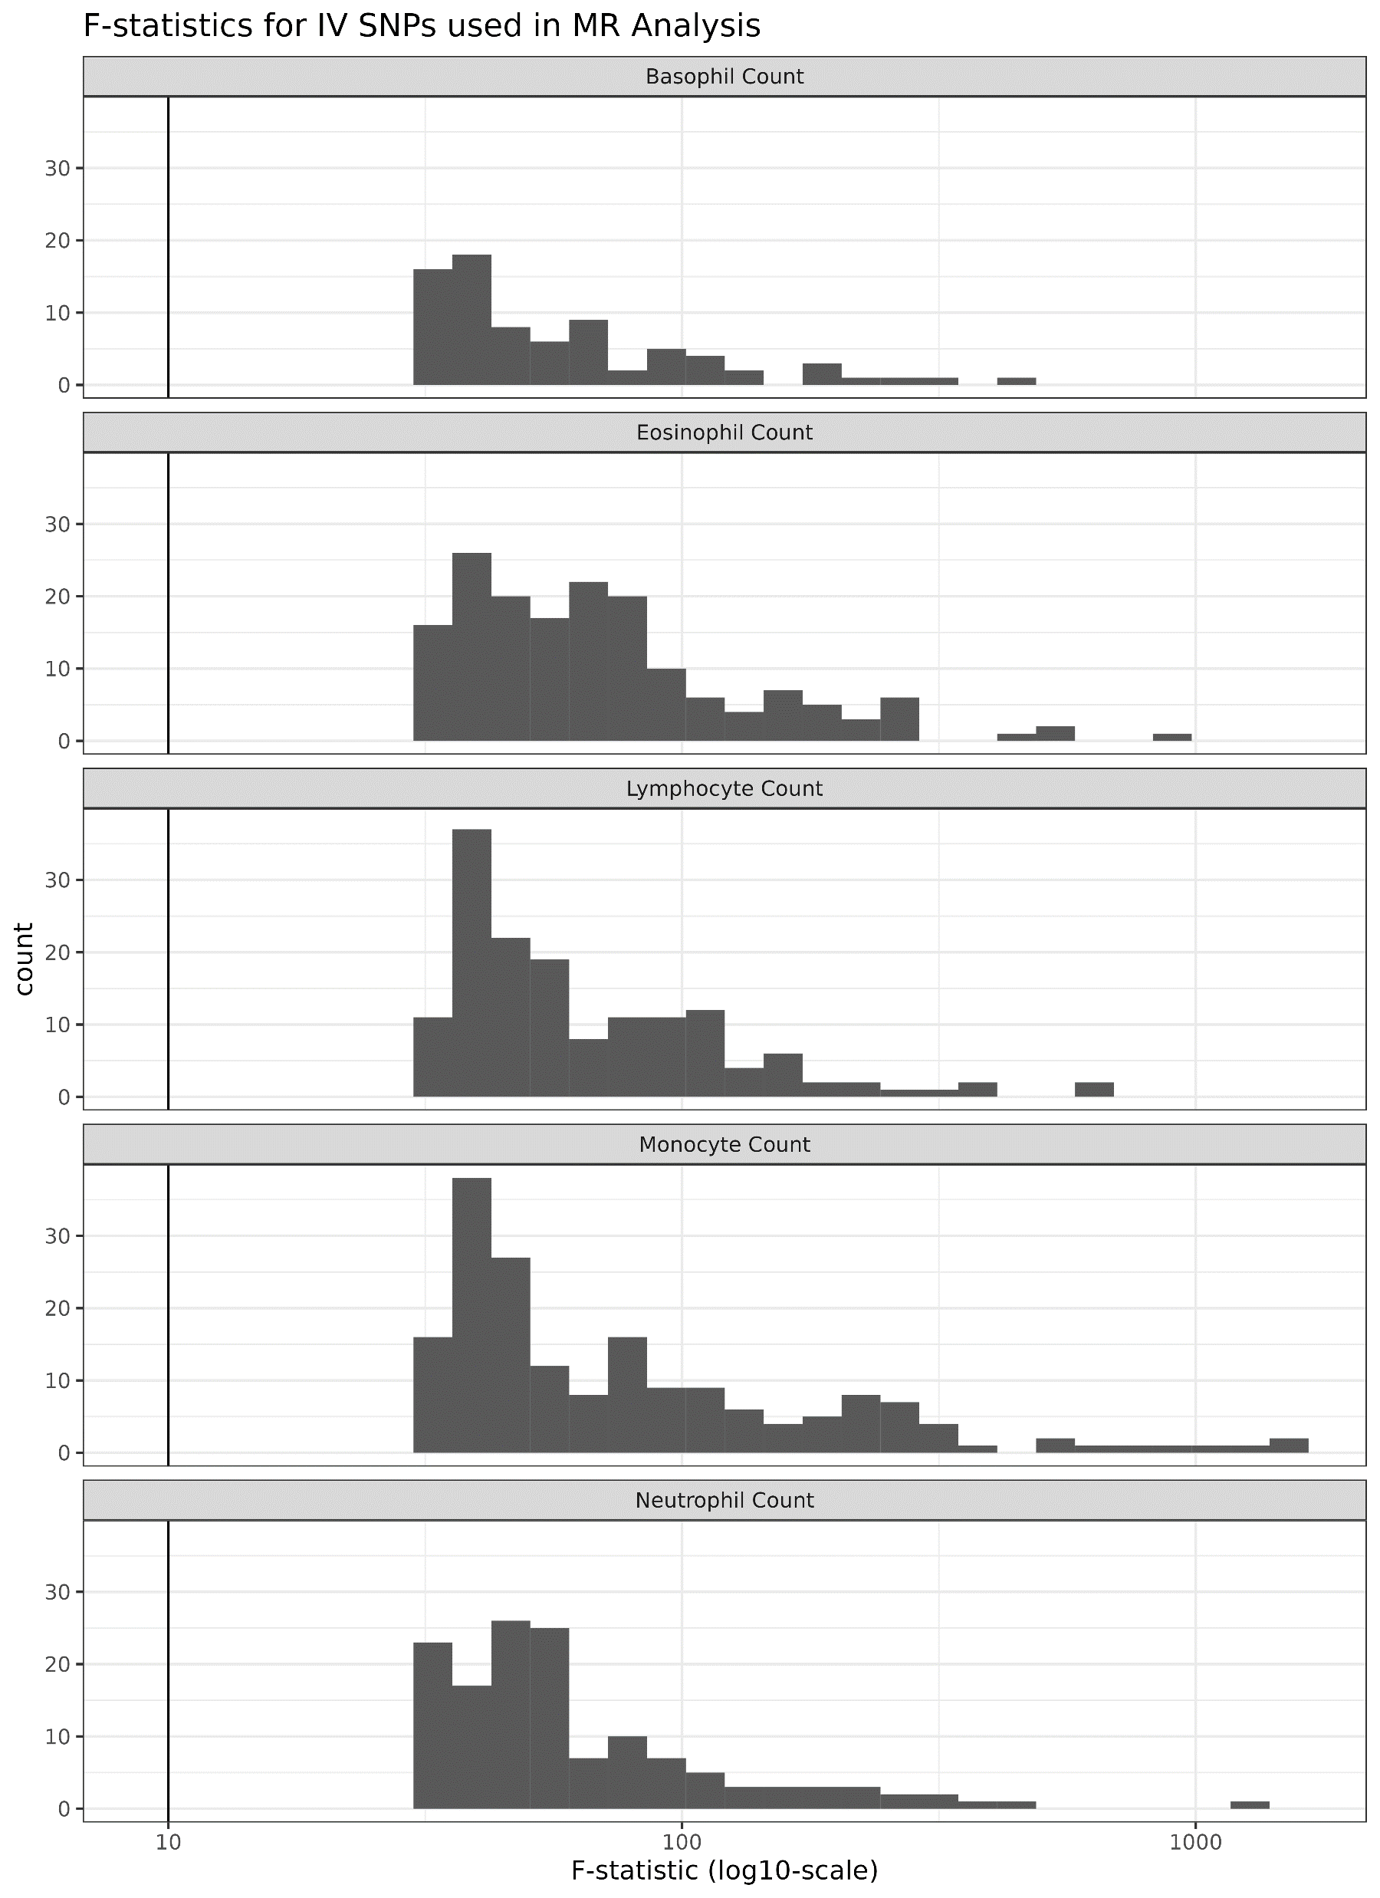
Additional file 1: Figure 1: F-statistics of IV SNPs used in MR Analysis.

Slide 2
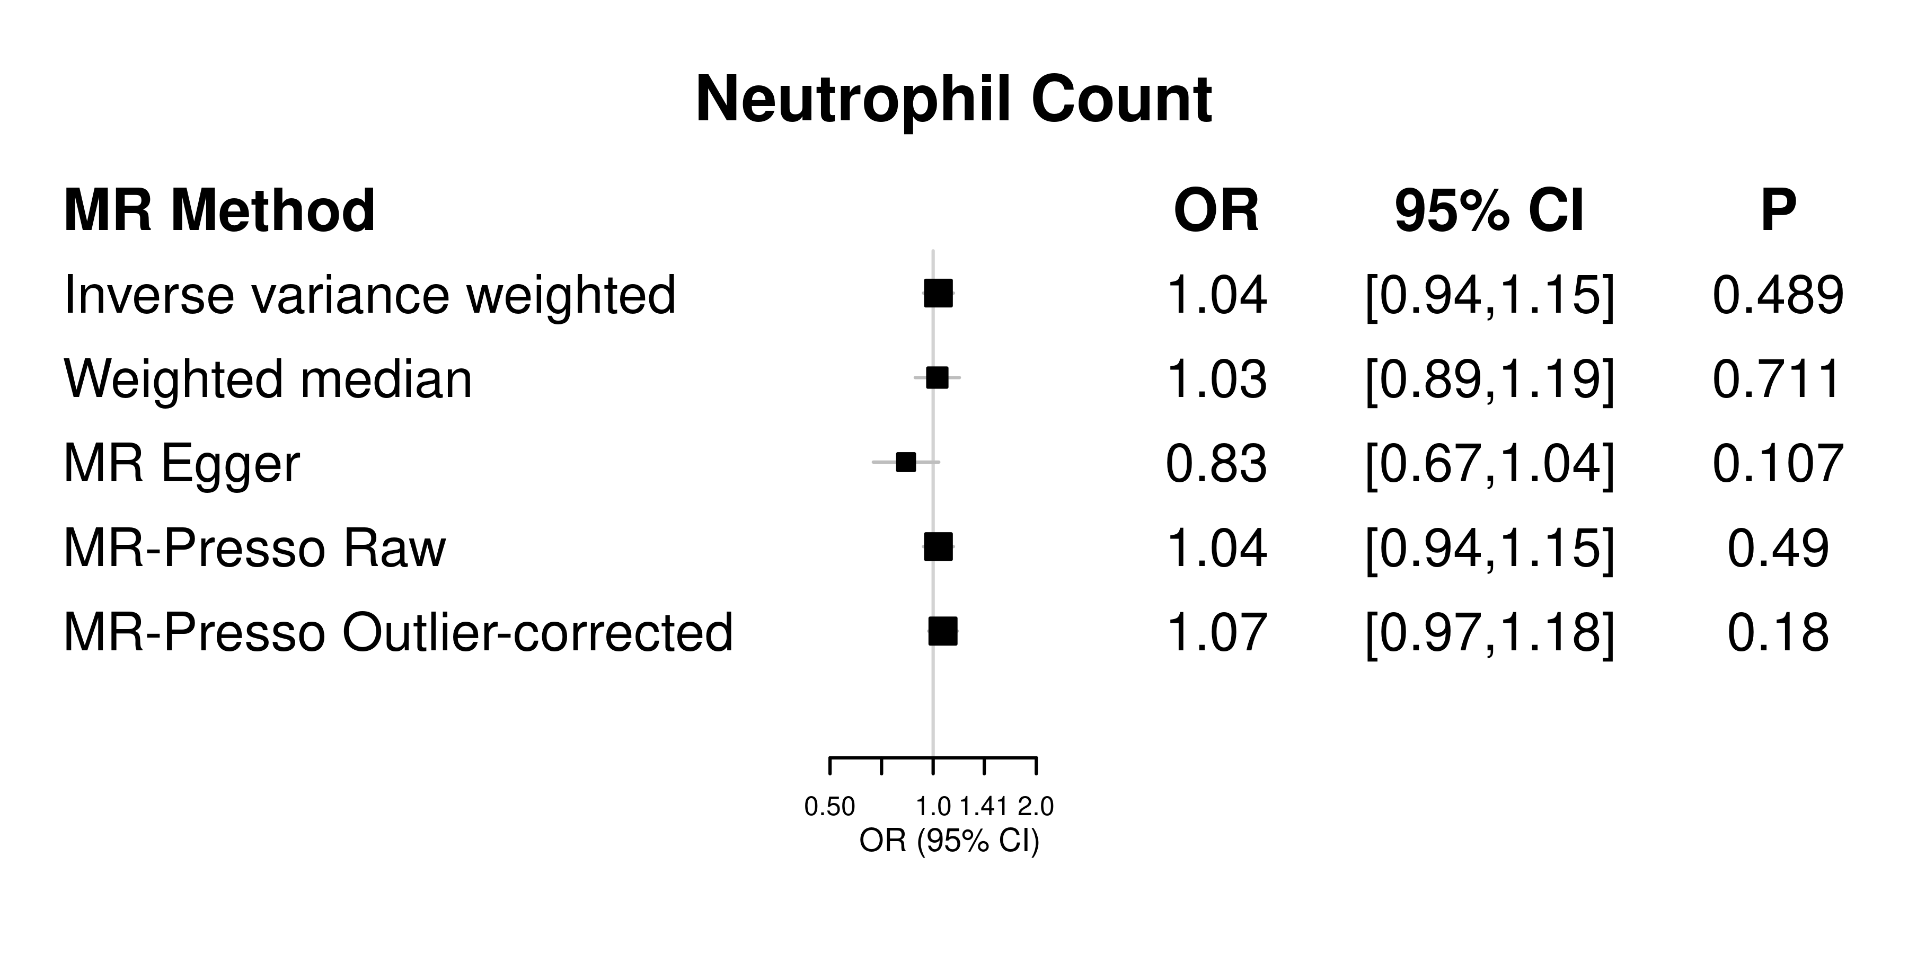
Additional file 1: Figure 2A: SNP effect on neutrophil count and CRS. Two-sample MR analyses performed using GWAS summary statistics for neutrophil count (exposure trait) and CRS (outcome trait). Primary analysis was performed using inverse-variance weighted two-sample MR.

Slide 3
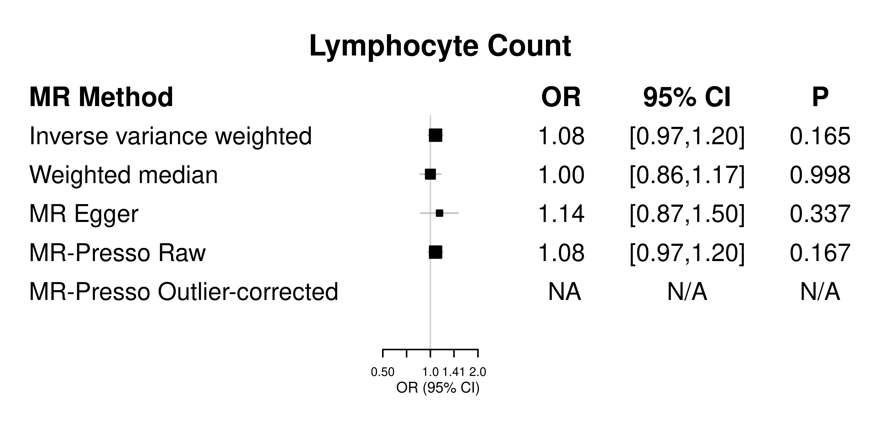
Additional file 1: Figure 2B: SNP effect on lymphocyte count and CRS. Two-sample MR analyses performed using GWAS summary statistics for lymphocyte count (exposure trait) and CRS (outcome trait). Primary analysis was performed using inverse-variance weighted two-sample MR.

Slide 4
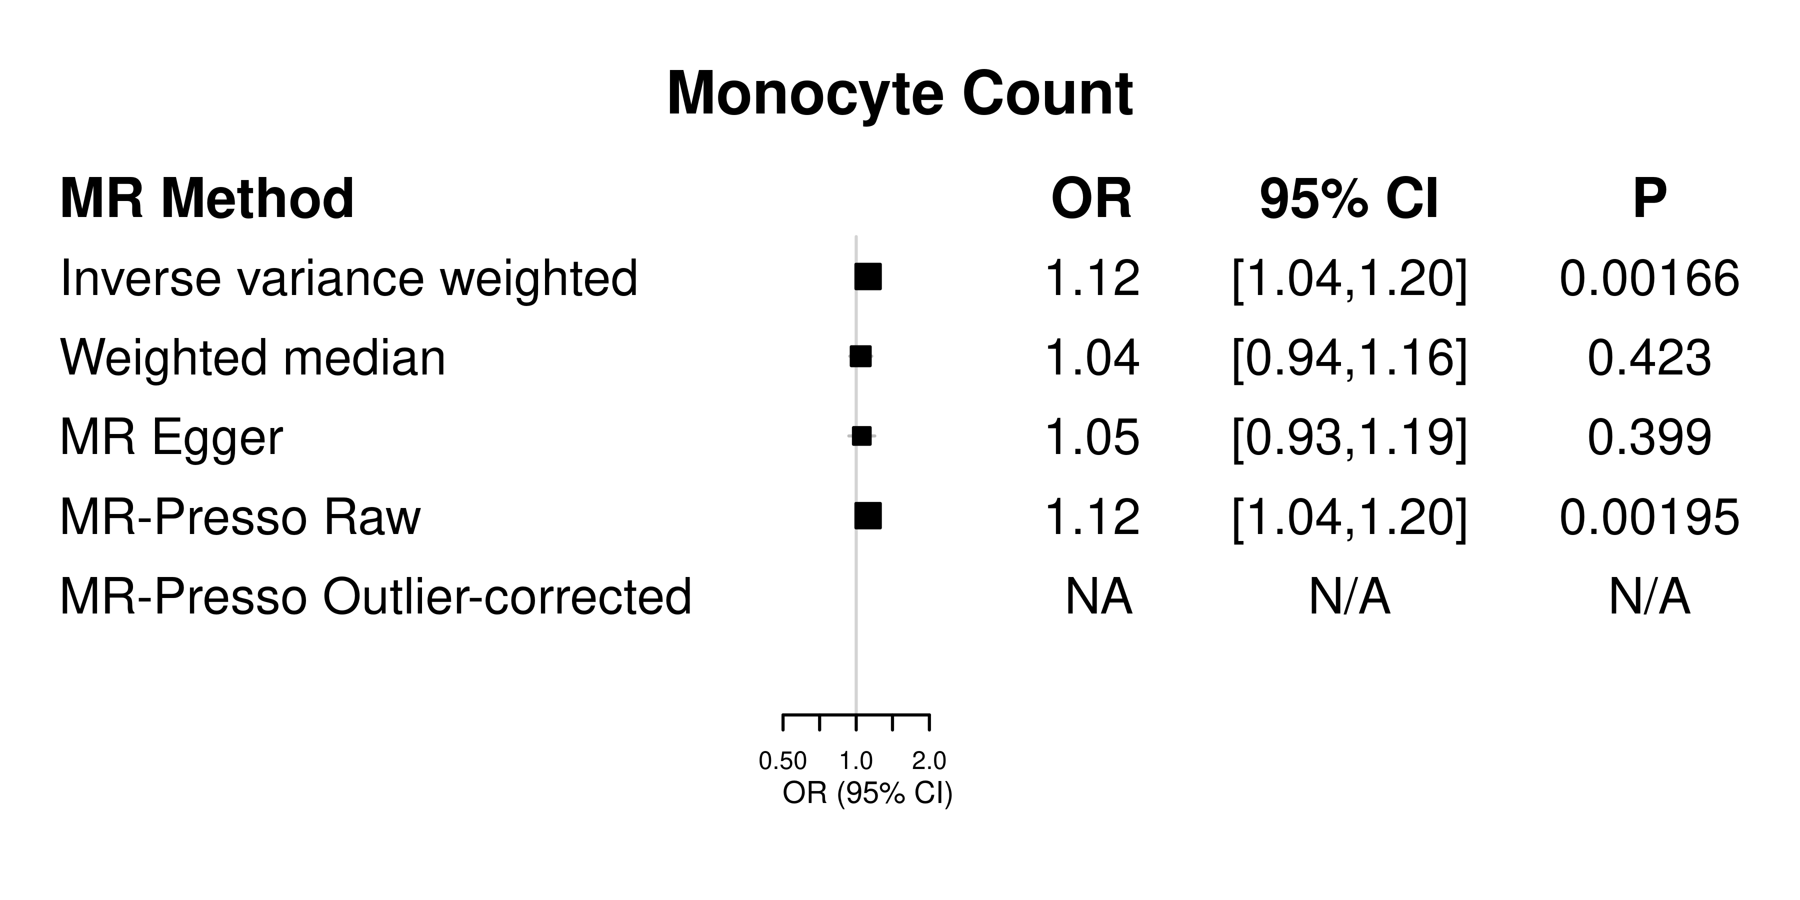
Additional file 1: Figure 2C: SNP effect on monocyte count and CRS. Two-sample MR analyses performed using GWAS summary statistics for monocyte count (exposure trait) and CRS (outcome trait). Primary analysis was performed using inverse-variance weighted two-sample MR.

Slide 5
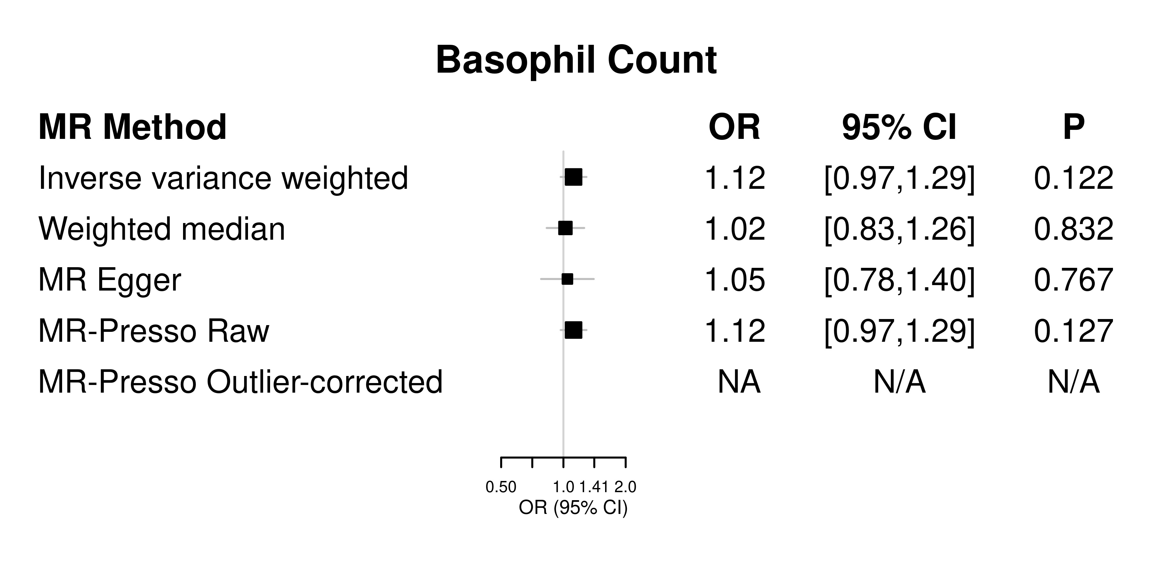
Additional file 1: Figure 2D: SNP effect on basophil count and CRS. Two-sample MR analyses performed using GWAS summary statistics for basophil count (exposure trait) and CRS (outcome trait). Primary analysis was performed using inverse-variance weighted two-sample MR.

Slide 6
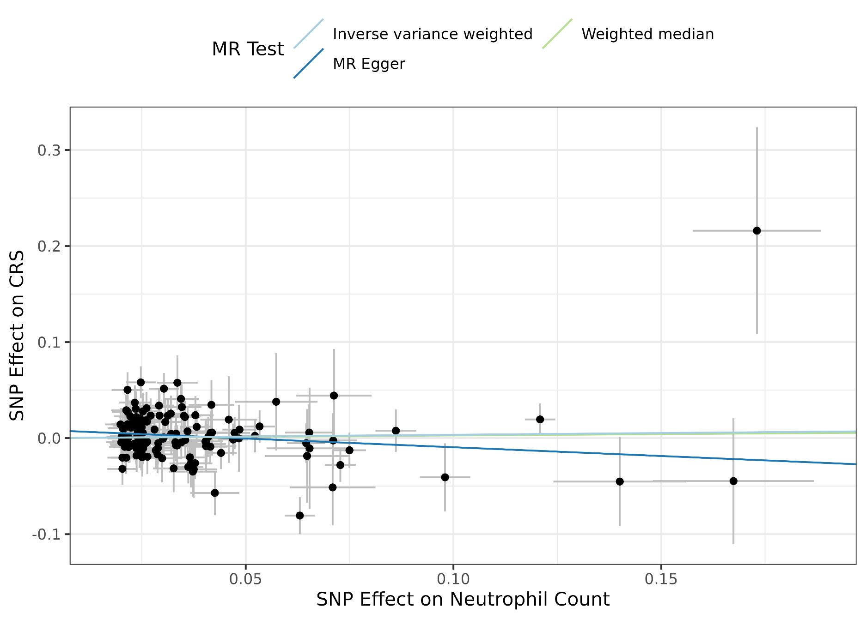
Additional file 1: Figure 3A: SNP effect on neutrophil count and CRS. Two-sample MR analysis performed using GWAS summary statistics for neutrophil count (exposure trait) and CRS (outcome trait). Inverse variance weighted MR results: OR 1.04, 95% CI(0.94,1.15), p=0.49

Slide 7
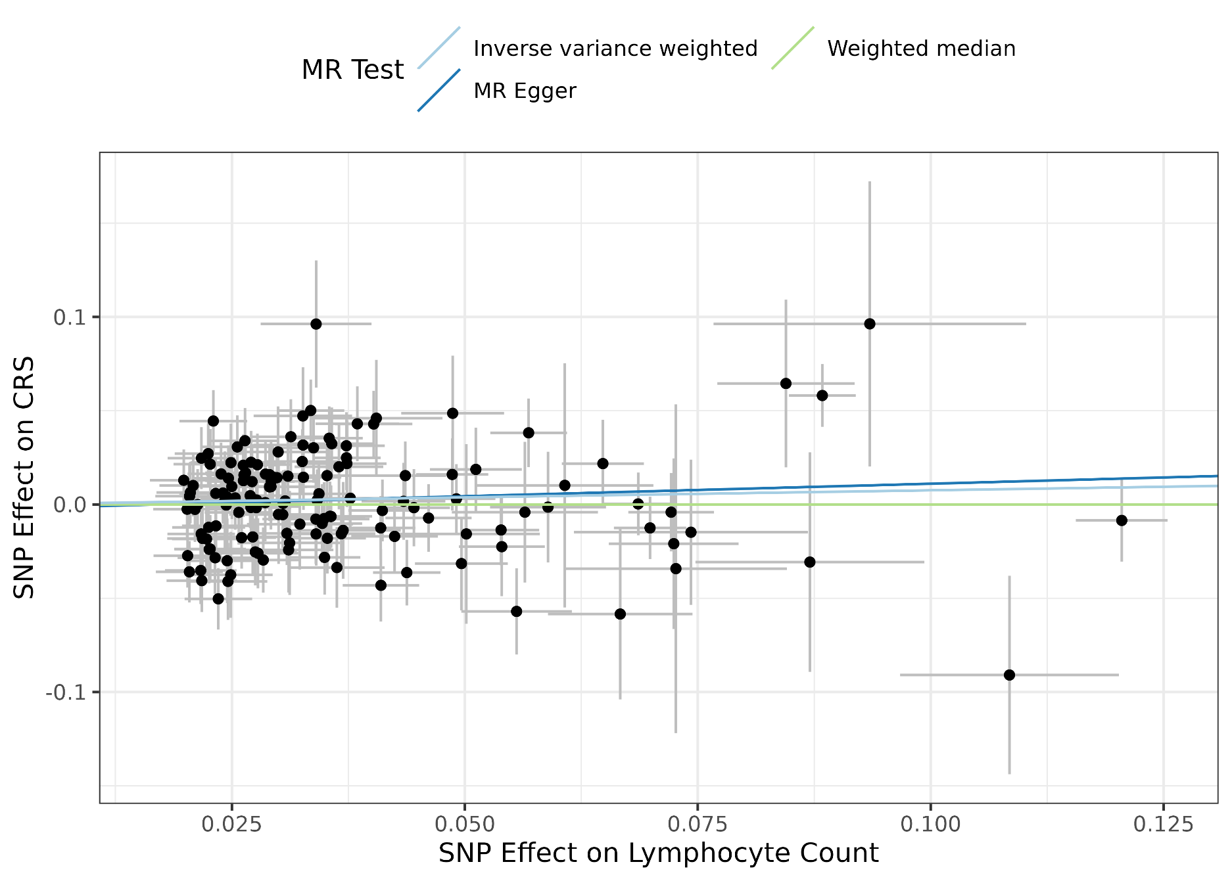
Additional file 1: Figure 3B: SNP effect on lymphocyte count and CRS. Two-sample MR analysis performed using GWAS summary statistics for lymphocyte count (exposure trait) and CRS (outcome trait). Inverse variance weighted MR results: OR 1.08, 95% CI(0.97,1.20), p=0.17

Slide 8
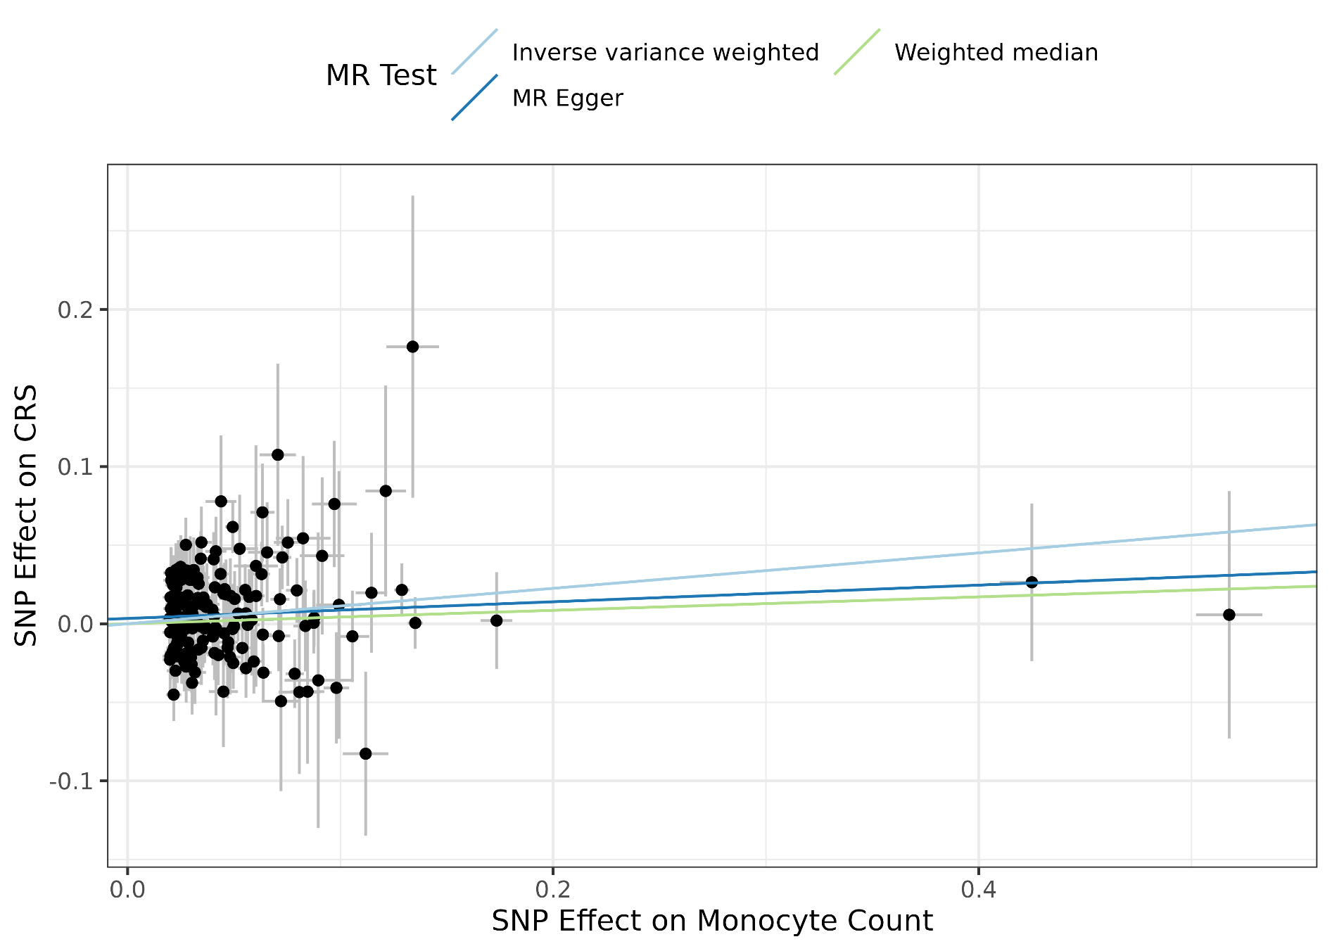
Additional file 1: Figure 3C: SNP effect on monocyte count and CRS. Two-sample MR analysis performed using GWAS summary statistics for monocyte count (exposure trait) and CRS (outcome trait). Inverse variance weighted MR results: OR 1.12, 95% CI(1.04,1.20), p=0.002

Slide 9
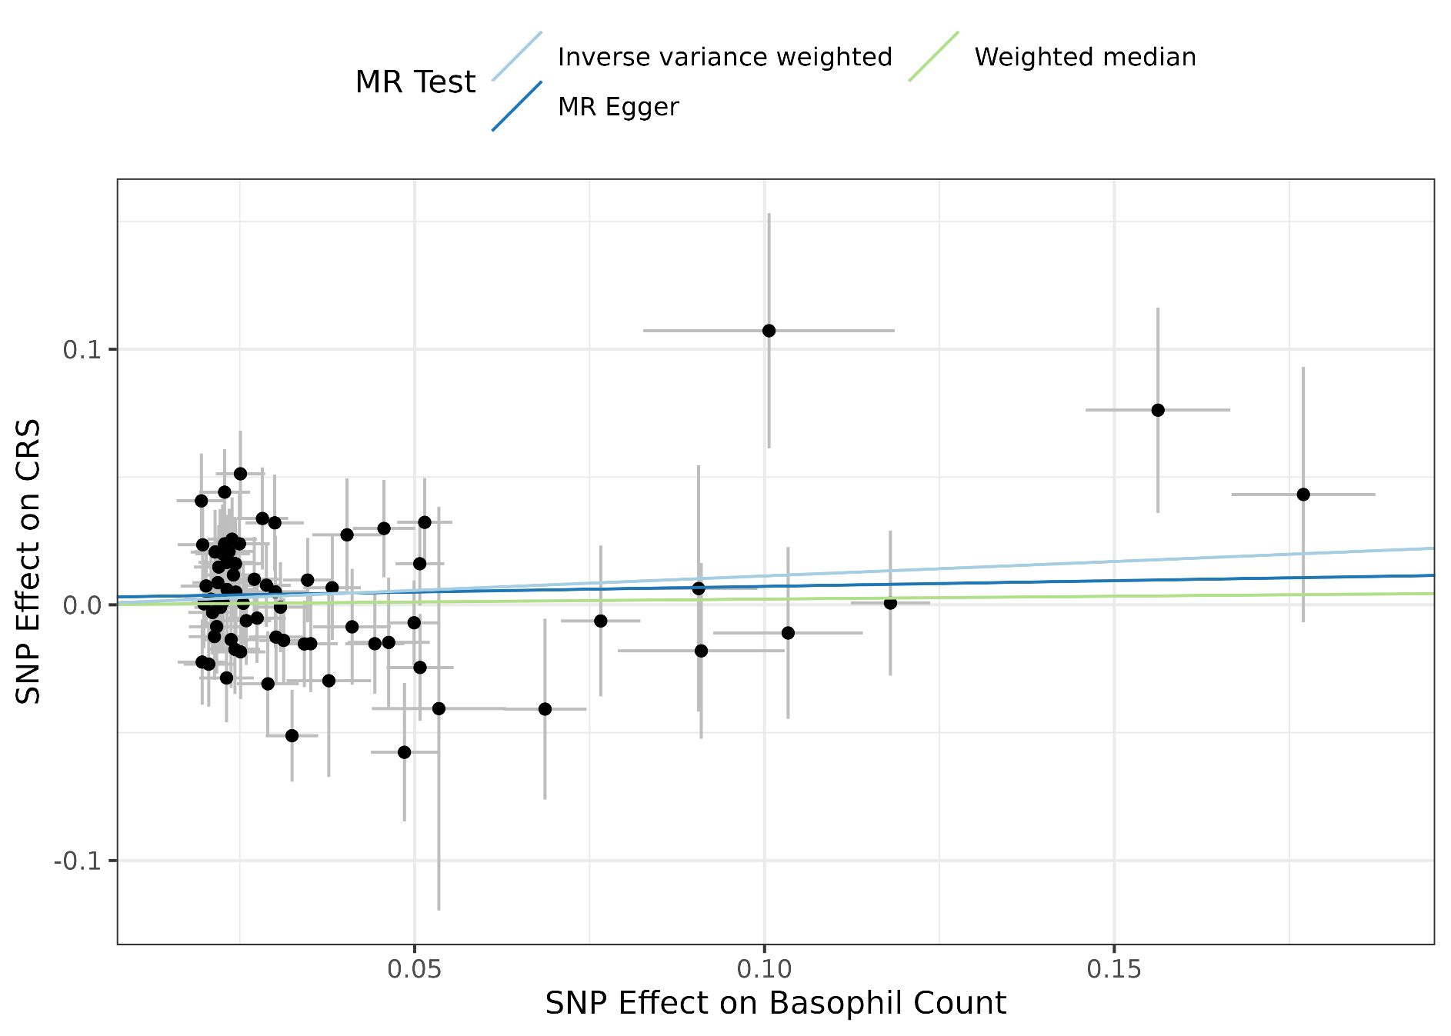
Additional file 1: Figure 3D: SNP effect on basophil count and CRS. Two-sample MR analysis performed using GWAS summary statistics for basophil count (exposure trait) and CRS (outcome trait). Inverse variance weighted MR results: OR 1.12, 95% CI(0.97,1.29), p=0.12

Slide 10
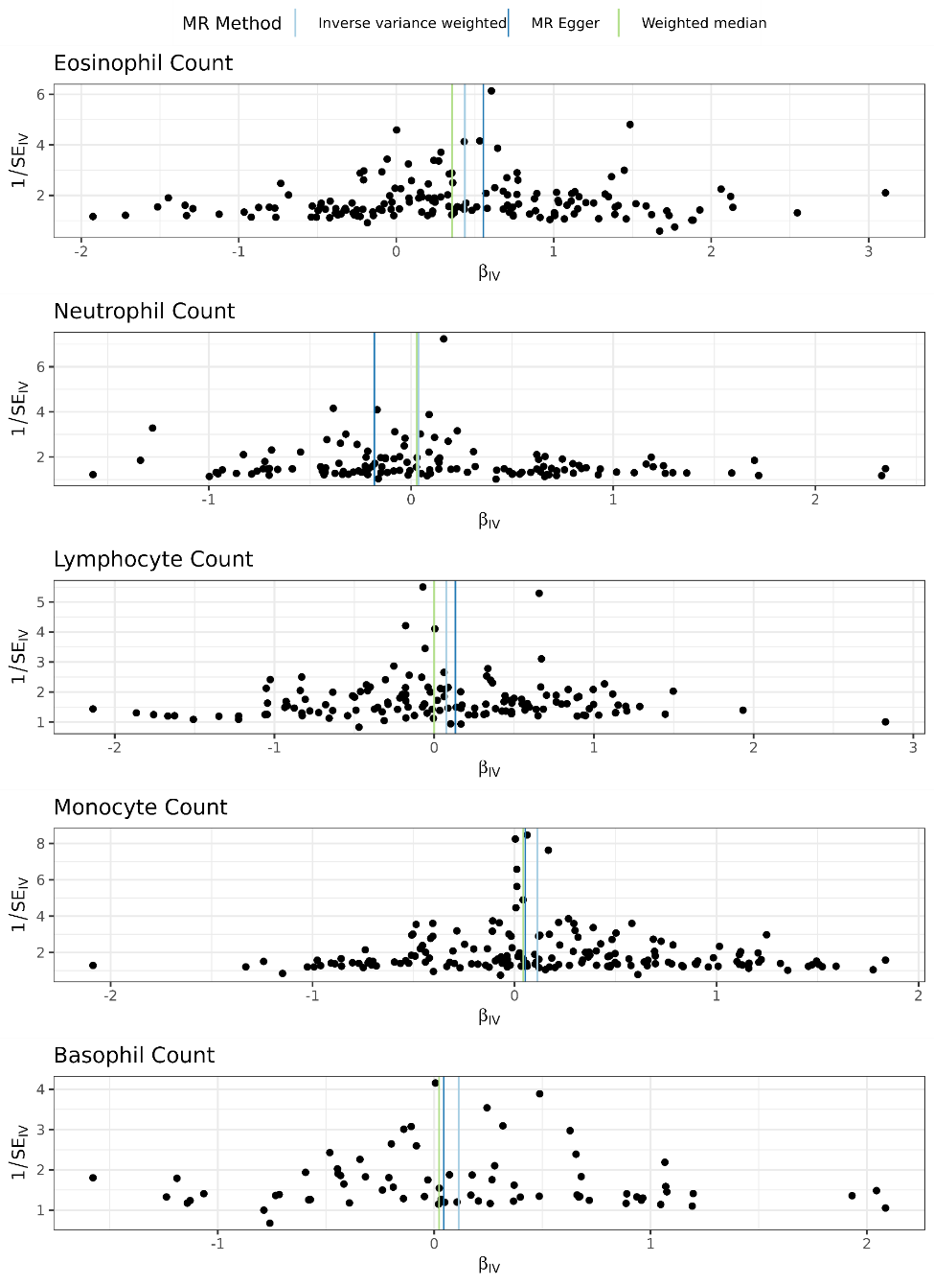
Additional file 1: Figure 4: Funnel plots for white blood cell types

