Slide 1
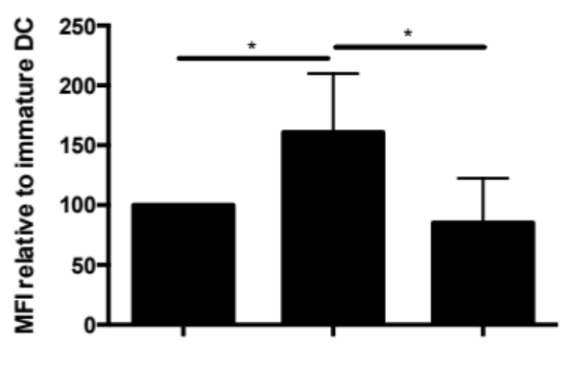
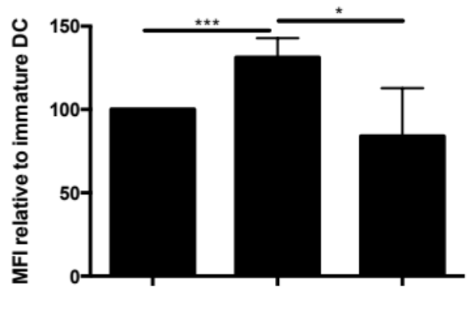
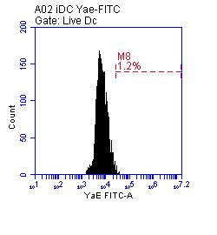
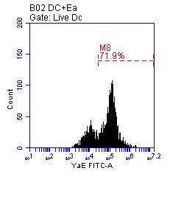
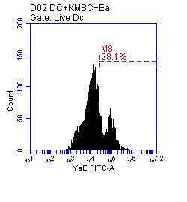
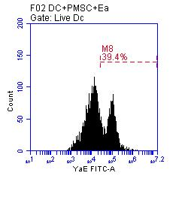
A.
B.
DC + + +
LPS - + +
MSC - - +
DC + + +
LPS - + +
MSC - - +
C.
Number
YAe
DC
Eα
MSC
+ + + +
+ + +
- Wt
Wt
Jag 1^{KD}
Additional file 4: Figure S4

