Slide 1
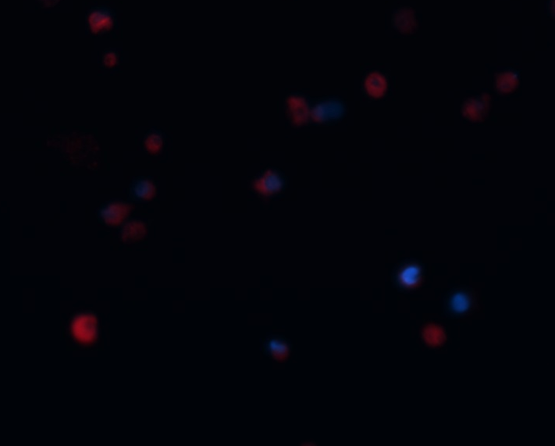
A
A) Rhodamine staining of live FTM HUCPVCs at Step3 of differentiation demonsrating the viability of many of the rounded cells (arrows). Blunted arrows indicate dying cells.
E
Shlush et al. Supplementary Figure 1

Slide 2
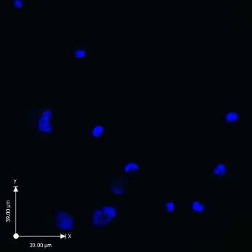
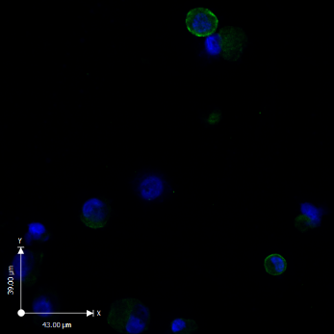
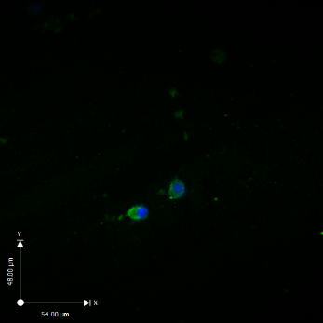
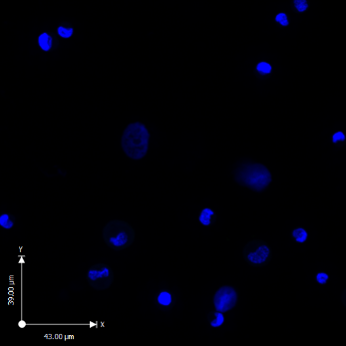
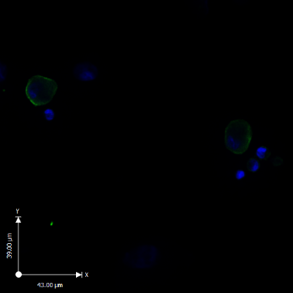
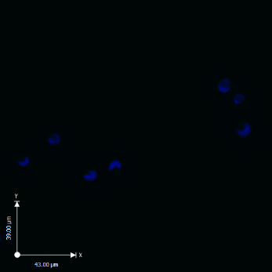
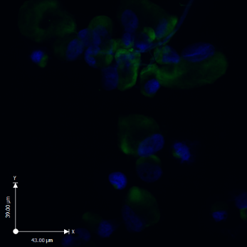
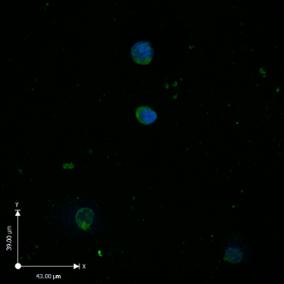
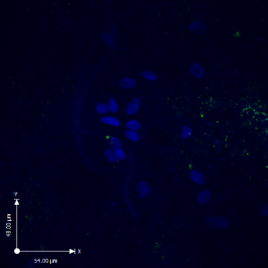
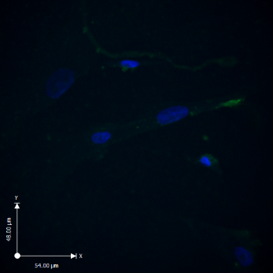
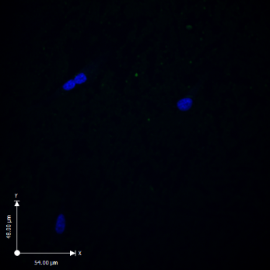
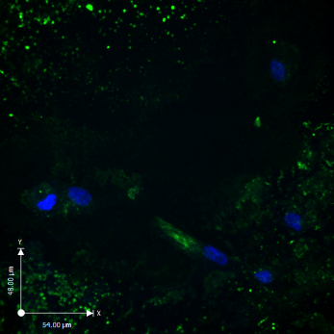
UNDIFF
STEP3
POSITIVE CONTROL
A
FSHR
FTM
GLCs
term
UNDIFF
STEP3
B
DAZL
FTM
NTERA2
C
VASA
FTM
I
Lower magnification images shown in Figure 3 D,H,I for immunostaining of FTM HUCPVCs and term HUCPVCs as well as positive controls for Sertoli cell-associated marker FSHR (A), as well as germ cell-associated markers DAZL (B) and VASA (C).
FTM
term
term
Shlush et al. Supplementary Figure 2

Slide 3
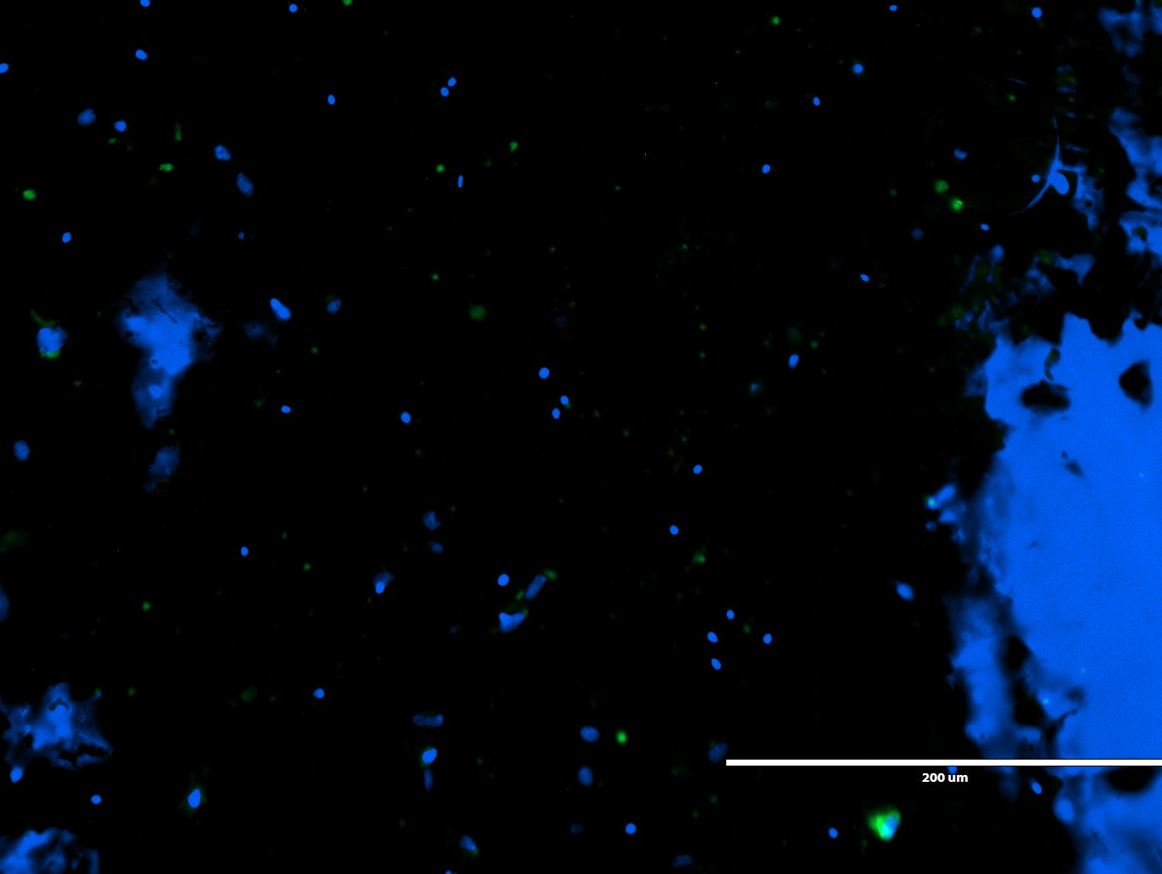
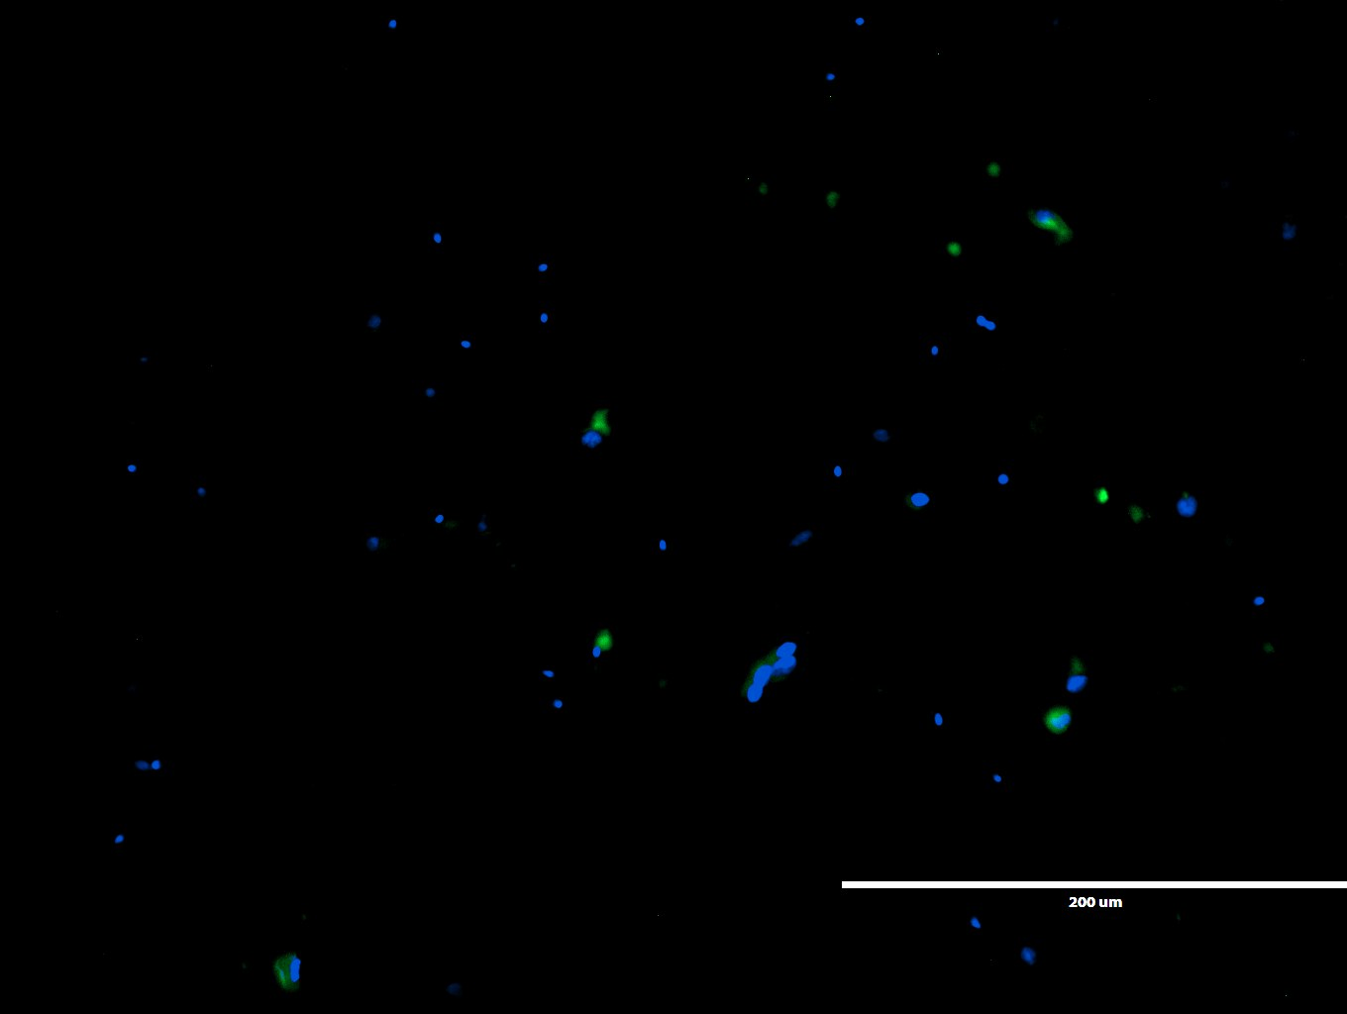
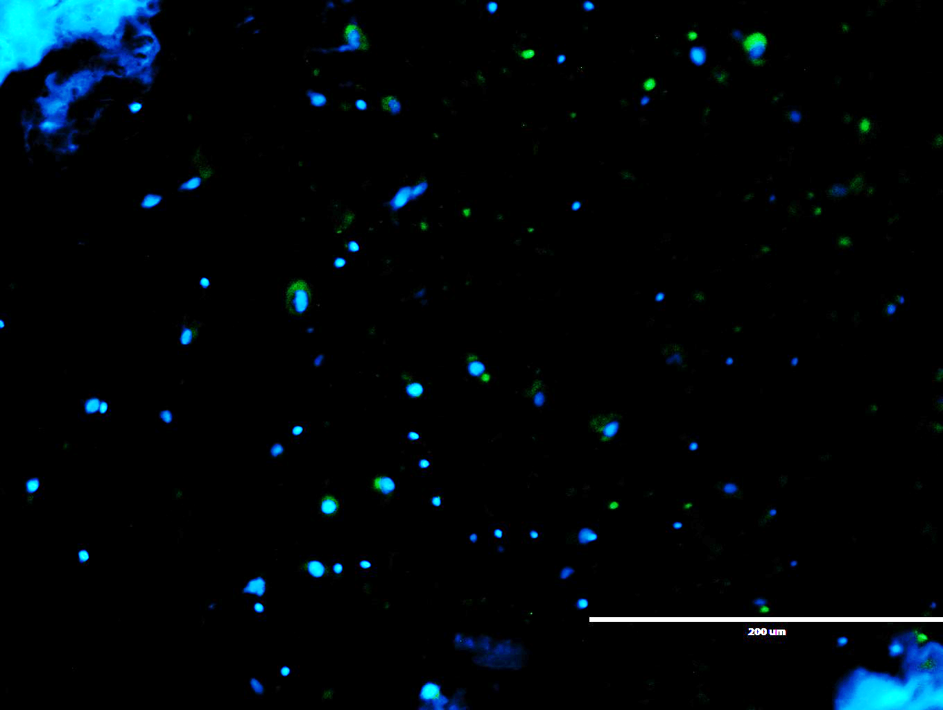
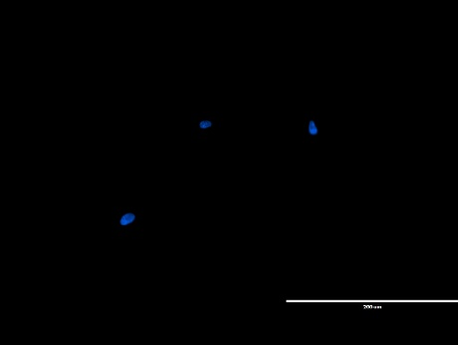
A
DAZL
B
GPR125
2ndary Only
C
Immunostaining of dissociated human testicular cells derived from orchiectomy tissue for germ cell markers (A) DAZL, and (B) GPR125. A negative secondary antibody only immunostaining control is included (C).
Shlush et al. Supplementary Figure 3

Slide 4
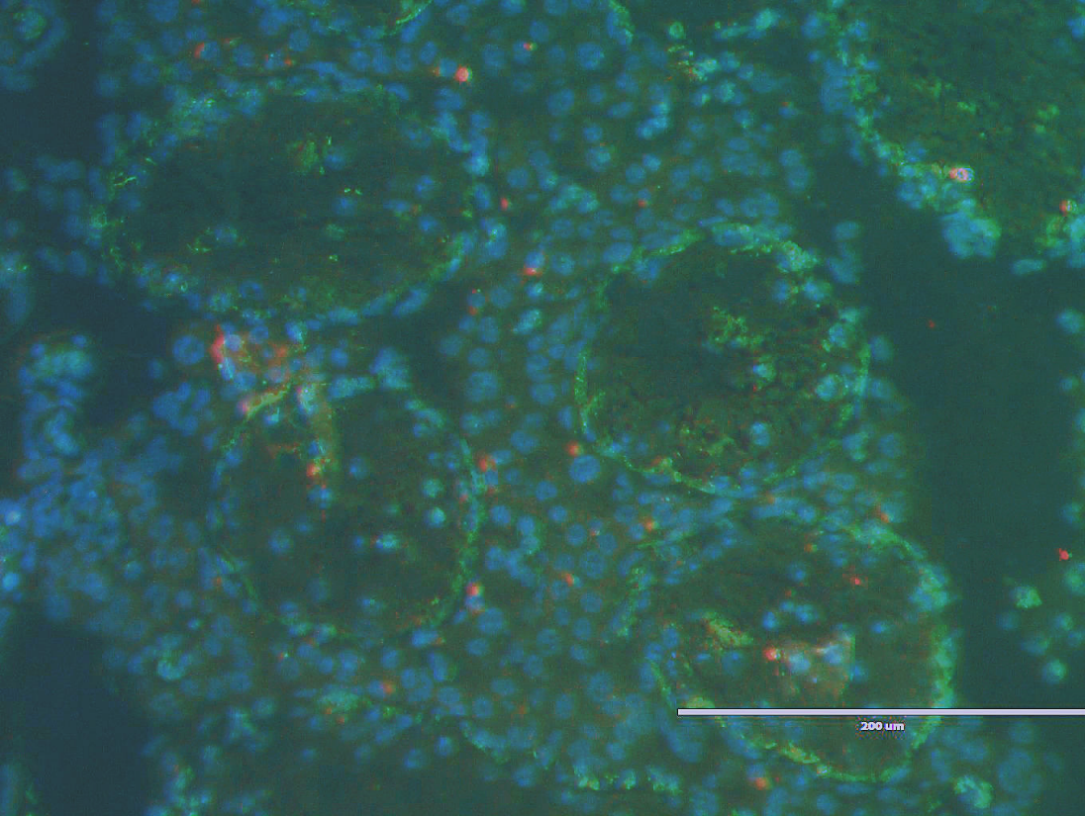
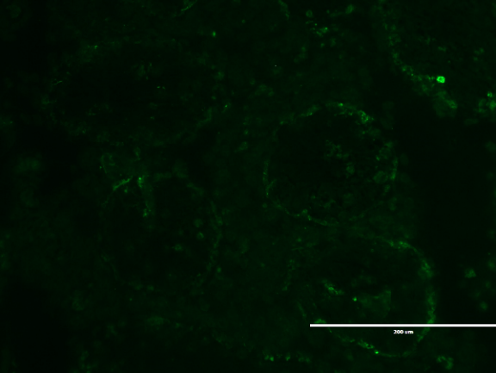
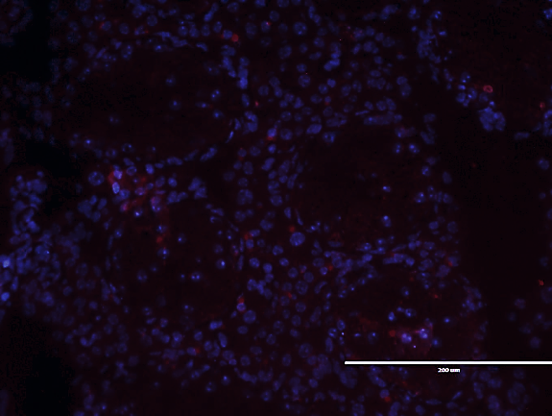
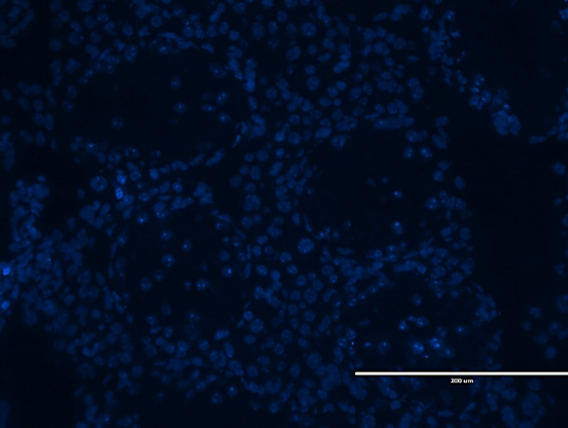
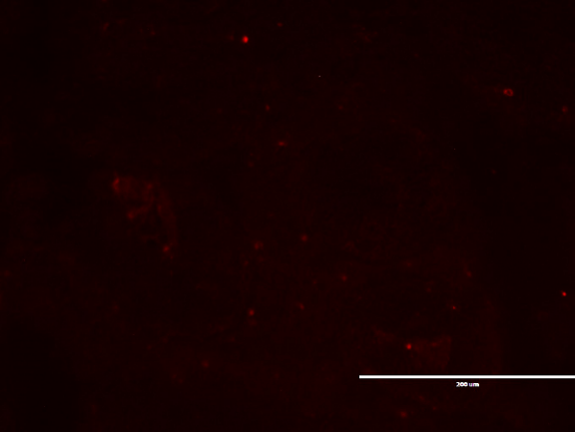
DAZL
PKH26
Hoechst
DAZL
PKH26
Hoechst
Hoechst
PKH26
Immunostaining of xenograft assay testicular sections for DAZL (in addition to what is shown in Figure 5) showing merged and non-merged channels for DAZL (green), PKH26 (red) and Hoechst counterstain (blue).
Shlush et al. Supplementary Figure 4

